Slide 1
STAKEHOLDER REVIEW
Email Forwarding &
Account Deletion Automation
Selecting the right offboarding workflow for IT, HR, Infosec & Management
Prepared by: Jagruth P • IT, Netradyne • April 2026
Audience: IT Head • Infosec

Slide 2
CONTEXT
Why we built this automation
Today, offboarding mailbox forwarding is managed by IT manually — error-prone at scale.
!
T
i
Manual & risky
Hard deadline
Audit trail required
IT manages each forwarding rule by hand. One missed deadline can leave forwarding active or delete an account too early.
Policy gives a 30-day window with up to 2 extensions (90-day cap). The deletion deadline cannot wait for slow approvals.
HR, Infosec, and management need a documented record of every alert, extension, and deletion — across the whole lifecycle.
Goal: replace manual handling with a reliable, recoverable, fully audited automation — and align stakeholders on the right level of human approval.
Email Forwarding & Account Deletion Automation • Stakeholder Review
3

Slide 3
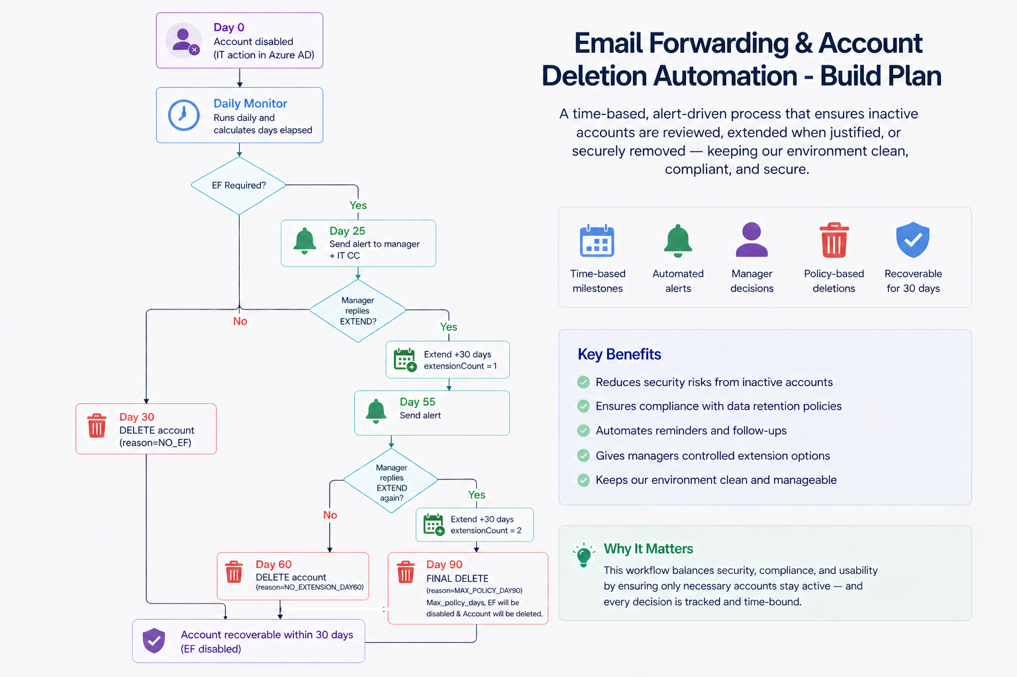
OPTION A
Workflow A — Fully automated reply-based extension
Core building blocks
Azure AD – source of truth for terminated/disabled users
Daily monitor (Azure Function, 9 AM IST)
Reply webhook (Azure Function, HTTP)
Power Automate – routes manager replies
Azure Table Storage – per-user state & audit log
Microsoft Graph – read forwarding state, delete users
Azure Key Vault – SMTP & secret storage
Email Forwarding & Account Deletion Automation • Stakeholder Review
4

Slide 4
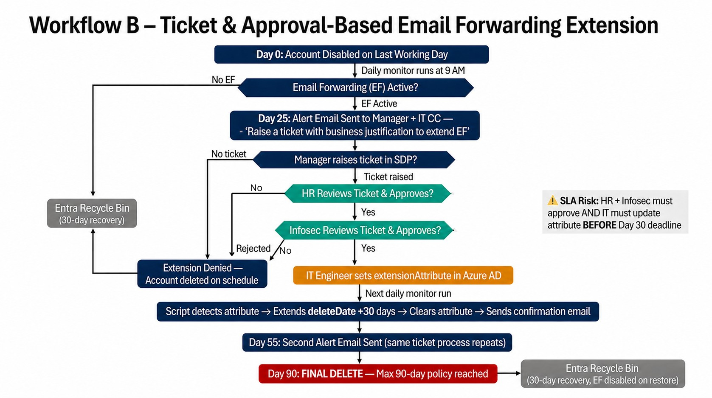
OPTION B
Workflow B — Ticket + HR/Infosec approval
How it works
Day 25
Alert email asks manager to raise a ticket with business justification.
Ticket
ServiceDeskPlus ticket created and routed to HR and Infosec.
Approve
HR + Infosec must both approve. SLA assumed: ≤ 2 business days each.
Update
IT engineer manually updates extensionAttribute in Azure AD.
Detect
Daily monitor detects the attribute, extends deletion, clears the flag.
1–5 days
~15+/yr
2 SLAs
3–5 days
Extension processing time
Manual IT actions (50 offboardings)
HR & Infosec approval gates
Additional dev effort to build
Email Forwarding & Account Deletion Automation • Stakeholder Review
6

Slide 5
COMPARISON
Side-by-side: how the two workflows differ
Dimension | Workflow A — Automated | Workflow B — Approval-based
Extension request | Manager replies EXTEND to alert email | Manager raises a ticket with justification
Approval | Manager's reply is sufficient | HR + Infosec must both approve
IT involvement | Zero per request | Manual attribute update in Azure AD
Time to process | Seconds | 1–5 business days
Deadline risk | Low — reply processed immediately | High — approval may miss Day 30
Audit trail | Full — Table Storage + function logs | Ticket system + Azure AD audit
HR / Infosec visibility | Yes (can be CC'ed) | Full — they are active approvers
Cost to run | ≈ $3–4 / month | ≈ $3–4 / month + IT engineer time
Email Forwarding & Account Deletion Automation • Stakeholder Review
7

Slide 6
OUR RECOMMENDATION
Adopt Workflow A — Fully Automated
With the Hybrid option held in reserve as a Phase 2 add-on if compliance audit demands HR/Infosec co-sign.
Frees IT bandwidth
Reliable on deadline
Full audit trail
Zero ongoing manual effort once deployed — no per-request toil.
No approval-chain timing risk — zero missed Day-30 deletions.
Every alert, extension, deletion logged with timestamps and reasons.
Policy-compliant
Recoverable
Manager's signed EXTEND reply is the documented authorisation.
All deletions land in Entra recycle bin — 30-day recovery window.

