Slide 1


4th INTERNATIONAL CONFERENCE OF EMERGING TECHNOLOGIES (4th INCET 2023) Hosted By : Jain College of Engineering, Karnataka, India
PREDICTIVE ANALYSIS FROM PATIENT HEALTH RECORDS USING MACHINE LEARNING “PREDICTIVE ANALYSIS FROM PATIENT HEALTH RECORDS USING MACHINE LEARNING”
Paper ID: 1620,
Amrita School Of Engineering,
Amrita Vishwa Vidyapeetham, Amritapuri
Group Members :
P. Koushik Reddy
P. Jagruth Reddy
CH. Revanth Kumar Presented by:
K.V. Yokesh P. Koushik Reddy
P. Mohana Vamsi
Dr. K.L. Nisha

Slide 2
Contents of the Presentation
Introduction
Motivation
Objective
Related Works.
Dataset Description.
Method
Results
Conclusion

Slide 3

Introduction
Cardiovascular Disease or CVD is a class of diseases that involves the heart or blood vessels. They can be identified and predicted with the help of certain attributes of a patient such blood pressure, cholesterol, ECG results, etc.
A large majority of CVD cases can be prevented hence it is important to diagnose the at risk patients.
Machine Learning has emerged as a promising tool for predicting heart disease risk factors.

Slide 4

Motivation
Heart disease is the main reason for death in the world over the last decade. Almost one person dies of Heart disease about every minute in the India.
Cardiovascular disease is one of the main factors that increase mortality.
In order to reduce number of deaths from heart diseases there have to be a quick and efficient detection technique.
Researchers have been using several techniques to help health care professionals in the diagnosis of heart disease.

Slide 5

Objective :
To determine the most crucial features in differentiating a diseased person from a healthy person.
To provide an efficient method of predicting the risk of cardiovascular diseases in patients, which would result in lower costs and higher odds of survival for patients.

Slide 6
Related Works
Reference | Method | Accuracy(%) | Metrics
Palaniappan et al. [1] | NB based Heart Disease Diagnosis System | 86.12 | Accuracy
Olaniyi et al. [2] | Three Phase ANN Diagnosis System | 88.89 | Accuracy
Singh et al. [3] | K-nearest neighbour | 87 | Accuracy
Latha et al. [4] | Majority vote with NB, BN, RF and MP | 85.48 | Accuracy
Alfadli et al. [5] | Chi-Squared + GP | 84.24 | k-fold cross-validation
Reddy et al. [6] | Chi-Squared + SMO | 86.46 | 10-fold cross-validation

Slide 7
Dataset Description
S.No. | Features | Values
1 | Age | 27 to 77
2 | Sex | 0, 1
3 | CP | 0, 1, 2, 3
4 | TestBPS | 94 to 200
5 | Chol | 126 to 564
6 | FBS | 0, 1
7 | RestECG | 0, 1, 2
8 | Thalach | 71 to 202
9 | Exang | 0, 1
10 | Oldpeak | 0 to 6.2
11 | Slope | 1, 2, 3
12 | CA | 0, 1, 2, 3
13 | Thal | 0, 1, 2, 3
14 | Condition | 0, 1
The Heart Disease Cleveland UCI Dataset was used which has 298 observations along with 13 features and 1 target attribute.
The outcomes of some non-invasive diagnostic tests like exercise electrocardiogram, thallium scintigraphy and fluoroscopy of coronary calcification are among the 13 characteristics, together with other pertinent patient data.
The target variable comprises the outcome of the invasive coronary angiography, which indicates whether the patient has coronary artery disease or not.

Slide 8
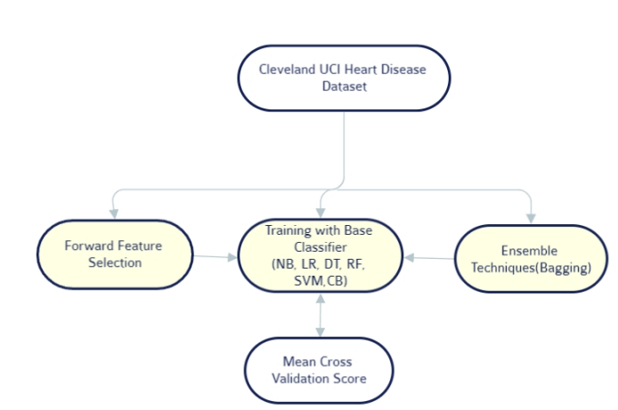
Proposed Method

Slide 9
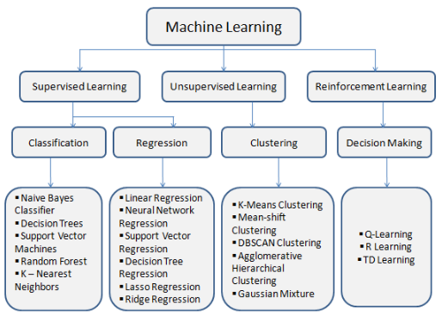
Methods : Classifier Models
1) Naïve bayes
2) Logistic Regression
3) Decision Tree
4) RF
5) SVM

Slide 10
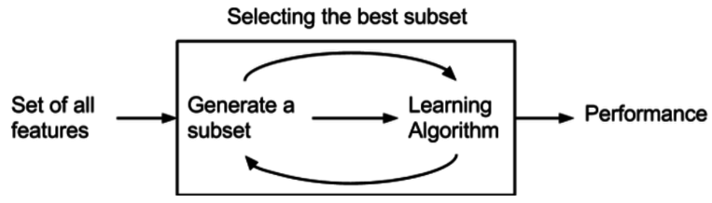
METHODS : Feature Selection
1) FORWARD FEATURE SELECTION
2) PERCENTILE FEATURE SELECTION
“Forward Feature Selection” is an iterative process called forward selection starts with the model having no features.
The feature that best enhances our model is added in each iteration until the performance of the model is not improved by the addition of a new variable.
Percentile Feature Selection is a technique that selects features based on their statistical significance.
A subset of the features that fall within a given percentile range is chosen after the features are ranked according to their scores.

Slide 11

Methods : Ensemble Classifiers
Ensemble methods are indeed a powerful strategy to ameliorate the accuracy of classifiers.
The core concept of ensemble methods is to combine the predictions of multiple individual models, called base models or weak models.
Then to create a final prediction that is more accurate and robust than any individual model.
There are various types of ensemble methods, such as “Bagging” and “Stacking”, each with its strengths and weaknesses

Slide 12
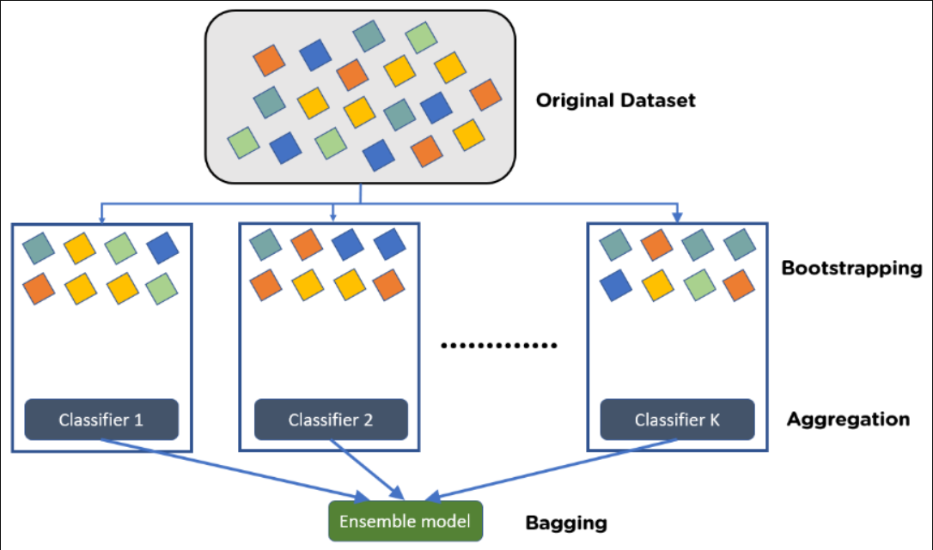
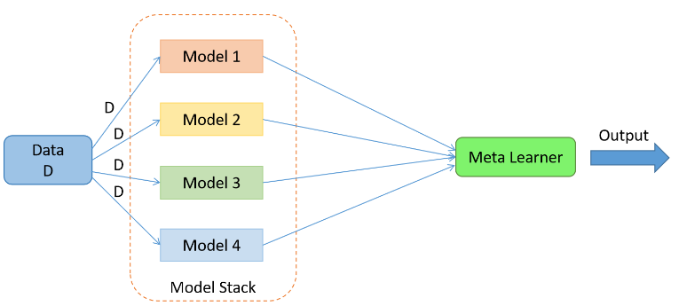
Types of Ensemble Classifiers :
“Bagging”, also called bootstrap aggregation, works by creating multiple datasets from the original data by random sampling with replacement.
These datasets are then used to train multiple models, each of which is slightly different due to the variation in the training data.
“Stacking”, is an ensemble learning technique that combines several machine learning models to enhance the performance of a single model.
This is accomplished by training a second-level model to learn the optimal method for combining the predictions of each individual model

Slide 13
Results :
We found that stacking five classifiers with Percentile feature selection and using linear SVC (a type of SVM with a linear kernel) as the primary classifier yielded the most successful result.
These three SGDC classifiers has different parameters (0.1, 100.0, and 0.5) to control the learning speed. An elasticnet penalty with a parameter of 0.001 was used to balance L1 and L2 regularization techniques.
Two Linear SVC classifiers with regularization parameters of 0.5 and 0.1, both using an L2 penalty. Percentile feature selection based on ANOVA F-value was applied to select top features.
The main classifier was a Linear SVC with a tolerance of 0.1, L1 penalty, and squared hinge loss function. The model achieved an average cross-validation accuracy score of 90.24%.

Slide 14
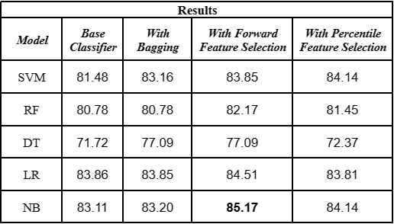
Accuracy using Feature Selection

Slide 15
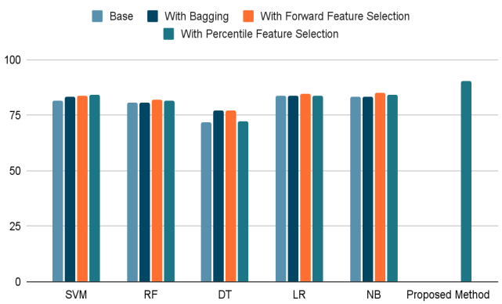
Results : Mean Cross-Validation Scores

Slide 16
Results: Comparison
Reference | Method | Accuracy(%) | Metrics
Palaniappan et al. [1] | NB based Heart Disease Diagnosis System | 86.12 | Accuracy
Olaniyi et al. [2] | Three Phase ANN Diagnosis System | 87.5 | Accuracy
Singh et al. [3] | K-nearest neighbour | 87 | Accuracy
Latha et al. [4] | Majority vote | 85.48 | Accuracy
Alfadli et al. [5] | Chi-Squared + GP | 84.24 | k-fold cross-validation
Reddy et al. [6] | Chi-Squared + SMO | 86.46 | 10-fold cross-validation
Proposed Method | Stacking classifiers with feature selection | 90.24 | 10-fold cross-validation

Slide 17
Conclusion:
Predictive analysis can be extremely useful in Cardiology as early risk detection would greatly help healthcare professionals.
In this paper, patient health records were used to predict the risk of CVD with the help of machine learning.
An algorithm that produced positive results using feature selection and ensemble techniques was developed, and an accuracy rate of 90.24 percent was achieved.

Slide 18
References
Palaniappan, S. and Awang, R. (2008) “Intelligent heart disease prediction system using data mining techniques,” 2008 IEEE/ACS International Conference on Computer Systems and Applications [Preprint]. Available at: https://doi.org/10.1109/aiccsa.2008.4493524.
Olaniyi, E.O., Oyedotun, O.K. and Adnan, K. (2015) “Heart diseases diagnosis using neural networks arbitration,” International Journal of Intelligent Systems and Applications, 7(12), pp. 75–82. Available at: https://doi.org/10.5815/ijisa.2015.12.08.
Singh, A. and Kumar, R. (2020) “Heart disease prediction using machine learning algorithms,” 2020 International Conference on Electrical and Electronics Engineering (ICE3) [Preprint]. Available at: https://doi.org/10.1109/ice348803.2020.9122958.
C. Beulah Christalin Latha, S. Carolin Jeeva, Improving the accuracy of prediction of heart disease risk based on ensemble classification techniques, Informatics in Medicine Unlocked, Volume 16, 2019, 100203, ISSN 2352-9148, [https://doi.org/10.1016/j.imu.2019.100203]
Mohammad Alfadli, K. and Omran Almagrabi, A. (2022) “Feature-limited prediction on the UCI Heart Disease Dataset,” Computers, Materials &amp; Continua, 74(3), pp. 5871–5883. Available at: https://doi.org/10.32604/cmc.2023.033603.
Reddy, K.V. et al. (2021) “Heart disease risk prediction using machine learning classifiers with attribute evaluators,” Applied Sciences, 11(18), p. 8352. Available at: https://doi.org/10.3390/app11188352.
Dataset-https://archive.ics.uci.edu/ml/datasets/Heart+Disease.

Slide 19
Thank You

