Slide 1
PRESENTATION ON
DISH IS WISH

Slide 2
Team Members
1. Jagruti Digambar Patil.
2. Shweta Baburao Desai.
3. Sheetal Shantaram Tiwari.

Slide 3
Objective
To provide an online platform which gives list for all hotels and recipies in all the regions online.

Slide 4
Software development methodology followed:-
Agile development model
Agile development model is also a type of Incremental model. Software is developed in incremental, rapid cycles. This results in small incremental releases with each release building on previous functionality. Each release is thoroughly tested to ensure software quality is maintained. It is used for time critical applications. Extreme Programming (XP) is currently one of the most well known agile development life cycle model.

Slide 5
Advantages
Nowadays, internet has reached almost to everywhere.
So it is necessary to utilize the available resources efficiently and for the benefits of all the users.
We should able to get all the things in one look .
There will be the city wise listing of all hotels and kitchen compass with their contact numbers and address.
Facility to add into the wish list.
Will display all brands and their products .
So that users will get all information at once anywhere so that it saves time.

Slide 6
Data flow diagrams
A data flow diagram (DFD) is a graphical representation of the "flow" of data through an information system, modeling its process aspects.
A DFD shows what kind of information will be input to and output from the system, where the data will come from and go to, and where the data will be stored.
DFD for dish_is_wish are as follows,

Slide 7
Context Level diagram
Request
Dish_Is_Wish
System
Visitor
Admin
Response
Dish_Is_Wish

Slide 8
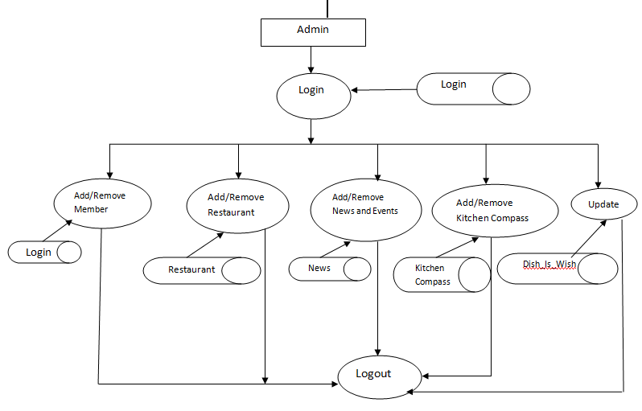
DFD

Slide 9
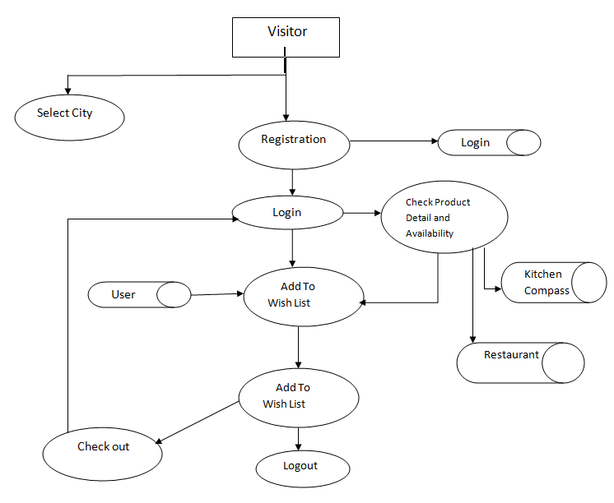
DFD

Slide 10
E-R Diagram
has
Visitor
City
Register
Has
User
Search for
Recipies
Restaurant
Kitchen Compass

Slide 11
E-R Diagram
Admin
Update.
Exhibitions
News
Restaurant
Recipes

Slide 12
UML
The Unified Modeling Language (UML) is a general-purpose modeling language in the field of software engineering.
The basic level provides a set of graphic notation techniques to create visual models of object-oriented software-intensive systems. Higher levels cover process-oriented views of a system.
The UML diagrams for dish_is_wish are as follows:

Slide 13
Usecase for Visitor

Slide 14
Usecase for members

Slide 15
Activity for Login member

Slide 16
Activity for visitor

Slide 17
Class Diagram

Slide 18
Sequence Diagram

Slide 19
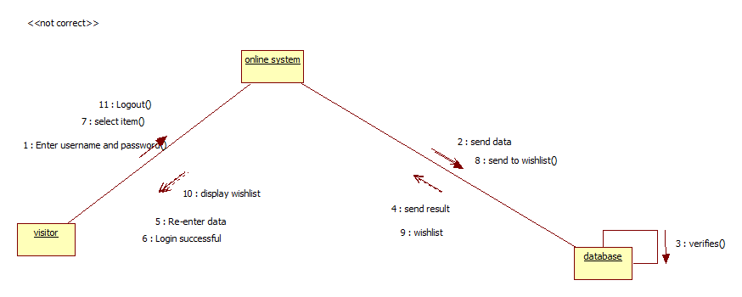
Collaboration Diagram

Slide 20
Component Diagram

Slide 21
Deployment Diagram

Slide 22
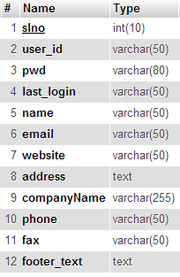
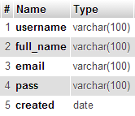
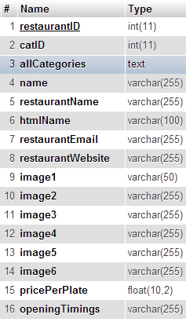
Database Table Structure
Admin_details
login
restaurant

Slide 23
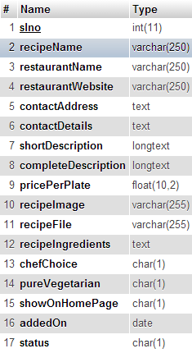
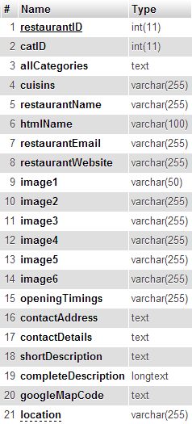
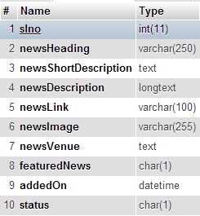
news
recipie
Kitchen_compass

