Slide 1
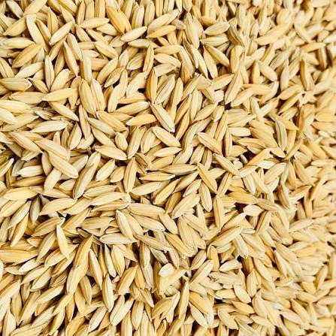

FARMHUB
A central hub for farming
products and equipment
ANDROID MOBILE APPLICATION
DHANASHRI • 2617
JAGRUTI • 2621
MAGNUS • 2628
SMARTER ACCESS. SHARED RESOURCES.

Slide 2
PROJECT OVERVIEW
Introduction
FarmHub is an Android platform that brings agricultural products and equipment rental together in one place. It connects customers with agricultural sellers and equipment owners, while providing role-based access and Firebase-backed data management.
01
One platform
Browse farm inputs and request equipment rentals without switching between separate services.
02
Shared resources
Equipment owners can list machinery that may otherwise remain unused.
Project focus
Make essential farming resources easier to discover, access and coordinate.
03
Digital workflow
Authentication, orders, bookings and inspection records are managed in the app.
02

Slide 3
WHY FARMHUB IS NEEDED
Problem Statement & Existing System
!
High equipment cost
↔
Underused machinery
＋
Scattered product access
Many farmers cannot justify purchasing machinery that may be needed only during specific seasons.
Privately owned equipment can remain idle while nearby farmers may need the same resource.
Seeds, fertilizers and crop-care products are often sourced from different sellers and channels.
Opportunity: connect agricultural product discovery and farmer-to-farmer equipment rental in a single mobile application.
03

Slide 4
WHAT THE APPLICATION AIMS TO ACHIEVE
Objectives of FarmHub
01
Centralize access
02
Enable equipment sharing
Bring agricultural products and equipment discovery into one mobile platform.
Help customers request rentals from approved equipment owners.
03
Supports Cash on Delivery
04
Organize workflows
Manage cart items and place product orders through Cash on Delivery.
Track rental requests, owner decisions, agreement acceptance and return inspection.
05
Control access by role
Provide separate customer, owner and admin navigation.
04

Slide 5
HOW FARMHUB ADDRESSES THE PROBLEM
Proposed Solution
CUSTOMERS
OWNERS / SELLERS
Discover products
and request rentals
List equipment
and farm products
FARMHUB
One mobile experience for products + rentals
FIREBASE
ADMIN
Authentication
and cloud data
Review owner applications
and view commission summary
05

Slide 6
ROLE-BASED NAVIGATION
User Roles
01
Customer
02
Equipment Owner / Seller
03
Administrator
• Register / sign in
• Browse products
• Manage cart and COD orders
• Browse equipment
• Submit rental requests
• View own orders and bookings
• Apply for owner access
• Add and edit equipment listings
• Manage product listings
• Review rental requests
• Approve or reject bookings
• Record return inspection
• Review pending owner applications
• Approve or reject applications
• View revenue summary
• Access protected admin screens
06

Slide 7
SECURE SIGN-IN AND ROLE RESOLUTION
User Authentication
Email and password registration and login using Firebase Authentication.
AUTHENTICATION FLOW
Sign-out functionality for active sessions.
Register / Sign in
↓
Registration supports Customer or Owner application selection.
Firebase Authentication
↓
Resolve account role
Owner registration creates a pending application for admin review.
↓
Role-specific home screen
Role checks determine which areas of the app a signed-in user can access.
07

Slide 8
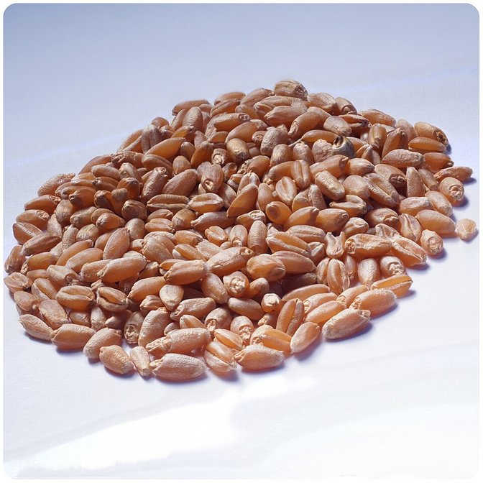
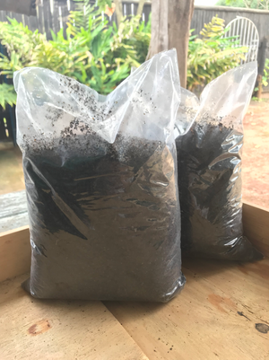
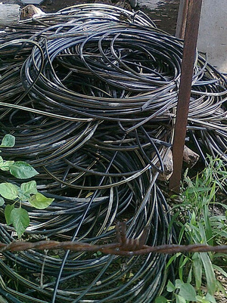
DISCOVER FARMING ESSENTIALS
Agricultural Product Marketplace
Browse published agricultural products.
View product details, price, category and seller information.
Check listed stock availability.
Search and filter products by category.
Owners / sellers can add and manage their product listings.
Seeds • Inputs • Irrigation
08

Slide 9
SIMPLE CHECKOUT WITH COD
Shopping Cart & Product Orders
01
1. Add to cart
02
2. Review order
03
3. Place COD order
Select products and quantities from the marketplace. Cart items can be updated or removed.
Check selected items, quantities, total amount and required delivery address.
Submit the product order using Cash on Delivery. The order is saved in Firestore.
09

Slide 10
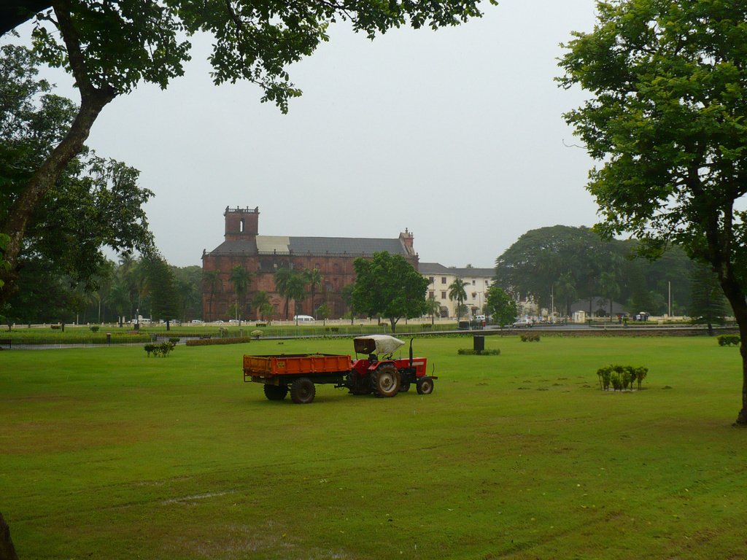
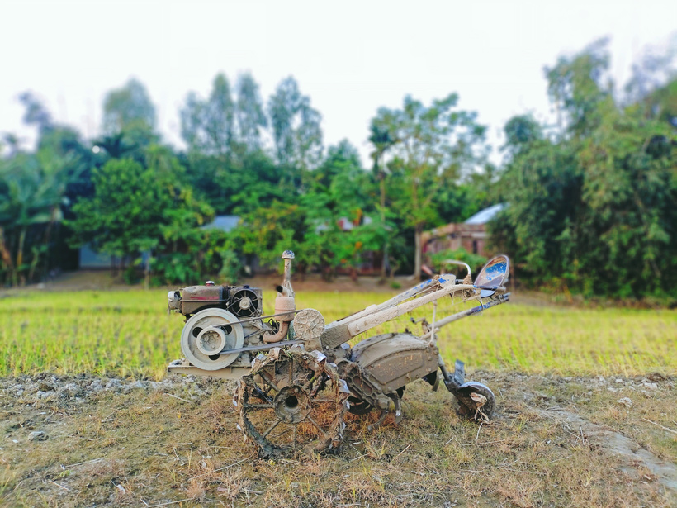
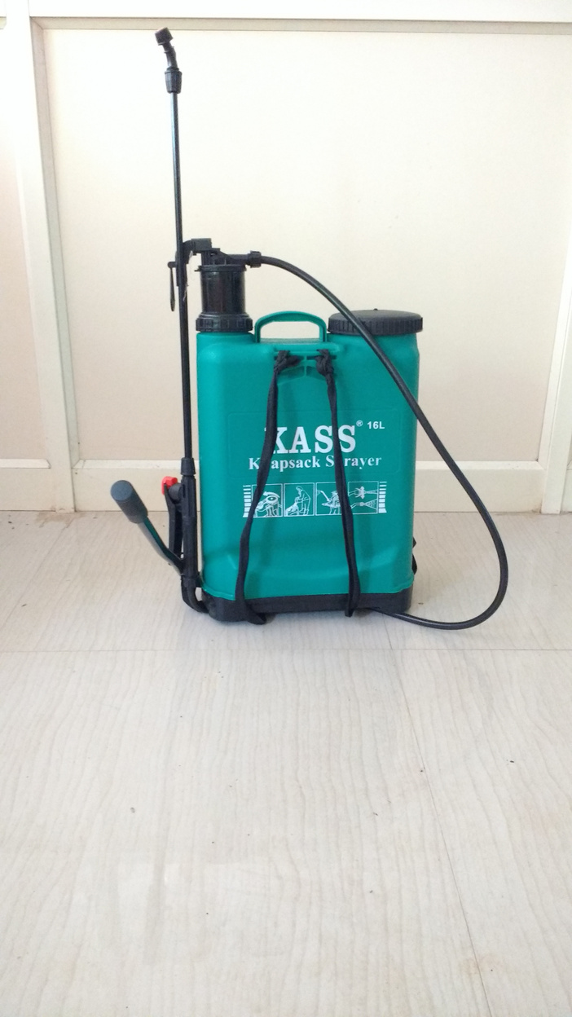
FIND AND REQUEST MACHINERY
Agricultural Equipment Rental
Browse published equipment listings.
View equipment details, rental price and location.
Select a rental date and submit a booking request.
Booking requests begin with Pending status.
Customers can view the status of their rental requests.
Tractors • Tillers • Sprayers
10

Slide 11
TOOLS FOR APPROVED OWNERS
Owner & Seller Management
01
Equipment listings
02
Booking management
03
Product management
Add equipment, edit listing details, manage availability and view owner equipment.
Review incoming rental requests and approve or reject pending bookings.
Add agricultural products and manage the seller's existing product listings.
11

Slide 12
OWNER APPLICATION REVIEW AND REVENUE OVERVIEW
Admin Module
OWNER APPLICATION REVIEW
REVENUE SUMMARY
Admin access is verified using an active admin record.
5%
Commission rate
Product orders + rental bookings
Pending owner applications are listed for review.
Admin can approve or reject an application.
Approval creates an owner approval record used by role checks.
FARMHUB • ANDROID APPLICATION
12

Slide 13
RECORD RENTAL TERMS AND EQUIPMENT CONDITION
Rental Agreement & Return Inspection
01
Agreement acceptance
02
Booking status
03
Return inspection
The customer accepts the rental agreement terms as part of submitting the booking request.
The request moves through Pending, Approved or Rejected based on the owner's decision.
The owner records return status, equipment condition, damage description and inspection charge.
Booking and inspection details are stored in Cloud Firestore.
13

Slide 14
ANDROID APPLICATION STACK
Tools & Technologies Used
Java
XML
Main programming language for application logic.
Layouts, screens and interface components.
Android SDK
Firebase Authentication
Android platform APIs and build tools.
Email/password sign-in and account management.
Cloud Firestore
Gradle
Cloud database for profiles, products, orders, equipment and bookings.
Build automation and dependency management.
ADB
Visual Studio Code
Install and debug the app on a connected Android device.
Source-code editing and project management.
Platform: Android | Architecture: Activity-based app + repository classes + Firebase backend
14

Slide 15
FROM MOBILE UI TO CLOUD DATA
System Architecture & Flow
ANDROID PRESENTATION
Activities • XML layouts • Role-based navigation
↓
APPLICATION LOGIC
Repositories • Product, equipment, booking and order workflows
↓
FIREBASE SERVICES
Firebase Authentication • Cloud Firestore
↓
DATA COLLECTIONS
userProfiles • products • equipment • orders • bookings • ownerApplications • admins
Firestore security rules help restrict access based on sign-in identity and approved roles.
15

Slide 16
MAIN INTERACTIONS BY USER ROLE
Use Case Overview
FARMHUB APPLICATION
OWNER
Browse products & equipment
Cart & place COD order
CUSTOMER
Request equipment rental
View orders & bookings
Manage listings & products
Approve / reject bookings
ADMIN
Review owner applications
View revenue summary
Conceptual use-case overview based on the implemented customer, owner and admin workflows.
16

Slide 17
CURRENT IMPLEMENTATION AND NEXT STEPS
Revenue Model & Future Enhancements
CURRENT REVENUE LOGIC
POSSIBLE FUTURE ENHANCEMENTS
5%
Integrate a secure online payment gateway.
Calculated commission rate
Expand admin tools and operational reports.
Add order fulfilment and delivery tracking.
Commission calculated on product orders.
Commission calculated on equipment rentals.
Introduce richer notifications and booking reminders.
Admin screen summarizes recorded commission.
Add analytics for product and equipment usage.
17

Slide 18
THANK YOU
Growing connections. Sharing resources.

