Slide 1

Github
Journey of Research
Ms. Jagruti Boda R.
Assistant professor
P P Savani University

Slide 2
Outline
What is Github?
Important Terms
Why Github?
How we can use?
Upload your code in github

Slide 3
What is Github?
GitHub is a website and cloud-based service that helps developers store and manage their code, as well as track and control changes to their code.

Slide 4
Important terms
Git
Version Control
Repository
clone

Slide 5

Important terms
Git : Git is a distributed version-control system for tracking changes in source code during software development. It is designed for coordinating work among programmers, but it can be used to track changes in any set of files.

Slide 6
Important terms
Version control: Version control is a type of system that allows you to keep track of changes made to your code over time. As such, version control is useful because: You can revert back to specific 'versions' of your code.

Slide 7

Important terms
Repository: In software development, a repository is a central file storage location. It is used by version control systems to store multiple versions of files. ... This may include multiple source code files, as well as other resources used by the program.

Slide 8
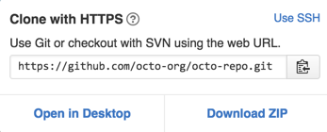
Important terms
Clone: Cloning a repository means that you're downloading a copy of the source code from source control.

Slide 9
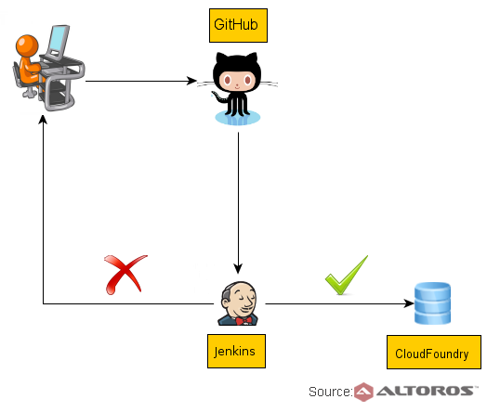
Why Github?

Slide 10
Upload my code in Github
Important link:
https://github.com/

Slide 11
References
https://images.app.goo.gl/WchVHTc6PnMauXUj8
https://images.app.goo.gl/Y5UjotAnrHFR4wXA7
https://images.app.goo.gl/DyUeQNvA8MXkqc5c6
https://images.app.goo.gl/NsLKj6iLLq7pK5X36
https://images.app.goo.gl/z9S7iaqrMRbyPS899

Slide 12


Slide 13


Slide 14
Any Question?
Write in comment section

