Slide 1















Split Bill Application
Presented by:-
Jagannath Nayak
Suraj Kumar Yadav

Slide 2

Objective
The goal of this project is to make it easier for people to manage shared expenses. Whether it’s splitting bills for a trip, rent, or a dinner outing, the "Split Bills" app helps users track who owes what, so everything is fair and clear. The app lets users create groups, log transactions, and settle balances, simplifying the process of managing group expenses.

Slide 3
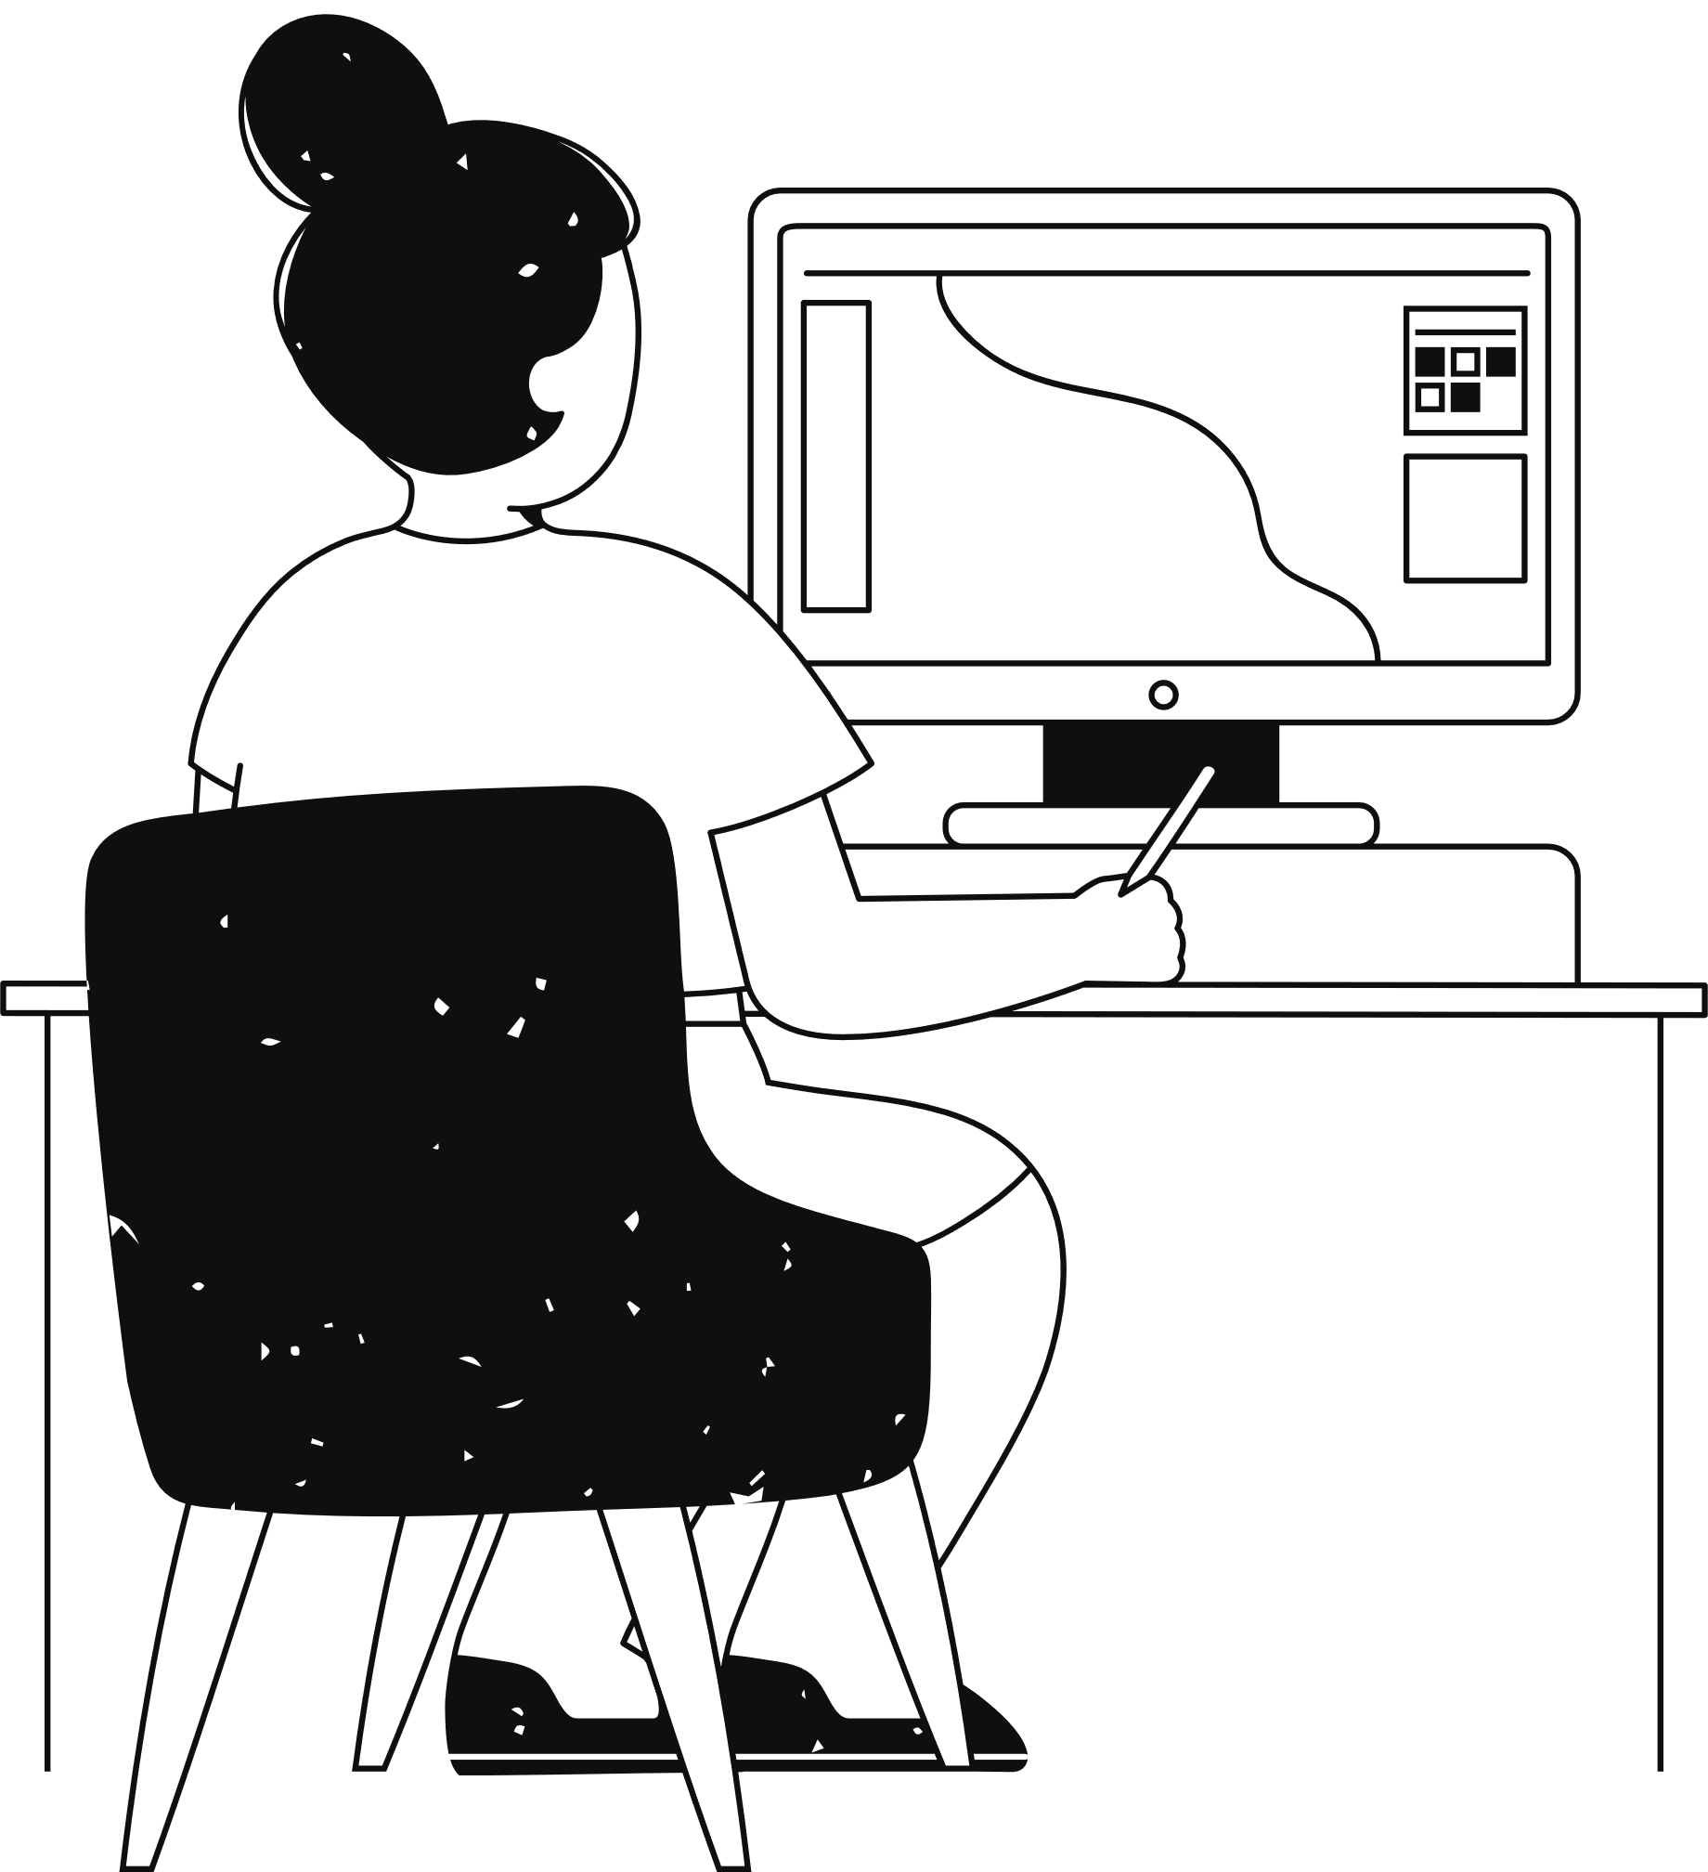
Introduction
The "Split Bills" app makes it easy to manage shared expenses, like splitting bills or rent, by handling all the calculations for you. With a simple command-line interface, users can create groups, add transactions, see who owes what, and settle up easily. It connects to a MySQL database using JDBC to store and retrieve all the data, so you can track expenses and ensure everyone pays their fair share without any confusion.

Slide 4
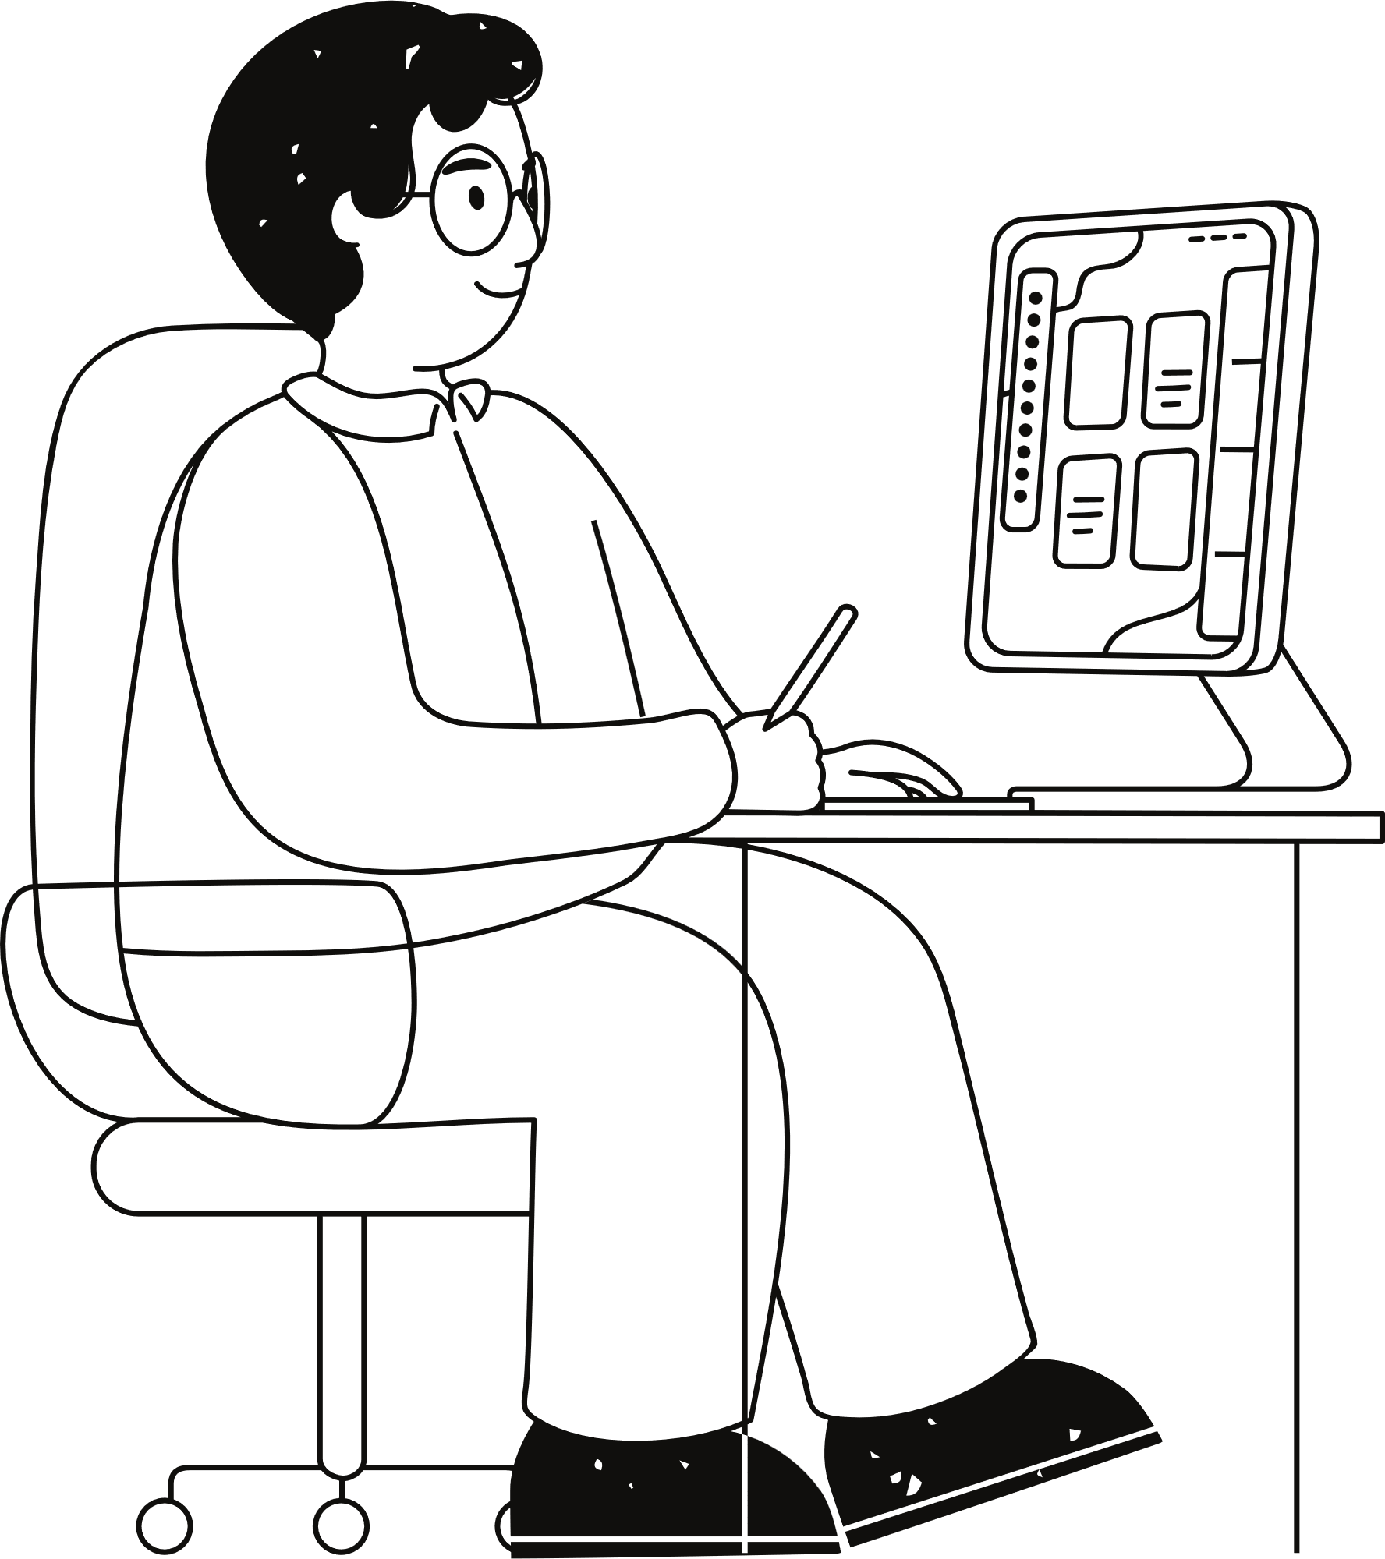
Problem Statement
One of the common struggles in shared expenses is keeping track of who owes what. Without a proper system, it can be confusing to figure out who paid, who still needs to pay, and how much each person owes. This often leads to disputes and mistakes.

Slide 5
Tools/Technologies
Used
Core JAVA
JDBC
MySQL

Slide 6

Logic??

Slide 7


Before
After

Slide 8
Timeline
01
02
03
04
05
Feasibility Study
Logic Building and Database Design
Coding and Implementation
Testing
Project Submission

Slide 9
Thank you very much!

