Slide 1
Time Series Forecasting
Analysis and Interpretations

Slide 2
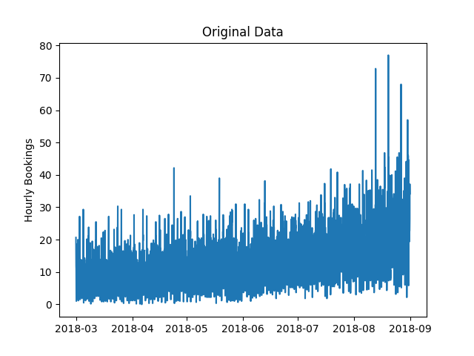
Original Data
Data then: Data points seperated by an interval of 10 mins
Data now: Converted to hourly data by taking the average.

Slide 3
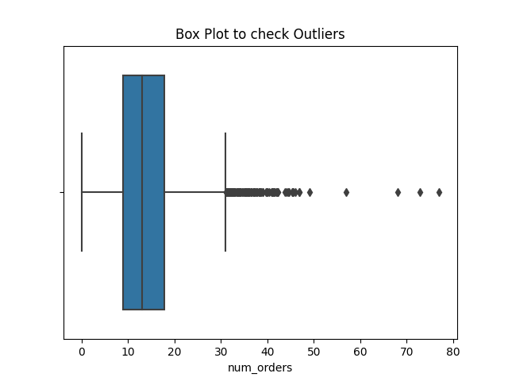
Box Plot
Box Plot: To check for outliers.
IQR: To remove the outliers w.r.t Q1 and Q2.

Slide 4
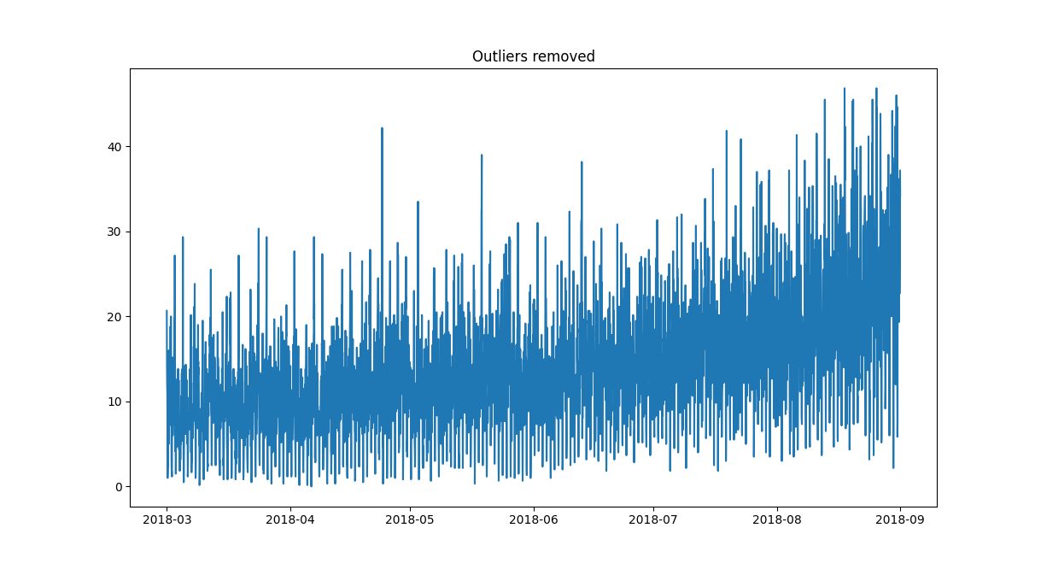
Data without Outliers

Slide 5
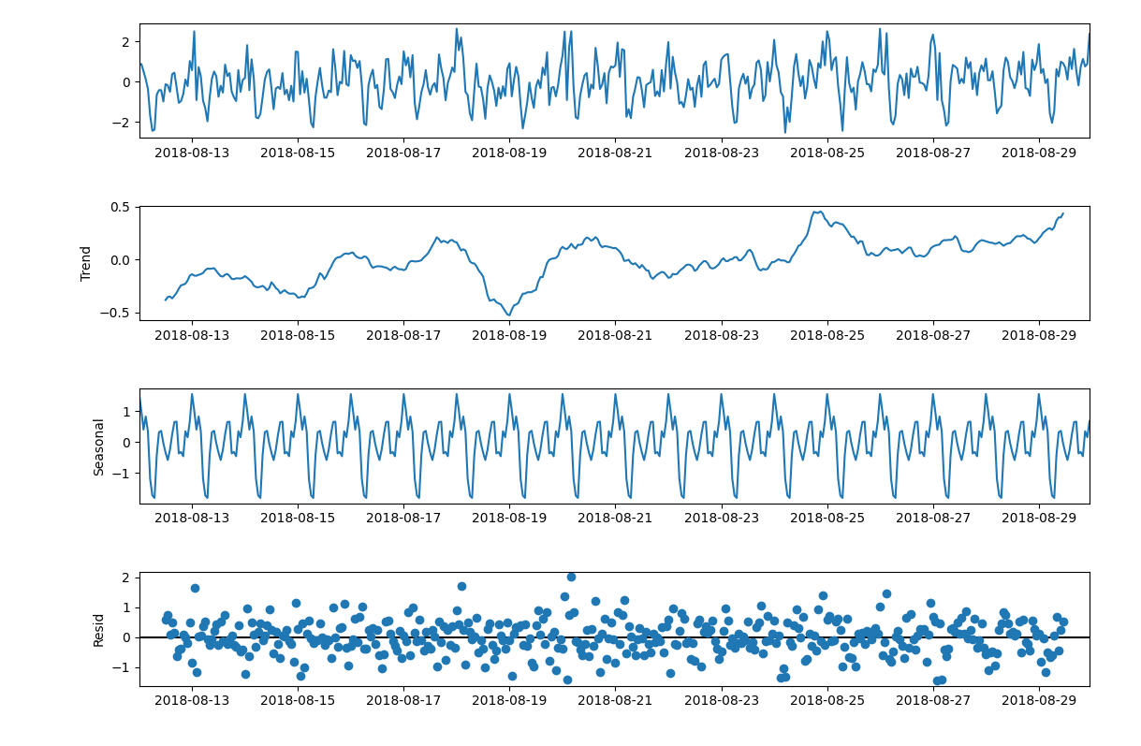
Series Decomposition
Decomposed data into trend, seasonal and residual components

Slide 6
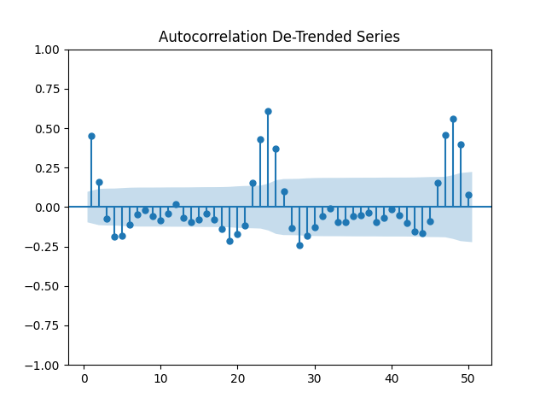
De-trended Series
Used Rolling average.
Observed seasonal patterns at periods 24 and 48 in the ACF plot.

Slide 7
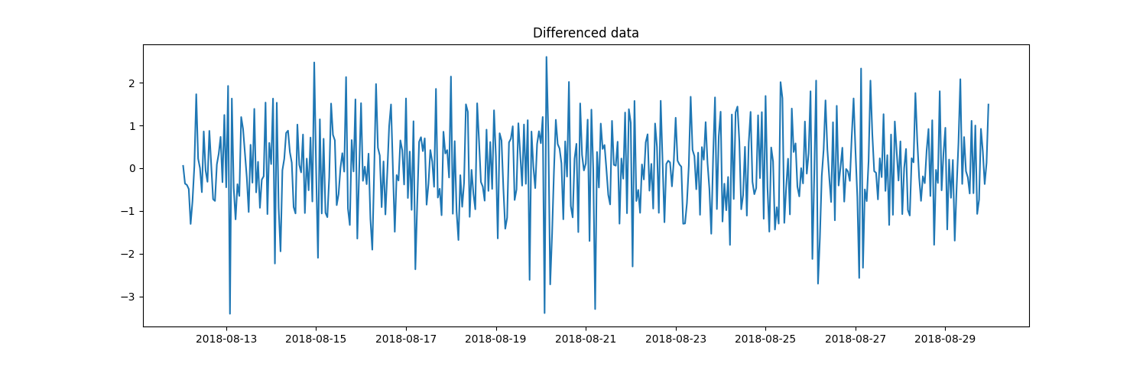
Transformation - Differencing
To check for Stationarity.
Taken the first difference.

Slide 8
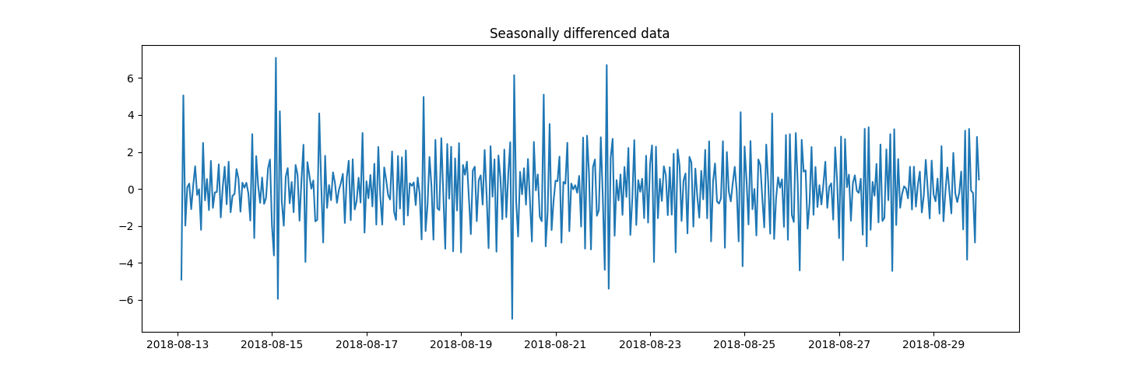
Transformation – Seasonal Differencing
To check for Stationarity.
Taken the seasonal period of 24 for differencing.

Slide 9
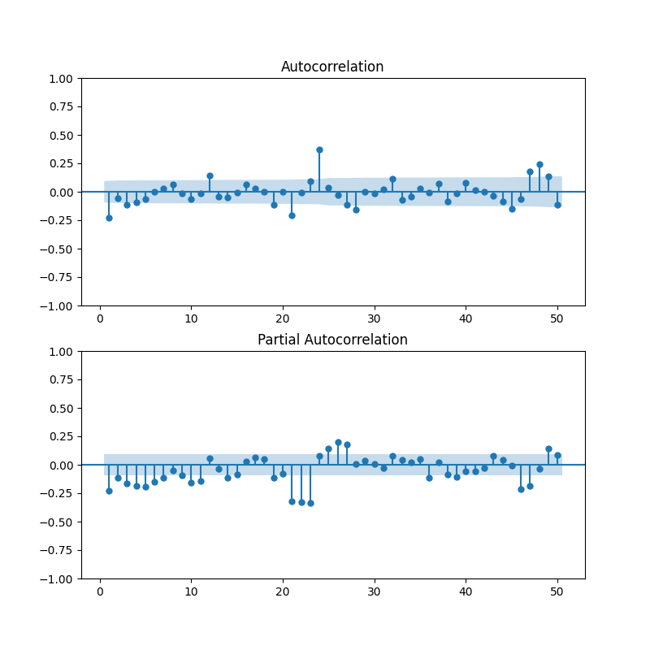
ACF and PACF of Differenced Data
To determine model order for non-seasonal patterns.

Slide 10
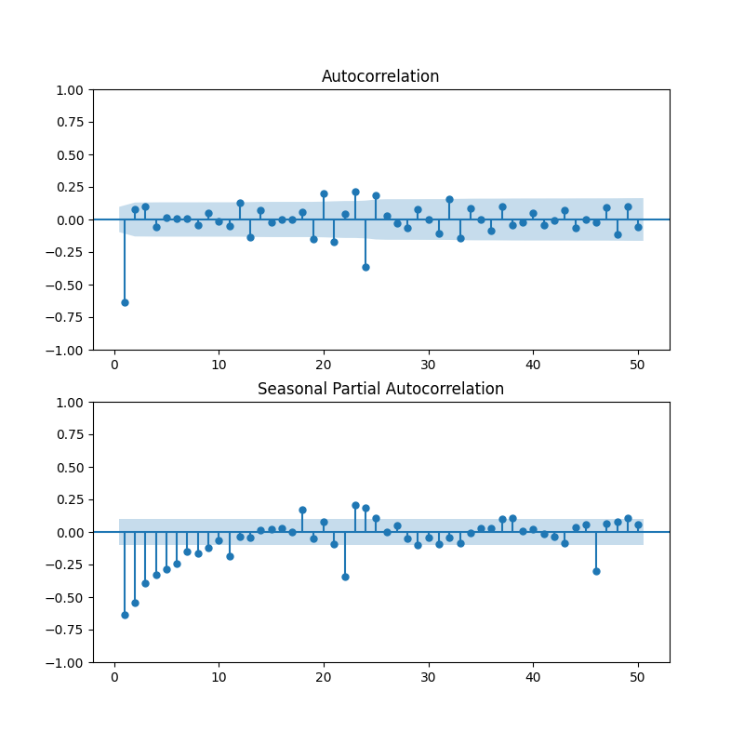
ACF and PACF of Seasonally Differenced Data
To determine model order for seasonal patterns.
Seasonal component visible at lags 1 and 24 for ACF.

Slide 11
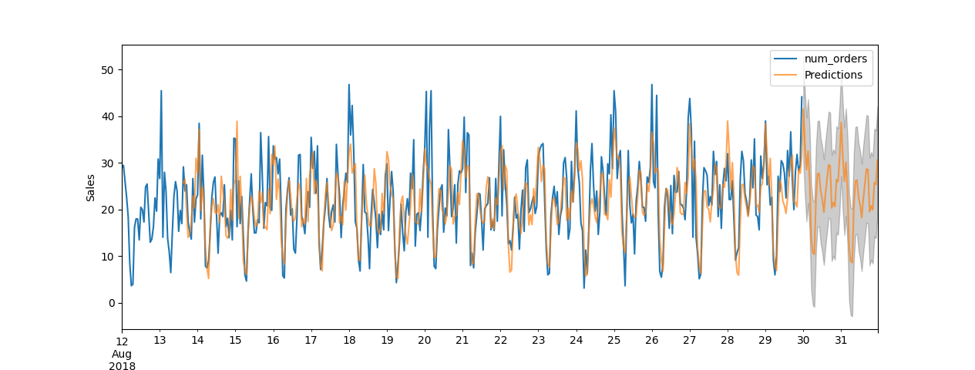
SARIMA Modelling
Can capture both non-seasonal and seasonal patterns.
Difficult to determine model order with ACF and PACF plots.
AIC values – Good at choosing predictive models
  Lower AIC values → Better Model
Data – Scaled after Box-Cox Transform
Mean RMSE – 0.5

Slide 12
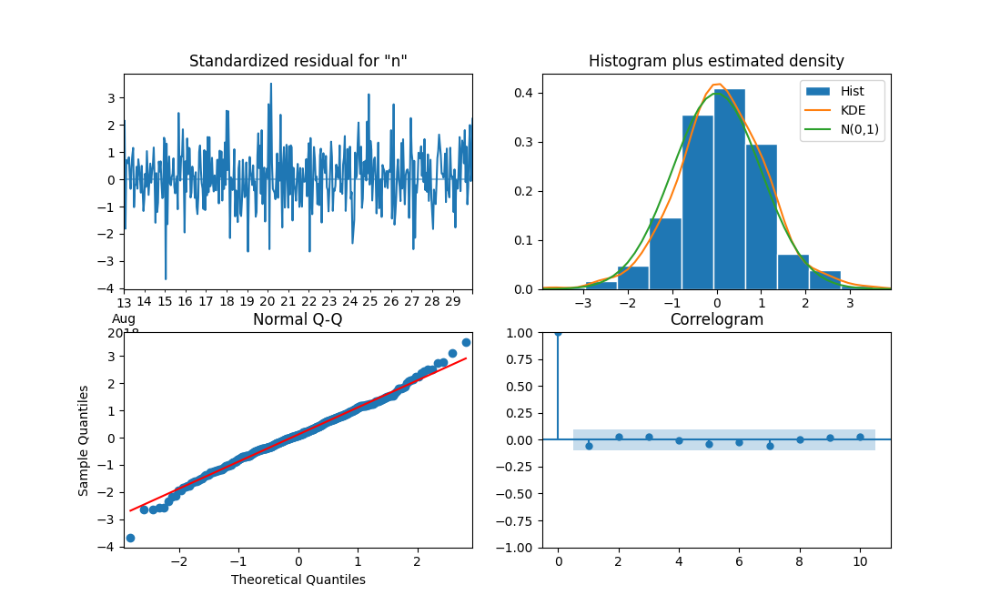
SARIMA Model Diagnostic
Model Order – Non Seasonal (1,0,1); Seasonal (0,1,1,24)
Mean Residual – 0.05
Residual looks like White Noise
Residual is close to Normal Distribution
Q – Q plot is close to linear
ACF in Correlogram shows no correlations at lag > 0

Slide 13
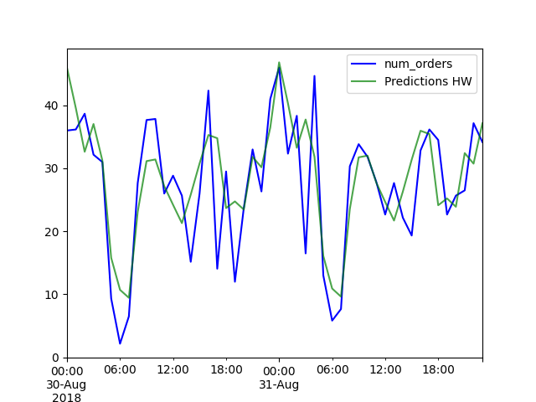
Exponential Smoothing
Model selected based on Trend and Seasonal Characteristics.
Trend – Additive
Seasonality – Additive
Mean RMSE – 0.9

Slide 14
Next Steps
Deep Learning approach – LSTMs. Can use CNN for feature extractor.
Data such as Booking Price and Holidays for Demand Forecasting. Can use weather information as an influencial factor.
  Advanced models such as Vector Auto-Regression and Dynamic Harmonic Regression could be used.

