Slide 1

Credit Card Fraud Detection with Machine Learning
Author – Jagadish Janakiraman
Date – 9/25/2023

Slide 2

Agenda
Overview
Data Pre-Processing
Model Selection
Hyperparameter Tuning
Model Evaluation

Slide 3

Overview
Objective - Predict fraudulent credit card transactions with the help of machine learning models.
Approach:
Data understanding: Load the data and understand the features.
Exploratory data analytics (EDA): Identify and mitigate skewness in the data.
Train/Test split: Use k-fold cross-validation.
Model building / hyperparameter tuning: Experiment with different models and fine-tune hyperparameters.
Model evaluation: Use appropriate evaluation metrics, considering the imbalanced dataset.

Slide 4
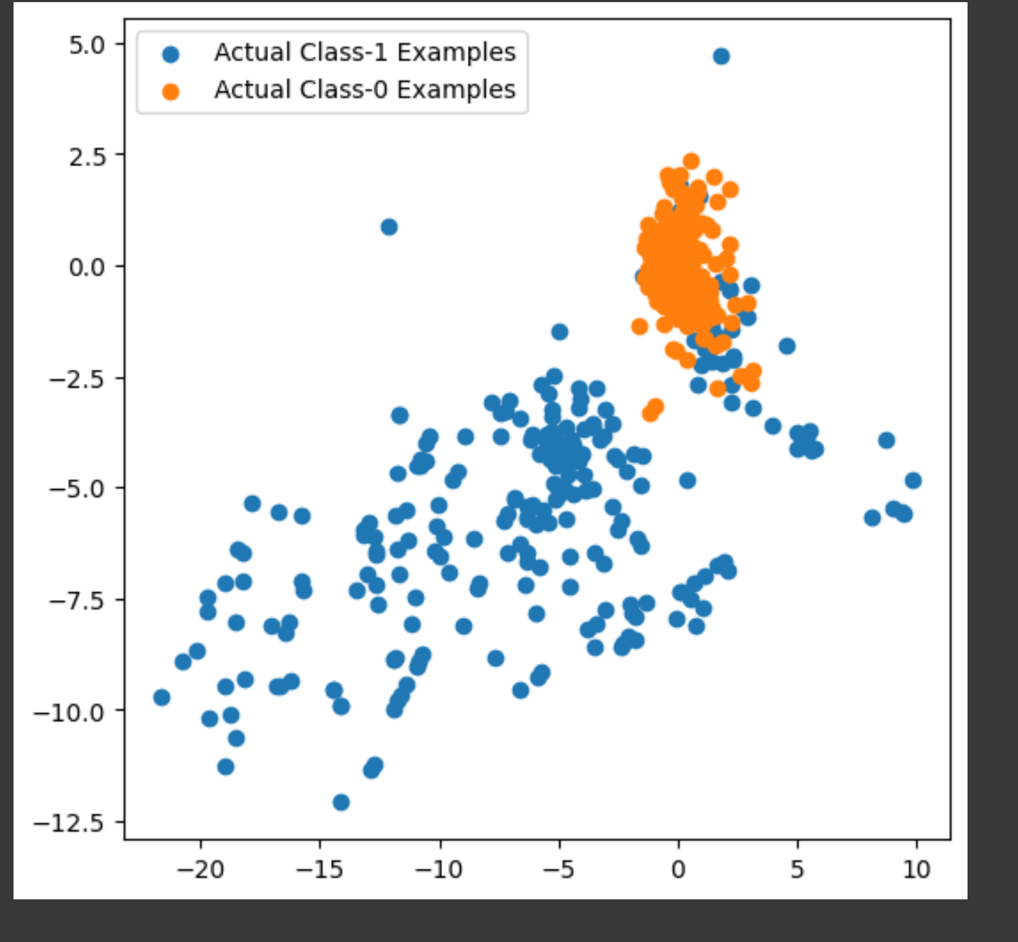
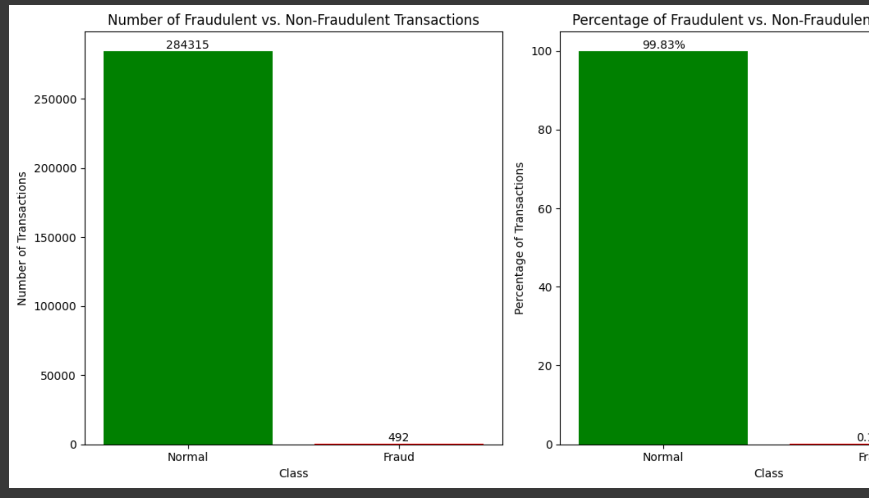
Data – Imbalanced Dataset
Imbalanced Dataset:284,315 Good Transactions
492 Fraud Transactions

Slide 5
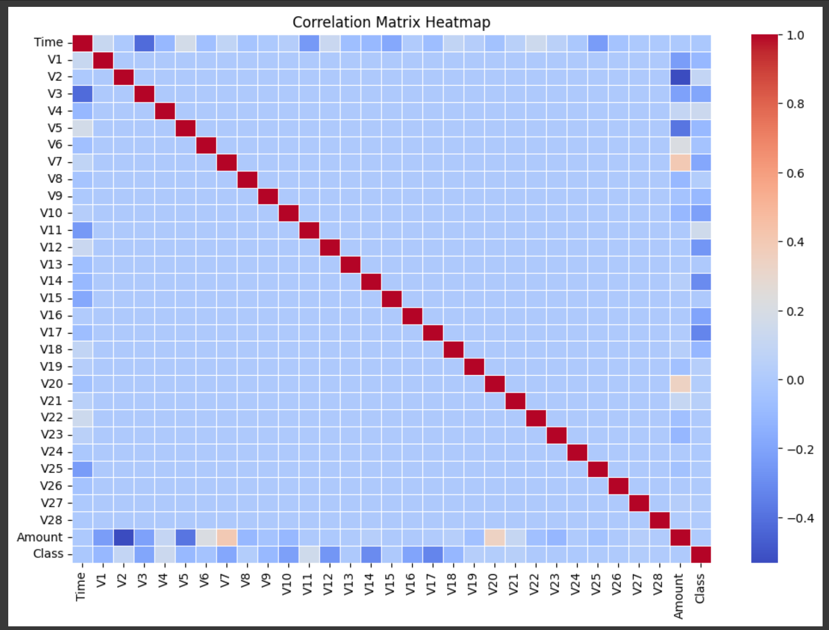
Data - Correlation
No high correlation between features.

Slide 6
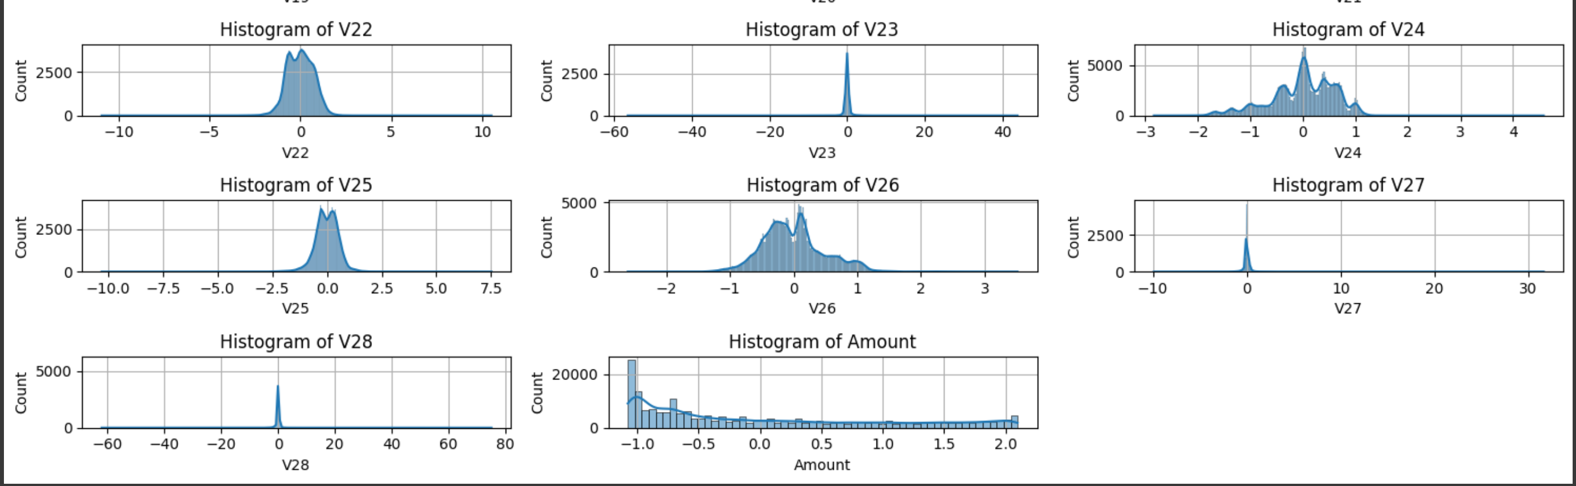
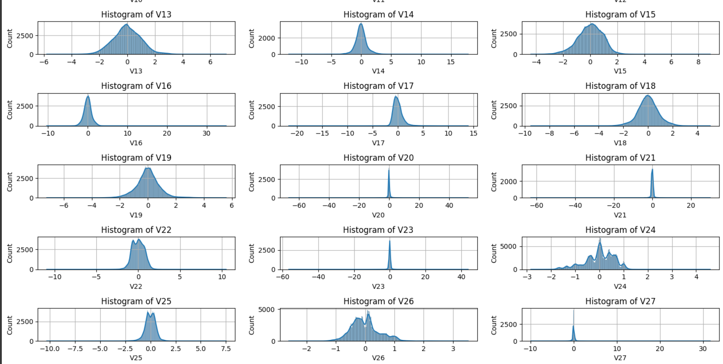
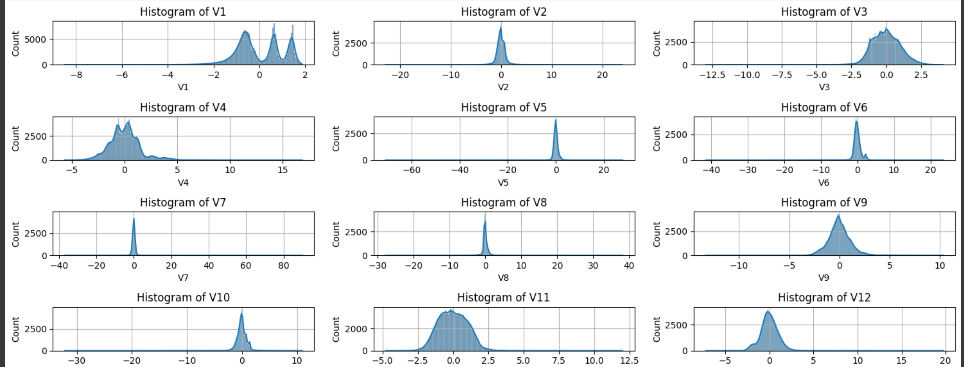
Normalized Data
Skewness removed using PowerTransformer.

Slide 7
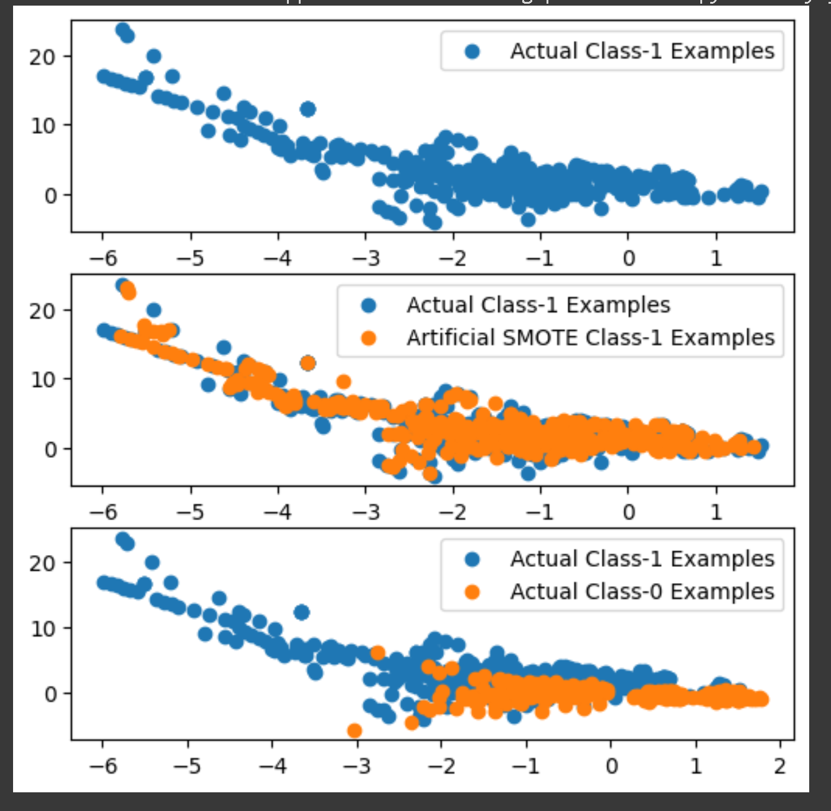
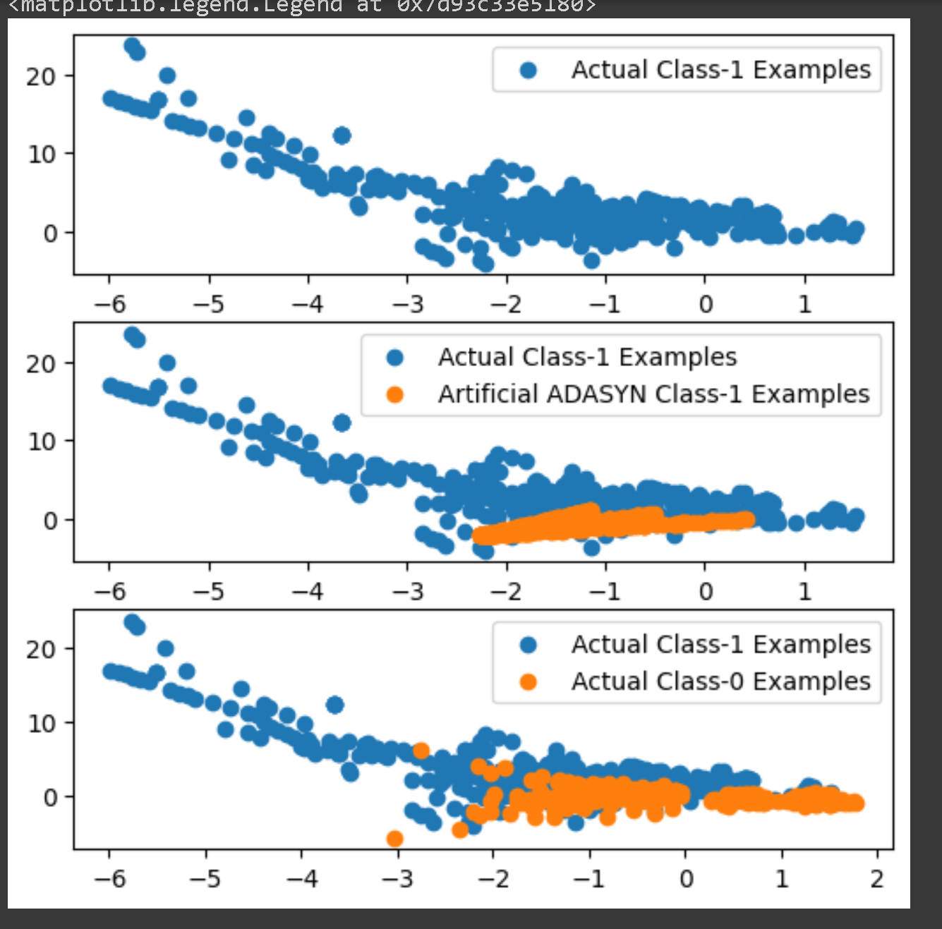
Oversampled Datapoints

Slide 8
Model Performance - Logistic Regression with Hyperparameter Tuning
Data Type | Data Oversampling | Size | Run Time | Evaluation - ROC AUC | Optimal ‘C’ Param
Imbalanced Dataset | NA | X_Train : 227845 X_Test : 56962 | 4.34 seconds | 0.9806 | 0.001
Balanced Dataset | Random Oversampling | X_train_ros : 454902 X_Test : 56962 | 8.22 seconds | 0.9718 | 10
Balanced Dataset | SMOTE | X_train_smote : 454902 X_Test : 56962 | 8.37 seconds | 0.9705 | 10
Balanced Dataset | ADASYN | X_train_adasyn : 454900 X_Test : 56962 | 7.72 seconds | 0.9714 | 10

Slide 9
Model Performance - XGBoost with Hyperparameter Tuning
Data Type | Data Oversampling | Size | Run Time | Evaluation - ROC AUC | Best Hyperparameters
Imbalanced Dataset | NA | X_Train : 227845 X_Test : 56962 | 3538.86 seconds | 0.9785 | learning_rate: 0.2 max_depth: 5 n_estimators: 300
Balanced Dataset | Random Oversampling | X_train_ros : 454902 X_Test : 56962 | 5510.31 seconds | 0.9779 | learning_rate: 0.2 max_depth: 4 n_estimators: 300
Balanced Dataset | SMOTE | X_train_smote : 454902 X_Test : 56962 | 8909.62 seconds | 1.00 | learning_rate: 0.2 max_depth: 5 n_estimators: 300
Balanced Dataset | ADASYN | X_train_adasyn : 454900 X_Test : 56962 | 8977.06 seconds | 0.9751 | learning_rate: 0.2 max_depth: 5 n_estimators: 300

Slide 10
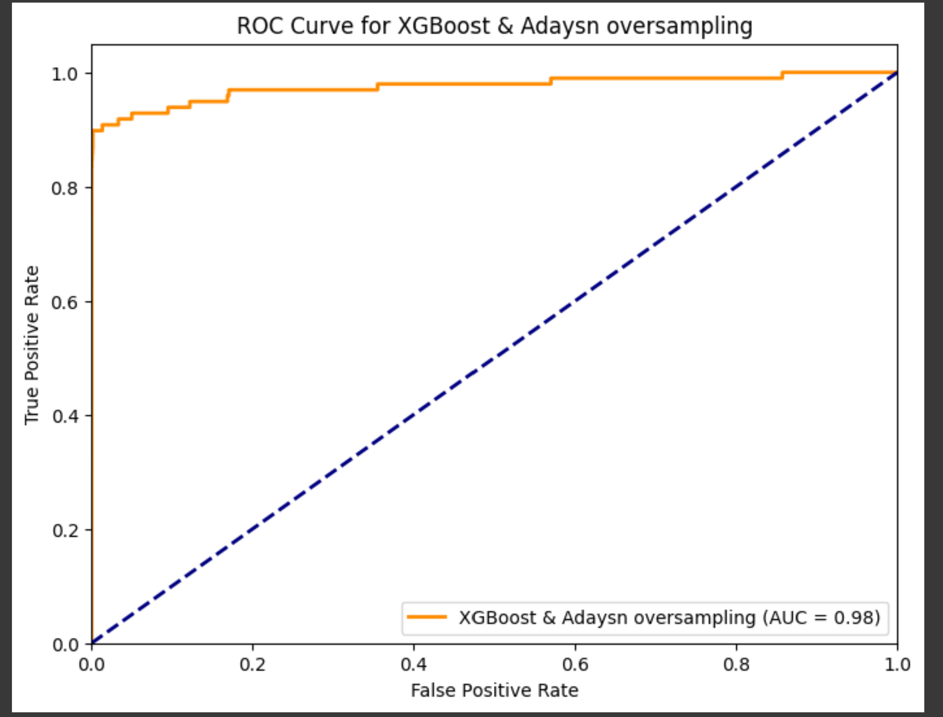
Model Evaluation
ROC curve is measured at all thresholds, the best threshold would be the one at which TPR is high and FPR is low, i.e., misclassifications are low.
To save banks from high-value fraudulent transactions, we need to focus on high recall to detect actual fraudulent transactions.
False Positive Rate (FPR): 0.0016 True Positive Rate (TPR): 0.8980 Best Threshold: 0.1210

