Slide 1

Credit Card Fraud Detection with Machine Learning
Author – Jagadish Janakiraman
Date – 9/25/2023

Slide 2

Agenda
Overview
Data Pre-Processing
Model Selection
Hyperparameter Tuning
Model Evaluation

Slide 3

Overview
Objective - Predict fraudulent credit card transactions with the help of machine learning models.
Approach:
Data understanding: Load the data and understand the features.
Exploratory data analytics (EDA): Identify and mitigate skewness in the data.
Train/Test split: Use k-fold cross-validation.
Model building / hyperparameter tuning: Experiment with different models and fine-tune hyperparameters.
Model evaluation: Use appropriate evaluation metrics, considering the imbalanced dataset.

Slide 4
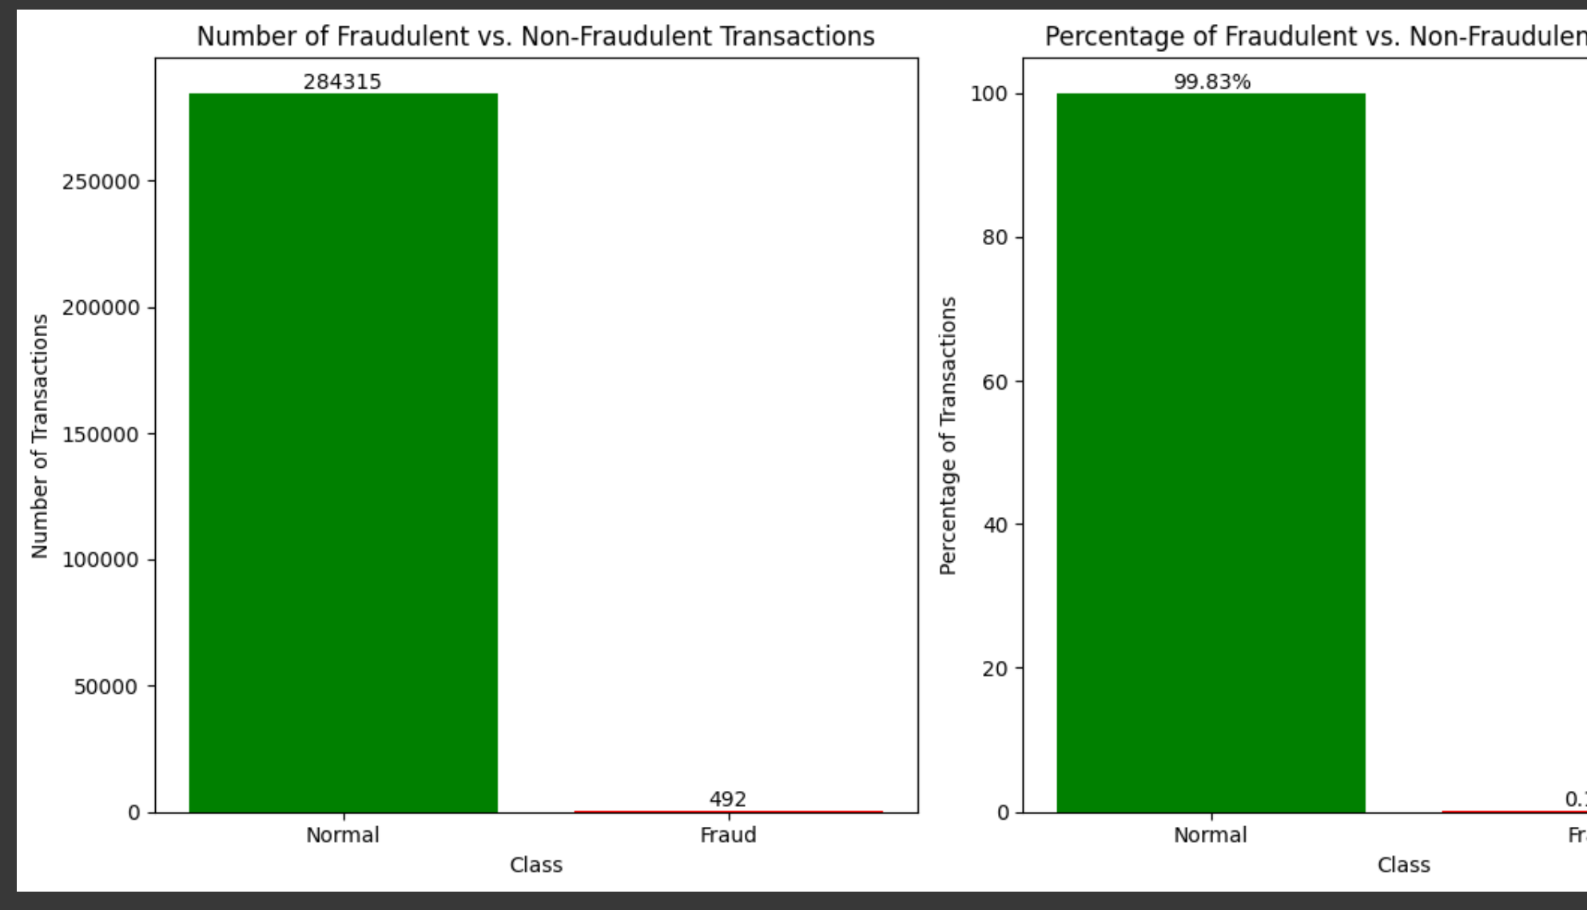
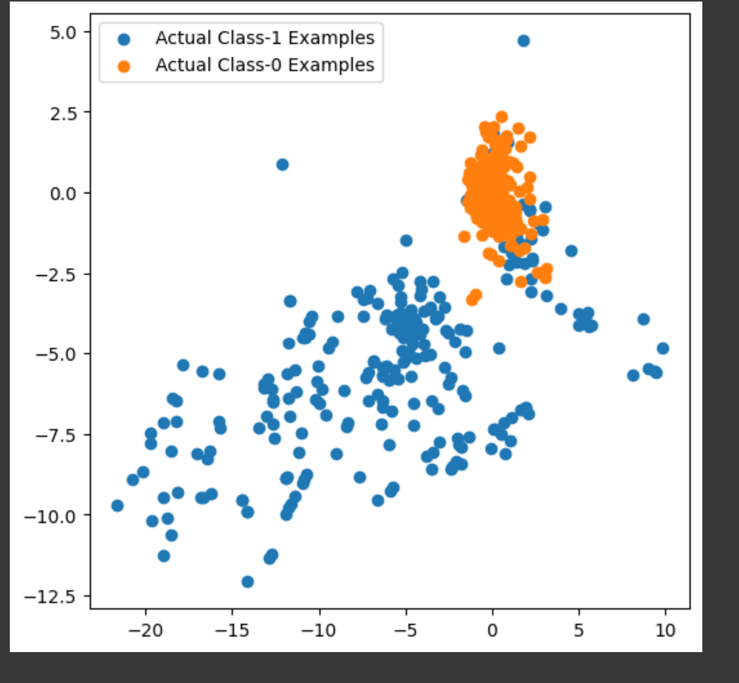
Data – Imbalanced Dataset
284,315 Good Transactions
492 Fraud Transactions

Slide 5
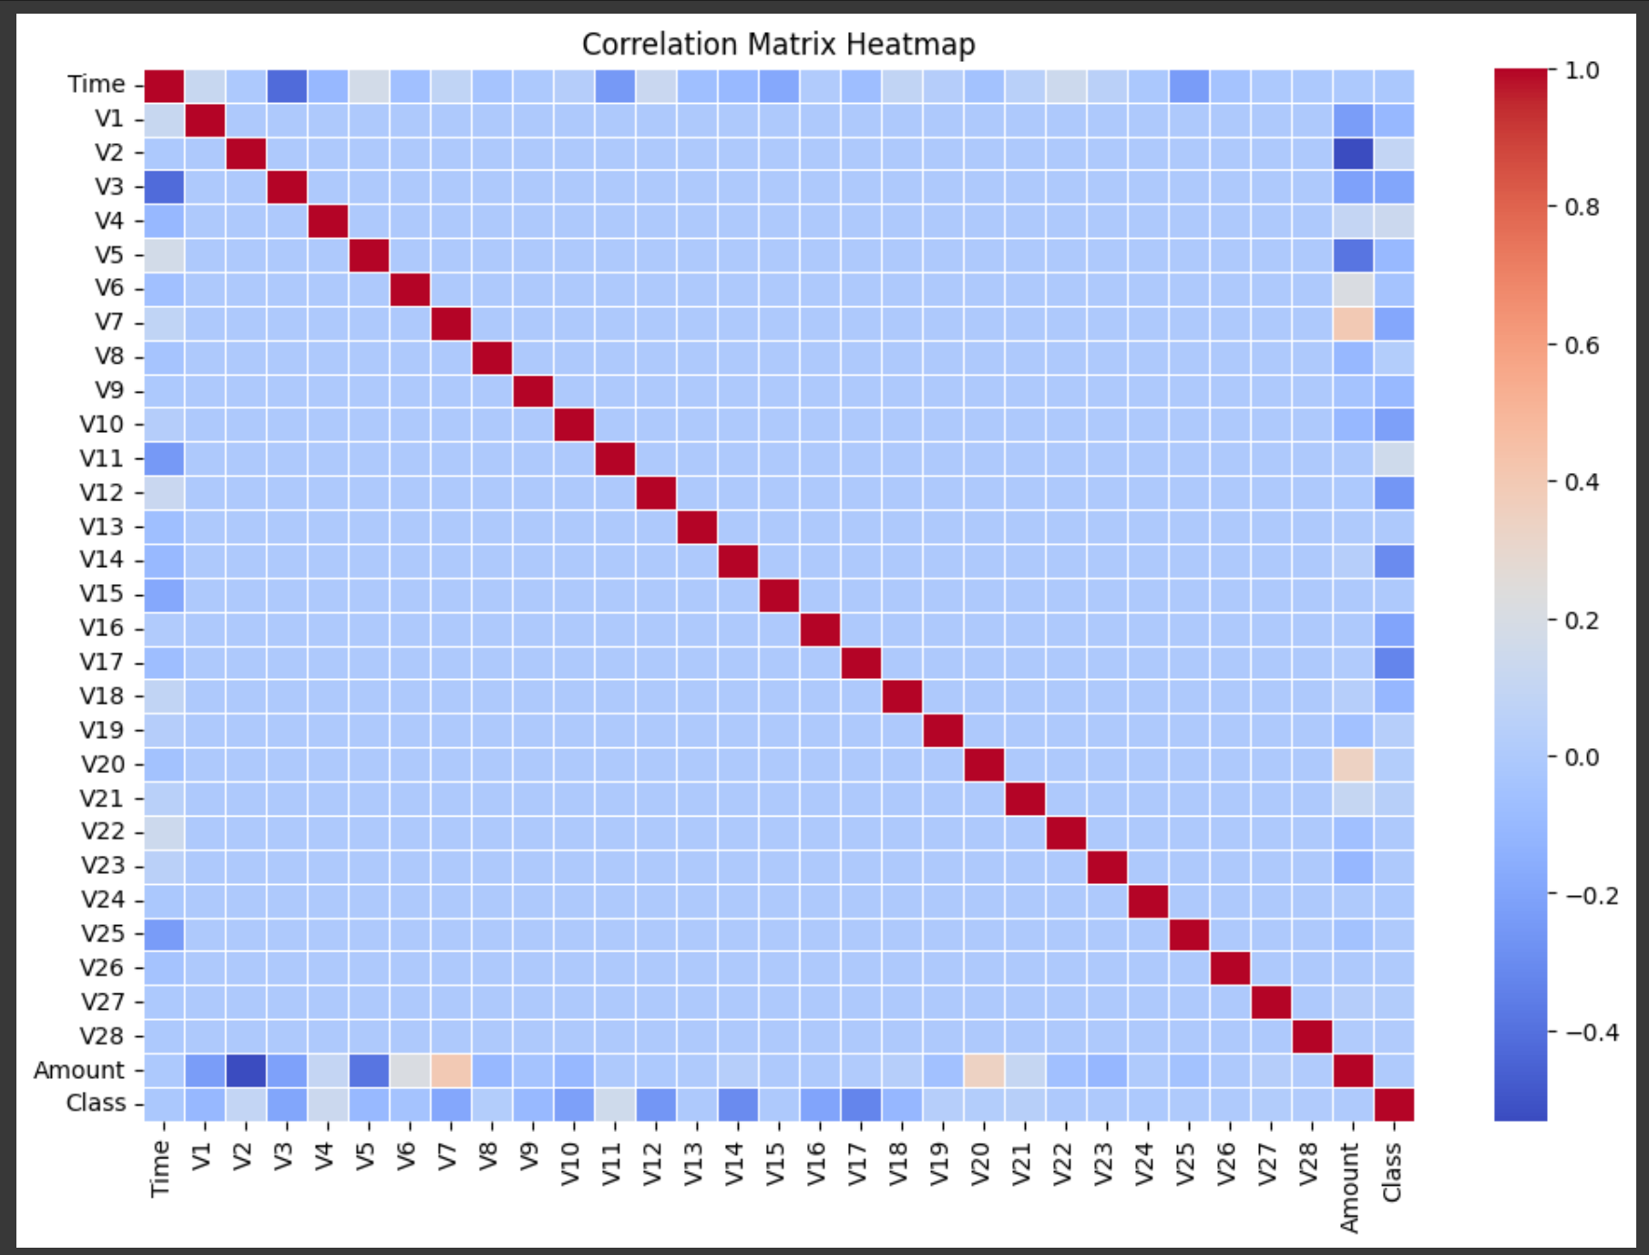
Data - Correlation
No high correlation between features.

Slide 6
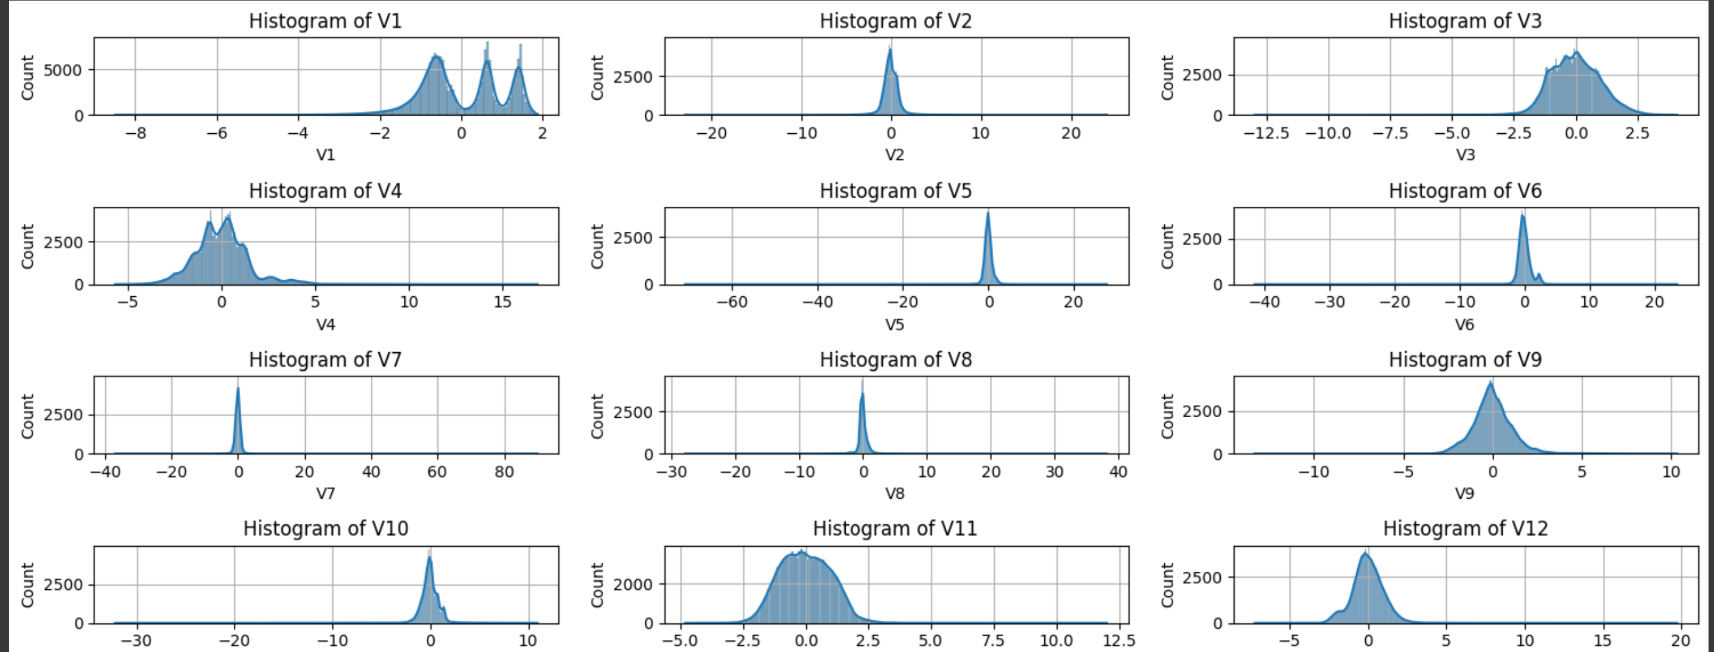
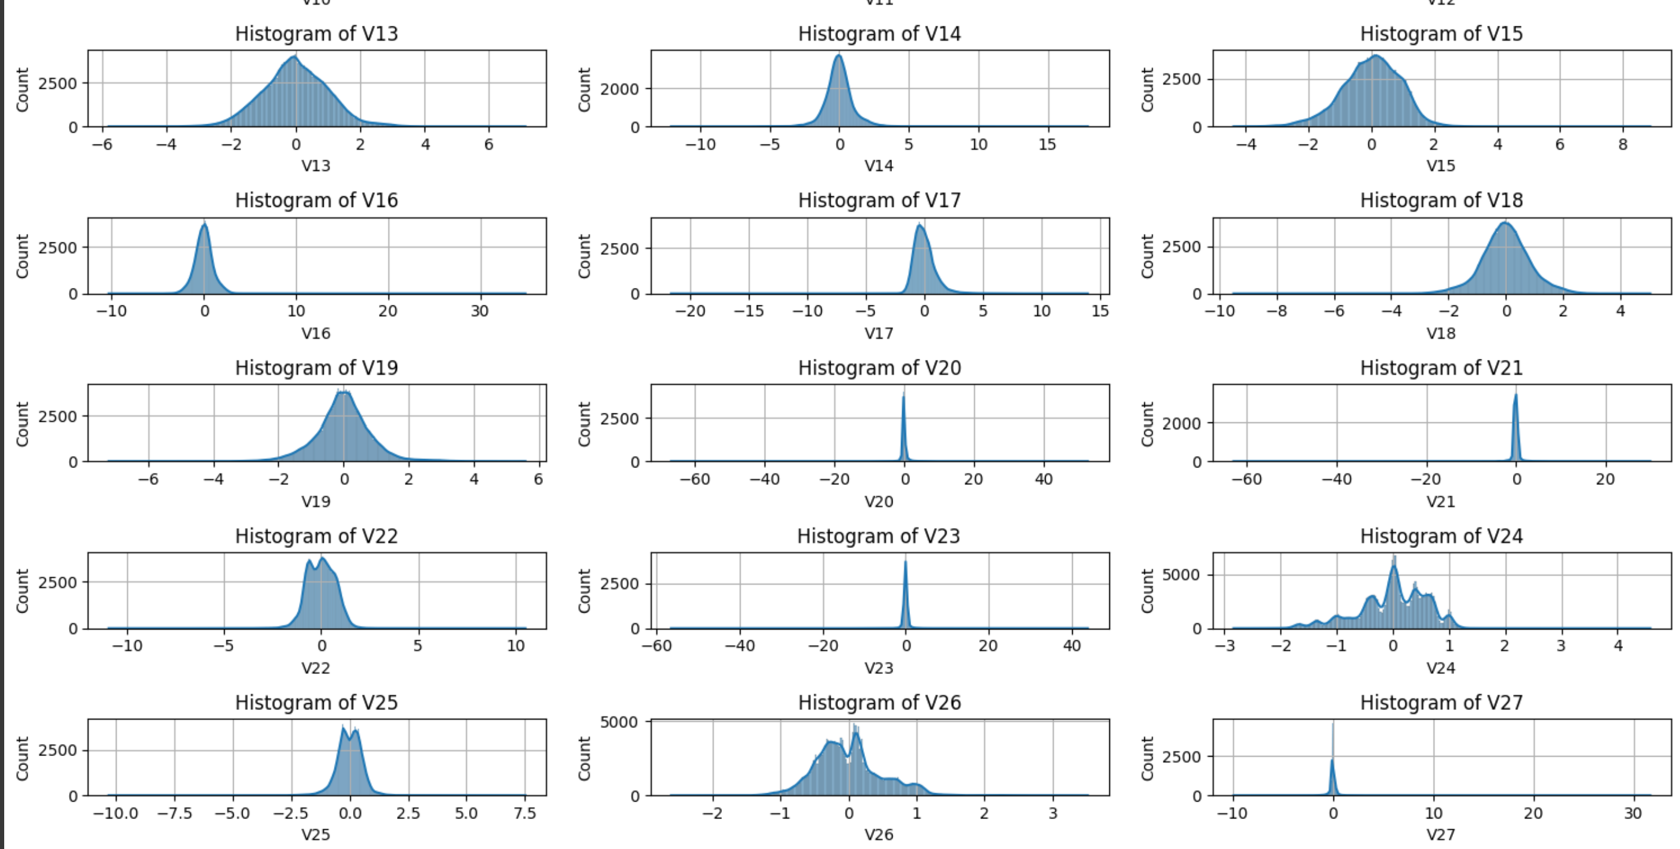
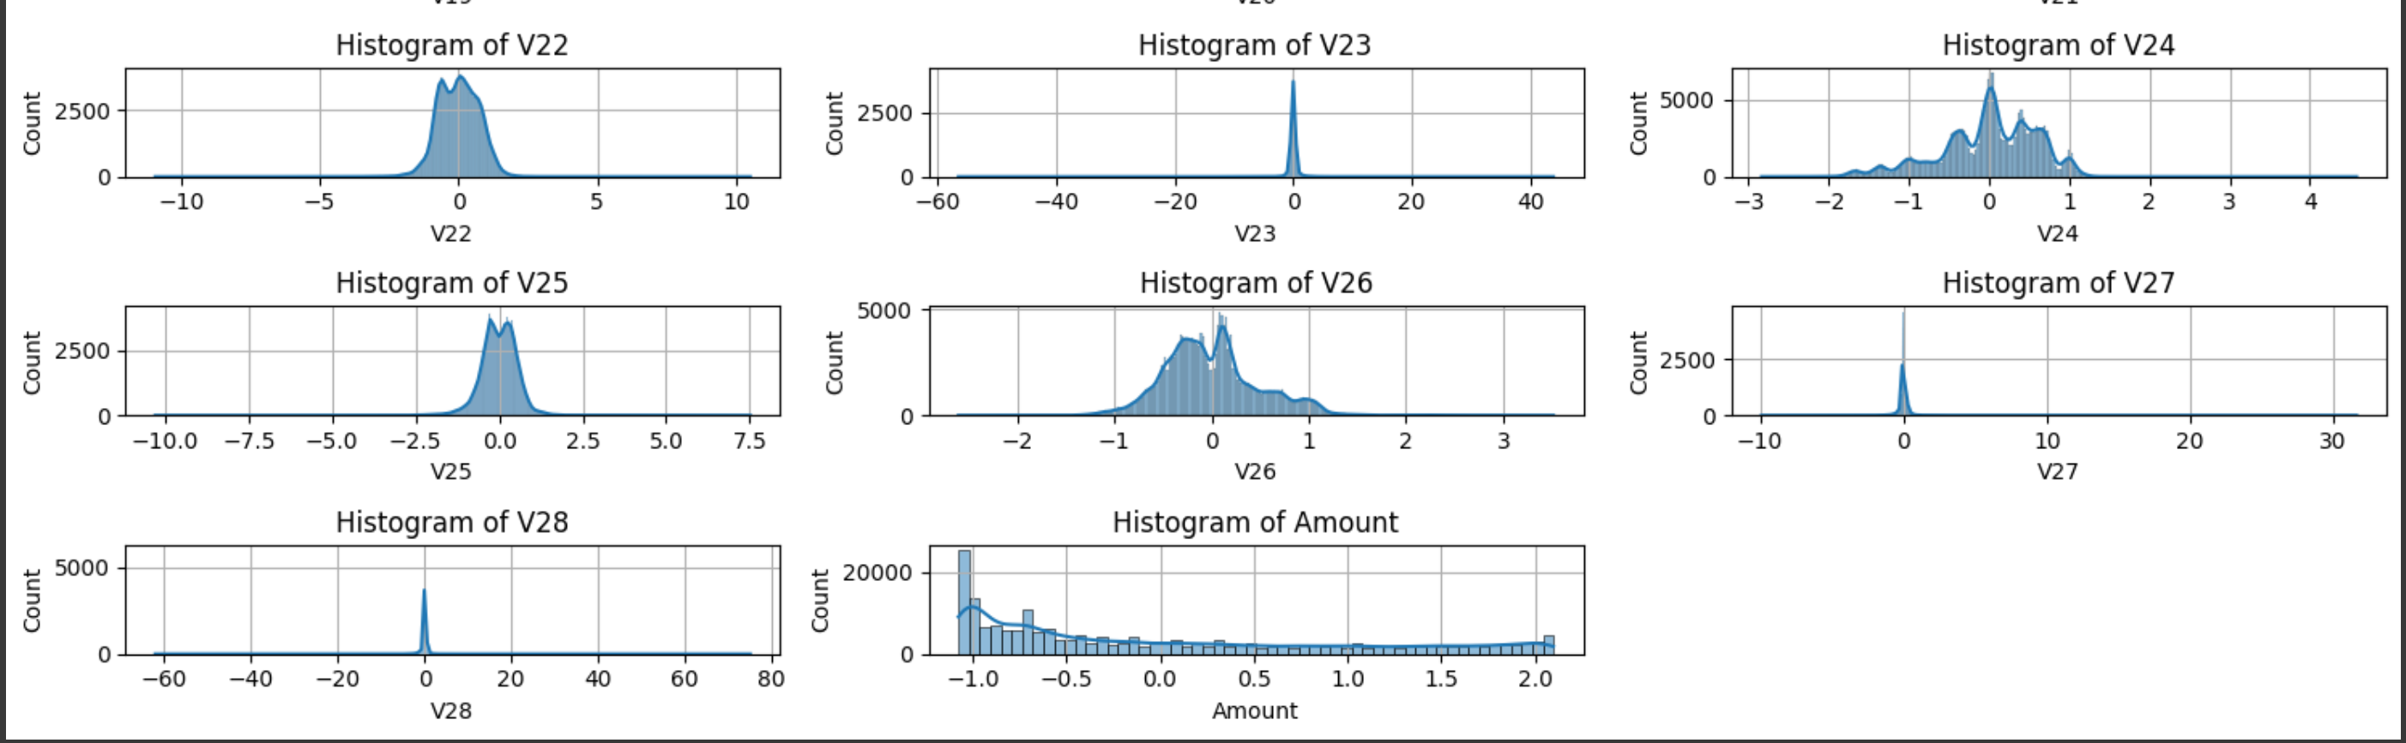
Normalized Data
Skewness removed using Power Transformer.

Slide 7
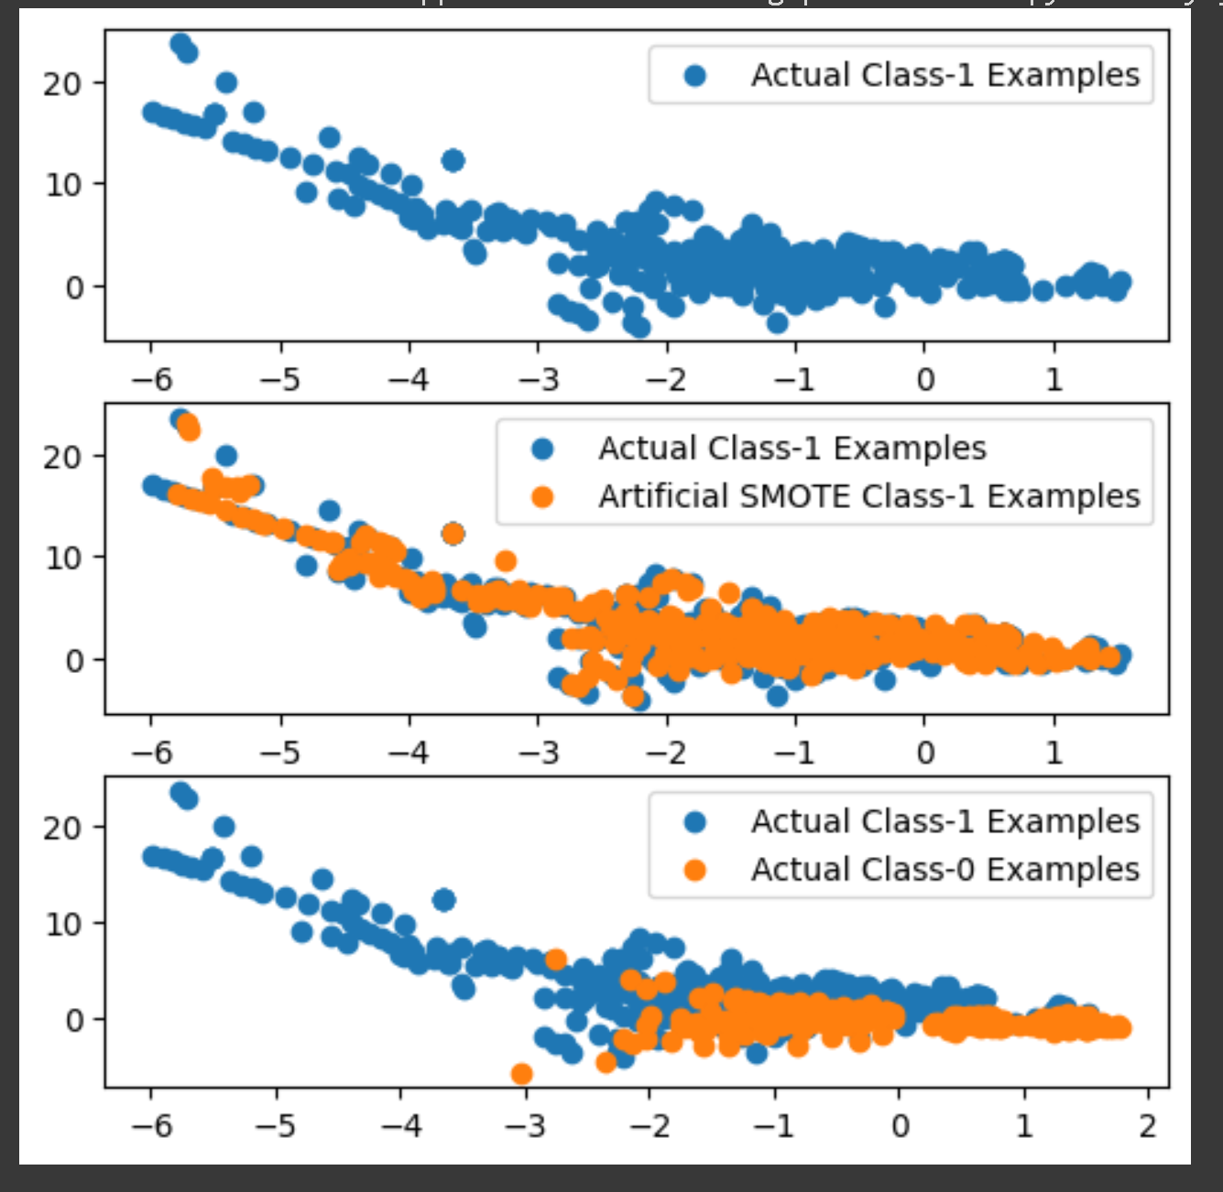
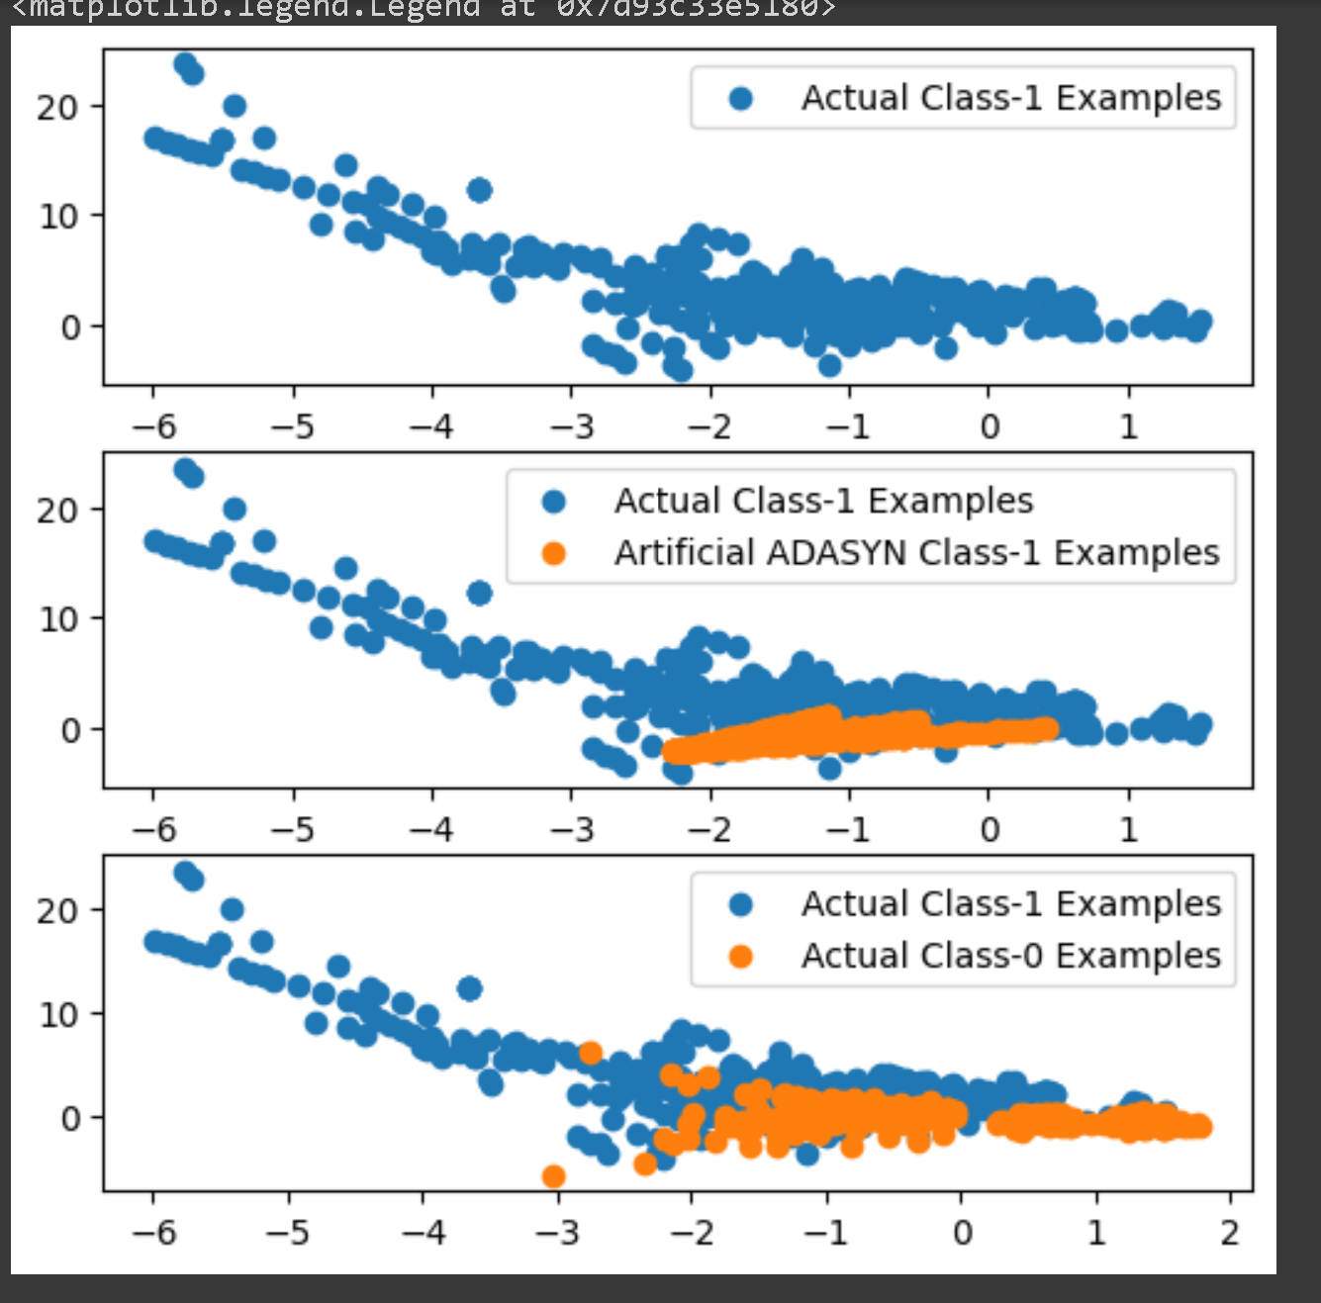
Oversampled Datapoints
ADASYN adaptively generates synthetic samples in regions of the feature space with low minority class density, while SMOTE interpolates between existing minority class samples, making ADASYN suitable for highly imbalanced datasets with clustered minority instances and SMOTE appropriate for datasets with more evenly distributed minority class instances.

Slide 8
Model Performance - Logistic Regression with Hyperparameter Tuning
Data Type | Data Oversampling | Size | Run Time | Evaluation - ROC AUC | Optimal ‘C’ Param | F1 (Class 1) | Recall / True Positive Rate (TPR)
Imbalanced Dataset | NA | X_Train : 227845 X_Test : 56962 | 4.34 seconds | 0.9806 | 0.001 | 72.73% | 0.6531
Balanced Dataset | Random Oversampling | X_train_ros : 454902 X_Test : 56962 | 8.22 seconds | 0.9718 | 10 | 10.15% | 0.9184
Balanced Dataset | SMOTE | X_train_smote : 454902 X_Test : 56962 | 8.37 seconds | 0.9705 | 10 | 10% | 0.9184
Balanced Dataset | ADASYN | X_train_adasyn : 454900 X_Test : 56962 | 7.72 seconds | 0.9714 | 10 | 3% | 0.92

Slide 9
Logistic Regression Summary
Model Performance: Model #1 has the highest ROC AUC and F1 Score for Class 1, indicating better overall performance in terms of classification. However, the recall for Model #1 is lower than Models #2 and #3.
Balancing Technique: Models #2 and #3 use random oversampling and SMOTE, respectively, to balance the dataset. They achieve high recall, indicating their ability to detect fraudulent transactions effectively. However, the F1 Score for Class 1 is relatively low.
Model #4: While Model #4 has a high recall, its F1 Score for Class 1 is the lowest among the models.
In a production environment, the choice depends on the specific goals and constraints:
If Recall Is Critical: If the primary goal is to detect fraudulent transactions at all costs (high recall), then Models #2 and #3 (balanced with random oversampling or SMOTE) might be suitable because they have the highest recall values.

Slide 10
Model Performance - XGBoost with Hyperparameter Tuning
Data Type | Data Oversampling | Size | Run Time | Evaluation - ROC AUC | F1 | Recall / True Positive Rate (TPR)
Imbalanced Dataset | NA | X_Train : 227845 X_Test : 56962 | 3256 seconds | 0.9785 | 60.42% | 0.9082
Balanced Dataset | Random Oversampling | X_train_ros : 454902 X_Test : 56962 | 5073 seconds | 0.9779 | 40.09% | 0.9286
Balanced Dataset | SMOTE | X_train_smote : 454902 X_Test : 56962 | 7910 seconds | 1.00 | 9.58% | 0.9184
Balanced Dataset | ADASYN | X_train_adasyn : 454900 X_Test : 56962 | 8226 seconds | 0.9751 | 63.27% | 0.8980

Slide 11
XGBoost Performance Summary
ROC AUC: Balanced Dataset with SMOTE achieves the highest ROC AUC of 1.0, indicating perfect separation between classes. However, this might be due to overfitting, especially considering the low F1 Score.
F1 Score: Balanced Dataset with ADASYN has the highest F1 Score of 63.27%, which indicates a good balance between precision and recall. It's also the highest among all models.
Recall/TPR: Balanced Dataset with Random Oversampling has the highest recall (0.9286), indicating that it effectively identifies actual fraudulent transactions.
Runtime: Imbalanced Dataset has the lowest runtime, followed closely by Model #2. Model #3 and Model #4 have significantly higher runtimes.

Slide 12
Conclusion
High ROC AUC: Both XGBoost and Logistic Regression models exhibit strong performance in terms of ROC AUC, indicating their ability to discriminate between fraudulent and non-fraudulent transactions.
High Recall: XGBoost models, particularly when trained on imbalanced data (XGBoost #1) or with ADASYN (XGBoost #4), demonstrate high recall values, which are essential for effectively capturing actual fraudulent transactions.
High F1 Score: For a balance between precision and recall, XGBoost on imbalanced data (XGBoost #1) and ADASYN-balanced data (XGBoost #4) achieve noteworthy F1 Scores.
Based on these considerations and the importance of effectively detecting fraudulent transactions while keeping false alarms low, we recommend exploring XGBoost models, especially XGBoost #1 (trained on imbalanced data) and XGBoost #4 (trained with ADASYN). Further fine-tuning and deployment considerations can help determine the final production model.
Please note that model runtime, while a consideration during training, may not significantly impact real-time predictions in production scenarios.

