Slide 1

Credit Card Fraud Detection with Machine Learning
Author – Jagadish Janakiraman
Date – 9/25/2023

Slide 2

Agenda
Overview
Data Pre-Processing
Model Selection
Hyperparameter Tuning
Model Evaluation

Slide 3

Overview
Objective - Predict fraudulent credit card transactions with the help of machine learning models.
Approach – The project pipeline can be briefly summarized in the following steps
Data understanding: Load the data and understand the features present in it. This would help you choose the features that you will need for your final model.
Exploratory data analytics (EDA): For the current data set, Gaussian variables are used, Z-scaling is not required for the PCA columns. Skewness in the data is identified and mitigated, as it causes problems during the model building phase.
Train/Test split: Here, for validation, k-fold cross-validation method is used. Identify an appropriate k value so that the minority class is correctly represented in the test folds.
Model building / hyperparameter tuning: This is the final step where you can try different models and fine-tune their hyperparameters until you get the desired level of performance on the given data set. You should try and check if you get a better model by various sampling techniques.
Model evaluation: Here, you need to evaluate the models using appropriate evaluation metrics. Note that since the data is imbalanced, it is more important to identify fraudulent transactions accurately than non-fraudulent ones. Choose an appropriate evaluation metric that reflects this business goal.

Slide 4
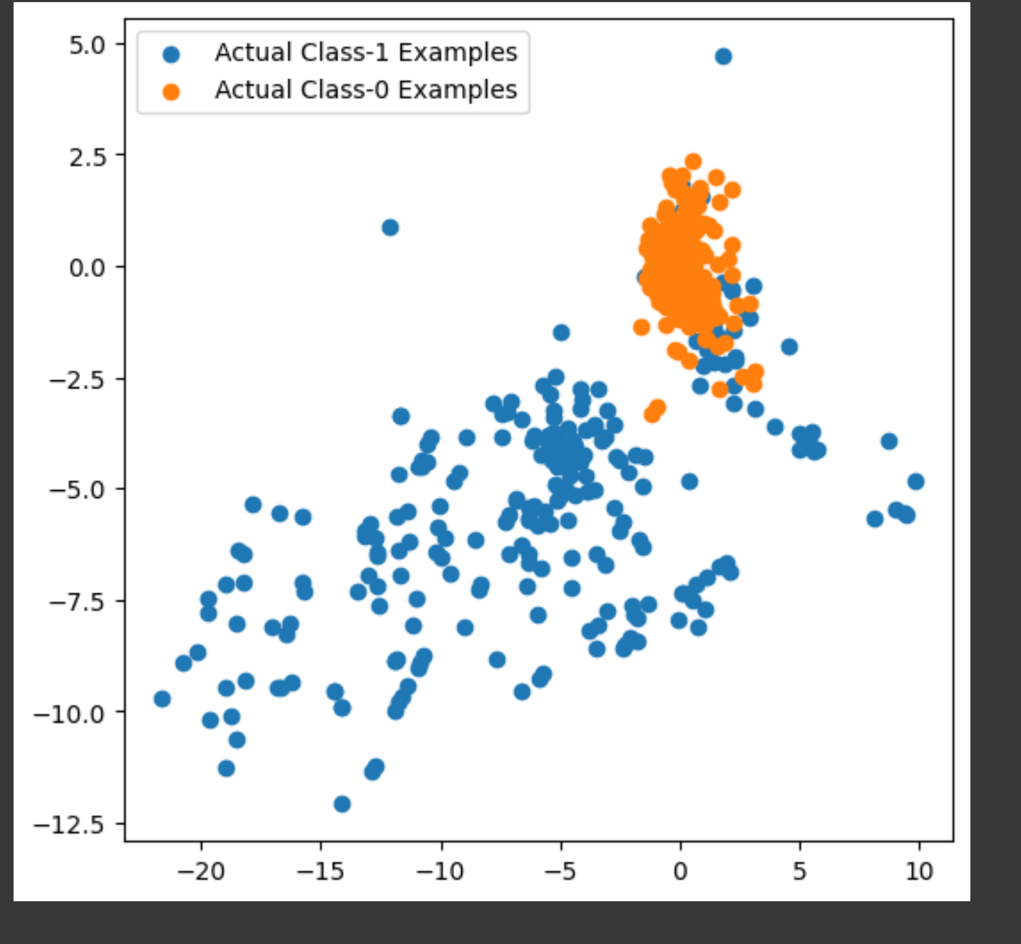
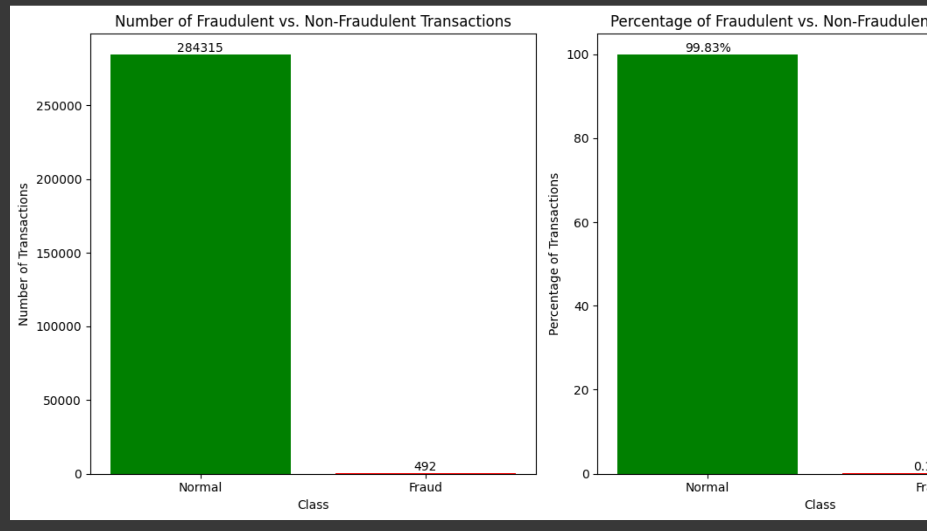
Data – Imbalanced Dataset
The data is highly imbalanced. 284315 Good Transactions and 492 Fraud transactions.
Predictions with Imbalanced dataset gives X ROC

Slide 5
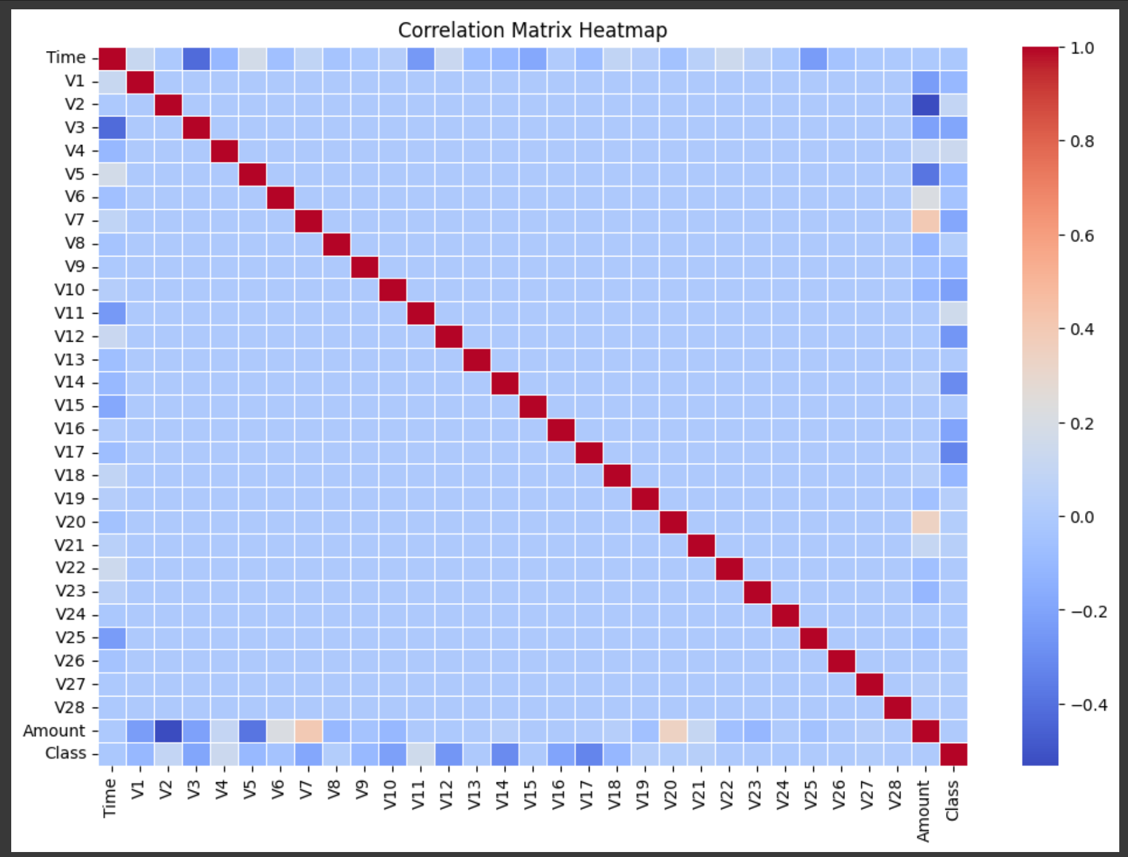
Data - Correlation
There is no high correlation between features. So, column need not to be dropped due to correlation.

Slide 6
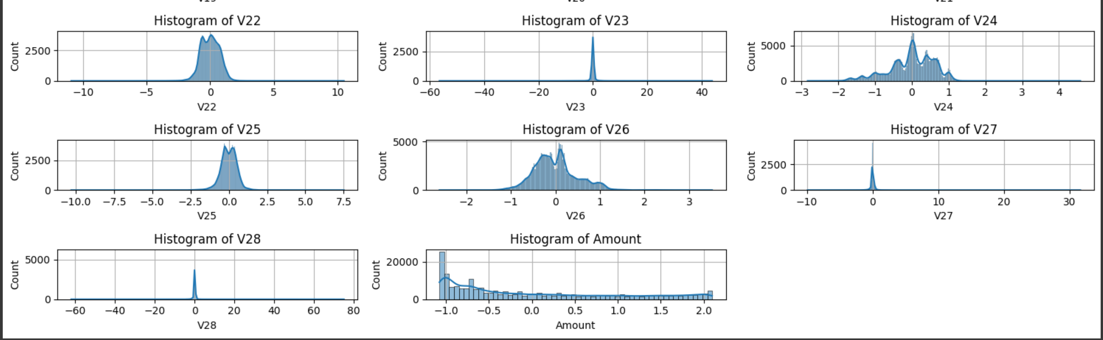
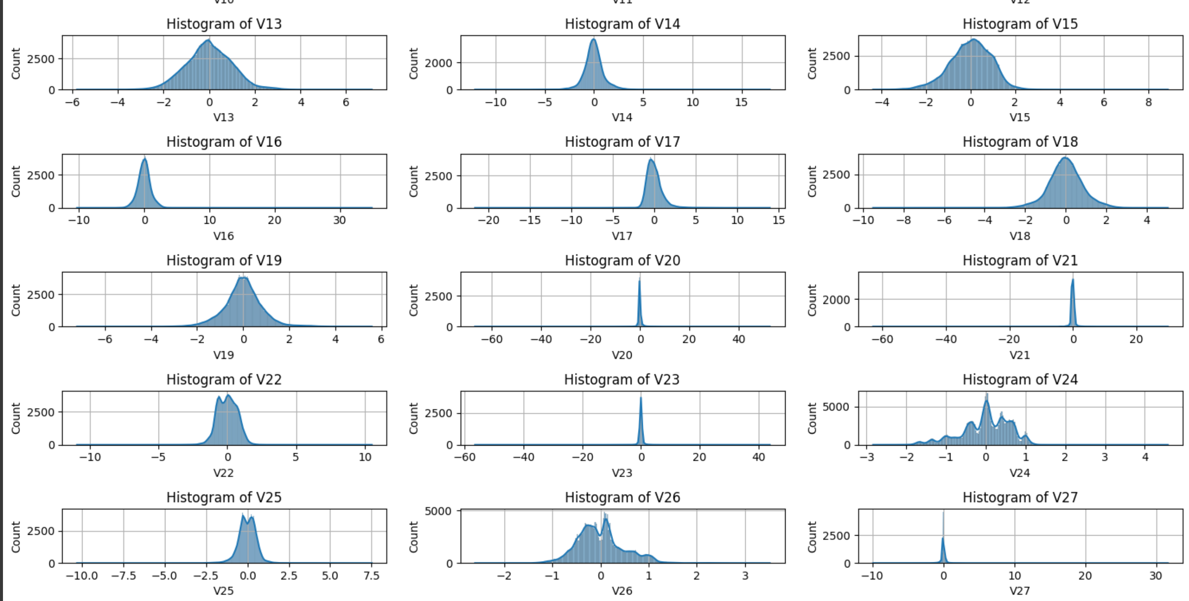
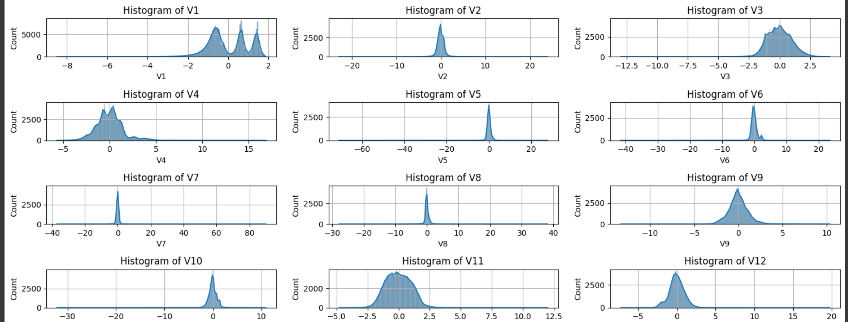
Normalized Data
Skewness in data is removed using PowerTransformer.
Originally N numbers of columns had skewed data -

Slide 7
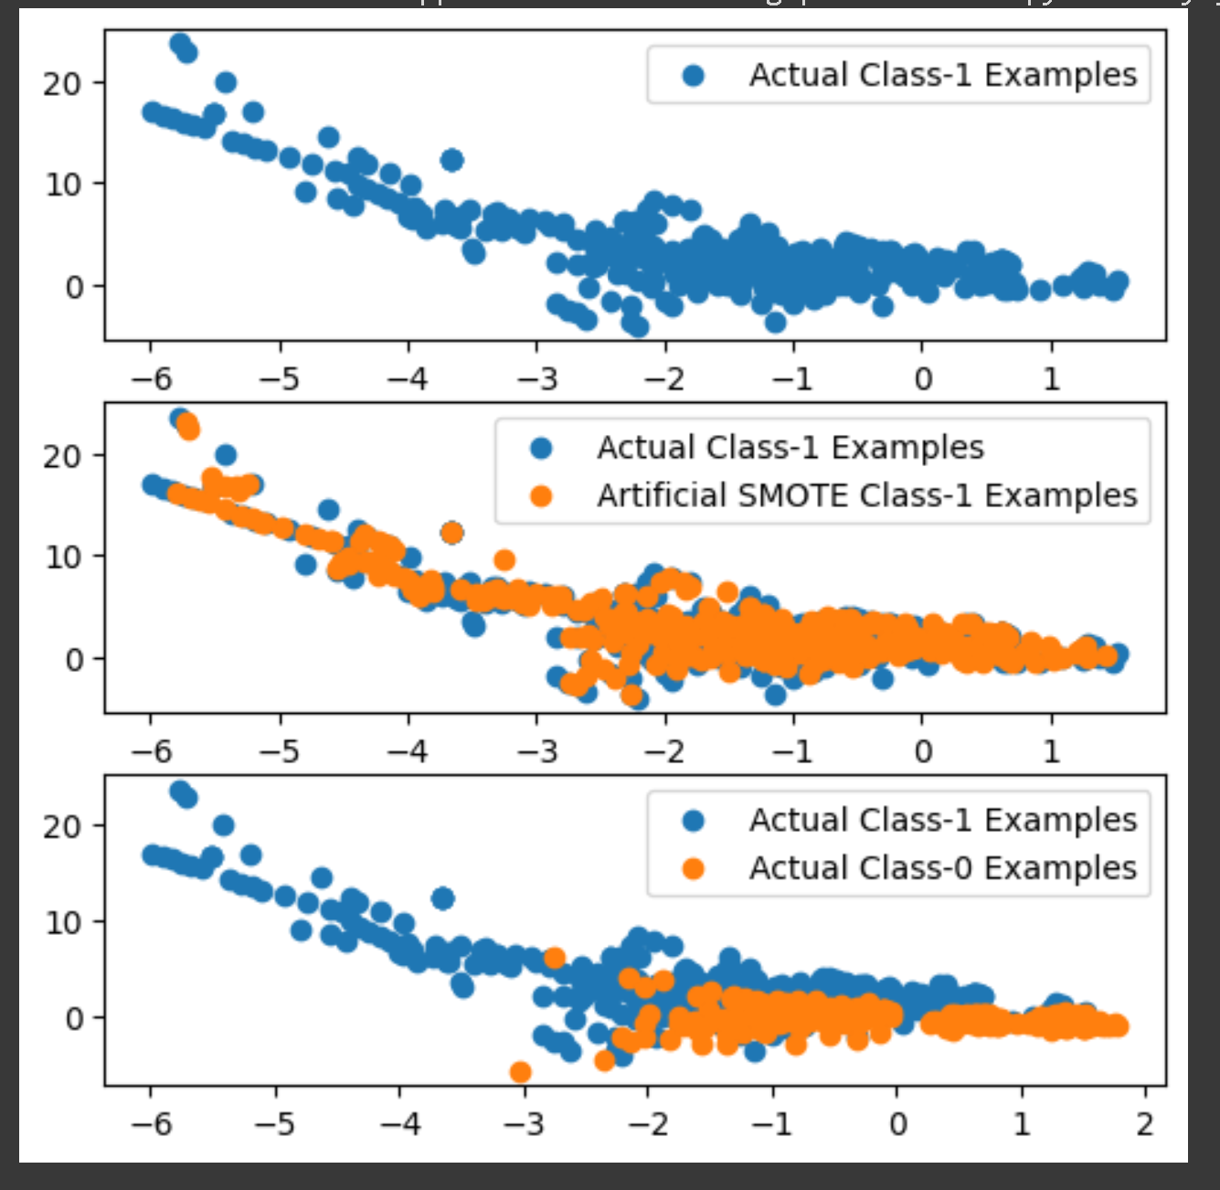
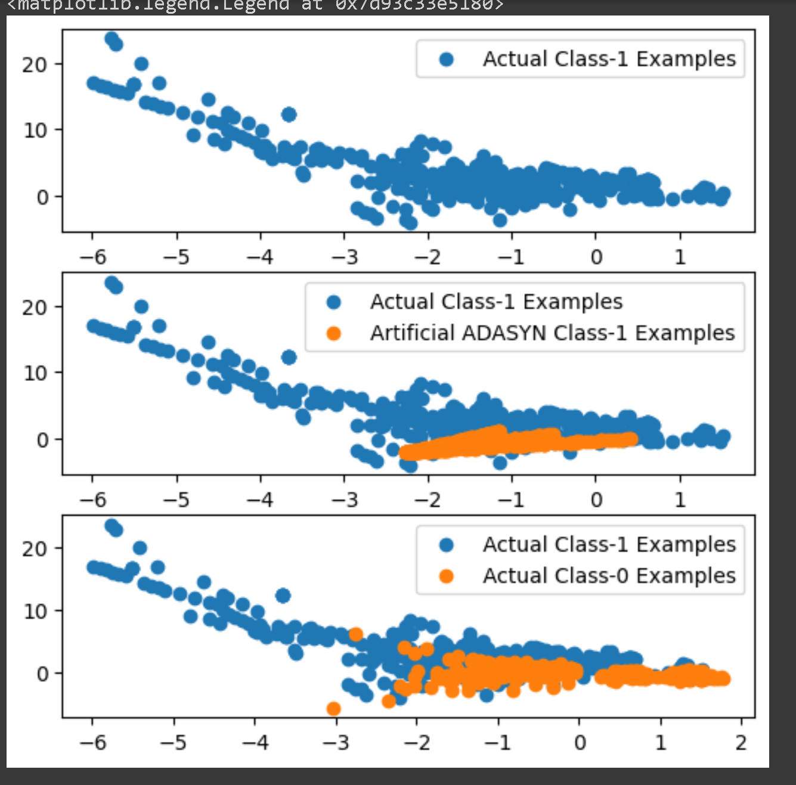
Oversampled Datapoints

Slide 8
Model Performance - Logistic Regression with Hyperparameter Tuning
Data Type | Data Oversampling | Size | Class 1 | Run Time | Evaluation - ROC AUC | Optimal ‘C’ Param
Imbalanced Dataset | NA | X_Train : 227845 X_Test : 56962 | y_Train : 394 y_Test : 98 | 4.34 seconds | 98.06 | 0.001
Balanced Dataset | Random Oversampling | X_train_ros : 454902 X_Test : 56962 | y_Train : 394 y_Test : 98 | 8.22 seconds | 97.18 | 10
Balanced Dataset | SMOTE | X_train_smote : 454902 X_Test : 56962 | y_Train : 394 y_Test : 98 | 8.37 seconds | 97.05 | 10
Balanced Dataset | ADASYN | X_train_adasyn : 454900 X_Test : 56962 | y_Train : 394 y_Test : 98 | 7.72 seconds | 97.14 | 10

Slide 9
Model Performance - XGBoost with Hyperparameter Tuning
Data Type | Data Oversampling | Size | Class 1 | Run Time | Evaluation - ROC AUC | Best Hyperparameters
Imbalanced Dataset | NA | X_Train : 227845 X_Test : 56962 | y_Train : 394 y_Test : 98 | 3538.86 seconds | 97.85 | learning_rate: 0.2 max_depth: 5 n_estimators: 300
Balanced Dataset | Random Oversampling | X_train_ros : 454902 X_Test : 56962 | y_Train : 394 y_Test : 98 | 5510.31 seconds | 97.79 | learning_rate: 0.2 max_depth: 4 n_estimators: 300
Balanced Dataset | SMOTE | X_train_smote : 454902 X_Test : 56962 | y_Train : 394 y_Test : 98 |  |  | learning_rate: 0.2 max_depth: 5 n_estimators: 100
Balanced Dataset | ADASYN | X_train_adasyn : 454900 X_Test : 56962 | y_Train : 394 y_Test : 98 |  |  | learning_rate: 0.2 max_depth: 5 n_estimators: 100

Slide 10
Model Evaluation
ROC curve is measured at all thresholds, the best threshold would be the one at which TPR is high and FPR is low, i.e., misclassifications are low.
To save banks from high-value fraudulent transactions, we need to focus on high recall to detect actual fraudulent transactions.

