Slide 1

Credit Card Fraud Detection with Machine Learning
Author – Jagadish Janakiraman
Date – 9/25/2023

Slide 2

Agenda
Overview
Data Pre-Processing
Model Selection
Hyperparameter Tuning
Model Evaluation

Slide 3

Overview
Objective - Predict fraudulent credit card transactions with the help of machine learning models.
Approach:
Data understanding: Load the data and understand the features.
Exploratory data analytics (EDA): Identify and mitigate skewness in the data.
Train/Test split: Use k-fold cross-validation.
Model building / hyperparameter tuning: Experiment with different models and fine-tune hyperparameters.
Model evaluation: Use appropriate evaluation metrics, considering the imbalanced dataset.

Slide 4
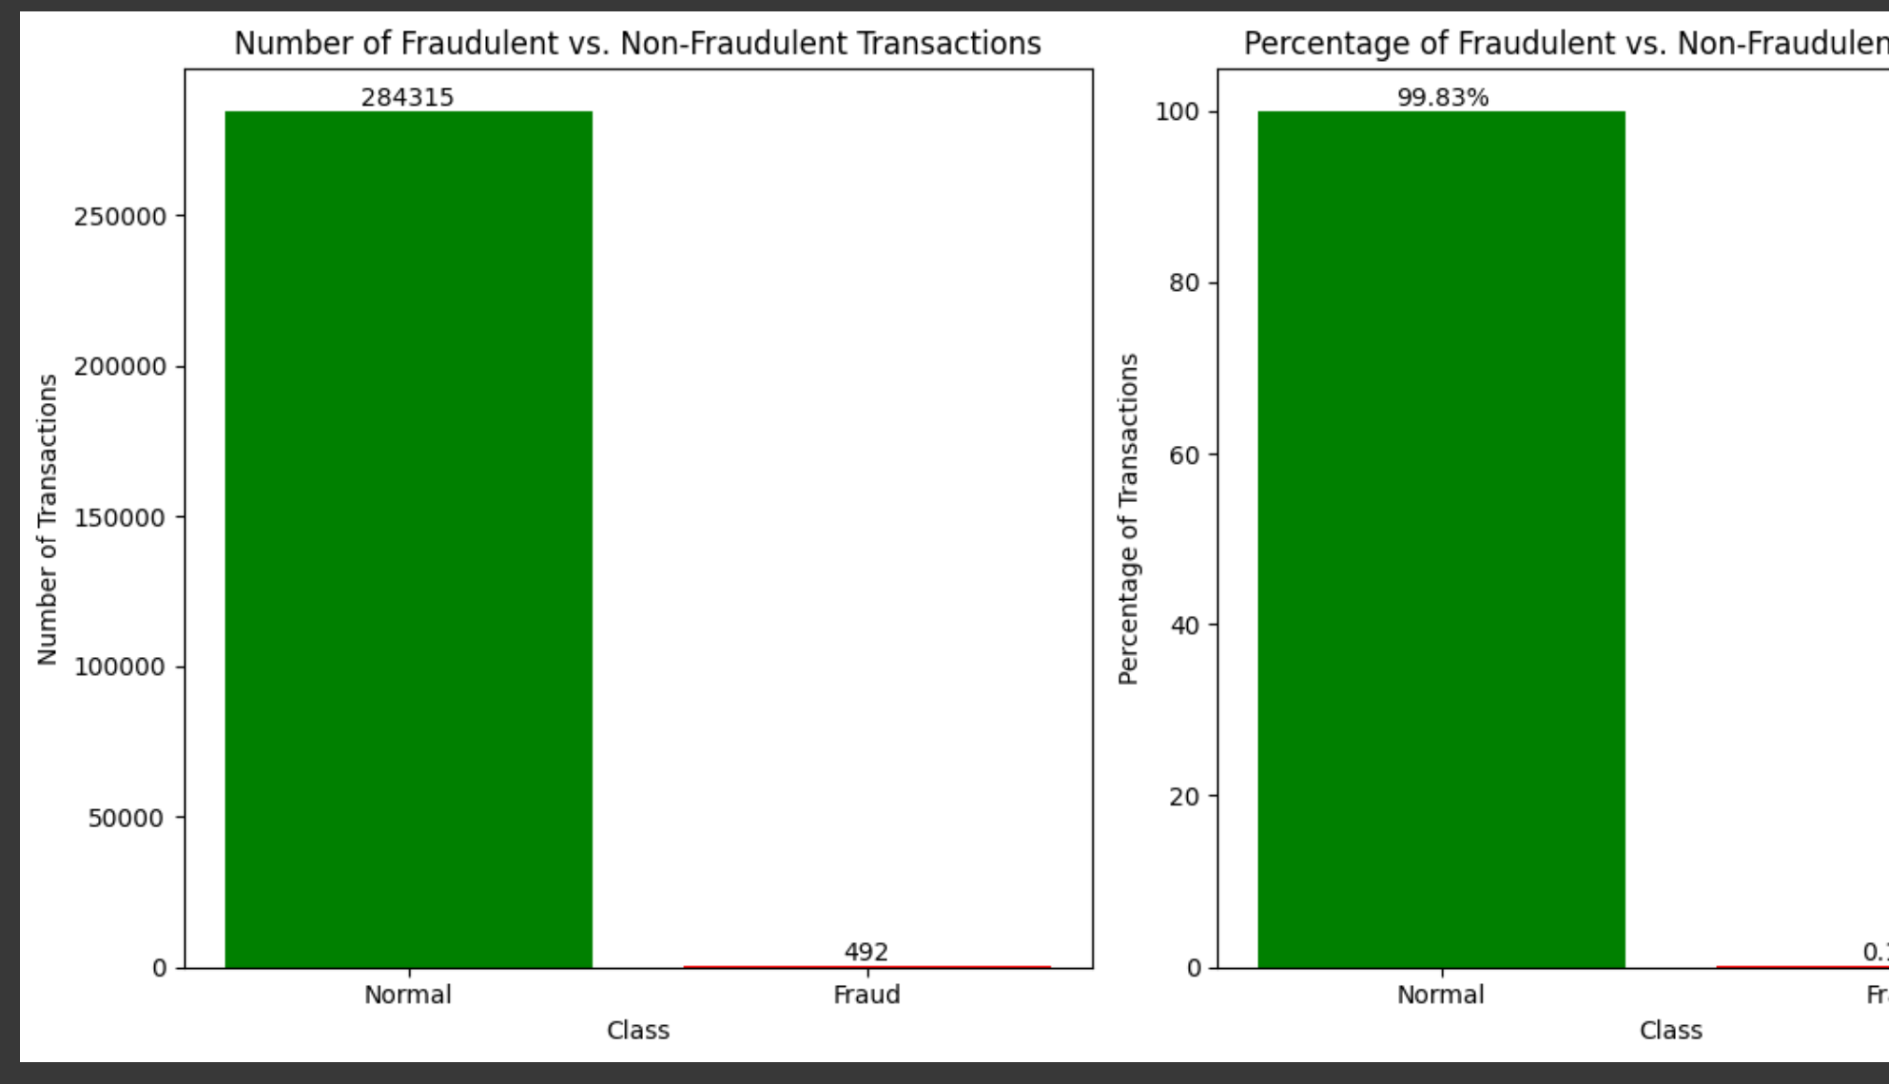
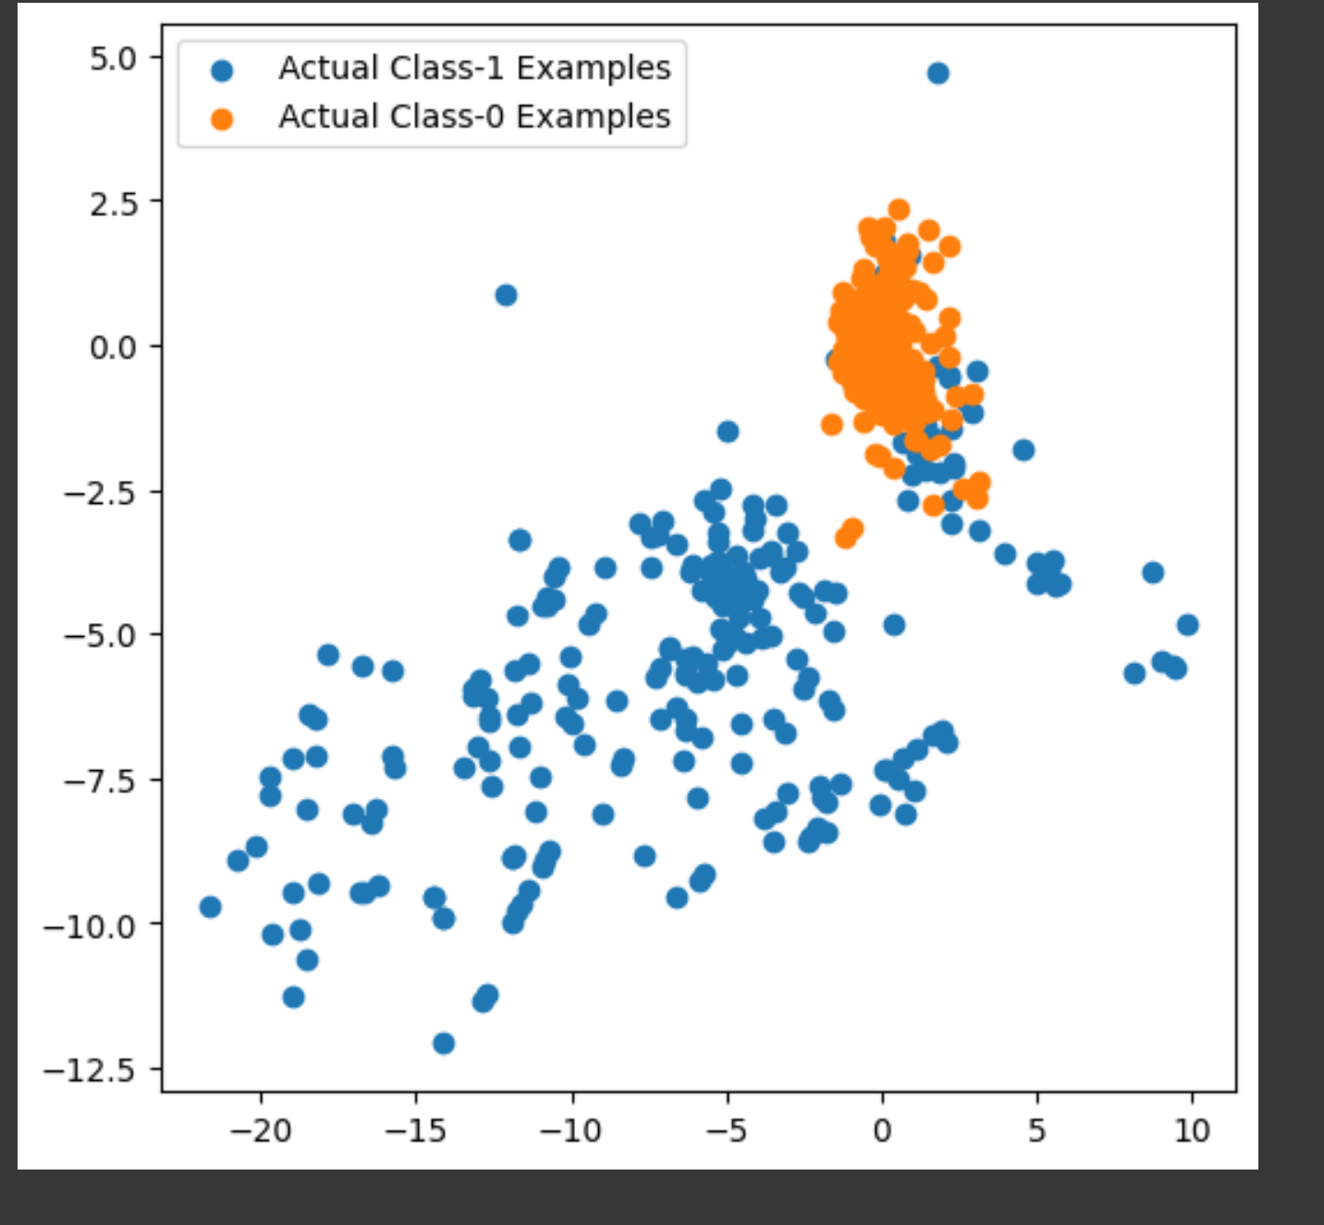
Data – Imbalanced Dataset
284,315 Good Transactions
492 Fraud Transactions

Slide 5
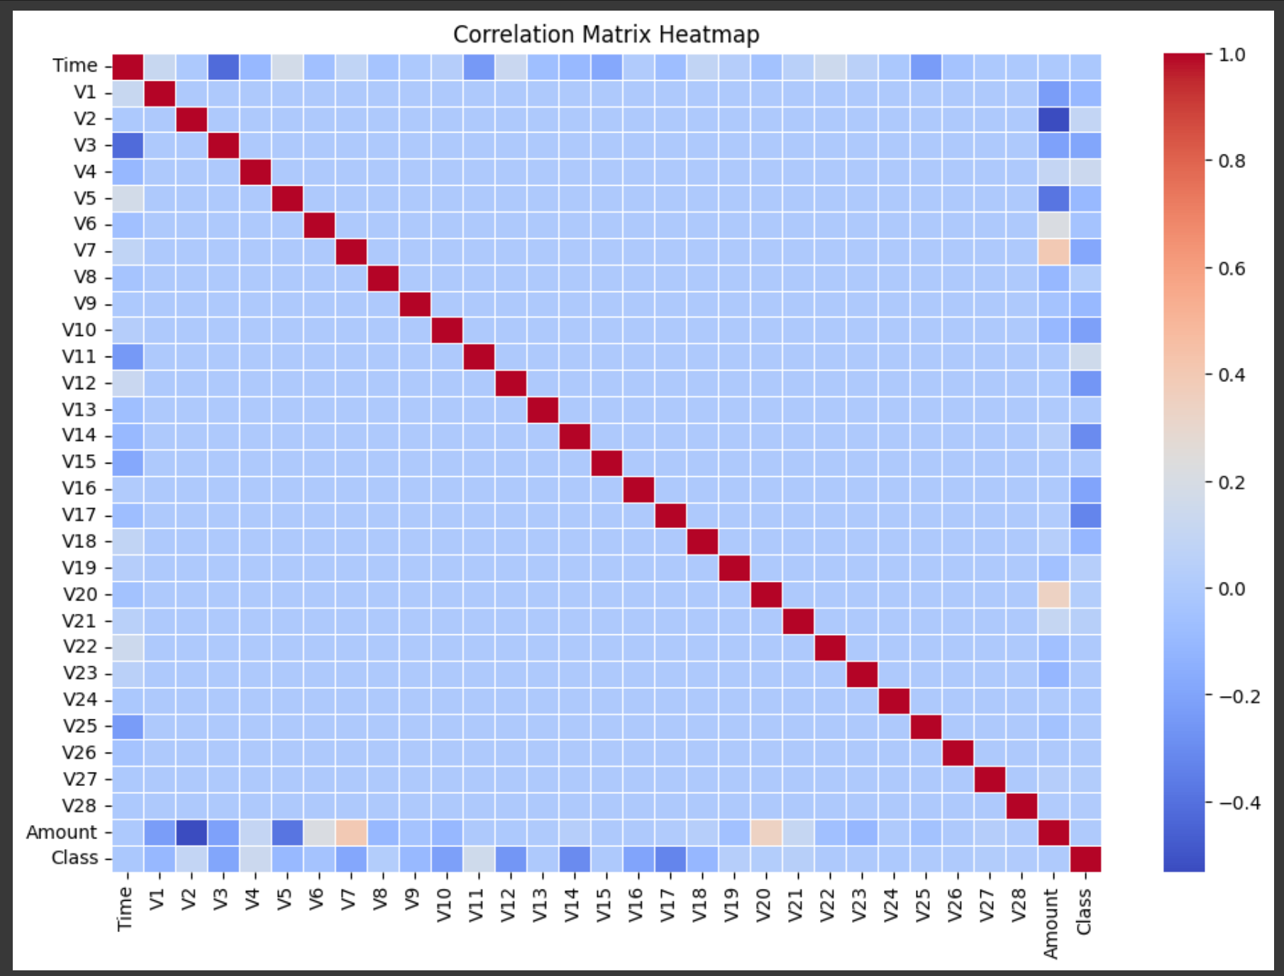
Data - Correlation
No high correlation between features.

Slide 6
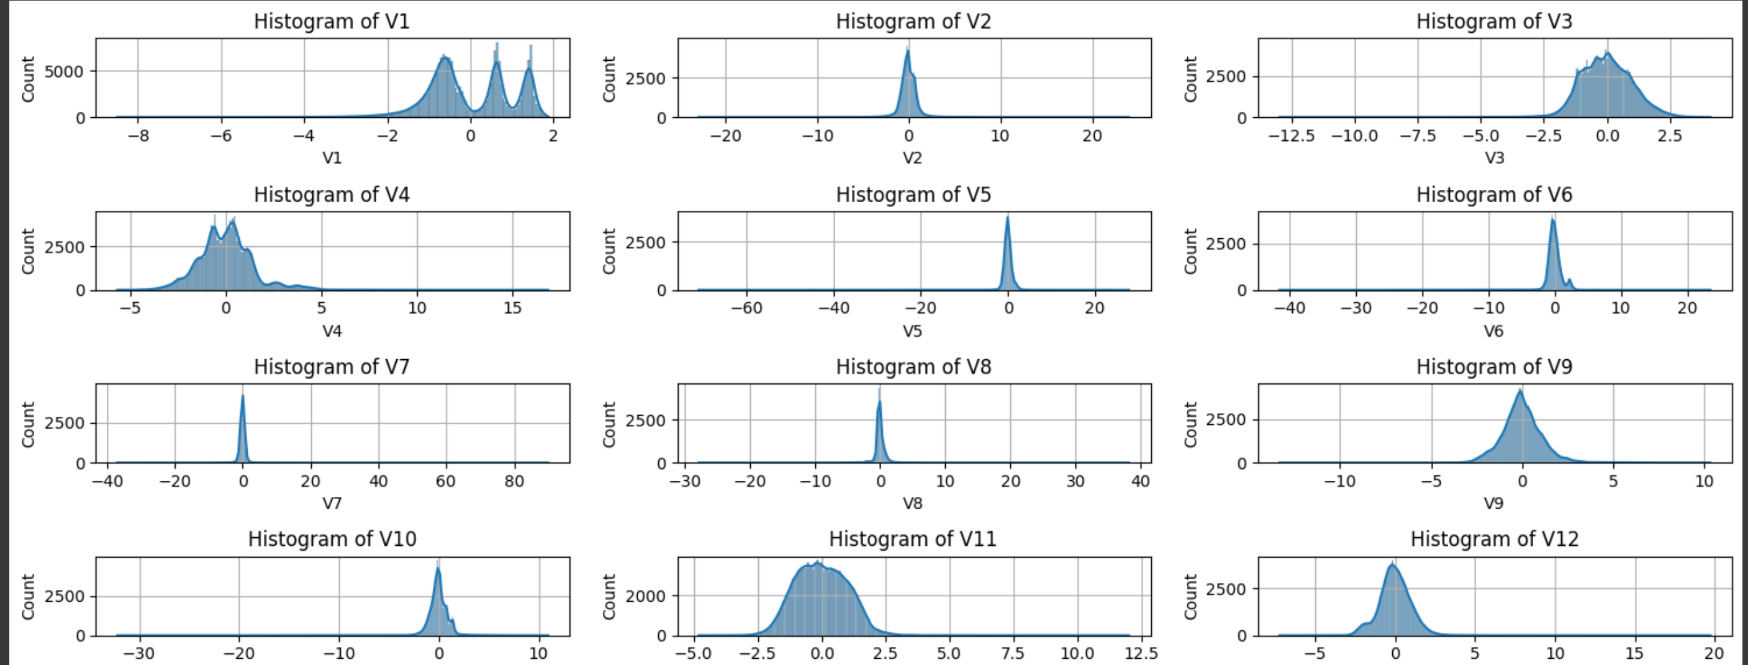
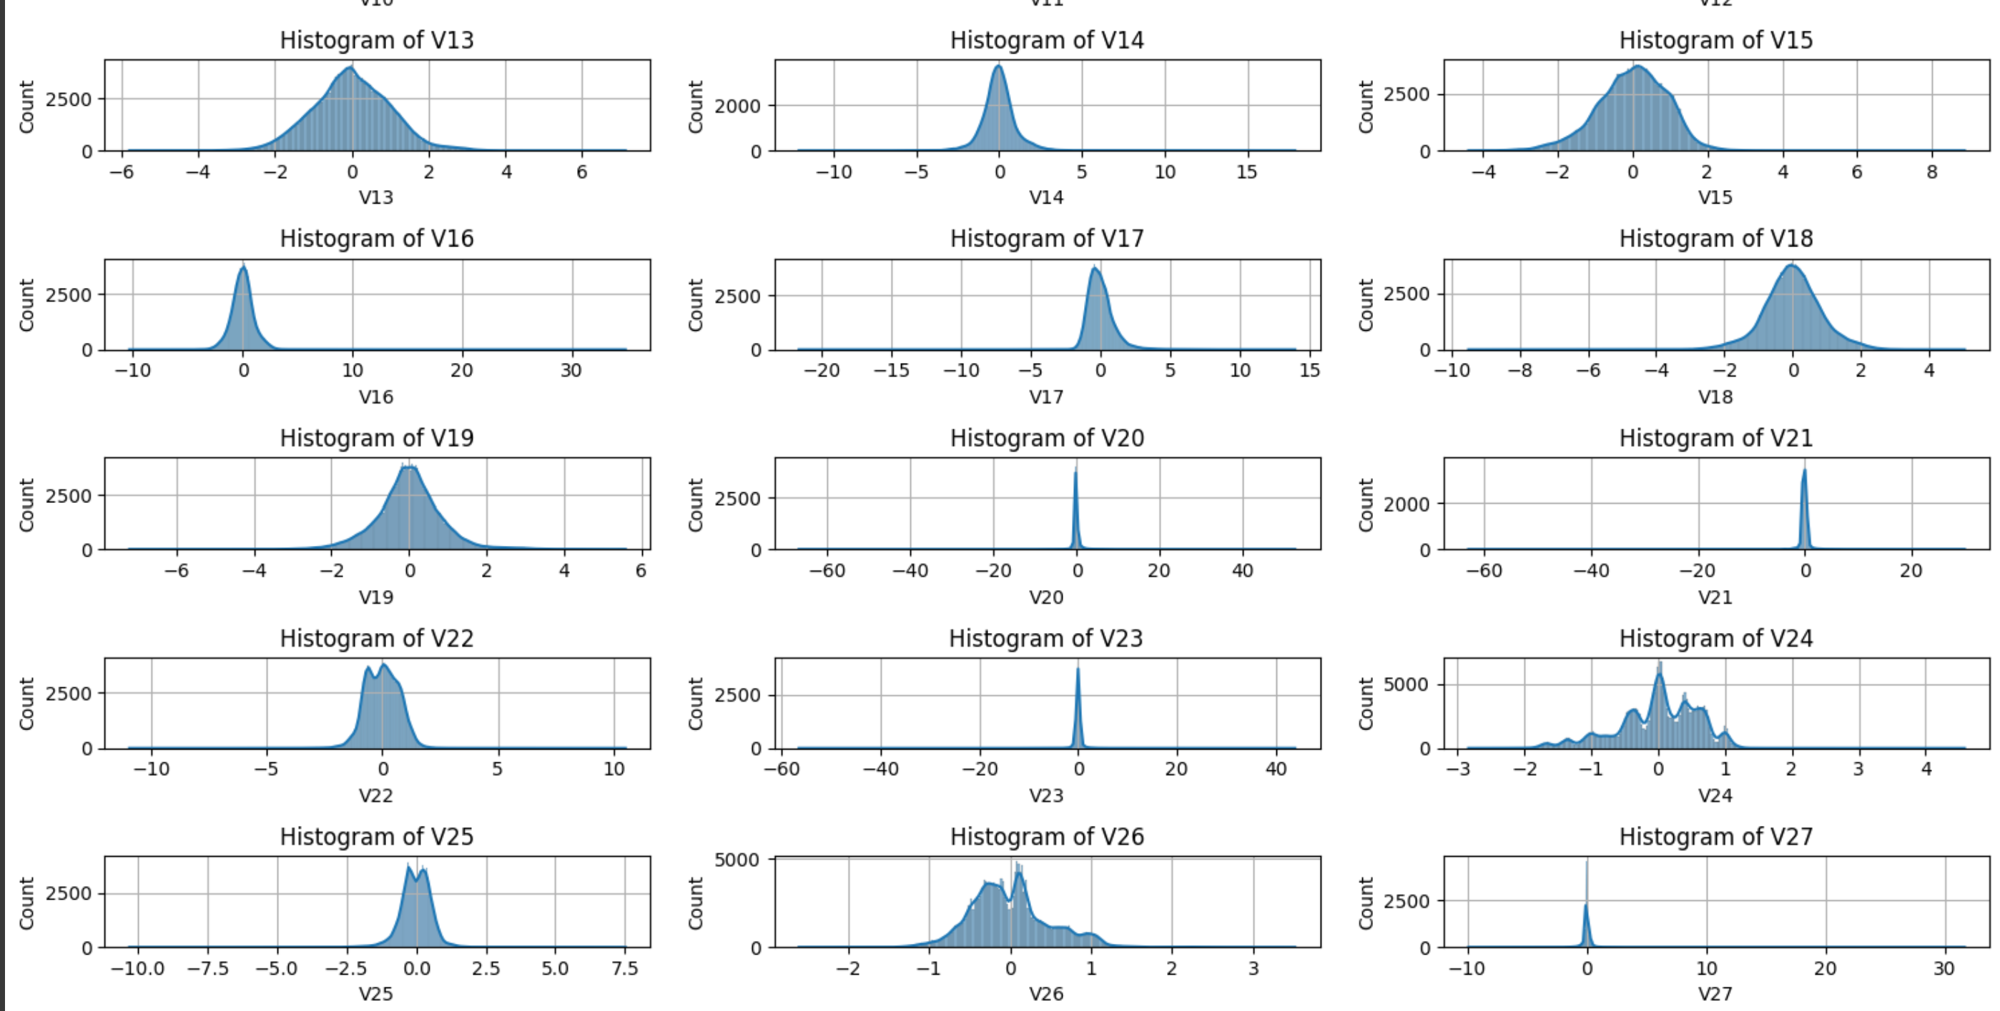
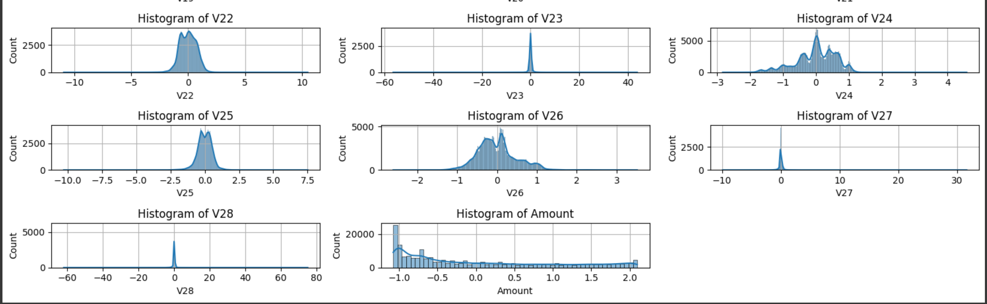
Normalized Data
Skewness removed using Power Transformer.

Slide 7
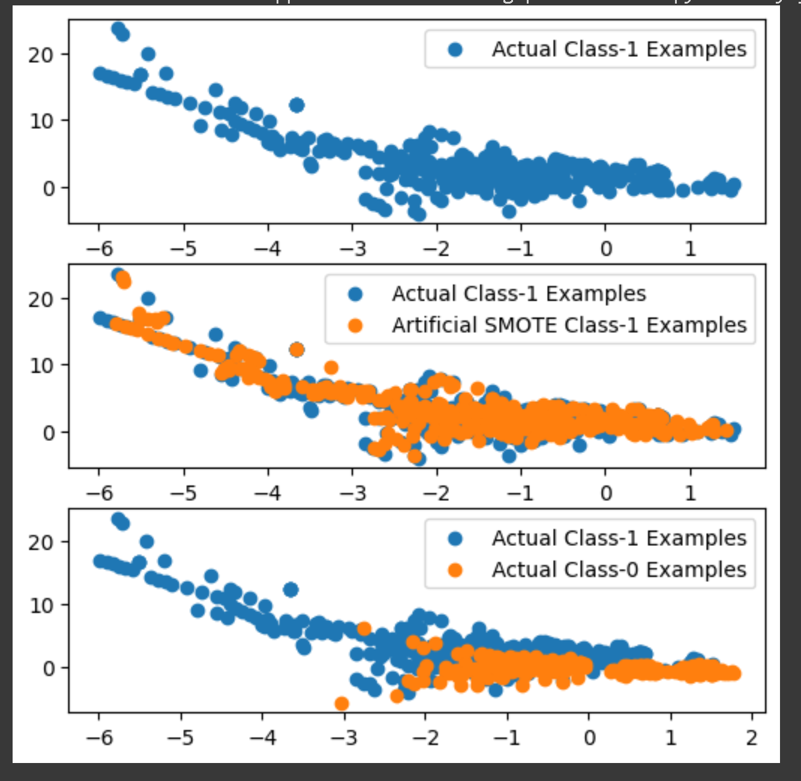
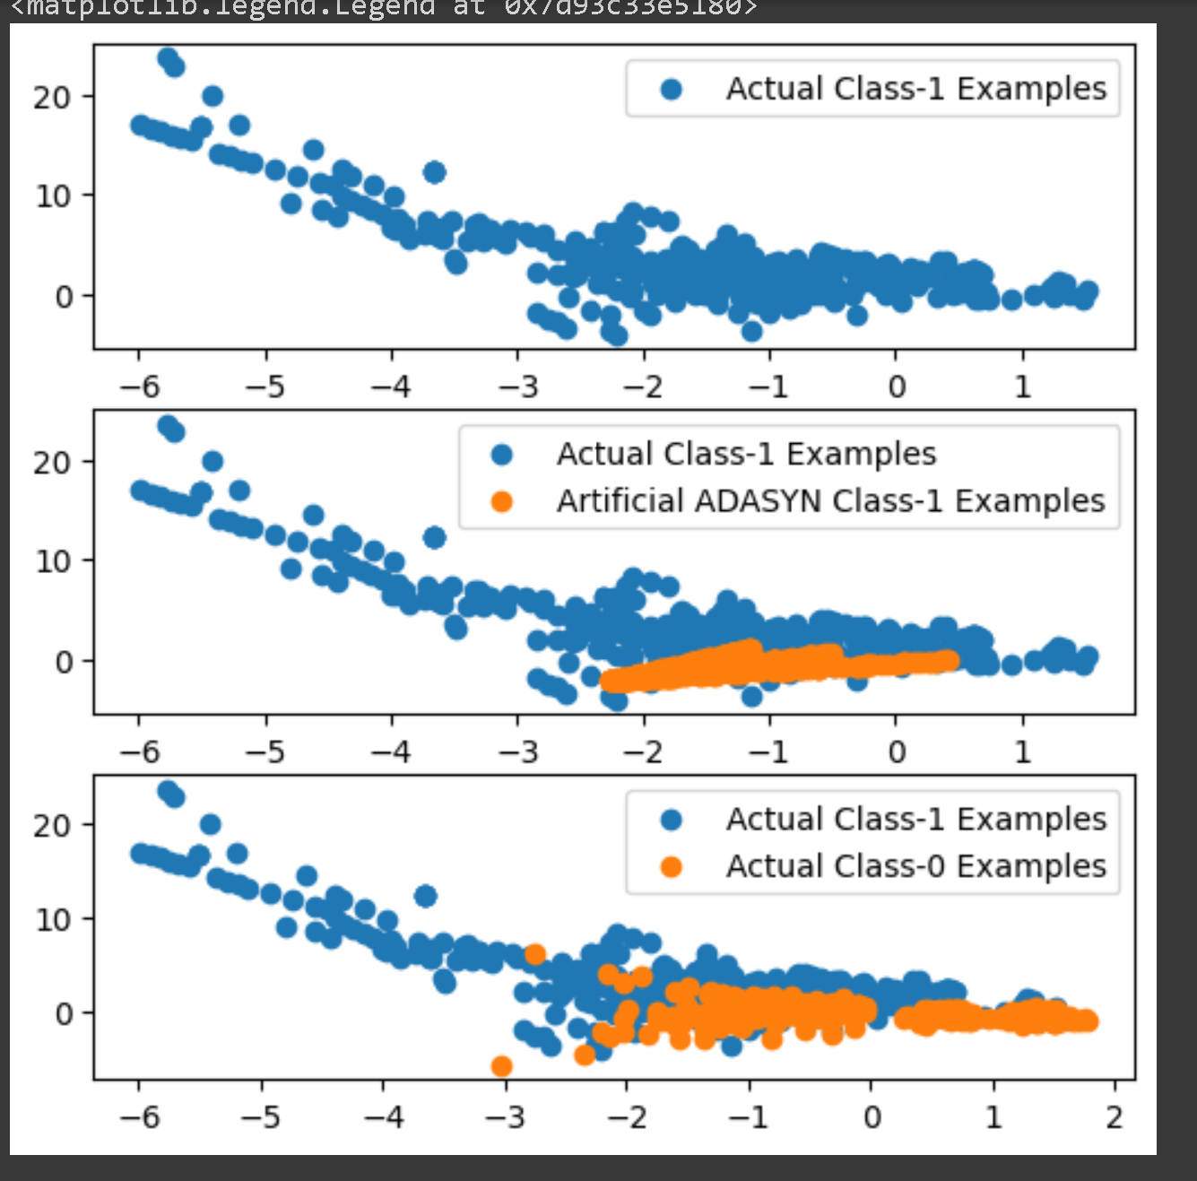
Oversampled Datapoints
ADASYN adaptively generates synthetic samples in regions of the feature space with low minority class density, while SMOTE interpolates between existing minority class samples, making ADASYN suitable for highly imbalanced datasets with clustered minority instances and SMOTE appropriate for datasets with more evenly distributed minority class instances.

Slide 8
Model Performance - Logistic Regression with Hyperparameter Tuning
Data Type | Data Oversampling | Size | Run Time | Evaluation - ROC AUC | Optimal ‘C’ Param
Imbalanced Dataset | NA | X_Train : 227845 X_Test : 56962 | 4.34 seconds | 0.9806 | 0.001
Balanced Dataset | Random Oversampling | X_train_ros : 454902 X_Test : 56962 | 8.22 seconds | 0.9718 | 10
Balanced Dataset | SMOTE | X_train_smote : 454902 X_Test : 56962 | 8.37 seconds | 0.9705 | 10
Balanced Dataset | ADASYN | X_train_adasyn : 454900 X_Test : 56962 | 7.72 seconds | 0.9714 | 10

Slide 9
Model Performance - XGBoost with Hyperparameter Tuning
Data Type | Data Oversampling | Size | Run Time | Evaluation - ROC AUC | Best Hyperparameters
Imbalanced Dataset | NA | X_Train : 227845 X_Test : 56962 | 3538.86 seconds | 0.9785 | learning_rate: 0.2 max_depth: 5 n_estimators: 300
Balanced Dataset | Random Oversampling | X_train_ros : 454902 X_Test : 56962 | 5510.31 seconds | 0.9779 | learning_rate: 0.2 max_depth: 4 n_estimators: 300
Balanced Dataset | SMOTE | X_train_smote : 454902 X_Test : 56962 | 8909.62 seconds | 1.00 | learning_rate: 0.2 max_depth: 5 n_estimators: 300
Balanced Dataset | ADASYN | X_train_adasyn : 454900 X_Test : 56962 | 8977.06 seconds | 0.9751 | learning_rate: 0.2 max_depth: 5 n_estimators: 300

Slide 10
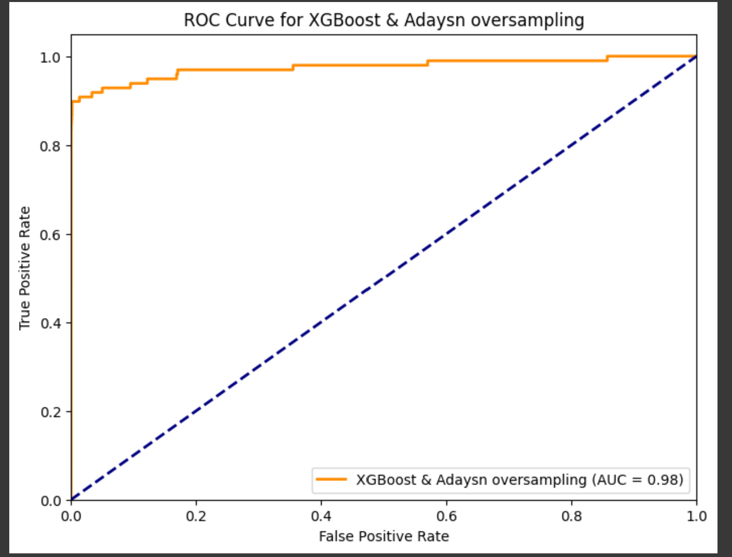
Model Evaluation with ADASYN
In summary, the selection of a threshold value, such as 0.1210, plays a crucial role in binary classification. It determines how predictions are categorized into classes, with a focus on optimizing TPR and FPR to minimize misclassifications, especially in scenarios like fraud detection.
1 | ROC Curve Analysis | - ROC curve evaluates model performance at different thresholds. - The best threshold balances True Positive Rate (TPR) and False Positive Rate (FPR) to minimize misclassifications.
2 | Focus on High Recall | - Priority is to detect actual fraudulent transactions, especially high-value ones. - High Recall ensures fewer fraudulent cases go undetected.
3 | Threshold Values | - Best Threshold: 0.1210 - Threshold Interpretation: Predicted probabilities ≥ 0.1210 → "class 1" (positive class), Predicted probabilities < 0.1210 → "class 0" (negative class).

Slide 11
Interpreting an F1 Score of 0.9455 in Classification
F1 Score Overview | - The F1 Score is a key metric for evaluating classification models. - It combines precision and recall to provide a balanced performance measure.
Understanding the F1 Score of 0.9455 | - An F1 Score of 0.9455 indicates a high-performing classification model. - It suggests a strong balance between precision and recall.
Precision and Recall | - High Precision: Model's positive predictions are highly likely to be correct. - High Recall: Model effectively captures most actual positive cases.
Practical Significance | - The model excels in identifying the target class, such as fraudulent transactions. - Minimizes both false positives (false alarms) and false negatives (missed detections).
Application in Credit Card Fraud Detection | - Especially valuable for detecting fraudulent transactions accurately. - Balances the need to catch fraud (recall) and avoid false alarms (precision).
Summary | - An F1 Score of 0.9455 reflects the model's excellence in handling imbalanced data. - It signifies the model's ability to accurately detect the target class. Overall, this F1 Score is a strong indicator of the model's effectiveness in credit card fraud detection, where precision and recall are both critical for success.

Slide 12
Conclusion
Choosing between SMOTE and ADASYN based solely on ROC AUC score may not be the best approach, as both techniques have their advantages and disadvantages. The ROC AUC score is just one aspect to consider when selecting a final model. Here are some factors to weigh in your decision:
Data Distribution : SMOTE tends to create synthetic samples that are closer to the original samples, while ADASYN focuses on those minority samples that are difficult to classify. Depending on your dataset and the specific characteristics of fraudulent transactions, one method may be more appropriate than the other. Consider the nature of your data and whether SMOTE or ADASYN aligns better with the underlying distribution.
Computational Resources : SMOTE is computationally less intensive than ADASYN, as it generates synthetic samples in a simpler manner. If you have limited computational resources and need a quicker solution, SMOTE might be a better choice.
Interpretability: Consider the interpretability of your model. Sometimes, simpler models are preferred over complex ones, especially in applications where interpretability is crucial. If a simpler model with SMOTE achieves a satisfactory ROC AUC score and is easier to interpret, it might be a better choice.
Other Evaluation Metrics: ROC AUC is just one evaluation metric. It's important to also look at other metrics like precision, recall, F1-score, and confusion matrices. Evaluate the models based on these metrics to understand their performance in correctly classifying fraudulent transactions.
Business Considerations: Think about the real-world impact of your model. Consider the cost of false positives and false negatives. Depending on the specific business scenario, you might prioritize recall (identifying most fraudulent transactions) over precision (minimizing false positives) or vice versa.
Cross-Validation: Ensure that your model's performance is consistent across different cross-validation folds. A model that consistently performs well on various folds is more reliable.
Ensemble Methods: Consider using ensemble methods that combine the strengths of both SMOTE and ADASYN. You can create an ensemble of models trained on datasets balanced with SMOTE and ADASYN to potentially improve overall performance.
In summary, it's recommended to conduct a thorough evaluation of both SMOTE and ADASYN, considering not only the ROC AUC score but also the factors mentioned above. Depending on your dataset and specific business needs, one technique may emerge as the better choice. Ultimately, the goal is to select a model that offers a good balance between performance and practicality.

