Slide 1
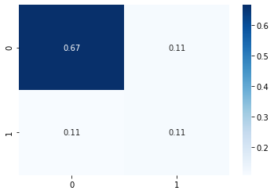
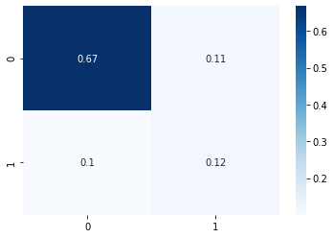
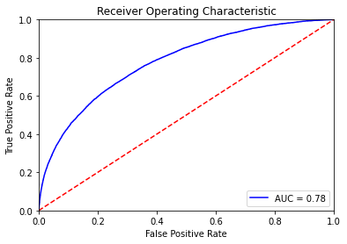
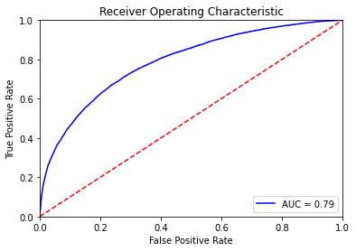
Logistic Regression Model
Base Model Result
Tuned Model Result

Slide 2
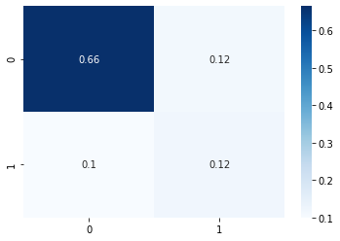


Randam Forest Model
Base Model Result
Tuned Model Result

Slide 3
LGBM Model
Base Model Result
Tuned Model Result

Slide 4
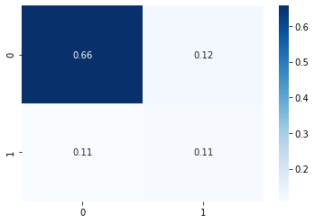
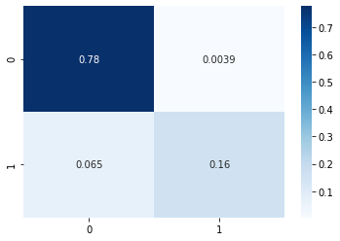

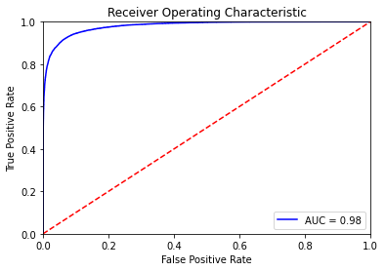
CatBoostClassifier Model
Base Model Result
Tuned Model Result

