Slide 1
Lecture 4 — Programming and Simulations
553.283 Intro to R

Slide 2
Programming in R
Instead of entering simple and singular commands in the command line, it’s often helpful to write a more complicated script consisting of multiple commands, if-else statements, loops, etc.
Open up an external script editor (such as those included with R and RStudio) to write your code, then either copy/paste it into the console or click Run.

Slide 3
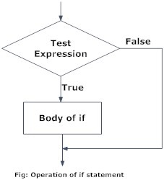
if statements
Decision making is an important part of programming, one that can be achieved in R using if and if-else statements.
The syntax for an if statement is
  if(test_expression){
    body_of_if
  }
If test_expression is TRUE, body is executed; if it is false, nothing happens.
E.g., if statement that tells us if a number is positive.
  x = 5
  if(x > 0){print("Positive number”)}

Slide 4
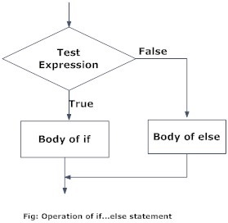
if-else statements
Syntax is:
  if(test_expression) {
  body_of_if
  } else {
  body_of_else
  }
The else part is optional and is only evaluated if test_expression is FALSE.
E.g., include else statement in example from previous slide, one that tells us that the number is not positive:
  x=-5
  if(x>0){
      print(“Positive number”)
  } else {
      print("Non-positive number”)
  }

Slide 5
if-else, cont
If the body of both the if and else statements are one line, we can write the entire if-else as a single line:
Previous example:
  if(x>0) print("Positive number”) else print(“Non-positive number”)
This allows us to set objects equal to one line if-else statements:
    x =-5
    y = if(x>0) 5 else 6

Slide 6
Nested if-else
Can construct a “ladder” of if-else statements that allows to run a particular block of code among many alternatives.
The syntax is:
  if(test_expression1){
    body1
  } else if(test_expression2){
    body2
  } else if(test_expression3){
    body3
  } else {
    body4
  }
E.g.,
  if(x<0){
    print("Negative number")
  } else if(x>0){
    print("Positive number")
  } else {
    print(“Zero")
  }

Slide 7
ifelse() function
Just as most basic functions in R are properly vectorized (meaning they both take in and output vectors), ifelse() is a vectorized form of the basic if-else statement.
The syntax is
  ifelse(test_expression, if_vector, else_vector)
Here, test_expression is a vector of logical values. If the ith entry is true, the ith entry of if_vector is returned, otherwise that of else_vector is returned.
E.g.,
  a = c(1,2,3); b = letters[1:3]; x = -1:1
  y = ifelse(x<0, a, b)

Slide 8
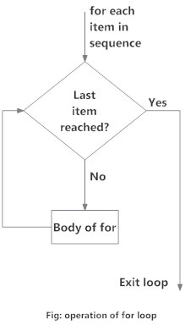
for loops
Loops are used to repeat a specific block of code. A for loop is used to iterate over a vector.
Syntax is
  for(val in sequence){
    body_of_loop
  }
Here, sequence is a vector and val takes on each of its values during the loop. At each iteration body_of_loop is run.
E.g., write a for loop that counts the number of negative numbers in a vector:
  x = c(-1,-2,3,-4)
  count = 0
  for(val in x){
  if(val < 0) count = count+1
  }
  count

Slide 9
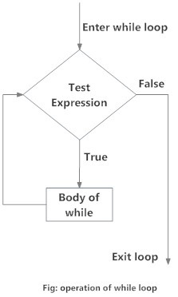
while loops
A while loop is used to iterate until a specific condition is met.
Syntax is
  while(test_expression){
    body_of_loop
  }
The test_expression is evaluated and the body runs if the result is TRUE.
After the body runs the test_expression is again evaluated.
This is repeated each iteration until test_expression is FALSE, in which case the loop exits.
E.g.,
  i = 1
  while(i<6){
  print(i)
  i = i+1
  }

Slide 10
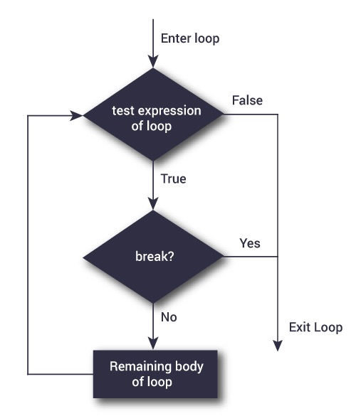
break statement
A break statement is used inside a loop to stop the iterations and exit the loop. If we have nested loops, break leaves the innermost loop where it is found.
Syntax is
  if(test_expression){break}
Note that break can also be in the body of an else statement.
E.g., construct loop that iterates over a vector, but breaks if value 3 is present:
  x = 1:5
  for(val in x){
  if(val==3){break}
  print(val)
  }

Slide 11
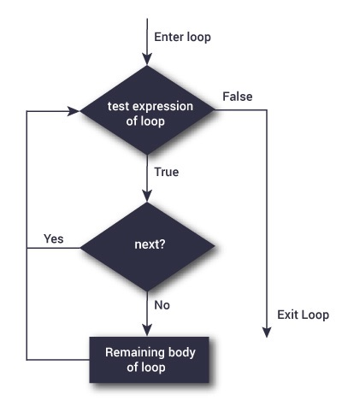
next statement
A next statement is used when we want to skip a current iteration of a loop without terminating it. Upon encountering next, R skips the rest of the loop and starts the next iteration.
Syntax is similar to break
  if(test_expression){next}
E.g., contruct loop that prints all non-3 entries of a vector:
  for(val in x){
  if(val ==3){next}
  print(val)
  }

Slide 12
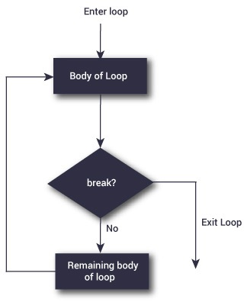
repeat loop
A repeat loop is used to iterate over a block of code multiple times. Unlike for and while loops, repeat loops have no innate condition check, so we must include a break statement in the body.
Syntax is
  repeat{
  body_of_loop
  if(exit_condition){break}
  }
E.g., construct a repeat loop that outputs the integers 1 through 6:
  x = 1
  repeat{
  print(x)
  x=x+1
  if(x==6){break}
  }

Slide 13
Writing functions in R
The object-oriented workflow of R makes it relatively straightforward to create our own functions in addition to the vast libraries of functions that already exist.
Functions are created in the following manner:
  function.name = function( arguments ){body}
We can write functions directly in the console, but it’s often helpful to use an external editor (like the ones included in R and RStudio).
We’ll get started with a true classic:
  hello = function(){print(paste('hello world'))}
  This creates a function, without any arguments, that prints the phrase ‘hello world’ whenever we call it by typing hello() in the command line.

Slide 14
Example of a function
Let’s create a slightly more complicated function that takes two numerical arguments x and y, and prints the sentence “x raised to the power of y is x^y”.
In script editor:
  pow = function(x, y){
  result = x^y
  print(paste(x, "raised to the power", y, "is", result))
  }
Test it out by entering pow(8, 2) or pow(x=8, y=2) in the command line.
Note that print(paste()) allows us to print concatenated strings.

Slide 15
Named Arguments
When we write a function, we explicitly define an default ordering to the arguments, so when we call the function and omit the arguments’ names, the ordering of the arguments we enter matches that of the default ordering.
If we include names when we call the function, we can change the ordering of the arguments.
E.g., the following three commands are equivalent:
  pow(8, 2)
  pow(x = 8, y = 2)
  pow(y = 2, x = 8)

Slide 16
Default Values for Arguments
We can assign default values to function arguments.
This is done by writing arg.name = def.value in the function declaration.
E.g., change pow() function to default to squaring a number:
  pow = function(x, y = 2){same_body}
Then test it out:
  pow(3)
  pow(3, 1)
Here y is optional and defaults to the value 2 when we don’t provide another number.

Slide 17
return() values from functions
Many times we require our functions to do some processing and return the result. We accomplish this with return().
Syntax is return(value).
E.g., let’s write a function that returns whether a number is negative, positive, or zero:
  check = function(x){
    if(x>0){result = "Positive"}
    else if(x<0){result = "Negative"}
    else {result = "Zero"}
    return(result)
  }
Test it out via the commands check(-10), check(0), check(1).

Slide 18
return(), cont
If there are no explicit returns in a function, the function returns the last evaluated expression. It’s generally more helpful to include a return() command.
If return() is not the final command of a function — if, say, it’s embedded in an if-else statement — it immediately ends the function.
The following two functions perform the same task as the one on the previous slide.
  #no return() command
  check = function(x){
    if(x>0){result = "Positive"}
    else if(x<0){result = "Negative"}
    else {result = "Zero"}
    result
  }
  #return() command not on final line
  check = function(x){
    if(x>0){return("Positive")}
    else if(x<0){return("Negative")}
    else {return("Zero")}
  }

Slide 19
Multiple Returns
The return() function can only return a single object. If we want to return multiple objects, we create a list.
E.g.,
  multi_return = function(){
    my_list = list(color= "red", size= "20", shape= "round")
    return(my_list)
  }
This function returns a list with values we can access using $ notation:
  a = multi_return()
  a$color
  a$size
  a$shape

Slide 20
Recursive functions
It’s possible for R functions to call themselves via a process called recursion.
This allows us to solve problems by breaking them into smaller and simpler sub-problems.
A classic example is finding a natural number n’s factorial n!:
  The recursive formula for a factorial is n! = n(n-1)!, which continues until 0! = 1 appears. We can implement this via the following function:
  recursive.factorial = function(x){
    if(x==0) return(1)
    else return(x*recursive.factorial(x-1))
  }
  This function calls itself until x is reduced all the way to 0.

Slide 21
Infix Operators
Most of the operators in R (e.g., +, -, /, *, %>%) are binary (i.e., have two operands); hence they are known as infix operators, used between the operands. These operators actually do a function call.
The expression a+b is actually calling the function `+`(a, b). Note the back ticks ( ` ) surrounding the + symbol.
It’s possible to define our own infix operators via the syntax
  `%infix.name%` = function(x,y){body}
E.g., let’s define an infix operator that finds the squared distance between two numbers:
  `%squared_dist%` = function(x,y){
    return((x-y)^2)
  }
And test it out:
  13 %squared_dist% 25

Slide 22
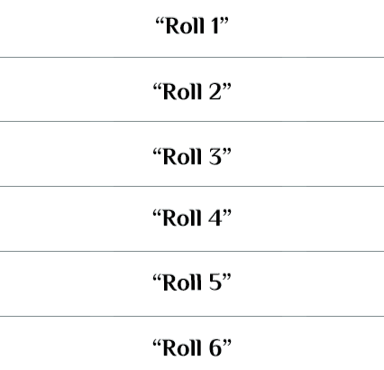
Probability Crash Course
Given a sample space/set of outcomes S, a probability measure P is a function that maps sets of elements/outcomes in S to the real line that satisfies the the following three properties:
  For any subset E of S, 0≤P(E)≤1.
    I.e., probability is a function that takes values between 0 and 1, inclusive.
  P(S) = 1.
    I.e., something must happen.
  For any disjoint subsets E1 and E2 of S, P(E1 or E2) = P(E1)+P(E2).
E.g., roll a six-sided die. S consists of outcomes such as “roll a 3”. The probability of each outcome is 1/6.
P(“roll a prime number”) = P(“roll 2 or 3 or 5”)
= P(“roll 2”) + P(“roll 3”) + P(“roll 5”)
= 1/6 + 1/6 + 1/6
= 1/2

Slide 23

Random Variables
There is much that can be said about random variables. We’ll try and give a brief treatment.
Given a sample space S of random outcomes ω, a random variable X is a deterministic function from S to the real line.
I.e., once we observe the outcome, we know the value of the random variable.
E.g., same example as previous slide. The outcomes in S are not numbers, they are simple events. If we define X := squared value of the roll, then X is a random variable that can take the values 1, 4, 9, 16, 25, or 36.
X(“roll 3”) = 9

Slide 24
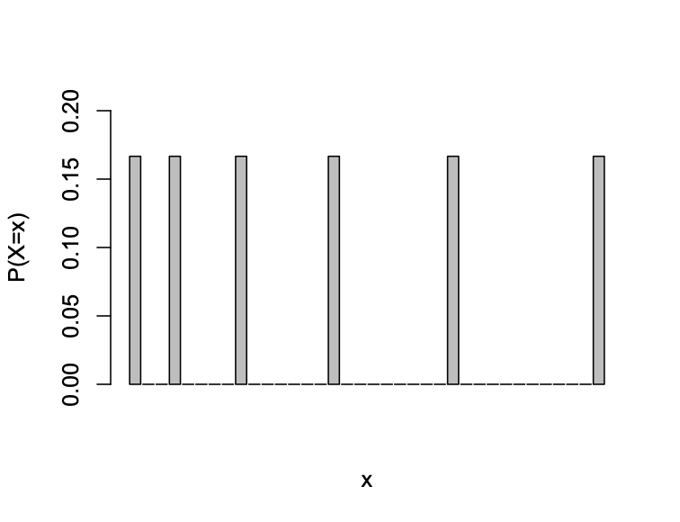
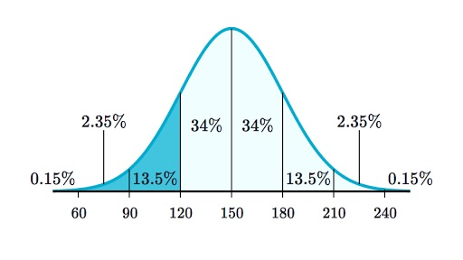
Distributions of Random Variables
Once we have a sample space S and a random variable X, we can treat the set of possible values of X as another sample space SX.
The probability measure we define on SX is the probability distribution of X.
Discrete r.v.s: Can take a finite or countably infinite (e.g., set of integers) number of values. The probability measure is P(X=x).
Continuous r.v.s: Can take an uncountably infinite (e.g., intervals of real numbers) number of values. The probability measure is P(X≤x), but we usually define these with the f(x) = dP(X=x)/dx.
E.g., previous slide’s example. X is a discrete random variable that takes values in {1, 4, 9, 16, 25, 36}. The probability distribution is
  P(X=1) = P(X=4) = . . . = P(X=36) = 1/6
  P(X = literally any other number) = 0
Often helpful to represent probability distributions with a proportion histogram (discrete) or a piecewise curve (continuous)

Slide 25
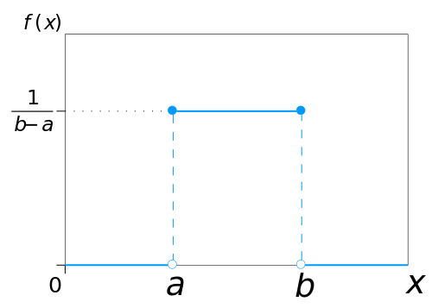
5.2.1: The d, p, q, and r functions
R contains basic functions that randomly generate numbers based on probability distributions and compute probabilities and quantiles associated with those distributions.
E.g., the continuous uniform distribution is used to model random variables that can take any value in an interval with equal probability. We write X~Unif(a, b). Then
  dunif(x, a, b): returns the height of the density function
  punif(x, a, b): returns P(X≤x)
  qunif(p, a, b): returns x such that P(X≤x) = p
  runif(n, a, b): returns a vector of n randomly generated numbers
  Defaults are a=0 and b=1.

Slide 26
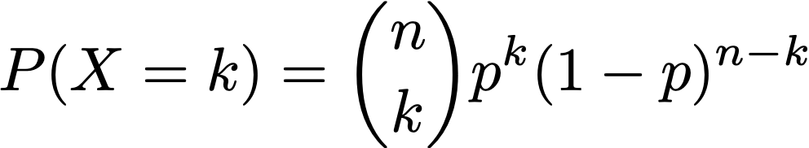
5.2 cont: Bernoulli and Binomial Distributions
Bernoulli: Models a single trial with outcomes success (value is 1) and failure (value is 0). Single parameter is p = P(success). We write X~Bern(p). E.g., roll a fair die, X = 1 if it comes up odd and prime, 0 otherwise.
Binomial: Models the number of successes in multiple independent trials, each with the same success probability. Parameters are n = number of trials (size) and p = P(success). We write X~Bin(n, p). E.g, number of odd primes in n rolls of a fair die.
  R functions are dbinom(x, size, prob), pbinom(x,…), qbinom(p,…), and rbinom(n,…). No default values.
Note that a binomial random variable with n = 1 is a Bernoulli random variable. Hence there are no built-in functions for the Bernoulli.

Slide 27
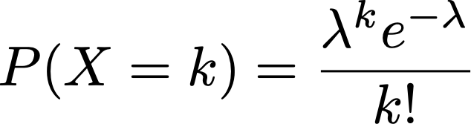
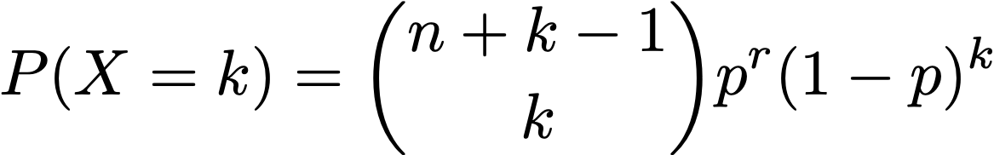
5.2 cont: Poisson and Negative Binomial Distributions
Poisson: Discrete distribution used to model number of occurrences of an event over a period of time, where the mean and variance are about the same. Single parameter is lambda, which is the average number of occurrences in that period of time. We write X~Poi(λ). E.g., the number of cars that pass by a particular house in one hour.
  R functions are dpois(x, lambda), ppois(x,…), qpois(p,…), and rpois(n,…).
Negative binomial: Used to model overdispersed count data (i.e., variance > mean). Parameters are size r and prob p. We write X~NB(r, p)
  R functions are dnbinom(x, size, prob), pnbinom(x,…), qpois(p,…), and rnbinom(n,…).

Slide 28

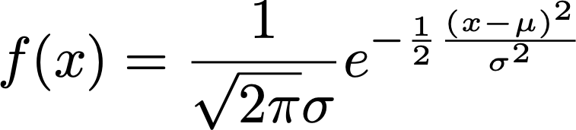
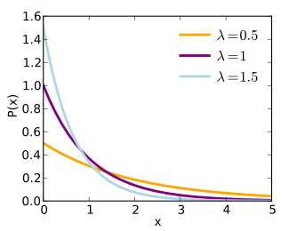
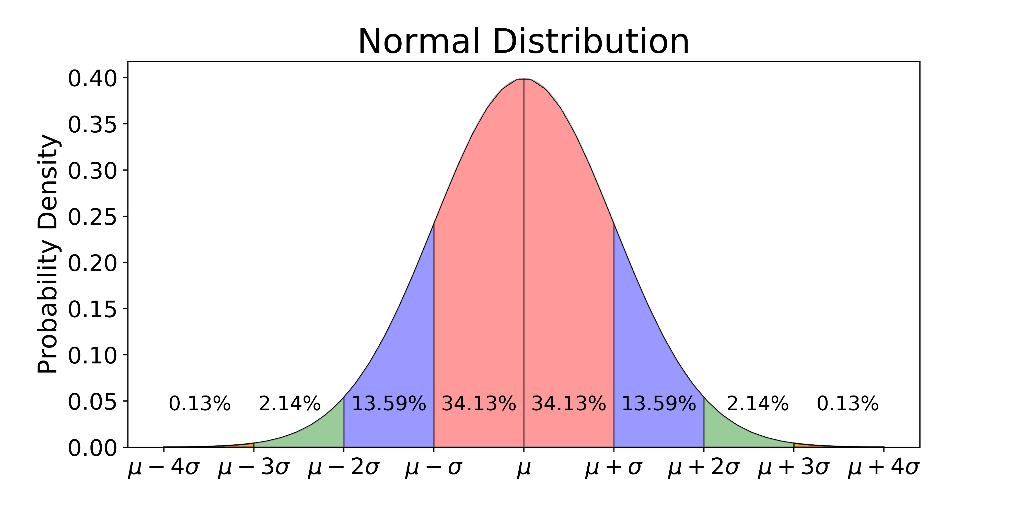
5.2 cont: Normal and Exponential Distributions
Exponential: Continuous distribution used to model the time between occurrences of events. Single parameter is rate, which is the reciprocal of the average number of occurrences of an event per unit time. We write X~Exp(λ).
  dexp(x, rate), pexp(x,…), qexp(p,…), rexp(n,…)
Normal: Continuous distribution used to model data whose density function looks like a bell curve. Two parameters are mu (the mean) and sd (the std dev). We write X~N(μ,σ).
  dnorm(x,mu,sd), pnorm(x,…), qnorm(p,…), and rnorm(n,…)

Slide 29
Sampling Distributions
We typically conduct simulations to investigate the distribution of certain statistics obtained from random samples.
Typically, the way we go about this is by generating multiple samples, finding the statistic for each sample, and finally plotting a histogram or density line to get a feel for what the distribution is after.

Slide 30
Central Limit Theorem
The classic example of sampling distribution is given by the Central Limit Theorem (CLT), which concerns the distribution of the sample mean.
According to the CLT, if X1, . . . Xn are independent and identically distributed with finite mean μ and variance σ², then the distribution of the sample mean Xbar is approximately N(μ, σ²/n), regardless of the distribution of the original Xi.
We can see this happen in real time via the following script:
  no_means = 1000
  sample_size = 10
  sample_means=c()
  for(i in 1:no_means){
    sample_means[i] = mean(rexp(sample_size))
  }
  plot(density(sample_means))
Repeat the above code with sample_size = 20, 30, . . . 100.
We can check that the distribution of the sample means is approximately normal (or not) via qqnorm(sample_means)

Slide 31
Simulating from non-standard distributions
Suppose some nonstandard distribution arises in our work, one for which no R functions exist.
We can write our own functions that allow us to sample from these distributions as well as compute relevant probabilities.
E.g., write d, p, and r functions for:
  dnewdist = function(x){
  vals = c(0,1,2)
  pmf = c(.3,.2,.5)
  if(x==0 | x==1 | x==2) return(pmf[x==vals])
  else return(0)
  }
  pnewdist = function(x){
  vals = c(0,1,2)
  prob = ifelse(x<0, 0, ifelse(x<1,.3,ifelse(x<2,.5,1)))
  return(prob)
  }
x | P(X=x)
0 | 0.3
1 | 0.2
2 | 0.5

Slide 32
Simulating from non-standard distributions, cont
To write an r function use runif(n), setting a random value depending on where random uniform values between 0 and 1 fall.
E.g., sample randomly from
  rnewdist = function(n){
    vals = runif(n)
    vec = ifelse(vals<.3, 0, ifelse(vals<.5,1,2))
    return(vec)
  }
This works as we want because a Unif(0,1) rv is less than .3 30% of the time, between .3 and .5 20% of the time and greater than .5 50% of the time.

Slide 33
E.g., Sampling Distribution of Mean and Std Dev of Example Distribution
Suppose we’re interested in the sampling distribution of the sample mean and std dev of 5 independent, identically distributed observations from the distribution on the previous slide.
  means=c(); std_devs=c()
  for(i in 1:10000){
  vec = rnewdist(5)
  means[i] = mean(vec); std_devs[i] = sd(vec)
  }
  hist(means, freq=F); lines(density(means))
  hist(std_devs, freq =F); lines(density(std_devs))

Slide 34
Bootstrap samples
Suppose we don’t have a density from which we can sample, but we have a lot of data.
The basic idea of a bootstrap sample is to sample with replacement from the sample and create a new sample of the same size as the original.
We repeat this sampling process multiple times and make inferences about the unknown parameters.
For each bootstrap sample we can compute a sample statistic, such as the sample mean. We can then use density to figure out the distribution of that statistic.

Slide 35

Bootstrap example
E.g., the bycatch (UsingR) dataset contains the number of albatross accidentally caught by squid fishers for 897 fishing net hauls.
The data are in tabular form, so we first have to expand it to include info for all hauls:
  hauls = with(bycatch, rep(no.albatross,no.hauls))
  n = length(hauls)
Now do 1000 bootstraps:
  boot.means = c()
  for(i in 1:1000){
  boot.samp = sample(hauls,n,replace=T)
  boot.means[i]= mean(boot.samp)
  }
The vector boot.means contains 1000 estimates of the population mean, which we can use to come up with a range of probable values for the true population mean:
  quantile(boot.means, c(.05,.95))

