Slide 1

BOARD PITCH · OCTOBER 2026 · CONFIDENTIAL
CitriSuraksha AI
Scan · Detect · Protect
An AI-powered citrus pest detection, advisory and surveillance platform —
built for farmers, agriculture departments and research institutions.
Born in Nagpur — the Orange City of India 🍊

Slide 2
THE PROBLEM
Citrus farming is losing money to pests every season
Pests and diseases are the single largest preventable cause of citrus yield loss — and the first 48 hours matter most.
📉
🧑🌾
💊
20–40% crop losses
No expert at the field edge
Blind pesticide spraying
FAO estimates that plant pests and diseases destroy up to 40% of global food crops every year. Citrus is hit by 20+ major pests.
Extension officers serve thousands of farmers. A wrong or late diagnosis travels village-to-village before anyone verifies it.
Mis-identification leads to wrong molecules, wasted spend, residue risk and destroyed friendly insects.
🦠
🗣️
🗺️
Citrus greening (HLB) threat
Advice not in the farmer's language
No field data for agencies
Asian citrus psyllid vectors the fatal greening disease. Early field detection is the only defence — and it needs trained eyes.
Departments and universities lack real-time, geo-tagged pest incidence data to act before outbreaks spread.
Scientific advisories rarely reach farmers in Marathi or Hindi, at the right crop stage, at the right week.
Source: FAO — up to 40% of global food crops are lost to plant pests and diseases annually.
CitriSuraksha AI · Scan · Detect · Protect · Board Pitch — Confidential
2

Slide 3
OUR SOLUTION
One platform, three connected surfaces
A complete digital protection layer for the citrus economy — from a farmer's phone to the board room of agriculture agencies.
📱
🧠
🖥️
Farmer Mobile App
AI + Cloud Backend
Admin & Expert Panel
Android & iOS (Expo). Scan a leaf with the camera and get an AI diagnosis with severity, symptoms, preventive & curative management — in English, Marathi or Hindi. History, care calendar, advisories, chat support and push alerts.
FastAPI + PostgreSQL + in-house vision service. A 21-class citrus pest classifier (20 pests + negative) that improves with every verified farmer upload. Firebase Cloud Messaging powers district-scale alerts.
Role-based web panel (admin, agronomist, data labeler, support) with 15 modules: review & correct AI results, publish advisories, manage pests & insecticides, train the AI, run push campaigns and answer farmer chats.
Scan → Detect → Protect in under 30 seconds, with a human expert always in the loop.
CitriSuraksha AI · Scan · Detect · Protect · Board Pitch — Confidential
3

Slide 4
PLATFORM OVERVIEW
How the pieces fit together
📱 Mobile App
🌐 Backend API
🧠 AI Service
🔔 Firebase Cloud
React Native (Expo SDK 54)
Android + iOS
Offline-safe, 3 languages
FastAPI + SQLAlchemy
PostgreSQL / SQLite
JWT auth, GZip, ORJSON
In-house vision engine
21-class pest classifier
Trained on our verified data
Admin SDK push
token registry
campaign logs
🖥️ Admin & Expert Panel — React + TypeScript (hosted independently)
Dashboard · Users & Farmers · Farmer Uploads review · Pest & Insecticide registry · Blog/Events/Calendar publishing · Train AI studio · AI Models · Push campaigns · Farmer Chat · Notifications · Settings
The vision model is trained in-house on our own verified dataset — full data ownership.
Deployment-flexible. Runs on a single VPS with or without Docker; admin panel ships as a static build to any web host; mobile builds via EAS.
CitriSuraksha AI · Scan · Detect · Protect · Board Pitch — Confidential
4

Slide 5
COMPLETE FLOW
From a photo in the orchard to a smarter AI
5
Farmer captures
5
App uploads
5
AI classifies
5
Instant report
Camera / gallery photo of pest, leaf or fruit damage
Image resized & stored securely; detection request queued
21-class CNN returns top-k pests, confidence & severity
Symptoms + preventive/curative + organic/chemical advice in farmer's language
5
Feedback loop
5
Expert review
5
Verified dataset
5
Retrained model
Farmer marks result correct/wrong; every scan is saved with geo & time
Admin/agronomist verifies or corrects each detection; can approve for training
Corrected uploads become labelled training images (stage-wise, 21 classes)
New model version registered & served — accuracy climbs every cycle
The loop never stops: more scans → more verified images → a sharper model → more trust → more scans.
CitriSuraksha AI · Scan · Detect · Protect · Board Pitch — Confidential
5

Slide 6
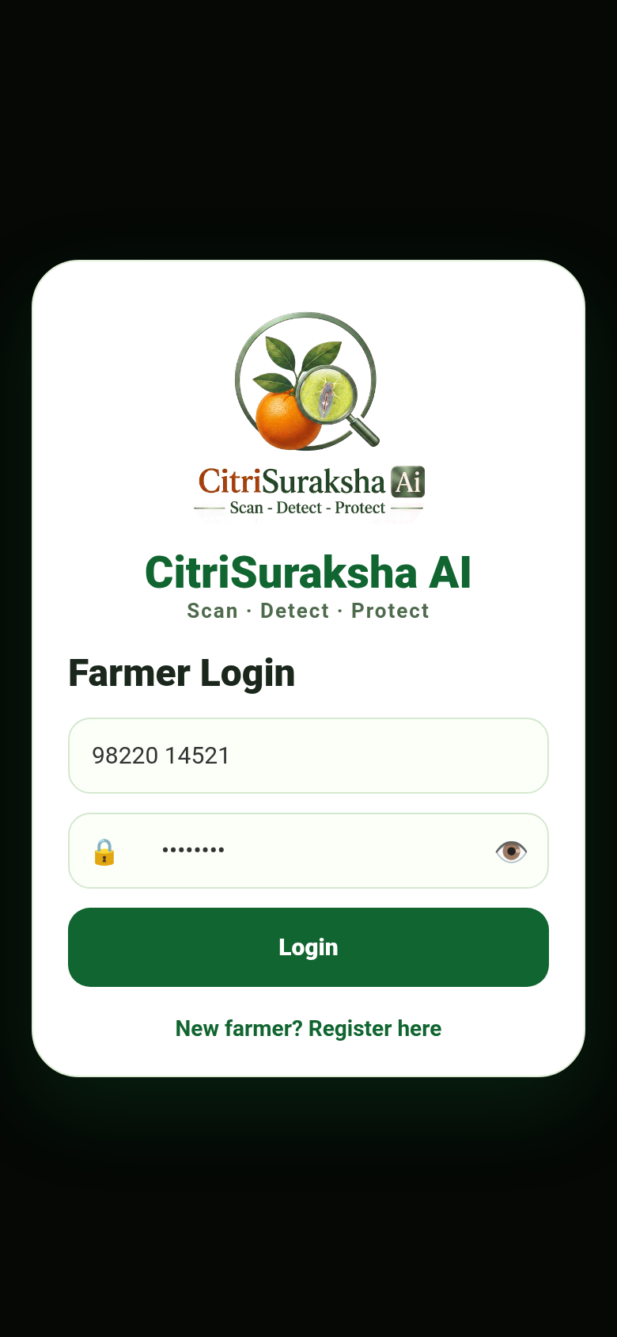
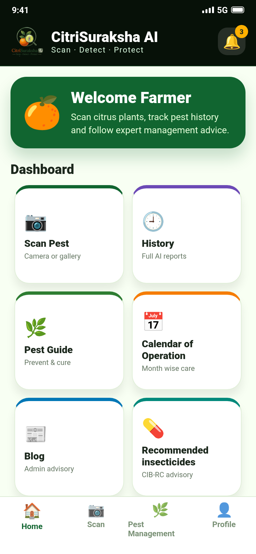
FARMER APP · SCREEN FLOW 1/4
A farmer-friendly front door
Simple login (phone + password) and a one-thumb dashboard — every feature is one tap away.
Onboarding in minutes — phone-number login, profile with farm details (village, crop, varieties, irrigation).
One dashboard, eight services — Scan, History, Pest Guide, Calendar of Operation, Blog, CIB-RC insecticides, Events and Chat.
Alerts at a glance — notification bell with unread badge, synced with Firebase push.
Built for low literacy load — large icons, colour-coded cards, emoji-supported UI.
CitriSuraksha AI · Scan · Detect · Protect · Board Pitch — Confidential
6

Slide 7
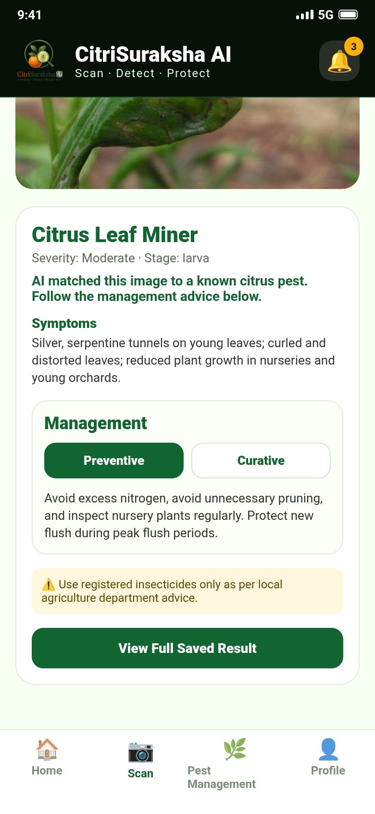
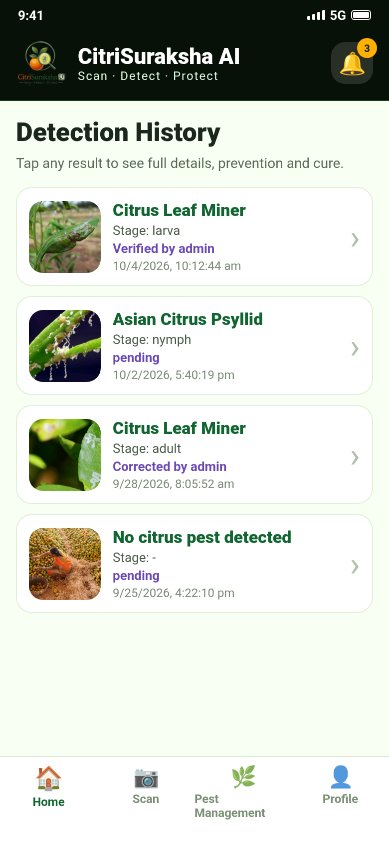
FARMER APP · SCREEN FLOW 2/4
The 30-second AI diagnosis
The heart of the product: point, shoot, and receive a complete pest management report.
Camera or gallery — photo is uploaded, analysed and answered in seconds.
Complete report — pest name, severity, lifecycle stage, symptoms, Preventive / Curative tabs with organic & chemical control.
Safety-first — every report carries a registered-pesticide advisory note.
Full history — every scan saved with review status (pending / verified / corrected by admin) — tap for the full dossier.
CitriSuraksha AI · Scan · Detect · Protect · Board Pitch — Confidential
7

Slide 8
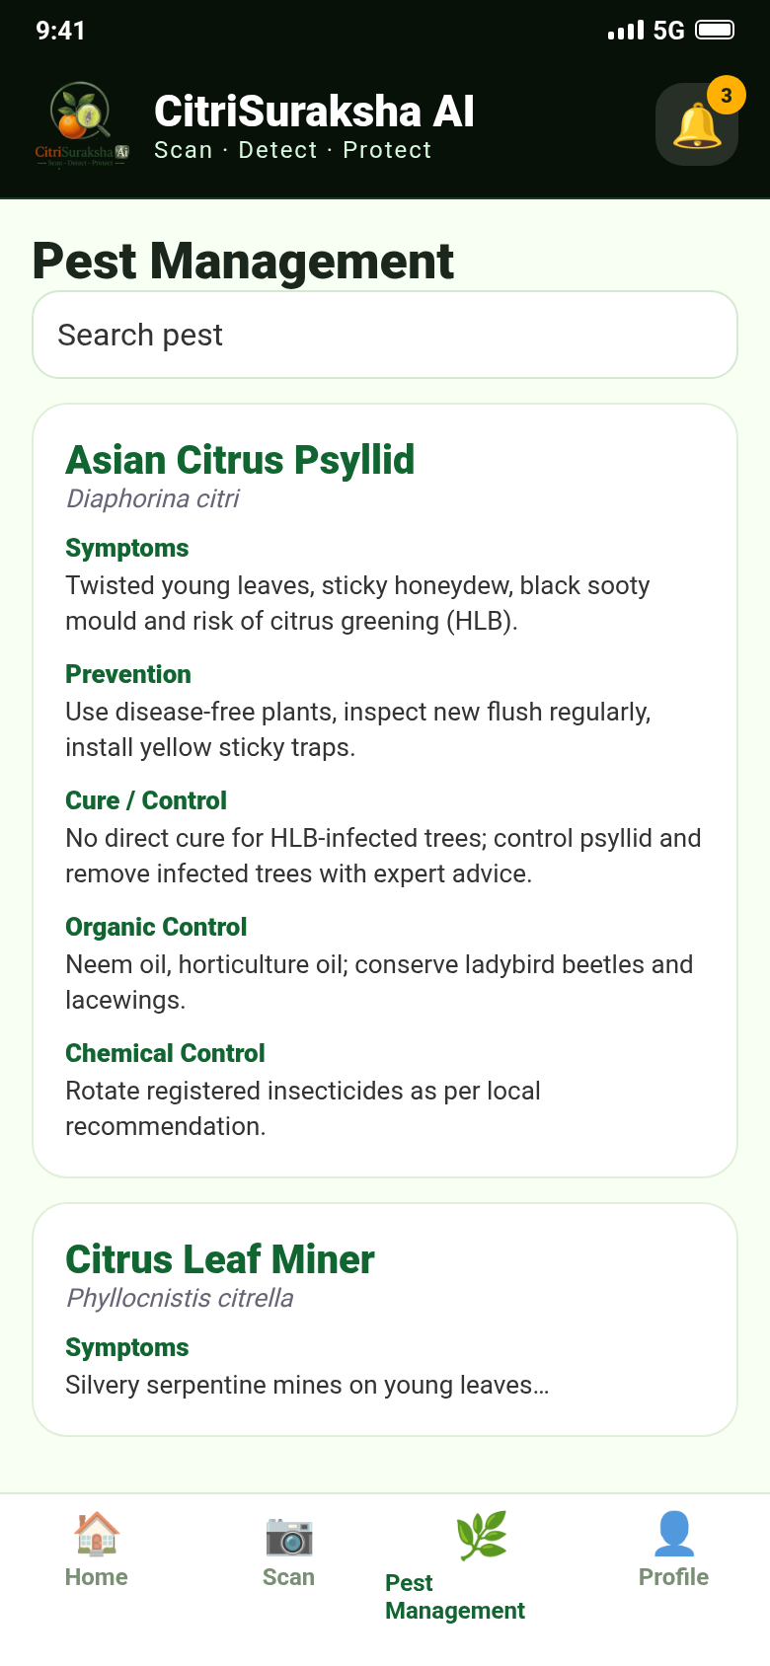
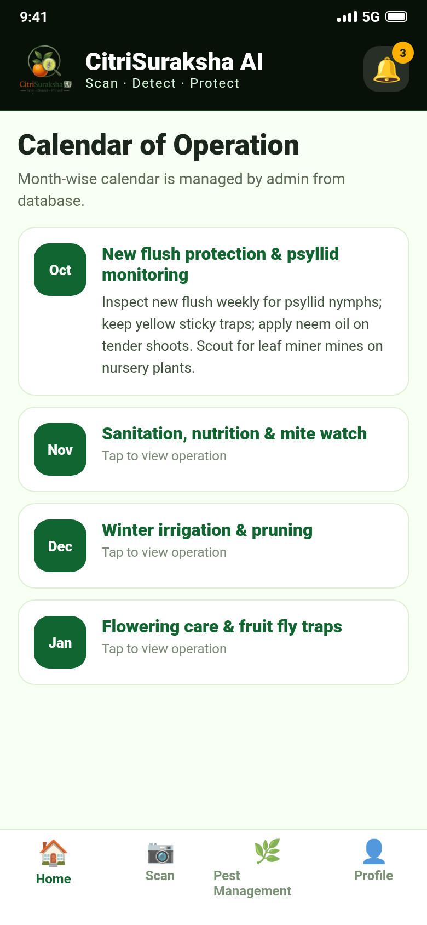
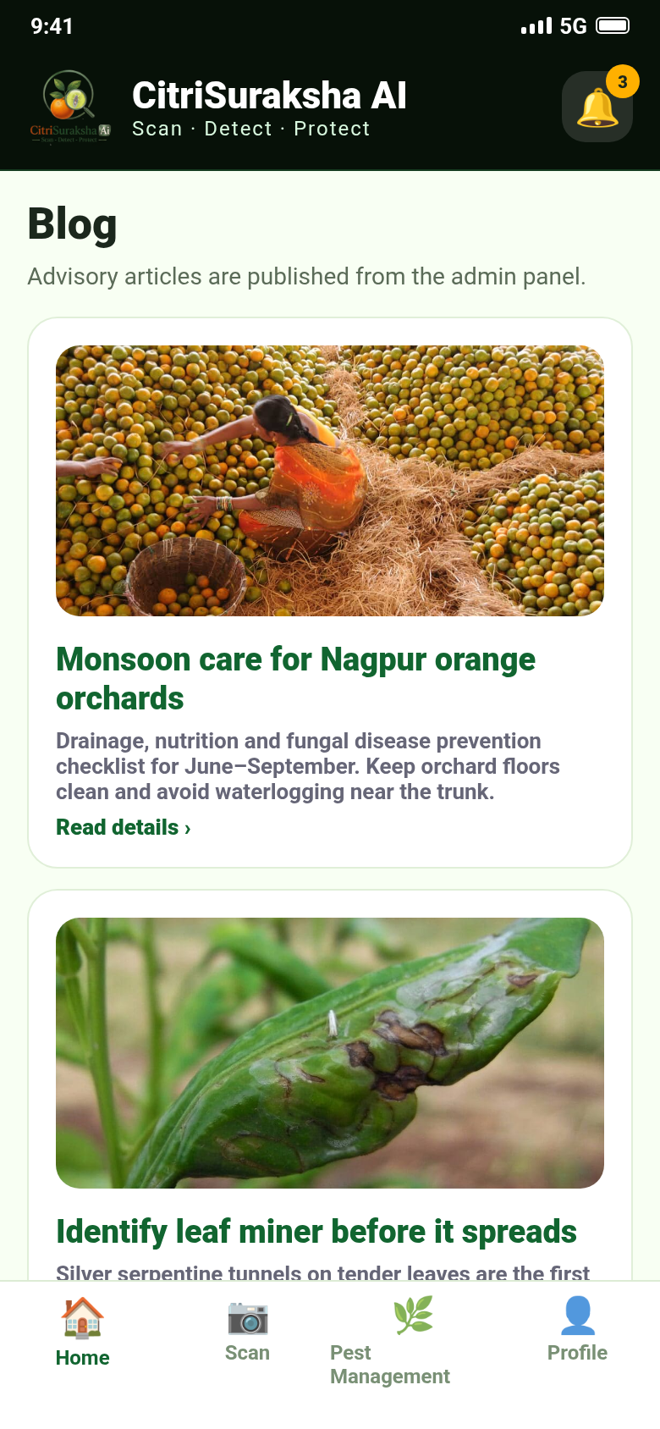
FARMER APP · SCREEN FLOW 3/4
A pocket plant-protection department
Knowledge compiled from a 33-page scientific citrus pest compendium and researcher-authored advisories.
Pest Guide: all 20 citrus pests with symptoms, prevention, cure, organic & chemical control.
Calendar of Operation: month-wise orchard care, admin-managed.
Blog & advisories published instantly from the admin panel.
CIB-RC recommended insecticide reference per pest.
CitriSuraksha AI · Scan · Detect · Protect · Board Pitch — Confidential
8

Slide 9
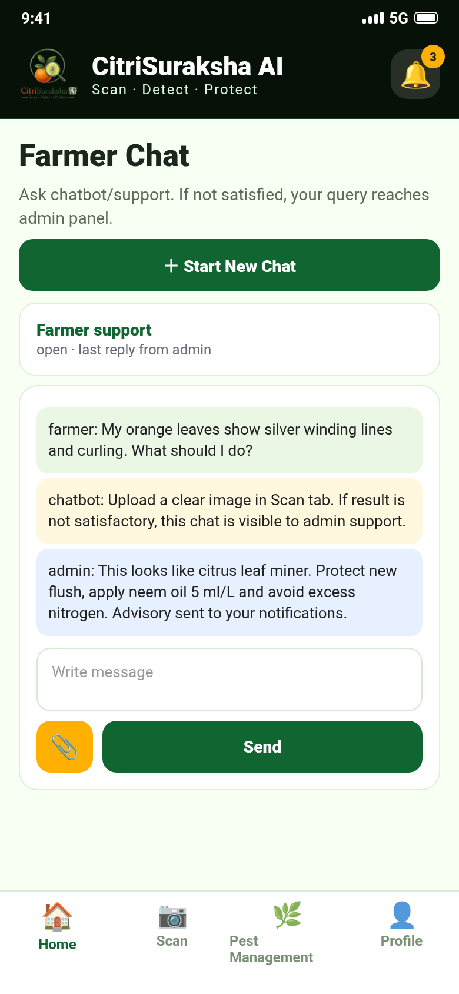
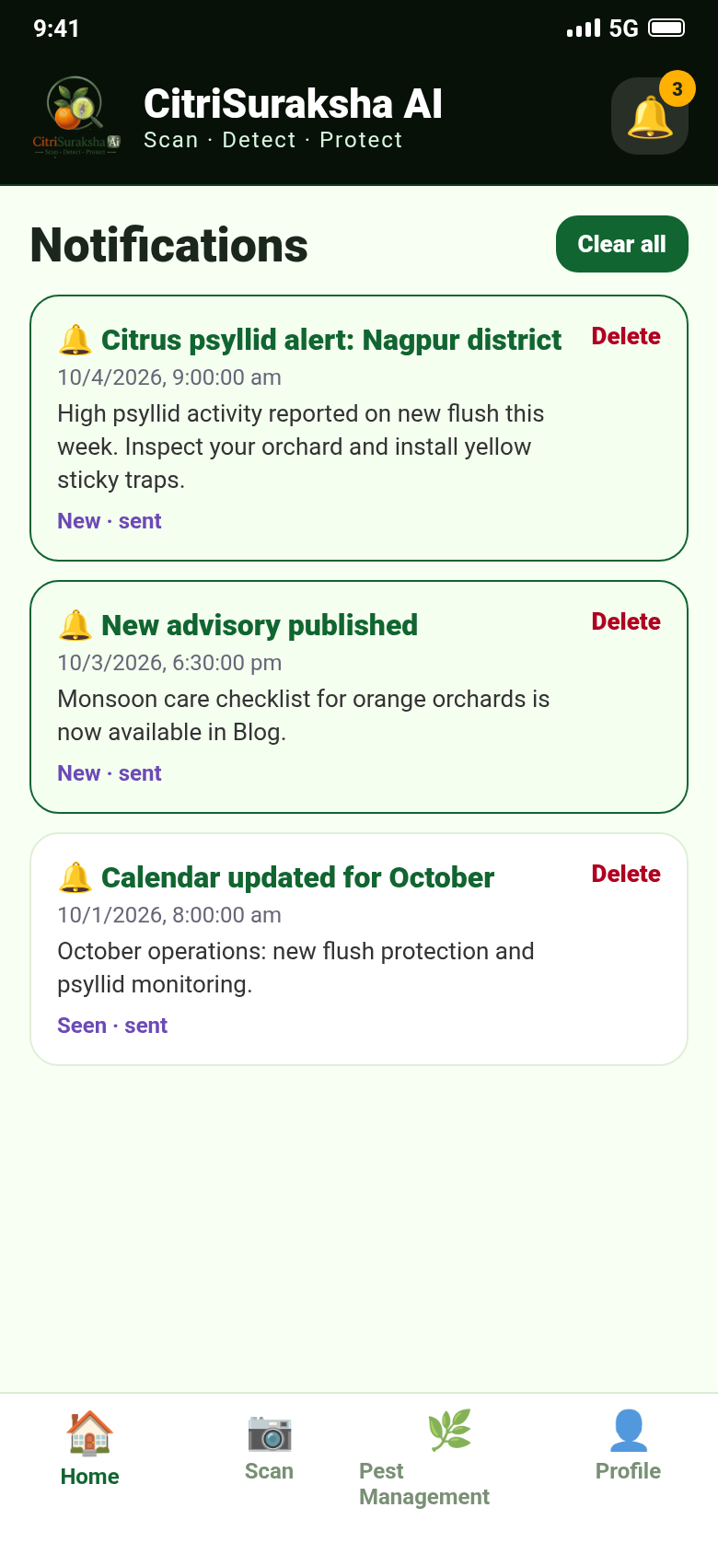
FARMER APP · SCREEN FLOW 4/4
Support that never sleeps
Chatbot first, human expert second — and district-scale push alerts when it matters.
Real-time chat — instant chatbot answers; unresolved queries appear in the admin panel; agronomists reply over WebSocket with attachments.
Push campaigns — Firebase Cloud Messaging delivers district pest alerts and advisories even when the app is closed.
In-app inbox — read/unread tracking, deep links into Events & Blogs.
CitriSuraksha AI · Scan · Detect · Protect · Board Pitch — Confidential
9

Slide 10
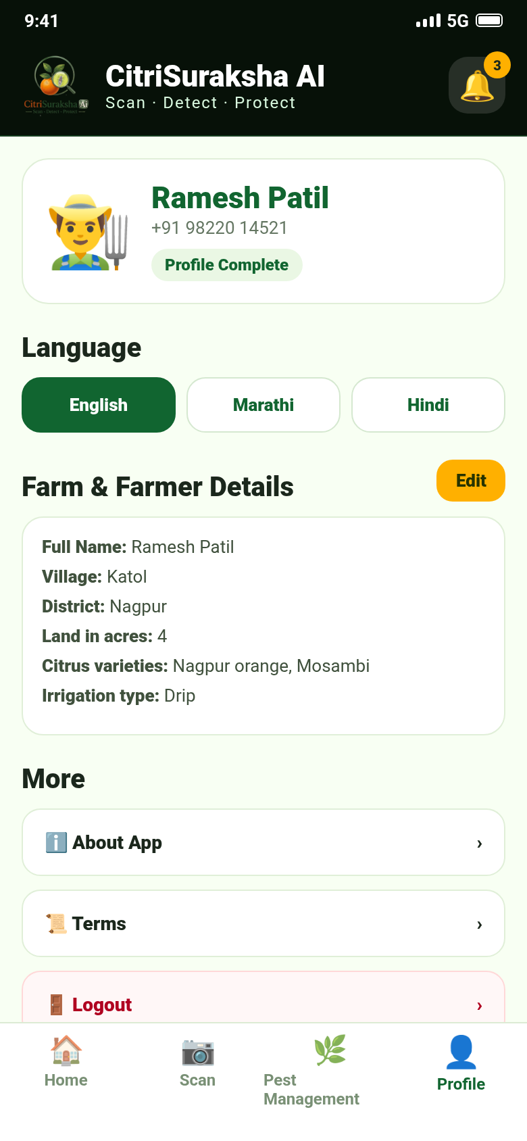
INCLUSION BY DESIGN
One tap — English, मराठी, हिंदी
The full experience (UI, pest names, symptoms, prevention & cure) is localised, stored per farmer, and switchable anytime.
Trilingual from day one — English, Marathi and Hindi dictionaries ship in the app; pest knowledge carries researcher-verified translations.
Farmer-owned profile — village, district, land, varieties and irrigation data enable targeted, crop-stage advice later.
Language follows the farmer — the choice is stored on the server, so advisories and blogs render in the farmer's language.
Extensible — the i18n layer makes adding further Indian languages a content exercise, not a rebuild.
"शेतकरी मित्रा स्वागत आहे" · "किसान मित्र आपका स्वागत है" · "Welcome Farmer"
CitriSuraksha AI · Scan · Detect · Protect · Board Pitch — Confidential
10

Slide 11
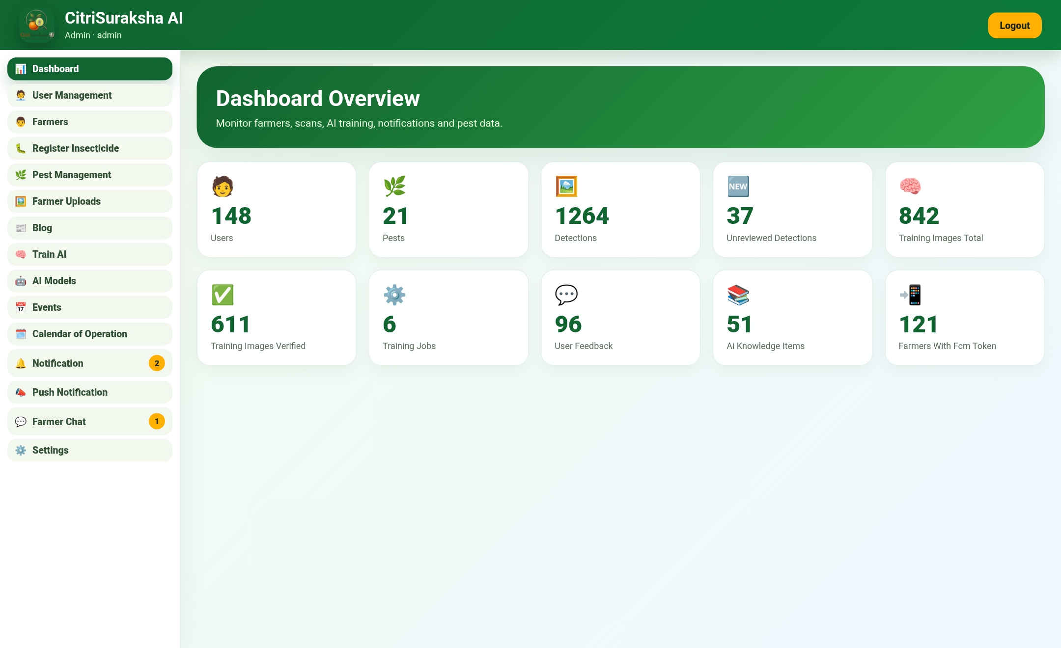
ADMIN PANEL 1/4
The command centre
One dashboard to run the entire ecosystem — illustrated with demo data.
Live KPIs: users, pests, detections, unreviewed queue, training images (total/verified), jobs, feedback, knowledge items, FCM-registered farmers.
15 role-based modules — admin, agronomist, data labeler and support each see only their workspace.
Every KPI card deep-links into its operational screen.
Illustrative demo data.
CitriSuraksha AI · Scan · Detect · Protect · Board Pitch — Confidential
11

Slide 12
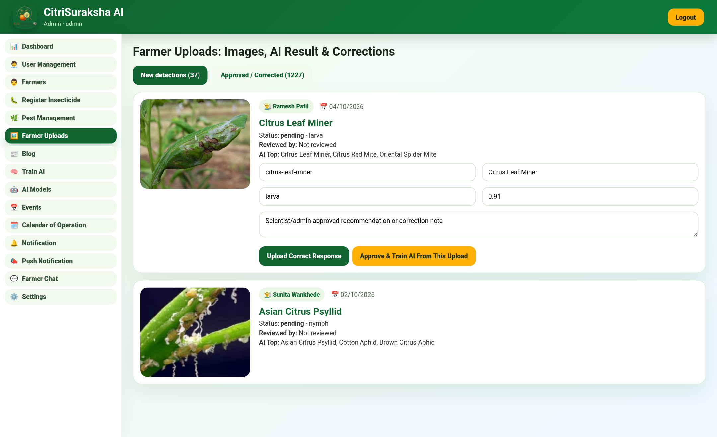
ADMIN PANEL 2/4
Human-in-the-loop expert review
Every farmer scan lands here for verification — this is where AI accuracy is manufactured.
Agronomists see the farmer's photo beside the AI's top-k answer.
One click to verify, correct the pest/stage, and attach a scientist-approved note.
"Approve & Train" converts a reviewed upload into a labelled training image instantly.
Farmers see Verified / Corrected status on their history — trust is visible.
CitriSuraksha AI · Scan · Detect · Protect · Board Pitch — Confidential
12

Slide 13
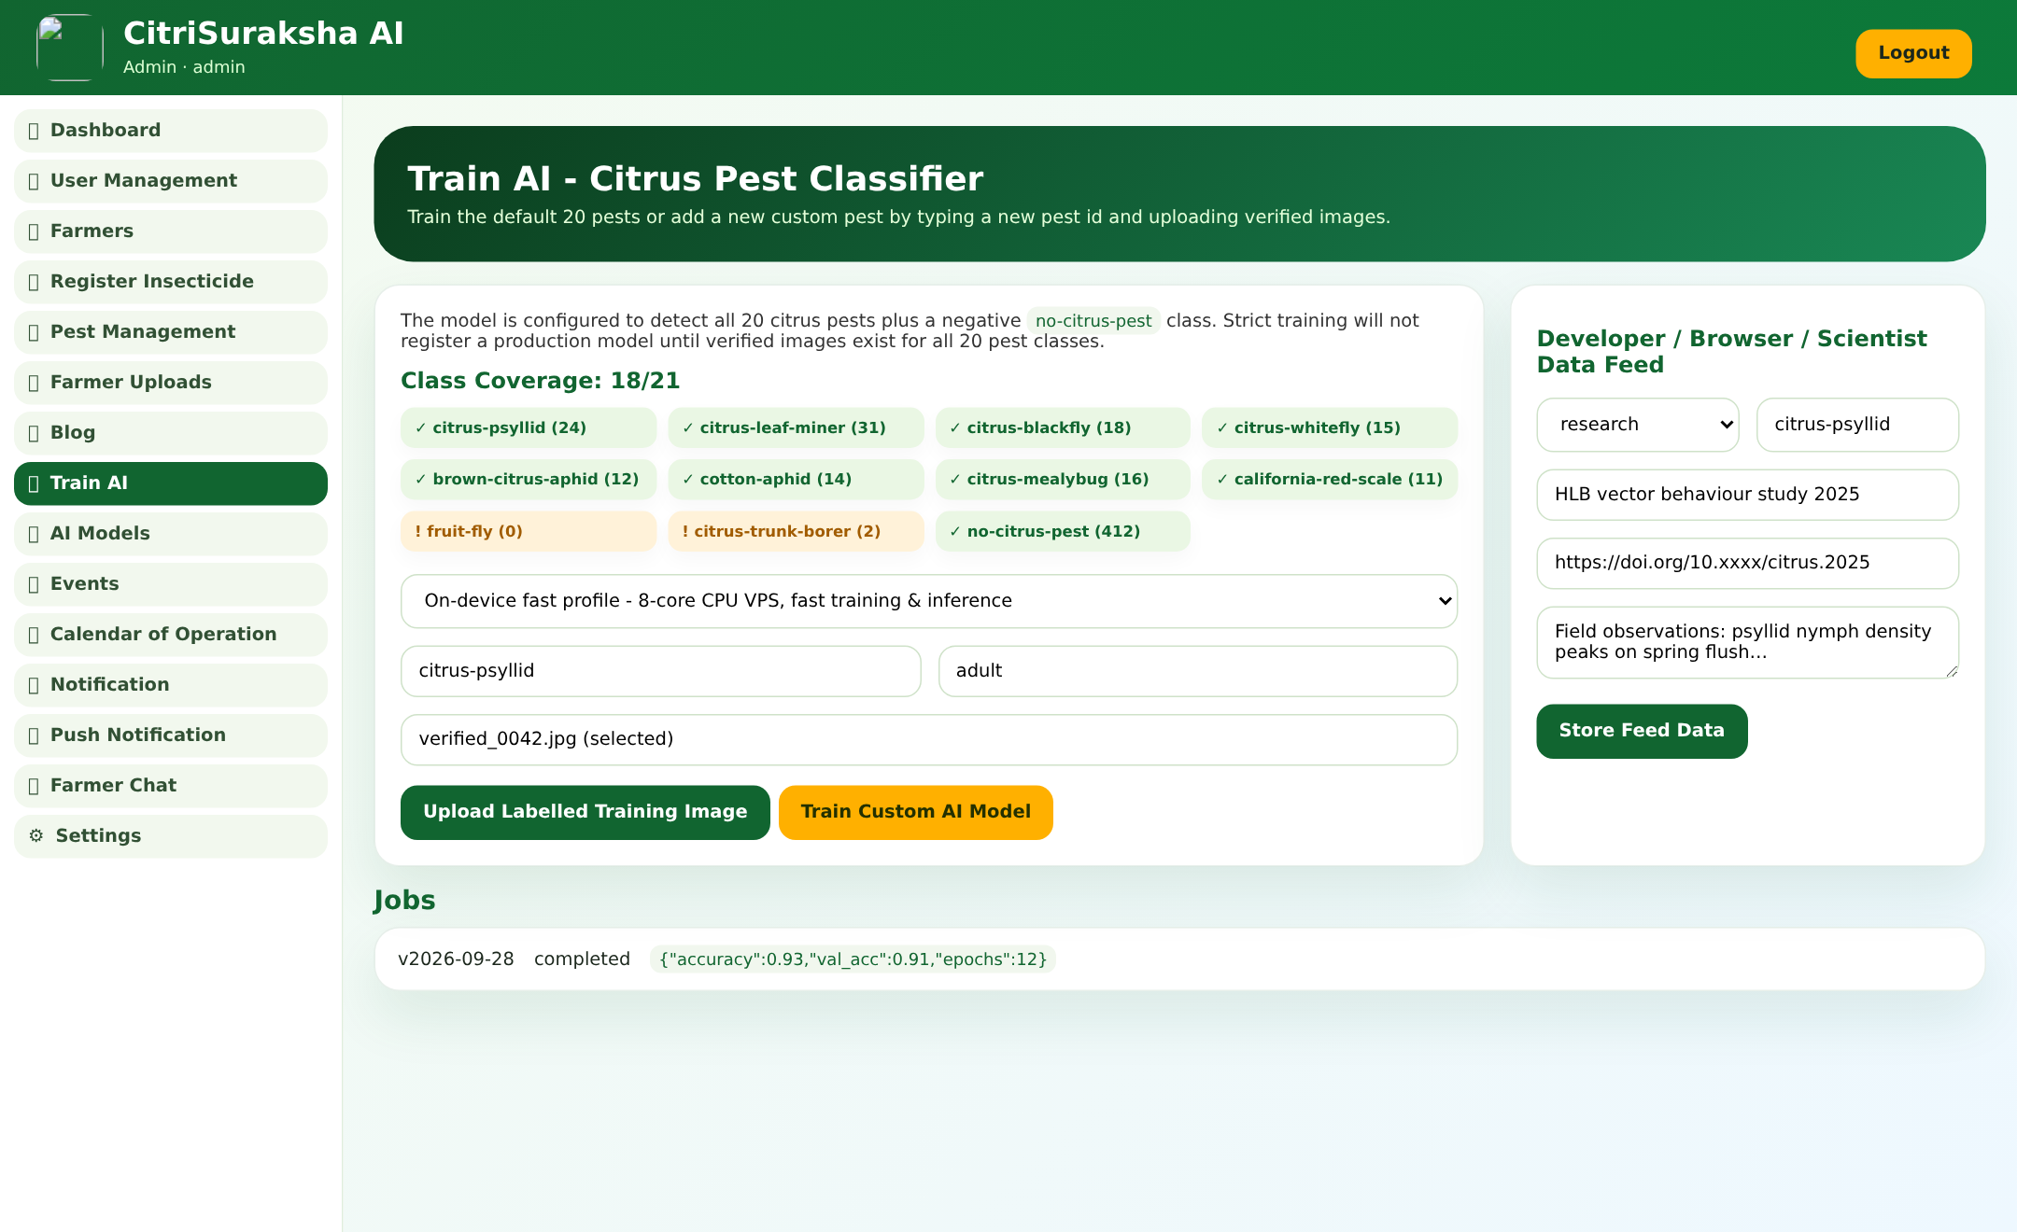
ADMIN PANEL 3/4
The AI Training Studio
Model training as an operational routine — not a research project.
Strict 21-class discipline: no production model is registered until verified images exist for all 20 pests + the negative class.
Live class-coverage board shows exactly which pest needs more photos.
Model profiles are selectable per training run; custom pests can be added.
Researcher / browser / developer data feeds enrich the knowledge base continuously.
CitriSuraksha AI · Scan · Detect · Protect · Board Pitch — Confidential
13

Slide 14
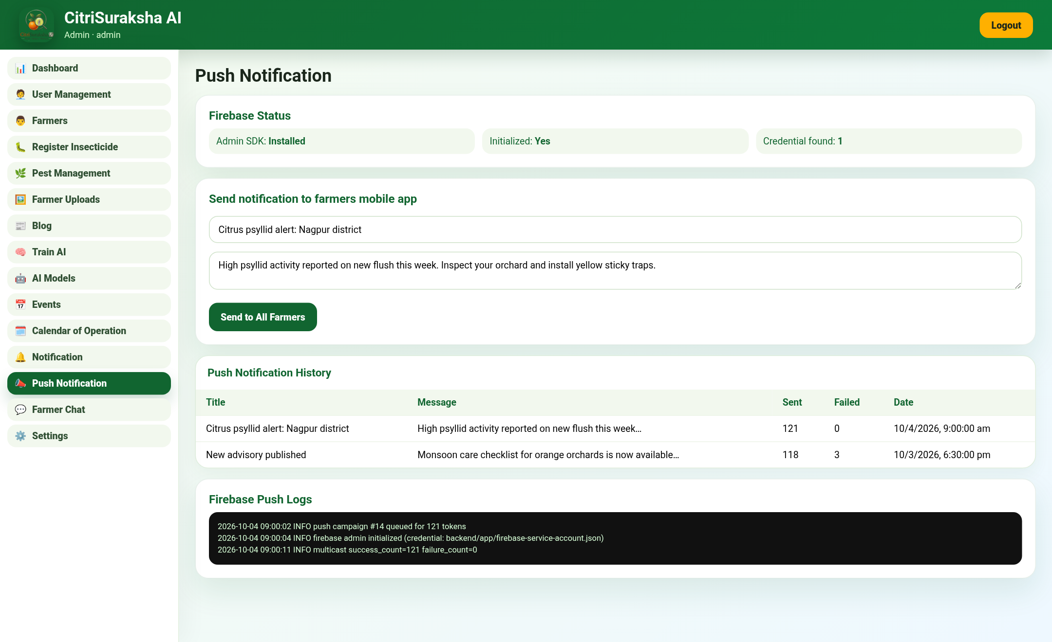
ADMIN PANEL 4/4
Alerts at district scale
Firebase Cloud Messaging turns one observation into thousands of protected orchards.
Compose once → deliver to every registered farmer device (121 tokens in demo).
Firebase status & delivery logs built into the panel for accountability.
Use cases: outbreak alerts, weather advisories, event announcements, new blog pushes.
Delivery analytics feed back into engagement KPIs.
CitriSuraksha AI · Scan · Detect · Protect · Board Pitch — Confidential
14

Slide 15
TECHNOLOGY DEEP-DIVE
The AI engine under the hood
Vision model
Training pipeline
Data hygiene & serving
In-house vision engine, trained only on our own verified dataset.
21 classes: 20 citrus pests + a no-citrus-pest negative class to reject irrelevant photos.
Outputs top-k predictions with confidence, severity and lifecycle stage.
Transfer-training CLI + in-panel trainer with job queue and metrics (accuracy / val-acc / epochs).
Strict mode: model registry refuses production registration until every class has verified images.
Model versions are registered, listed and switchable from the AI Models screen.
Backend normalises uploads (max 1024px JPEG) before inference; 25s guarded AI timeout; GZip + ORJSON responses.
Before enough real images exist, a deterministic bootstrap engine answers natural images and rejects blank/low-signal photos — the app is never dead.
Feedback (correct/wrong) and admin corrections flow straight into the labelled dataset.
Privacy & ownership: all images, labels and models remain on our servers — a strategic data asset, not a vendor's.
CitriSuraksha AI · Scan · Detect · Protect · Board Pitch — Confidential
15

Slide 16
COMPOUNDING ADVANTAGE
The data flywheel
Every stakeholder action makes the platform more valuable for every other stakeholder.
📷 Farmers scan
more orchards covered
Competitors can copy a model.
They cannot copy a labelled,
geo-tagged, expert-verified
citrus pest dataset built
season after season with
farmers and departments.
That dataset is the moat.
💬 Advisories improve
✅ Experts verify
fewer losses season on season
labels of research grade
Better AI
every cycle
🗺️ Data deepens
🧠 Model retrains
surveillance value for agencies
accuracy climbs
📈 Trust grows
adoption accelerates
CitriSuraksha AI · Scan · Detect · Protect · Board Pitch — Confidential
16

Slide 17
VALUE PROPOSITION
What the farmer gains
⚡
🎯
🗓️
Diagnosis in seconds
Right spray, right time
Prevention first
From "what is eating my crop?" to a named pest with severity — no travel, no waiting.
CIB-RC aligned, stage-wise chemical & organic options cut wasted pesticide spend.
Month-wise Calendar of Operation and alerts stop outbreaks before damage.
💬
📒
🔔
Expert in the pocket
Personal farm record
Never misses an alert
Chatbot + real agronomist replies in the farmer's own language.
Every scan saved — a digital crop-health history useful for loans & insurance.
District pest warnings and advisories arrive as push notifications.
Bottom line for the farmer: fewer losses, lower input cost, safer produce, and dignity — the expert now comes to them.
CitriSuraksha AI · Scan · Detect · Protect · Board Pitch — Confidential
17

Slide 18
VALUE PROPOSITION
What partner agencies gain
The same platform becomes critical infrastructure for everyone working in citrus.
🏛️ Agriculture Departments & KVKs
🎓 Universities & Researchers
Live, geo-tagged pest incidence from thousands of scans; outbreak alerts can be broadcast to a district in one click; extension staff triage with AI pre-screening.
A growing, expert-verified, stage-labelled image dataset + researcher data feeds — raw material for papers, new models and varietal studies.
🧪 Agri-input & Advisory Companies
🍊 FPOs & Grower Associations
Evidence-based demand signals: which pests, where, when — enabling responsible, targeted product guidance (CIB-RC aligned).
Protect member orchards at scale with shared advisories, calendars and alert channels; reduce collective losses.
🏦 Insurers & Rural Credit
📊 Policy & Planning
Time-stamped, photo-verified crop damage history de-risks assessment and claims.
Season-over-season pest maps inform spraying programs, nurseries policy and HLB containment strategy.
CitriSuraksha AI · Scan · Detect · Protect · Board Pitch — Confidential
18

Slide 19
MARKET
Why citrus, why now, why here
🍊 A crop worth protecting
📱 The phone is already there
India is among the world's leading citrus producers, and Maharashtra's Vidarbha region is home to the GI-tagged Nagpur orange. Citrus is a high-value, high-risk crop — perfect for AI protection.
Rural smartphone penetration and cheap data make an app-first solution viable today without any hardware rollout — the distribution channel already exists in the farmer's pocket.
🤝 Policy tailwinds
♻️ Expandable playbook
Digital agriculture, AI for farming and plant-surveillance programs are national priorities; departments actively seek technology partners for early-warning systems.
The pipeline (scan → verify → train → advise) is crop-agnostic. Citrus is the wedge; the same engine can serve other horticulture crops afterwards.
CitriSuraksha AI · Scan · Detect · Protect · Board Pitch — Confidential
19

Slide 20
TRACTION & READINESS
This is not a slide deck — the platform is built
A production-grade MVP across three codebases, ready for pilot deployment.
Farmer app — Expo SDK 54, Android & iOS builds, 18 screens, 3 languages, push-ready.
Backend — 12 API modules, role-based auth, review workflows, WebSocket chat, Firebase push with logs.
AI service — in-house training pipeline, model registry, strict 21-class coverage gates.
Knowledge — 20 citrus pests digitised from a 33-page scientific compendium; trilingual researcher-verified advisories; CIB-RC insecticide reference.
Admin panel — 15 modules with role-based navigation, badges, review & correction, training studio.
Ops-ready — deployment docs (with/without Docker), backup/restore scripts, DB switching SQLite↔Postgres.
Engineering highlights
Full IP & data ownership — every model trained in-house
Deterministic bootstrap keeps the app live pre-training
Human-in-the-loop on every single detection
Security: JWT auth, hashed passwords, gitignored service accounts
Resilient config: Docker or plain VPS, Postgres or SQLite
CitriSuraksha AI · Scan · Detect · Protect · Board Pitch — Confidential
20

Slide 21
ROADMAP
Four phases to category leadership
PHASE 0 · DONE
PHASE 1 · 0–6 MO
PHASE 2 · 6–12 MO
PHASE 3 · 12–24 MO
Platform MVP
Pilot: Nagpur district
Accuracy & automation
Scale & expand
App + backend + admin + AI pipeline built; knowledge digitised; deployment docs ready.
500-farmer pilot with a KVK/university partner; labelled-image drive for all 21 classes; first trained model v1.
Top-1 accuracy ≥ 90% on field images; on-device lite model; auto outbreak clustering from geo-data.
State-wide rollout (Maharashtra), additional citrus regions, second crop playbooks, agency data APIs.
KPIs we will report to the board quarterly: model accuracy, verified-image coverage, active farmers, scans/week, alert delivery rate, estimated loss avoided.
CitriSuraksha AI · Scan · Detect · Protect · Board Pitch — Confidential
21

Slide 22
THE ASK
What we need from the board
✅
💰
🤝
Approve the pilot
Fund the data drive
Open doors
Sanction a 6-month, 500-farmer pilot in Nagpur district with a named department/KVK partner.
Budget for field image collection, labelling camps with university students and agronomist review time — the fuel of the flywheel.
Introductions to agriculture departments, KVKs and FPO networks for partnerships and endorsements.
In return, the board receives:
• A defensible, data-backed AI asset in Indian horticulture • A public-good platform with strong CSR & policy alignment
• Recurring value streams: agency dashboards, certified advisories, research datasets • First-mover brand: "the app that protects oranges"
CitriSuraksha AI · Scan · Detect · Protect · Board Pitch — Confidential
22

Slide 23
MULTI-STAGE PIPELINE (AI v2)
From one CNN to a six-signal decision engine
Photo in, honest answer out - including 'I don't know'.
OpenCV quality gate
blur / light / corruption
Pest detector
box + crop
Legacy CNN signal
(bootstrap until trained)
Visual memory
verified-image similarity
Cross-check signal
secondary, always weak
Decision engine
6 honest outcomes
Decisions
Cross-checks
Knowledge join
identified · uncertain · unknown · poor_image · no_pest_detected · non_target_image. Unknowns are stored for clustering.
Model disagreement or a thin top-1/top-2 margin always downgrades to 'uncertain' - never a blind guess.
AI identifies; PostgreSQL provides symptoms, prevention, cure, organic/chemical control in EN/MR/HI.
Saying 'I don't know' is a feature: it feeds expert review, which feeds the dataset, which feeds accuracy.

Slide 24
GOVERNANCE
No unverified image trains. No unevaluated model deploys.
Dataset versions
Frozen evaluation
Comparison gate
Immutable manifests: class distribution, splits, dedupe report. Frozen test set can never leak into training.
Accuracy, macro P/R/F1, per-class AP, confusion matrix, latency - on the frozen test only.
Better overall but worse on one important pest = REJECT. Small regressions = manual review.
Approve → Deploy
One-click rollback
Bootstrap detector
Deploy requires frozen eval + comparison 'deploy'. Old production archived automatically.
The previous production model is always redeployable in a single call.
Verified classification images start detector box training (bootstrap boxes, clearly labelled).
Statuses: training → testing → approved → production → rejected / archived. Every move is audited.

Slide 25
CONTINUOUS IMPROVEMENT
The platform learns from every review
Priority review queue (active learning)
Novel-pest discovery
Unreviewed scans ranked by review_priority: low confidence, model disagreement, thin margins, visual novelty. Experts label what improves the model most.
Unidentified crops are embedded and clustered; coherent clusters surface as CANDIDATE NEW CLASS before anyone has named them.
Calibrated priorities
Farmer feedback loop
Review outcomes (AI right/wrong vs expert label) produce lift-based weight proposals for the queue - human-approved, never auto-applied.
Correct/wrong marks + admin corrections flow into verified labels; each dataset version retrains both classifier and detector.
More scans → smarter queue → better labels → sharper models → more trust → more scans.

Slide 26
VALIDATED & READY
Steps 1-12 complete - what the board should know
Latency in budget
Security 7/7
65+ automated tests
Per-stage budgets enforced; steady-state 0.004-0.04 s/image on CPU (report shipped).
Upload caps, traversal blocked, auth enforced, no tracked secrets, clean diagnostics.
AI service + backend suites green; admin panel builds clean; release runbook documented.
Full data ownership
Ingest tooling ready
Deployment flexibility
Every image, label and model stays on our own servers.
Labelled-drive ingestion with dedupe + provenance turns collected images into trainable data.
No vendor lock-in; deployment on one VPS with or without Docker.
WE ASK: approve the labelled-image drive + 500-farmer Nagpur pilot; open doors to KVKs/departments.
First trained models follow the runbook: dataset-v1 → frozen eval → compare → approve → deploy.

Slide 27
Thank you
Scan · Detect · Protect
CitriSuraksha AI · Nagpur, Maharashtra
Let's protect every orange orchard, one scan at a time. 🍊

