Slide 1

GreenFleet : Capstone Presentation
Submitted to
Submitted by
Proposed Solution
1
Background
Kinnari Parikh
Neha Tiwari
Niketha Venkatesh
Shriya Kartikeyan
Sahith Mattigunta
5
6
Simulation
Notes:
Big investment, multiple possibilities, unknown impacts => simulate scenarios and get the numbers
Decide based on simulations which scenario provides the best trade-off => Monte Carlo Simulation (Risk Software)

Slide 2
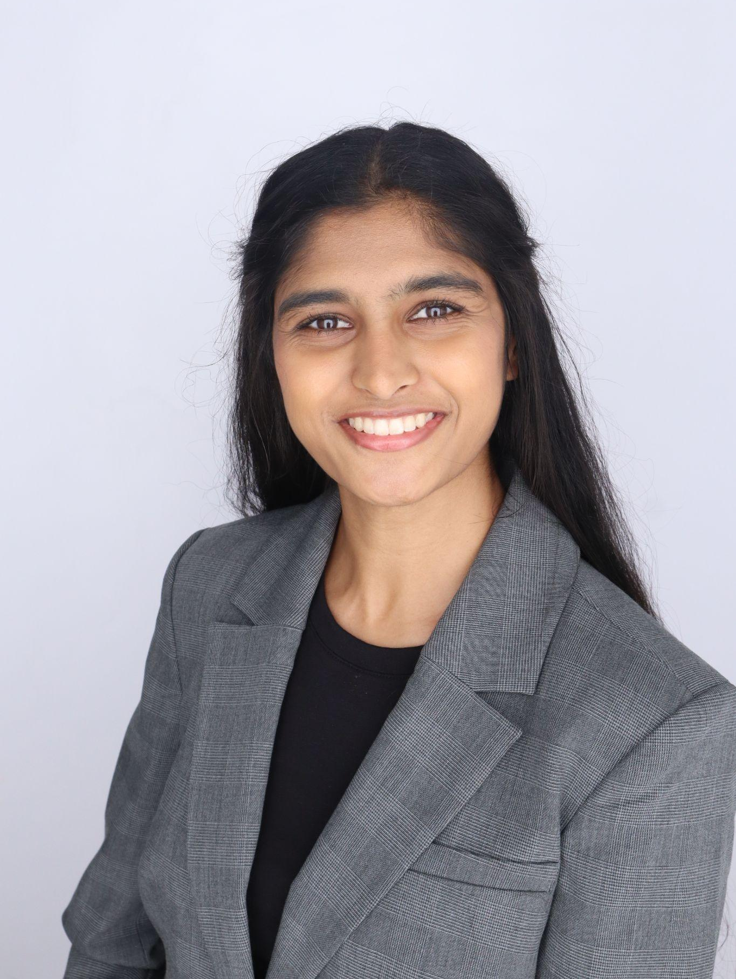

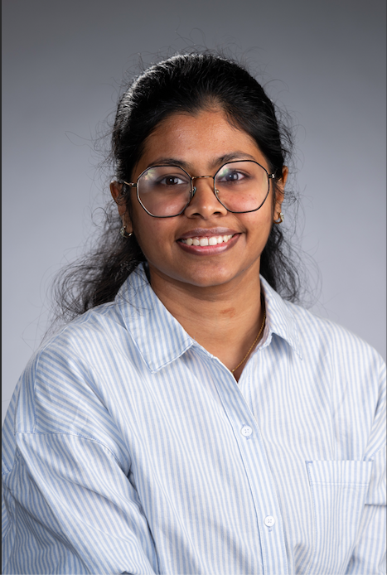


Meet the team:
1
Background
Kinnari Parikh
Neha Tiwari
Niketha Venkatesh
Shriya Karthikeyan
Sahith Mattigunta
2
kparikh3@asu.edu
ntiwar12@asu.edu
nvenka30@asu.edu
skarth28@asu.edu
vmattigu@asu.edu
Proposed Solution
4
Decision Tree & Bayes
5
6
Simulation
Notes:
Big investment, multiple possibilities, unknown impacts => simulate scenarios and get the numbers
Decide based on simulations which scenario provides the best trade-off => Monte Carlo Simulation (Risk Software)

Slide 3
Content
1
Background
2
Problem Statement
3
Proposed Solution
4
Decision Tree & Bayes
5
Analysis & Recommendations
6
Simulations
7
6
Simulation
Analysis & Recommendations
Notes:
Big investment, multiple possibilities, unknown impacts => simulate scenarios and get the numbers
Decide based on simulations which scenario provides the best trade-off => Monte Carlo Simulation (Risk Software)

Slide 4

About GreenFleet
i)
ii)
GreenFleet Motors, a prominent player in the electric vehicle (EV) industry, is in the midst of a pivotal growth phase.
The company is preparing to embark on two high-stakes investment decisions that will shape its long-term position in the global EV market.
Notes:
Big investment, multiple possibilities, unknown impacts => simulate scenarios and get the numbers
Decide based on simulations which scenario provides the best trade-off => Monte Carlo Simulation (Risk Software)

Slide 5
Problem Statement
i)
ii)
Lithium Resource Investment | Demand Prediction for EV manufacturing
GreenFleet acquired exploration rights to a potential lithium deposit in South America. Early assessments: 30% chance of a Rich Site → +$4M 40% chance of Moderate Site → $0 30% chance of Dry Site → –$1.8M Information Gathering: A $300K hydrogeological survey could provide predictive insights. | GreenFleet plans a new EV production facility Capacity: 10K–40K vehicles/year (in 5K steps) Investment to construct facility : $150M per 5K capacity Production cost : $20K/unit Selling price : $35K/unit Risks: Overproduction: Idle capacity Underproduction: Lost sales Demand uncertain Uniformly distributed between 7K–50K units YoY variability: Normally distributed with σ = 2.5K Demand levels correlated: ρ = 0.8
Notes:
Big investment, multiple possibilities, unknown impacts => simulate scenarios and get the numbers
Decide based on simulations which scenario provides the best trade-off => Monte Carlo Simulation (Risk Software)

Slide 6
Proposed Solution
i)
ii)
Lithium Resource Investment | Demand Prediction for EV manufacturing
Objective- Given probabilities and their respective monetary outcomes, decide whether to conduct the survey or not Based on survey results, whether to make the final investments Tool- Decision Tree (Precision Tree Software) | Objective- Given the big investment, multiple possibilities and unknown business impacts simulate the scenarios Balance risks & returns Maximize profit Tool – Monte Carlo Simulation (Risk Software)
Notes:
Big investment, multiple possibilities, unknown impacts => simulate scenarios and get the numbers
Decide based on simulations which scenario provides the best trade-off => Monte Carlo Simulation (Risk Software)

Slide 7
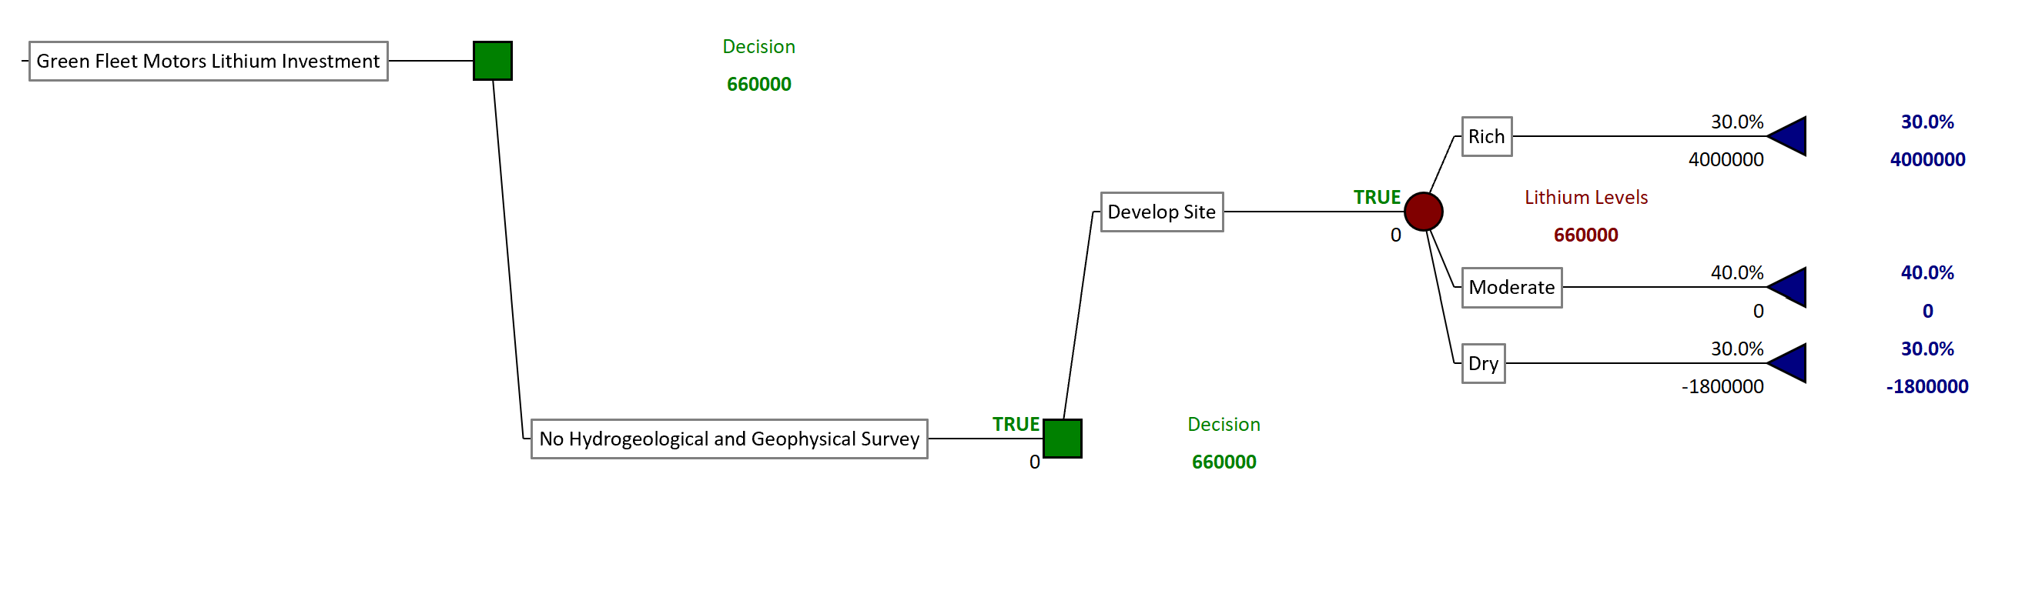
Decision Tree + Bayes
The optimal path based on the expected value of money shows no survey is best in the given conditions.
Notes:
Big investment, multiple possibilities, unknown impacts => simulate scenarios and get the numbers
Decide based on simulations which scenario provides the best trade-off => Monte Carlo Simulation (Risk Software)

Slide 8
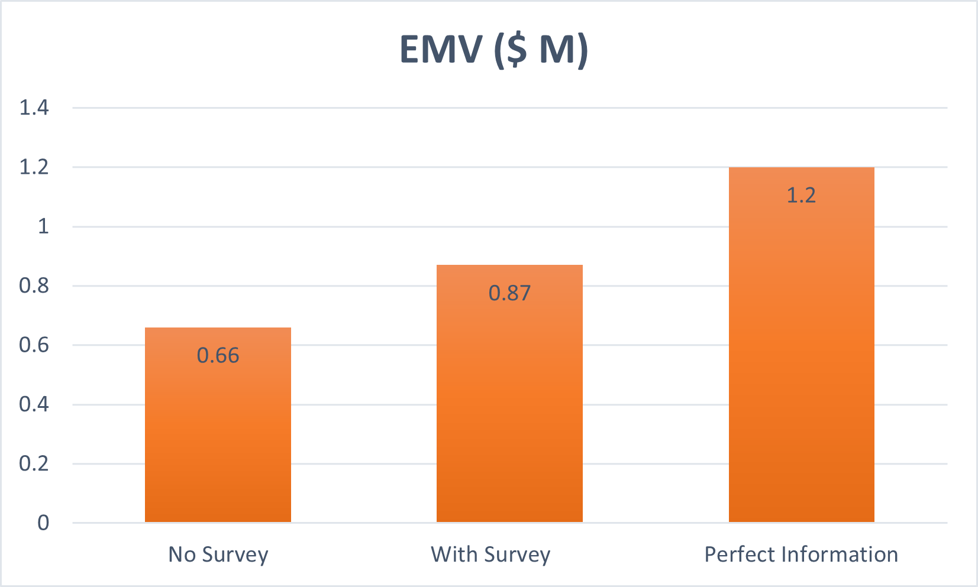
Findings
• Compared two options: invest directly vs. conduct survey first
• Survey cost: $0.3 M , Accuracy: 70–75 %
• Site outcomes: Rich (0.3) , Moderate (0.4) , Dry (0.3)
• Financial payoffs ($ M): Rich 4.0 , Moderate 0, Dry –1.8
Survey adds ≈ $0.21 M in expected value — about 40 % of perfect-information gain.
Notes:
Big investment, multiple possibilities, unknown impacts => simulate scenarios and get the numbers
Decide based on simulations which scenario provides the best trade-off => Monte Carlo Simulation (Risk Software)

Slide 9
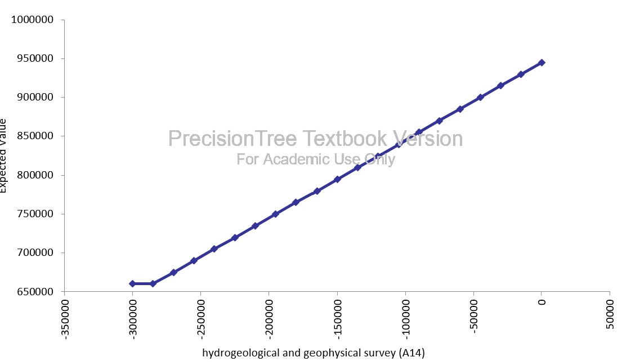
Sensitivity Analysis
• Tested impact of key assumptions
Varied hydrogeological survey cost from –$300 K to 0 to see how profitability changed.
Expected value rose steadily from ≈ $0.65 M to $0.95 M as survey cost decreased or accuracy improved.
• Explored best-case, worst-case, and most-likely scenarios
Found that once survey cost drops below $285 K, the project’s expected value starts to increase , making the survey financially worthwhile.
• Identified most influential driver
Survey accuracy and cost are the most influential factors; improving these parameters can raise project value by ≈ $0.3 M (≈ 45 % gain).
Sensitivity of survey cost
Notes:
Big investment, multiple possibilities, unknown impacts => simulate scenarios and get the numbers
Decide based on simulations which scenario provides the best trade-off => Monte Carlo Simulation (Risk Software)

Slide 10
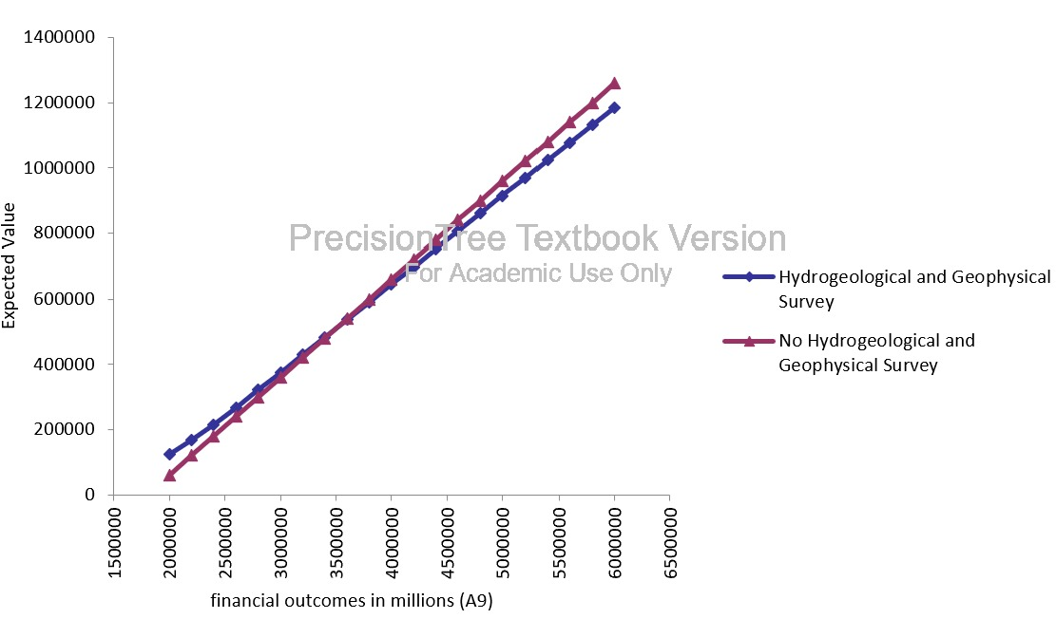
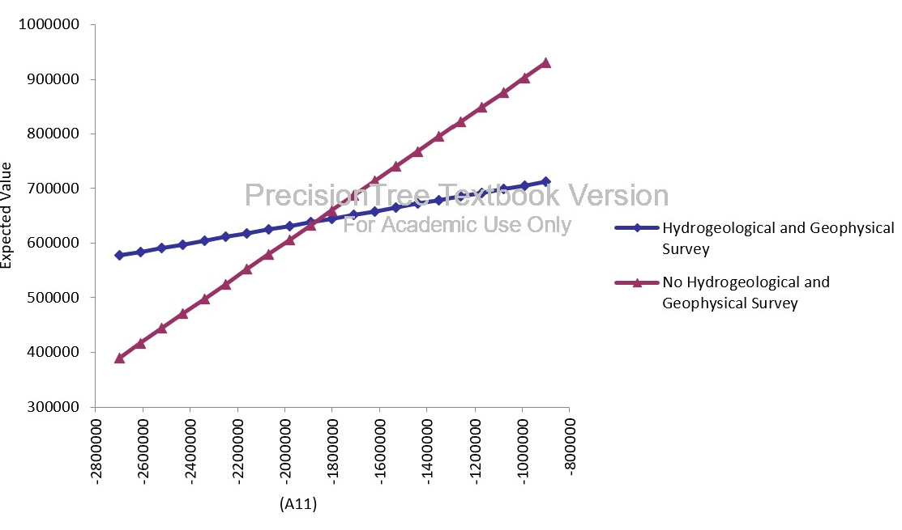
Constrained Recommendations
Sensitivity (change) | Survey | No Survey
Probability of rich sites | never | always
Payoff of rich sites | Payoff < $350,000 | Payoff > $350,000
Loss cost of dry sites | Loss cost < -$1,890,000 | Loss cost > -$1,800,000
Cost of Survey | Cost < $285,000 | Cost > $285,000
Sensitivity of rich site payoffs
Sensitivity of dry site loss costs
Notes:
Big investment, multiple possibilities, unknown impacts => simulate scenarios and get the numbers
Decide based on simulations which scenario provides the best trade-off => Monte Carlo Simulation (Risk Software)

Slide 11
Recommendations
Main Decision Rule:
$ 285,000 is the expected investment if a survey is done. Do Not Survey if cost exceeds $285,000.
Key Trade-offs:
Aspect | Insight
Benefit | Avoids large financial loss when probability of a dry site or high loss risk is significant.
Risk | Adds $ 0.3 – $ 0.6 M cost and survey predictions are imperfect (~25 % error margin).
Trade-off | Worth implementing only when downside risk dominates potential profit gain.
Next Steps:
Monitor P(Rich) as new geological data becomes available.
Conduct a smaller pilot survey to validate accuracy and refine Bayesian inputs.
Apply the same risk-analysis framework to Part II (EV capacity planning) via Monte Carlo simulation).
Notes:
Big investment, multiple possibilities, unknown impacts => simulate scenarios and get the numbers
Decide based on simulations which scenario provides the best trade-off => Monte Carlo Simulation (Risk Software)

Slide 12
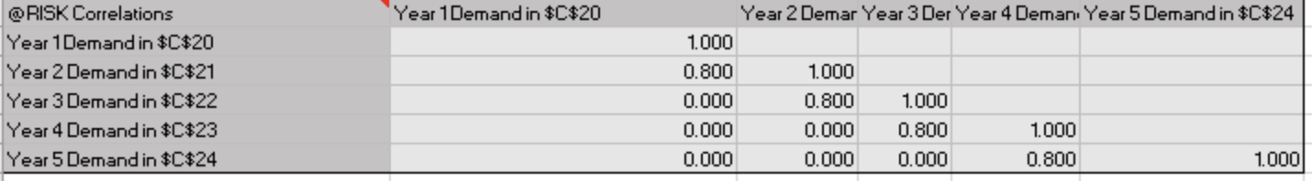
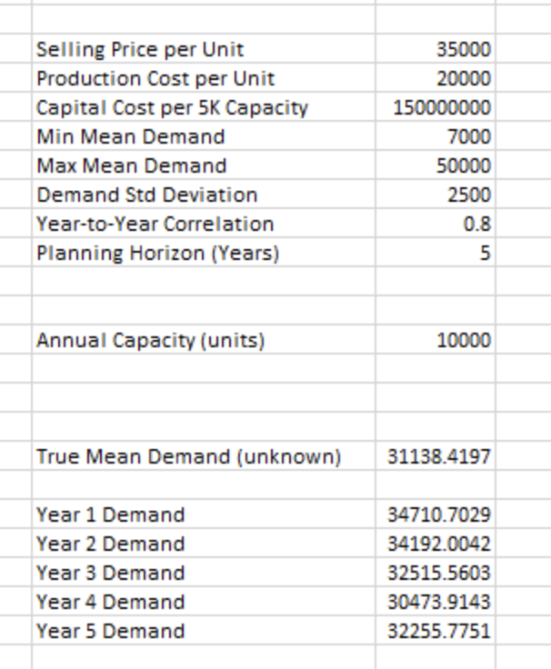
Using Risk Simulation – Simulation Model Setup
Decision Variable :
Annual production capacity: 10,000 to 40,000 units
RiskSimTable function tests all capacity levels simultaneously
Uncertain Variables :
Unknown Mean Demand: Uniform distribution (7,000 - 50,000 units)
Annual Demand: Normal distribution with unknown mean & SD = 2,500 units
5-year planning horizon with correlated demand across years
Correlation Structure :
Year-to-year correlation: 0.80 (consecutive years only)
Parameters :
Selling price: $35,000/unit | Production cost: $20,000/unit
Capital cost: $150M per 5,000-unit capacity increment
Margin: $15,000 per unit sold
Notes:
Big investment, multiple possibilities, unknown impacts => simulate scenarios and get the numbers
Decide based on simulations which scenario provides the best trade-off => Monte Carlo Simulation (Risk Software)

Slide 13
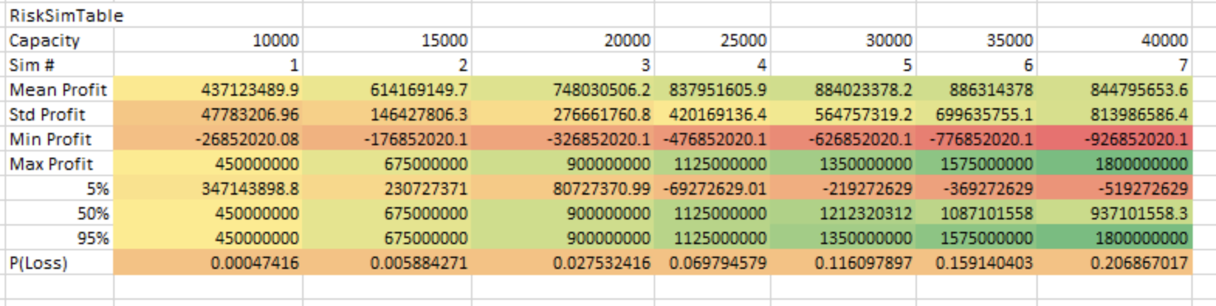
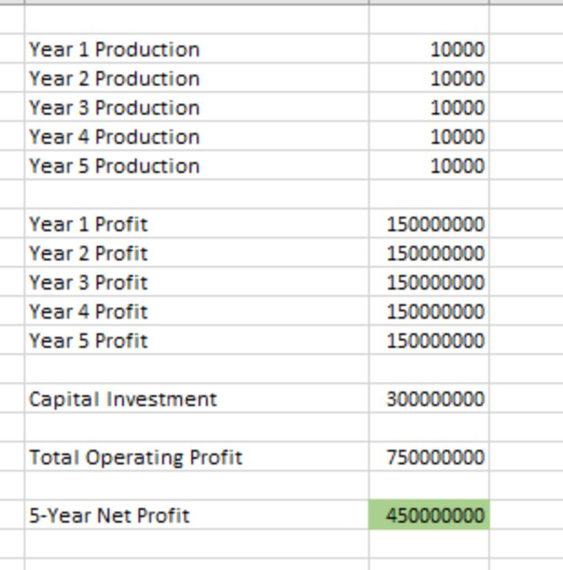
Using Risk Simulation – Simulation Execution and Results
Simulation Configuration:
5000 iterations per capacity
7 simulations
Used Monte Carlo sampling with correlation
Model Logic:
Production = MIN( capacity, Actual Demand) each year
Annual Profit = Units produced * $15000 margin
Net Profit = Total 5-year Profit – Capital Investment
Output Metrics Tracked :
Mean Profit, SD, 5th/50th/95th Percentiles, Probability of loss, Min/Max profit
Key Simulation Insights:
Optimal Capacity: 30000 units – with highest mean profit - $884M
Trade-off: Higher Capacity = Higher Potential but greater Risk
P(Loss) increases from 0.05% to 20.7%
Notes:
Big investment, multiple possibilities, unknown impacts => simulate scenarios and get the numbers
Decide based on simulations which scenario provides the best trade-off => Monte Carlo Simulation (Risk Software)

Slide 14
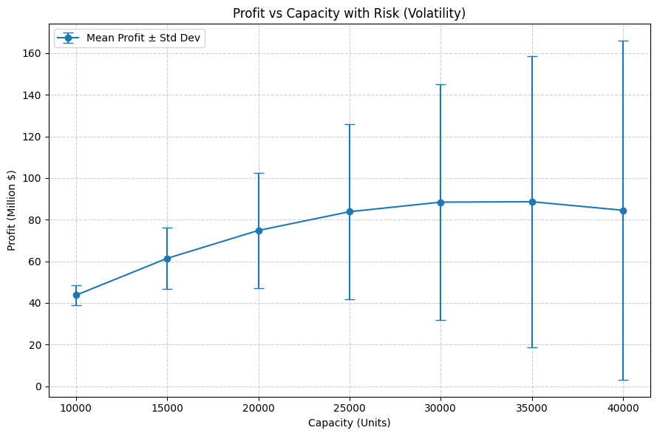
Findings: Profit vs Capacity
Capacity 30,000 and upwards the increase in profit expected becomes marginal and flattens.
Notes:
Big investment, multiple possibilities, unknown impacts => simulate scenarios and get the numbers
Decide based on simulations which scenario provides the best trade-off => Monte Carlo Simulation (Risk Software)

Slide 15
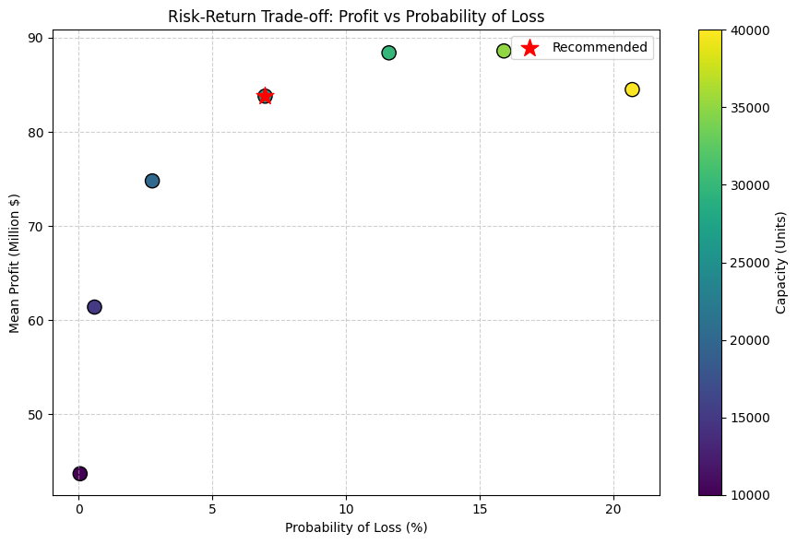
Findings: Probability of Loss
Higher capacity increases the potential profit expected but also increases loss probability
Notes:
Big investment, multiple possibilities, unknown impacts => simulate scenarios and get the numbers
Decide based on simulations which scenario provides the best trade-off => Monte Carlo Simulation (Risk Software)

Slide 16
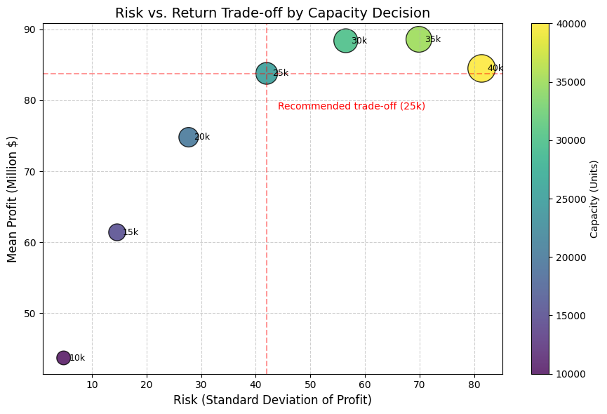
Findings: Volatility of Profit Expected
Optimal Profit – Risk trade-off is achieved by 25K capacity decision
Notes:
Big investment, multiple possibilities, unknown impacts => simulate scenarios and get the numbers
Decide based on simulations which scenario provides the best trade-off => Monte Carlo Simulation (Risk Software)

Slide 17
Recommendations
Strongly suggest moving forward with 25,000-unit capacity.
It demonstrates strong profitability with only 7% loss probability
Balances growth potential and financial risk in volatile demand conditions.
Future capacity expansions can be explored if strong demand sustains.
Delivers the strongest alignment with GreenFleet’s conservative risk averse position by maximizing return within moderate risk limits
Notes:
Big investment, multiple possibilities, unknown impacts => simulate scenarios and get the numbers
Decide based on simulations which scenario provides the best trade-off => Monte Carlo Simulation (Risk Software)

Slide 18
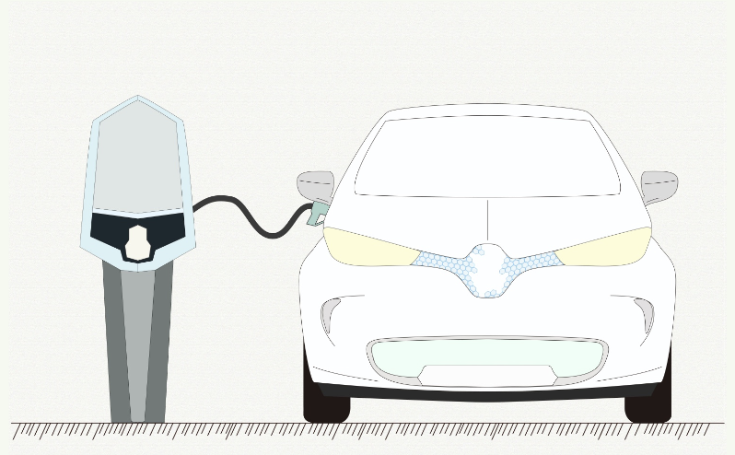
Questions
Notes:
Big investment, multiple possibilities, unknown impacts => simulate scenarios and get the numbers
Decide based on simulations which scenario provides the best trade-off => Monte Carlo Simulation (Risk Software)

Slide 19
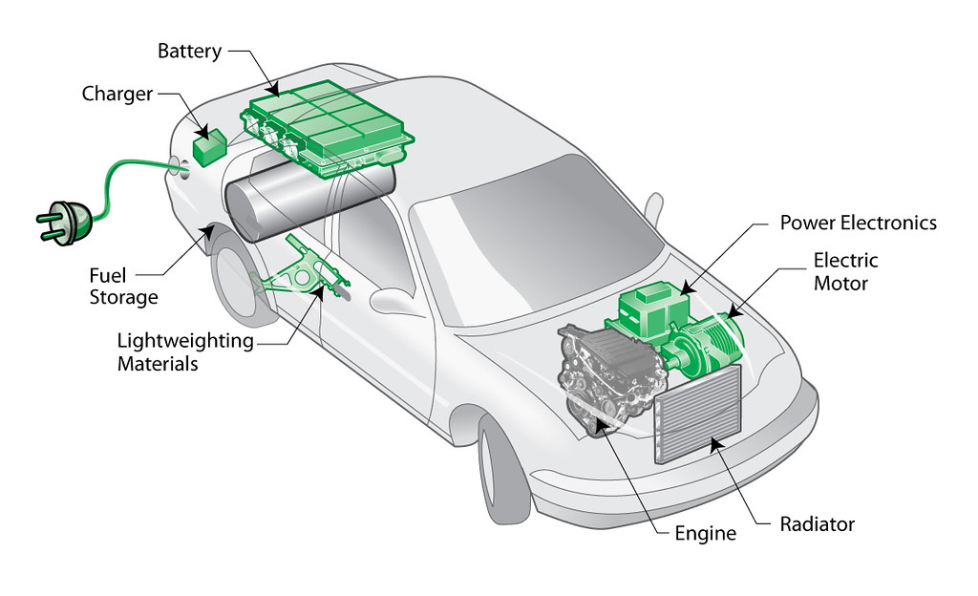
Thank you
ThePhoto by PhotoAuthor is licensed under CCYYSA.
Notes:
Big investment, multiple possibilities, unknown impacts => simulate scenarios and get the numbers
Decide based on simulations which scenario provides the best trade-off => Monte Carlo Simulation (Risk Software)

