Slide 1
IBM WebSphere Application Server V8.5.5
Tomcat Config Migration Tech Preview
Notes:
Template_FFW_IEA_STE.ppt
Page <number> of 12
This presentation describes the new Tomcat Config Migration Tech Preview which migrates configuration to IBM WebSphere Application Server V8.5.5 Liberty Profile.

Slide 2
Overview for Tomcat Config Migration Tech Preview
Migrates a subset of the Apache Tomcat server configuration and application configuration to the WebSphere Application Server Liberty profile
Generates server configuration files that are added to an existing Liberty server using the include configuration element
Note: The application itself should be migrated using the WebSphere Application Migration Tool – Apache Tomcat to WebSphere (WAMT) before migrating its configuration
Tomcat
Server
Tomcat
App
WAMT
Tomcat Config
Migration
Tech Preview
WebSphere
Application
Server V8.5.5
Liberty profile
Tomcat Config Migration Tech Preview
Notes:
Template_FFW_IEA_STE.ppt
Page <number> of 12
The Tomcat Config Migration Tech Preview migrates a subset of the Apache Tomcat server configuration and application configuration to the WebSphere Application Server Liberty profile.
The generated server configuration files are added to an existing Liberty server using the include configuration element. All the generated files are located in the specified Liberty server in a newly created migratedConfig directory.
The application itself needs to be migrated using the WebSphere Application Migration Toolkit (WAMT) before migrating its configuration and deploying on the WebSphere Application Server Liberty profile.
The Tech Preview is supported for Apache Tomcat 7, and WebSphere Application Server V8.5.5 Liberty profile.

Slide 3
Usage Scenarios
I want tools to help me migrate my existing Tomcat server configuration to Liberty so that I can more reliably and easily move to WebSphere Application Server Liberty Profile.
I want tools to help me migrate configuration in my applications to Liberty so that I can more reliably and easily move to WebSphere Application Server Liberty Profile.
Tomcat Config Migration Tech Preview
Notes:
Template_FFW_IEA_STE.ppt
Page <number> of 12
Additional information: Applications can depend on configuration located in the application web.xml and context.xml, as well as configuration located in the server.xml and context.xml on the Tomcat server. This Tech Preview migrates a subset of that configuration to the Liberty profile.

Slide 4
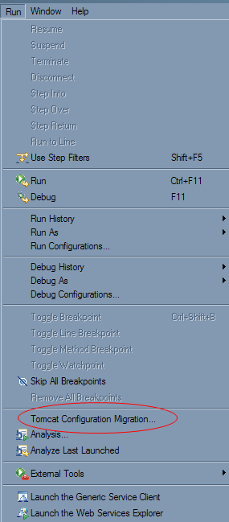
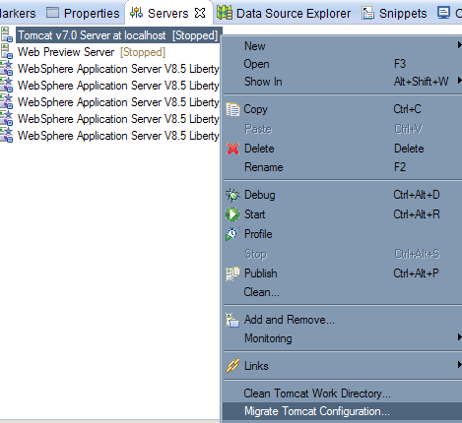
Migrating Tomcat server configuration – three options
1
2
Tomcat Config Migration Tech Preview
Notes:
Template_FFW_IEA_STE.ppt
Page <number> of 12
There are three ways to migrate the Tomcat server configuration using the Tomcat Config Migration Tech Preview.
Through the Run menu, select Tomcat Configuration Migration… and browse to the location of the Tomcat server installation on the file system
In the Servers view, select the Tomcat server and right click to select Migrate Tomcat Configuration…
In the Package Explorer, select the Tomcat server and right click to select Migrate Tomcat Configuration…

Slide 5
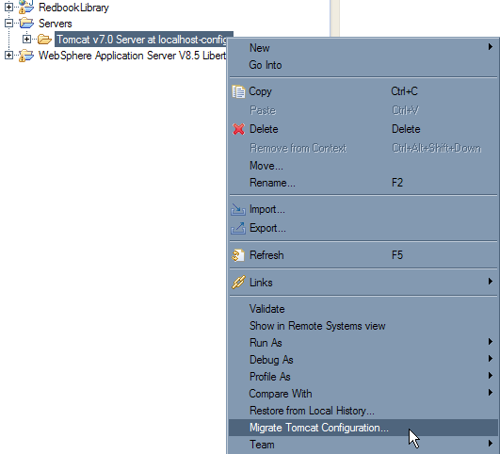
Migrating Tomcat server configuration
3
Tomcat Config Migration Tech Preview
Notes:
Template_FFW_IEA_STE.ppt
Page <number> of 12
There are three ways to migrate the Tomcat server configuration using the Tomcat Config Migration Tech Preview.
Through the Run menu, select Tomcat Configuration Migration… and browse to the location of the Tomcat server installation on the file system
In the Servers view, select the Tomcat server and right click to select Migrate Tomcat Configuration…
In the Package Explorer, select the Tomcat server and right click to select Migrate Tomcat Configuration…

Slide 6
Details on Migrated Configuration Files (Server)
Tomcat
Server
WebSphere Application
Server V8.5.5 Liberty profile
conf / server.xml
migratedConfig / server.xml
Tomcat Config
Migration
Tech Preview
conf / context.xml
migratedConfig / context.xml
conf / tomcat-users.xml
migratedConfig /
users-and-roles.xml
Tomcat Config Migration Tech Preview
Notes:
Template_FFW_IEA_STE.ppt
Page <number> of 12
The left side shows the location of the configuration files in the Tomcat server. The right side shows where the corresponding migrated configuration is located in the target Liberty profile server. The migration has a one to one correspondence for the migrated files.

Slide 7
Details on Migrated Configuration Files (Server)
WebSphere Application
Server V8.5.5 Liberty profile
server.xml
<include…>
migratedConfig / server.xml
migratedConfig /
server-updates-for-config.xml
<include…>
migratedConfig / context.xml
migratedConfig /
users-and-roles.xml
Tomcat Config Migration Tech Preview
Notes:
Template_FFW_IEA_STE.ppt
Page <number> of 12
The three generated files on the right are included in the generated server-updates-for-config.xml using the include configuration element. The server-updates-for-config.xml is included in the server.xml using the include configuration element.
Not shown on the slide are two additional files on the Liberty server – a copy of the original Liberty server.xml called server.xml.original, and a log with details about the migration called configMigration.log.

Slide 8
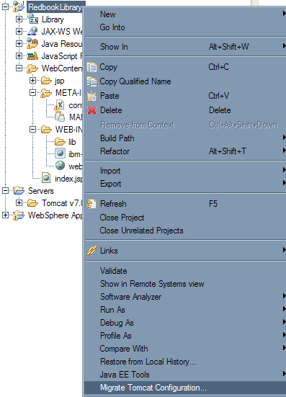
Migrating application configuration
Tomcat Config Migration Tech Preview
Notes:
Template_FFW_IEA_STE.ppt
Page <number> of 12
There is one way to migrate the application configuration using the Tomcat Config Migration Tech Preview.
In the Package Explorer, select the application and right click to select Migrate Tomcat Configuration…

Slide 9
Details on Migrated Configuration Files (Application)
Tomcat
Application
WebSphere Application
Server V8.5.5 Liberty profile
<application-name> /
META-INF / context.xml
Tomcat Config
Migration
Tech Preview
migratedConfig / <application-name> /
application-config-context.xml
<application-name> /
WEB-INF / web.xml
migratedConfig / <application-name> /
application-config-web.xml
Tomcat Config Migration Tech Preview
Notes:
Template_FFW_IEA_STE.ppt
Page <number> of 12
The left side shows the location of the configuration files in the application. The right side shows where the corresponding migrated configuration is located in the target Liberty profile server. The migration has a one to one correspondence for the migrated files.

Slide 10
Details on Migrated Configuration Files (Application)
WebSphere Application
Server v8.5.5 Liberty profile
server.xml
<include…>
migratedConfig / <application-name> /
application-config-context.xml
migratedConfig / <application-name> /
server-updates-for-application.xml
<include…>
migratedConfig / <application-name> /
application-config-web.xml
Tomcat Config Migration Tech Preview
Notes:
Template_FFW_IEA_STE.ppt
Page <number> of 12
The two generated files on the right are included in the generated server-updates-for-application.xml using the include configuration element. The server-updates-for-application.xml file is included in the server.xml using the include configuration element.
Not shown on the slide are two additional files on the Liberty server – a copy of the original Liberty server.xml called server.xml.original, and a log with details about the migration called configMigration.log.

Slide 11
Details on Migrated Configuration Elements
The following configuration elements are migrated:
  Tomcat users and roles from conf/tomcat-users.xml
  HTTP/1.1 Connectors from conf/server.xml
  Standard Manager from conf/context.xml
  Resource configuration for Apache Derby and IBM DB2 from conf/server.xml, conf/context.xml, and application META-INF/context.xml
  Resource configuration for IBM WebSphere MQ and Apache ActiveMQ from conf/server.xml, conf/context.xml, and application META-INF/context.xml
  Application security constraints from application WEB-INF/web.xml
Tomcat Config Migration Tech Preview
Notes:
Template_FFW_IEA_STE.ppt
Page <number> of 12
This is a list of the configuration elements that are currently migrated. We can look in more detail during the demonstration.

Slide 12
Demonstration
Section
Tomcat Config Migration Tech Preview
Notes:
Template_FFW_IEA_STE.ppt
Page <number> of 12
Now I will demonstrate migrating the configuration for the RedbookLibrary application introduced in the Redbook WebSphere Application Server V8.5 Migration Guide. Instructions for downloading the application are included in the Redbook, which is included in the references section at the end of this presentation.

Slide 13
Summary
Section
Tomcat Config Migration Tech Preview
Notes:
Template_FFW_IEA_STE.ppt
Page <number> of 12
To recap,..

Slide 14
Summary
WebSphere Application Migration Tool – Apache Tomcat to WebSphere
  Migrate the application
Tomcat Config Migration Tech Preview
  Migrate the Tomcat server configuration
  Migrate the application configuration
The migrated configuration is contained in a new migratedConfig directory in the Liberty server
The include configuration element is used to add the migrated configuration to the Liberty server
Tomcat Config Migration Tech Preview
Notes:
Template_FFW_IEA_STE.ppt
Page <number> of 12
Use WAMT to migrate the application itself.
Use the Tech Preview to migrate the Tomcat server configuration.
Then use the Tech Preview to migrate the configuration of one or more applications.
The migrated configuration is all contained in the migratedConfig directory and is added to the Liberty profile server using the include configuration element. The applications are published on the Liberty server as part of the migration.

Slide 15
References
WebSphere Application Server V8.5 Migration Guide – Redbook SG248048
http://www.redbooks.ibm.com/redbooks/pdfs/sg248048.pdf
WASdev Community
http://wasdev.net
Tomcat Config Migration Tech Preview – learn about, download, and PDF documentation
https://www.ibmdw.net/wasdev/docs/learn_wamt_tomcat_config_tp/
WebSphere Application Server Developer Tools for Eclipse Juno V8.5.5
https://www.ibmdw.net/wasdev/downloads/websphere-application-server-developer-tools-v8-5-5/
WebSphere Application Server V8.5.5 Liberty Profile
https://www.ibmdw.net/wasdev/downloads/websphere-application-server-liberty-profile/
WebSphere Application Server Migration Tool – Apache Tomcat to WebSphere
https://www.ibmdw.net/wasdev/downloads/websphere-application-server-migration-tools-v3-5/
Application Migration Tool Forum
https://www.ibm.com/developerworks/community/forums/html/forum?id=11111111-0000-0000-0000-000000002106
developerWorks article “Migrating from Apache Tomcat to the WebSphere Application Server Liberty Profile”
http://www.ibm.com/developerworks/websphere/library/techarticles/1306_king/1306_king.html
Tomcat Config Migration Tech Preview
Notes:
Template_FFW_IEA_STE.ppt
Page <number> of 12
See the following references for additional information about Tomcat Config Migration Tech Preview and other tools and documents referenced in this presentation.

