Slide 1
MYSTICNDT
Field Inspection &
Certification
One digital flow for South African NDT workshops — assign, inspect, supervise, L3 certify, deliver.
Demo tenant: Apex NDT & Engineering Services (Pty) Ltd
Product demo for owners · ops managers · quality leads

Slide 2
THE PROBLEM
Paper, WhatsApp, and surprise expiry days.
Jobs live in notebooks and chat threads
Status is tribal knowledge. Nobody sees open vs awaiting L3 vs delivered in one place.
Cert and cal surprises hit at the gate
Expired method certs, vision, or instrument cal only appear when a client or auditor asks.
L3 release is the bottleneck
Reports stall waiting for photos, signatures, and a clear approve / reject path.
MysticNDT · Apex NDT demo · Confidential
2 / 16

Slide 3
THE PROMISE
One flow: assign → inspect → supervise → L3 certify → deliver.
Ops plans with compliance built in
Method-matched people and equipment. Blocked assign when certs, vision, or cal are not valid.
Field evidence stays on the job
Readings, defects, and photos travel with the report — not in a separate photo album.
L3 signs once, client gets the certificate
Queue, review, approve or reject, digital sign-off, PDF path ready for dispatch.
MysticNDT · Apex NDT demo · Confidential
3 / 16

Slide 4
DEMO CAST
Four roles. One continuous job lifecycle.
Admin
Lesego (L1)
Thabo (L2)
Johan (L3)
Ops / planner
Field technician
Supervisor
Technical authority
Jobs, customers, equipment, dispatch, renewals
Assigned work, readings, photos, submit
Evaluate findings, complete & sign
QA review, certify, release report
MysticNDT · Apex NDT demo · Confidential
4 / 16

Slide 5
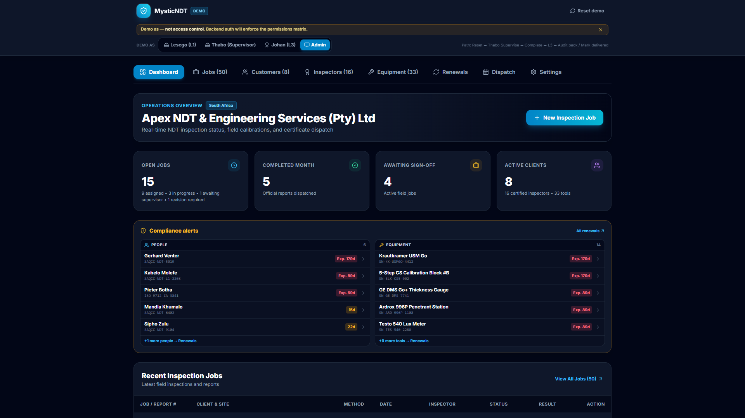
ADMIN · OPERATIONS
Live ops overview — not a static board.
Open jobs, renewals, and active clients at a glance — SAQCC / ISO language.
MysticNDT · Apex NDT demo · Confidential
5 / 16

Slide 6
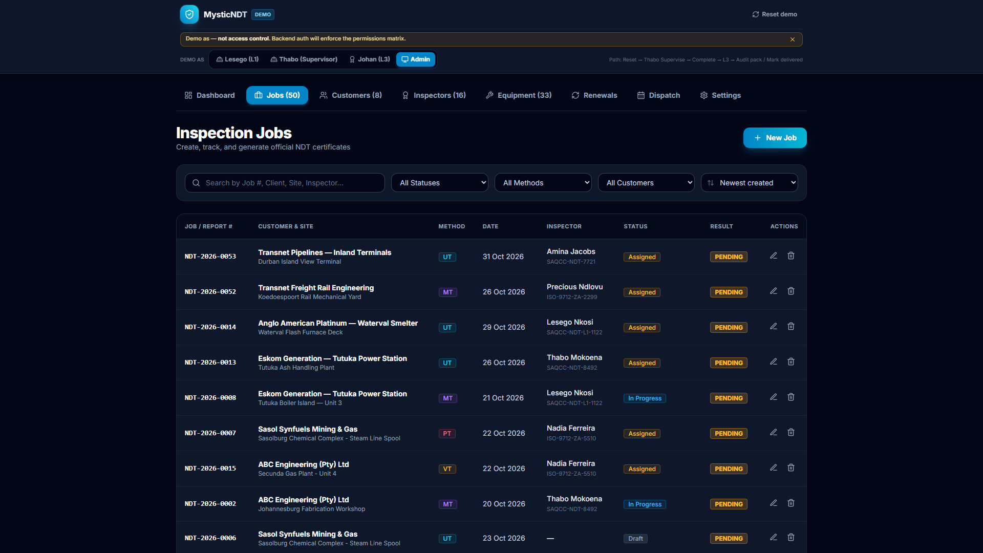
ADMIN · JOBS
Fifty jobs. Filterable. Sortable. Ownable.
Status, method, customer, and sort — UT / MT / PT / VT colour-coded.
MysticNDT · Apex NDT demo · Confidential
6 / 16

Slide 7
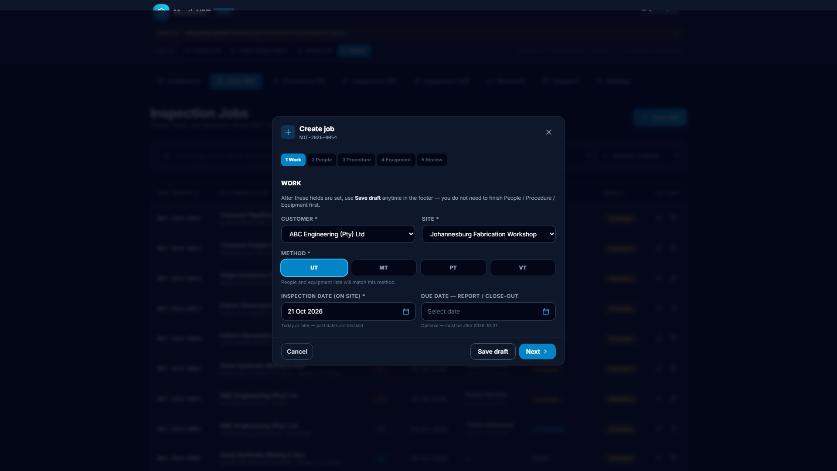
ADMIN · CREATE JOB
A guided wizard that sets the job up right.
Work → People → Procedure → Equipment → Review. Method drives eligibility.
MysticNDT · Apex NDT demo · Confidential
7 / 16

Slide 8
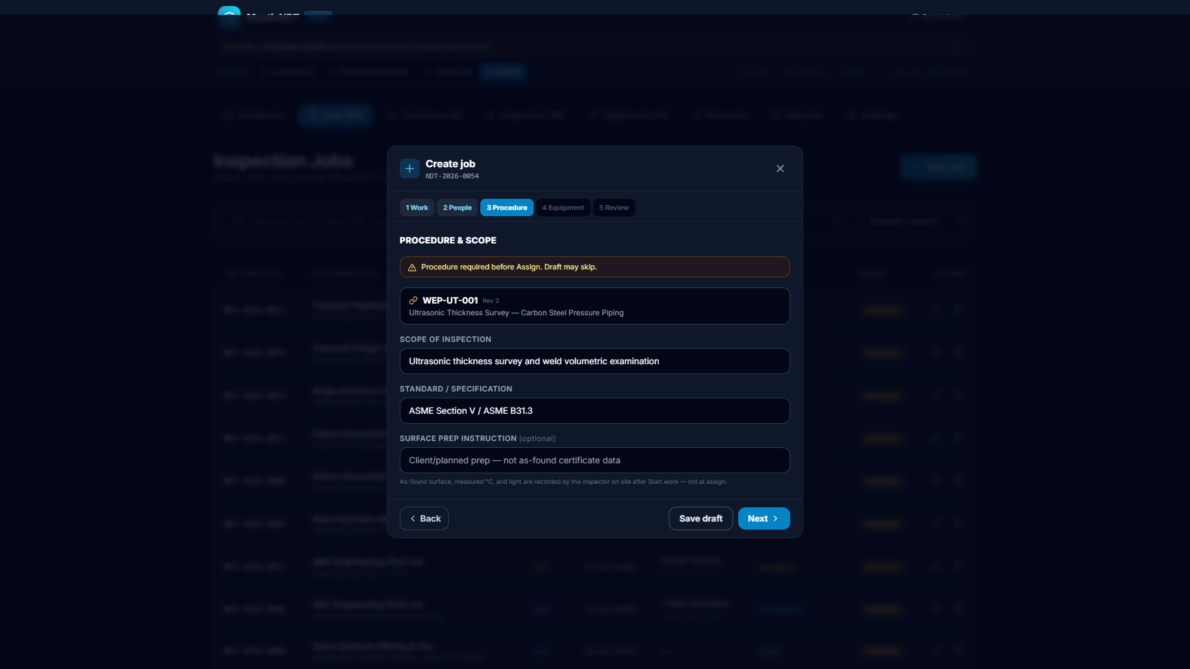
COMPLIANCE GATES
Expired certs never leave the yard.
Blocked assign for expired method cert, near-vision, or pending verification.
MysticNDT · Apex NDT demo · Confidential
8 / 16

Slide 9
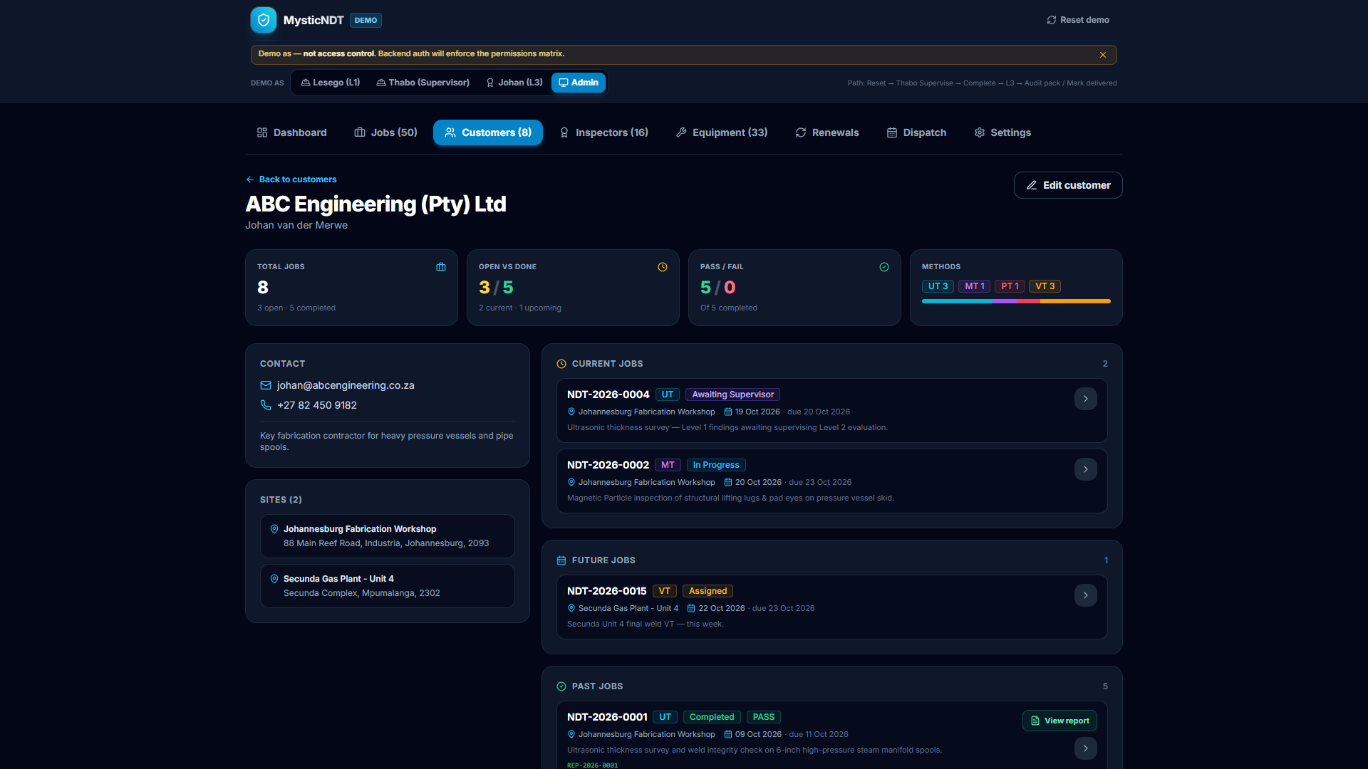
CUSTOMER INTELLIGENCE
Client history that sales and QA both use.
Past / current / future jobs, pass–fail stats, and View report on completed work.
MysticNDT · Apex NDT demo · Confidential
9 / 16

Slide 10
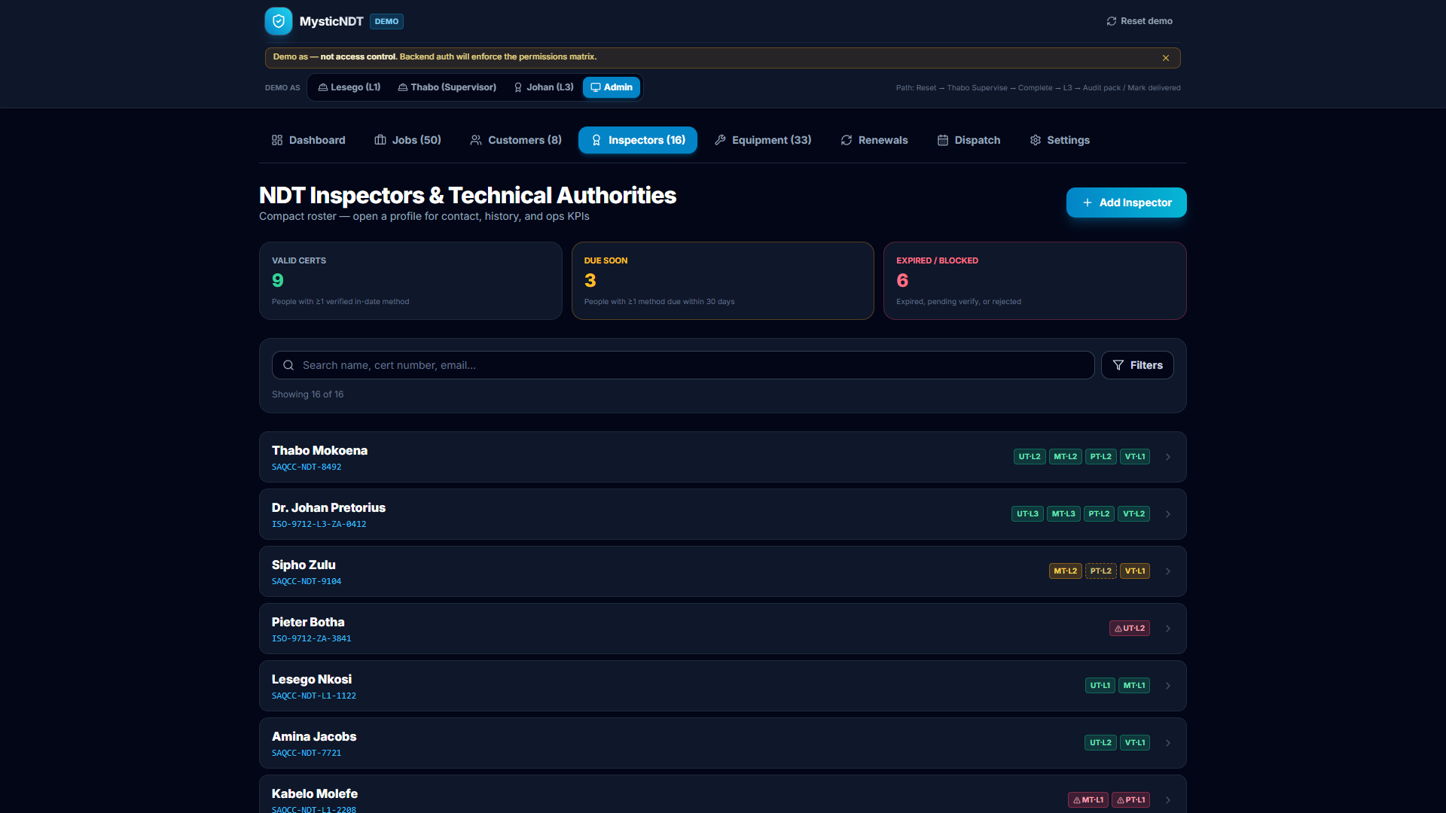
PEOPLE & RENEWALS
Roster health in seconds.
Valid · due soon · expired/blocked — filter by method, cert status, and level.
MysticNDT · Apex NDT demo · Confidential
10 / 16

Slide 11
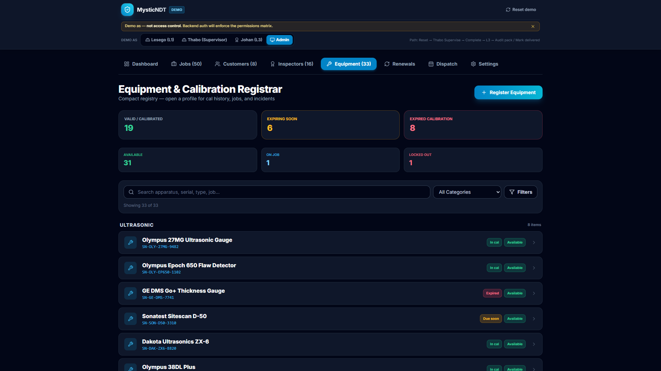
EQUIPMENT
On job vs available — with cal truth.
In cal, due soon, expired — Available, On Job, Locked Out before kit leaves store.
MysticNDT · Apex NDT demo · Confidential
11 / 16

Slide 12
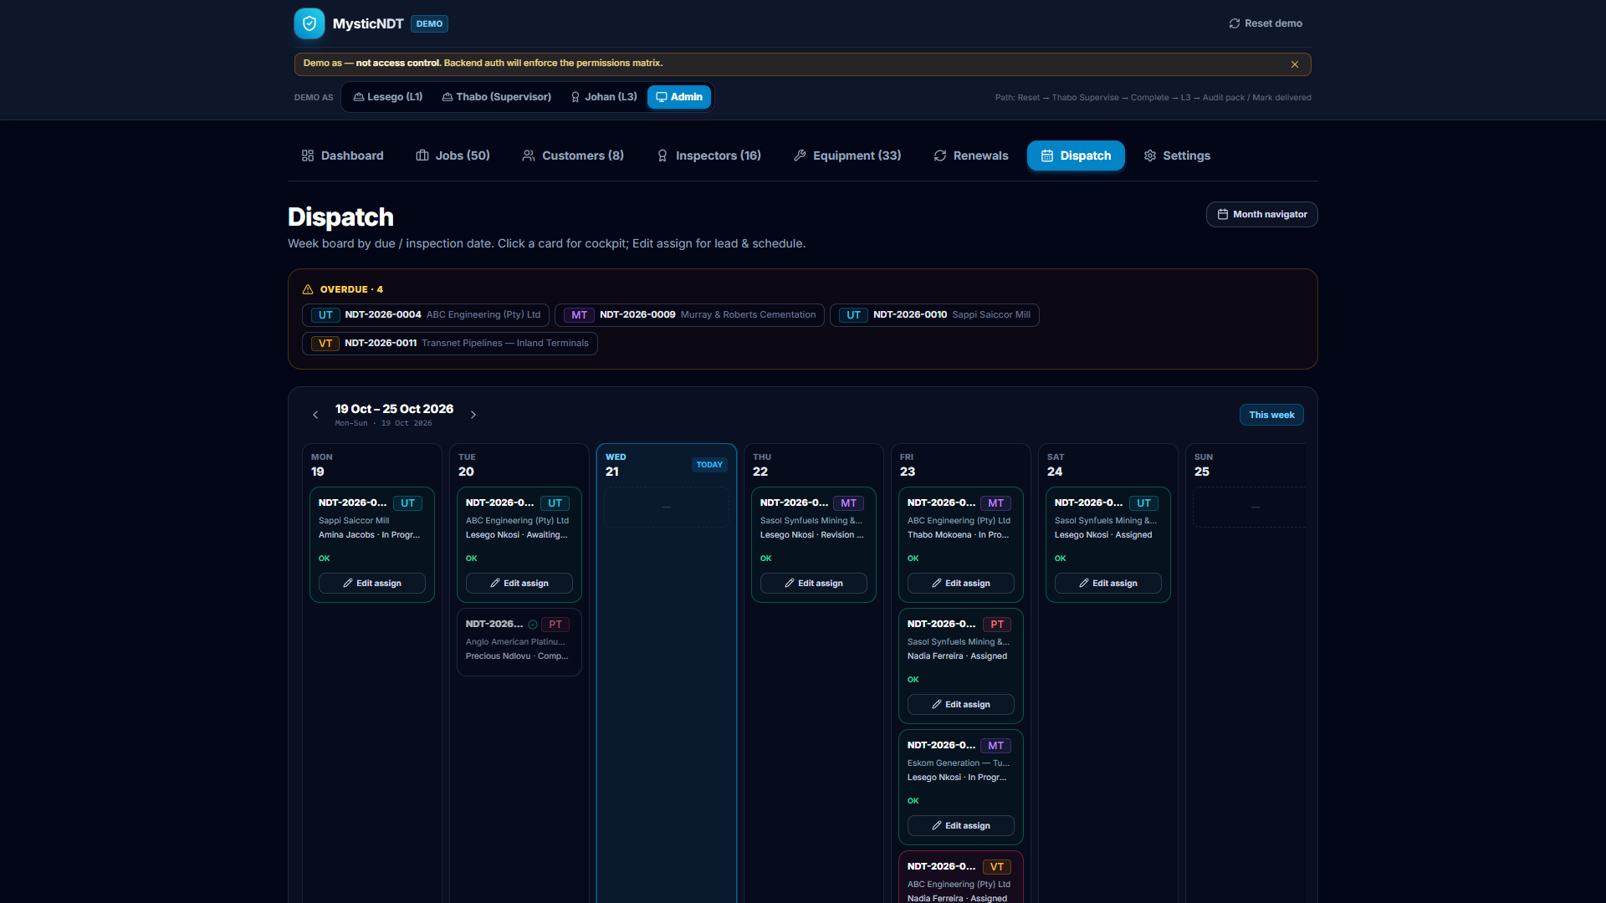
DISPATCH
The week on a calendar, not a whiteboard photo.
Month view by inspection / due date; eligibility colours keep risk visible.
MysticNDT · Apex NDT demo · Confidential
12 / 16

Slide 13
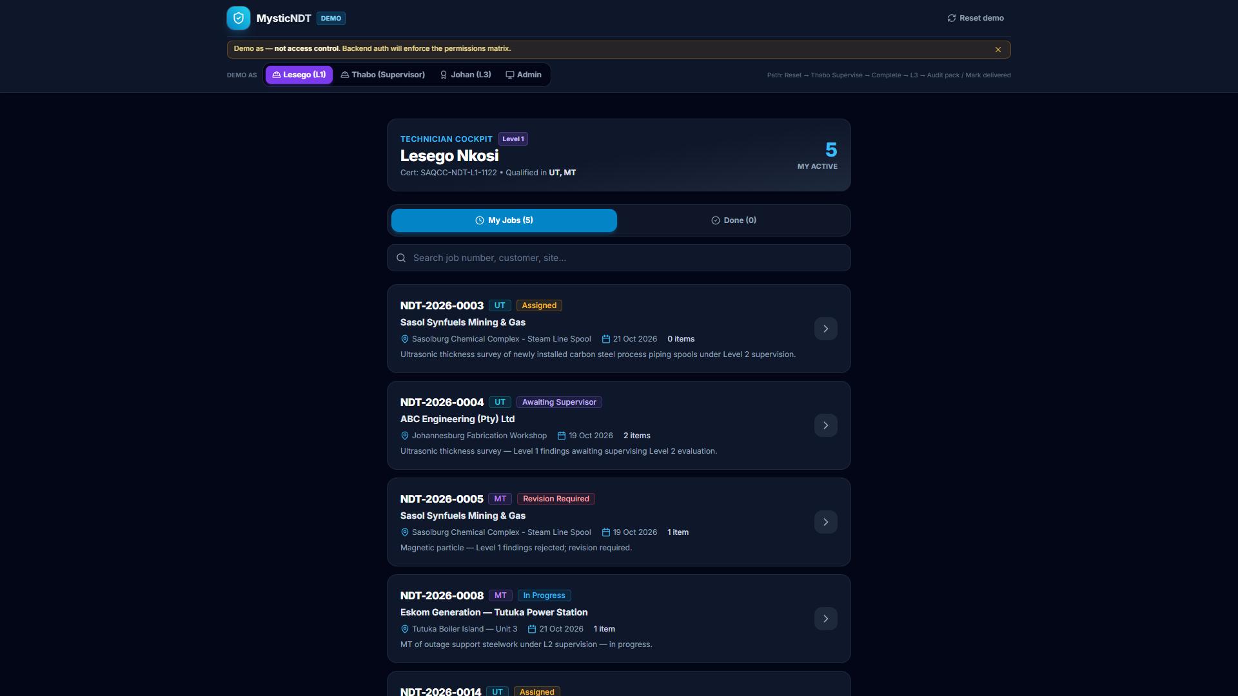
TECHNICIAN · LESEGO
Field cockpit: my jobs, my status.
Assigned, in progress, awaiting supervisor, revision required — tablet-ready.
MysticNDT · Apex NDT demo · Confidential
13 / 16

Slide 14
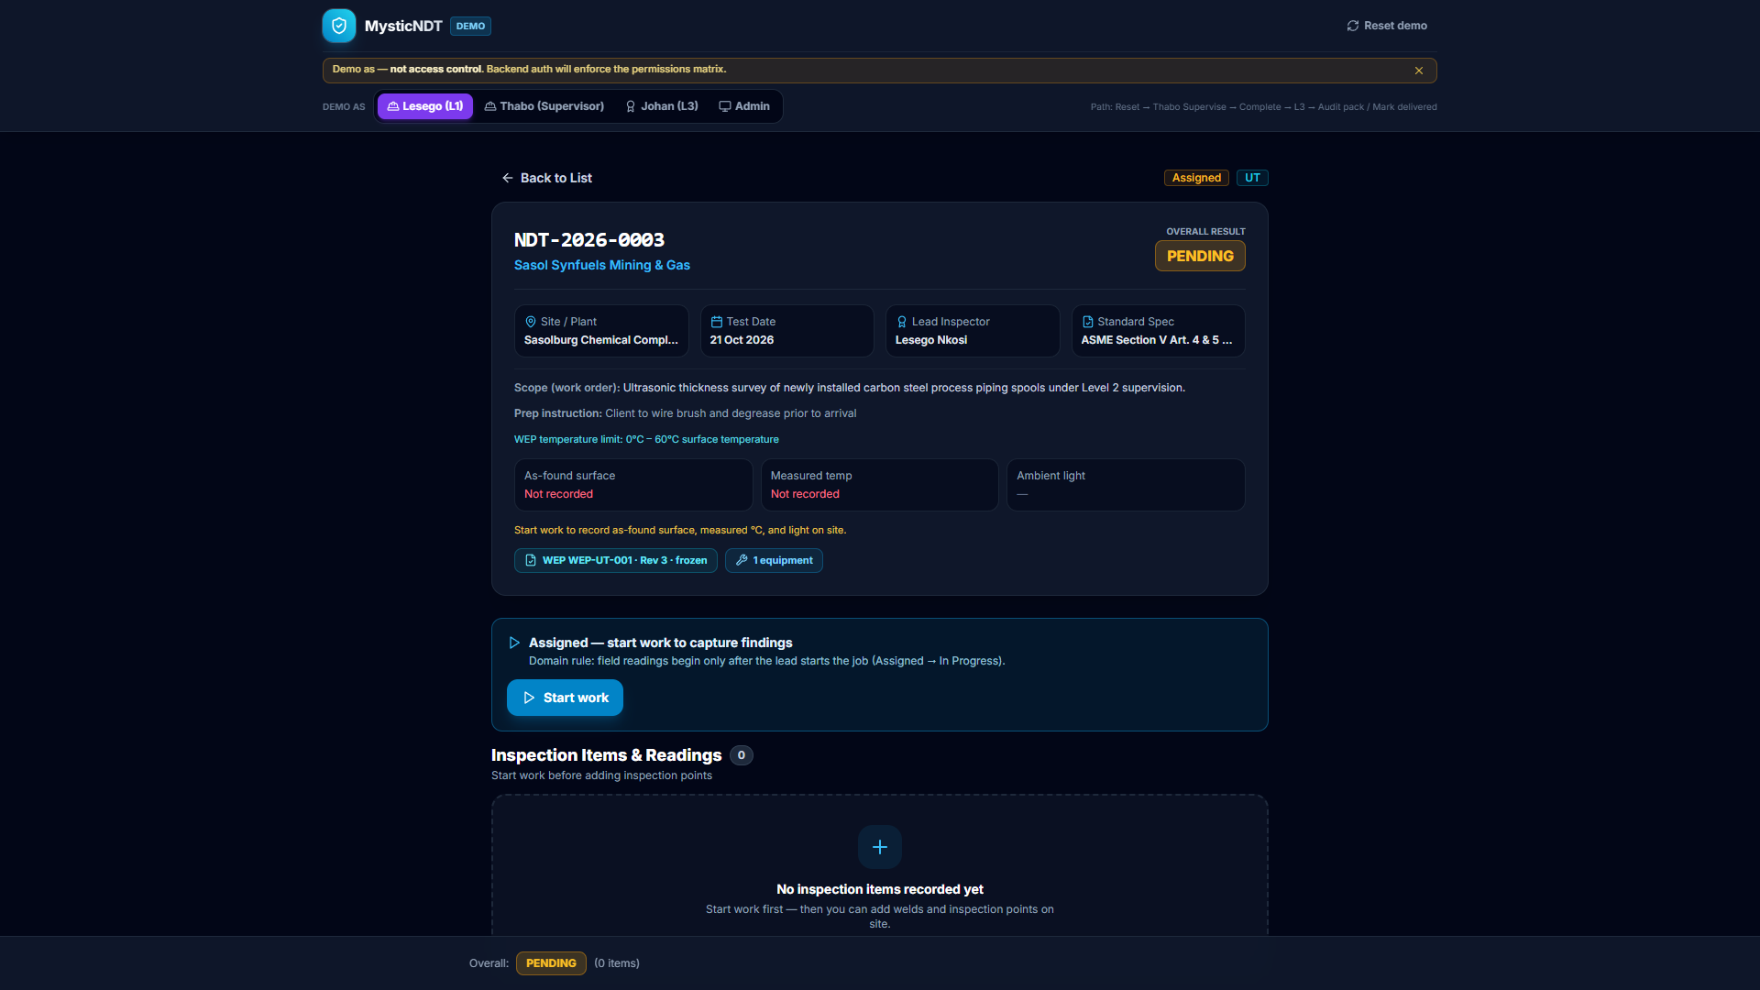
FIELD EVIDENCE
Pass, fail, photo — on the item.
Readings and criteria next to the indication; photos stay on the weld / component.
MysticNDT · Apex NDT demo · Confidential
14 / 16

Slide 15
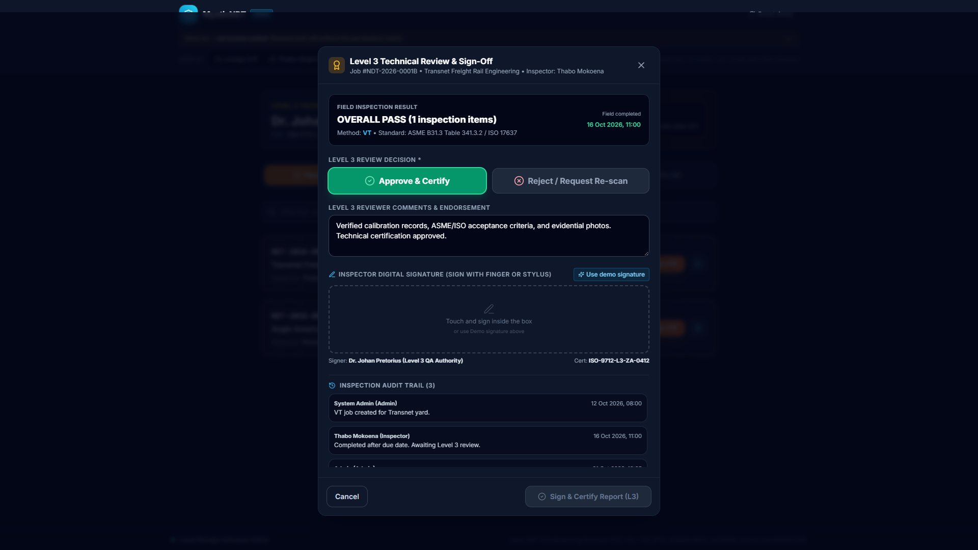
L3 · CERTIFY
Technical authority that unblocks the client.
Approve & certify or reject / request re-scan — digital signature ready for release.
MysticNDT · Apex NDT demo · Confidential
15 / 16

Slide 16
NEXT STEP
Run the Apex demo with your team.
Walk Admin → Lesego → Thabo → Johan on a live seeded week.
See compliance gates, field evidence, and L3 release in under 30 minutes.
1
2
3
Book a guided walkthrough
Map your methods, certs & cal rules
Pilot on one crew / one client
MysticNDT · Apex NDT demo · Confidential
16 / 16

