Slide 1

BIXBY- DIGITAL ASSISSTANT
Ezekiel Villadolid
John Richard Reyes
Jeahael Suhot

Slide 2


BIXBY
-Bixby is the Samsung intelligence assistant first introduced on the Galaxy S8 and S8+.
It's deeply integrated into the phone, meaning that Bixby is able to carry out a lot of the tasks you do on your phone.
-Bixby is available on Galaxy S20, S20+, S20 Ultra, Note10, Note10+, S10e, S10, S10+, Fold, Note9, S9, S9+, Note9, S8, and S8+.
-Bixby service availability may vary depending on country; Bixby recognizes selected languages and certain accents/dialects
-user interface may change and differ by device

Slide 3
Cont’d
-availability of Bixby features and content providers may vary depending on country/carrier/language/device model/OS version
-Samsung Account log-in and data network connection (Wi-Fi or data network) required
-Bixby controls selected apps, other apps to be supported
-Bixby is a virtual assistant developed by Samsung Electronics.
-On 20 March 2017, Samsung announced the voice-powered digital assistant named "Bixby.
-In October 2017, Samsung announced the release of Bixby 2.0 during its annual developer conference in San Francisco.
-Press and hold the Bixby button to talk to Bixby in a natural way, like a friend.
- You can ask Bixby to tell you things such as the weather, or what your next appointment is.

Slide 4
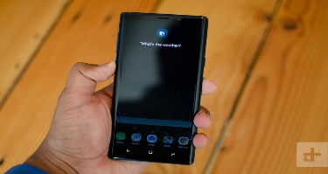
How to Use Bixby:
The Bixby have 3 incarnations of Samsung’s Assistant: Bixby Home, Bixby Vision, and Bixby Voice.
Bixby Voice
Bixby Voice is like Siri on steroids — in fact, it can rap insults at Siri in Korean. Not only that — it’s also built to adapt to a person’s manner of speaking rather than the other way around.
-According to Samsung, the assistant will be able to understand “Show me today’s weather,” “What’s the weather like today?,” or “What’s the forecast today?” — all variations of the same command.

Slide 5
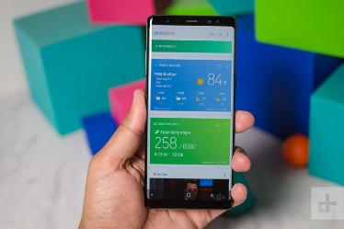
Cont’d
-You can activate it by saying, “Hey, Bixby,” or by holding down the Bixby button while you talk.
-If you don’t want to look like you’re talking to your phone in public, you can talk to Bixby by holding your phone up to your ear, like a phone call.
Bixby Home
Samsung calls Bixby Home a “social stream for your device,” and that’s more or less accurate. It’s a unified card-like interface of reminders, contextually relevant information, and social media updates.

Slide 6
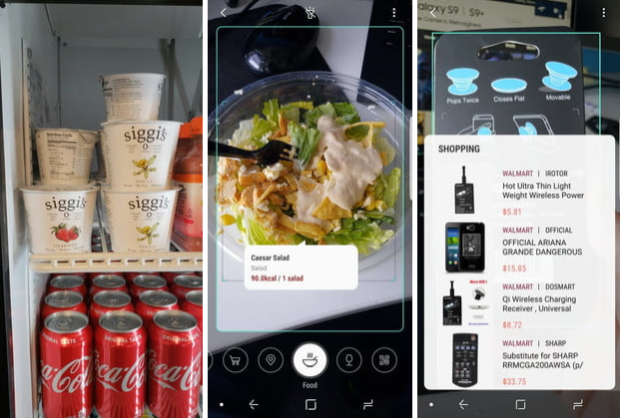
Bixby Vision
Bixby Vision taps into machine learning and database partnerships to make the camera a little more useful. Bixby Vision recognizes several categories of objects: Place, Text, Image, Food, QR Codes, Wine, and Shopping. You launch it by tapping the Bixby button in the Galaxy S10’s camera app or the Bixby Vision icon on the upper-left side of the camera interface.

Slide 7
Best Bixby Features
1. Bixby voice command
You can use Bixby to perform a variety of functions with its voice commands. You will be surprised at how efficient the Bixby command works. It can execute complex commands. Take, for instance; you can ask Bixby to ‘Play videos on my TV.’, ‘Open Instagram and upload two of my latest pictures,’ ‘Open gallery and find images from London,’ etc.

Slide 8
Best Bixby Features
2. Bixby quick commands
Using Bixby doesn’t have to come with the pains of memorizing long voice commands. If you rely more on Bixby’s voice commands to get things done, you can shorten them for faster input. E.g., instead of using the voice command ‘take a screenshot,’ you can set Bixby to recognize the quick voice command ‘screenshot.’
Here’s how to set up quick commands for Bixby:
Press Bixby’s dedicated button or swipe across your device from left to right to enter Bixby settings.
From Bixby’s menu, choose the ‘Quick Commands’ option.
Select ‘Make Your own Quick Command.’
Tap on ‘Bixby Command’ and select the command you wish to replace.
Tap the microphone icon, record your quick command.

Slide 9
Best Bixby Features
3. Use Bixby to translate
You saw Chinese inscriptions, and you wonder what it means? Don’t wander too far; let Bixby read and translate the Chinese inscription to English or other languages.
To do this, follow these steps:
Turn on your device’s camera.
Tap on Bixby’s vision icon (an eye icon).
Focus the camera on inscriptions.
Tap ‘Text’ and crop the word or inscription you want to translate.
Tap on ‘Translate,’
Swipe your finger across the word you wish to translate, and boom! Bixby will read out the meaning of the inscription.

Slide 10
Best Bixby Features
4. Convert images to text
Do you want to get a work typed out? Easy! Ask Bixby to extract the text for you.
Turn on your device’s camera.
Tap on Bixby’s vision icon (an eye icon).
Focus the camera on the image text you wish to extract.
Tap on ‘Text’ and select ‘Extract.’
Bixby will then convert the text to an editable format. You can save, edit, or share the copied text.

Slide 11
Best Bixby Features
5. Find photos
Surfing through thousands of images in your photos gallery can be a herculean task. Use the voice command ‘Hi, Bixby, open gallery and find photos of babies.’ Afterward, Bixby will open your photos gallery, search, filter your images, and present you with only babies’ photos.

Slide 12
Best Bixby Features
6. Post your photos on social media
Bixby can help you open your social media accounts and make a post on your behalf. Use the voice command, ‘Hi Bixby, post my most recent image on Facebook.’ Afterward, Bixby will open your Facebook account and create a post for you. Add a caption to the image and post it to Facebook.

Slide 13
Bixby Other Features
Find your location
Don’t you know where you’re? Bixby can help you determine your location.
Send your location
You need a friend to send you directions or come pick you up at your location? Use the voice command ‘Hi Bixby, text Bob my location.’ Your friend will get a text of your location and meet you or send you the directions you need.
Bixby routine
Bixby routine puts your phone in various modes based on set triggers. Bixby uses triggers like location, time, charging status, or connectivity mode to automate predetermined actions that form part of your daily routines.

Slide 14
Bixby Other Features
Control smart home appliances
Use Bixby for navigation
Access your device’s Settings with Bixby
Ask Bixby to install an app
Read your Gmail messages
Use Bixby to take a picture or a selfie or change camera settings
Music control
Manage apps

Slide 15


Slide 16

THANK YOU FOR WATCHING AND LISTENING ☺!

