Slide 1
Use of RShiny to Explore Consequences of Anti-Kickback Healthcare Regulatory Policies
Jonathan Harris

Slide 2

Introduction
Financial relationship between physicians and industry are common, and frequently necessary to improve care:
R&D
Research studies
Consulting
Speaker fees
Educational materials
Meals
May create conflict of interest
Patients receive the product, but doctors/admin are the real customer
Highly regulated by government
Figure. Can’t pay doctors to use products, but can pay them for services, like staring in a tv show

Slide 3
Physician Payments Sunshine Act (PPSA)
Part of Affordable Care Act (section 6002)
Passed in 2010
Open Payment Database
Requires medical device manufacturers to disclose all financial transactions between [openpayments.gov]
Even vending machine purchases

Slide 4
Medicare Part D Drug Plan
Proposed by Bill Clinton (1999)
Passed as part of the Medicare Modernization Act (2003)
Available drug payment coverage for Medicare patients [cms.gov]
Medicare Part D Database
Law requires recording of all prescription claims written to participating patients
Includes, but not limited to:
Doctor-specific id number
Number of claims
Cost of medicine

Slide 5
Project Proposal
Combine both 2016 datasets
Use RShiny to explore the unintended (or intended) consequences of financial relationships between drug companies and the clinicians prescribing their products
Utility of analysis
General interest to public
Opioid epidemic, healthcare cost
Healthcare companies
Maximize profits within existing laws
Regulatory agencies
Understand effect of existing policies and guide future changes
Figure. Medical device companies and the regulating government agencies

Slide 6
Methodology
Initial idea not feasible
Alternative approach
Open Payment Dataset
Able to Clean csv in Python
14M → 10M datapoints
Learned about RAM constraints of RShiny
Medicare Part D Dataset
24M datapoints
Top 50 Drug Dataset [Propublica.org]
Used aforementioned datasets:
Top 50 most prescribed medications
Top 50 highest physician payments
Data cleaning:
Removed missing data
Truncated dataset to top 20 drugs with highest physician payments
3M → 900k datapoints
Truncated variables to minimize RShiny lag

Slide 7
Top 20 Drugs Associated with Most Payments
Anticoagulant
Eliquis
Pradaxa
Xarelto
Antiepileptic
Latuda
Lyrica
Asthma
Spiriva
Symbicort
Bladder
Myrbetriq
Vesicare
Diabetes
Humalog
Humulin
Invokana
Janumet
Januvia
Tradjenta
Victoza
Eye Allergy
Restasis
Opioid
Oxycontin
Thyroid
Sensipar
Vasodialator
Ranexa

Slide 8
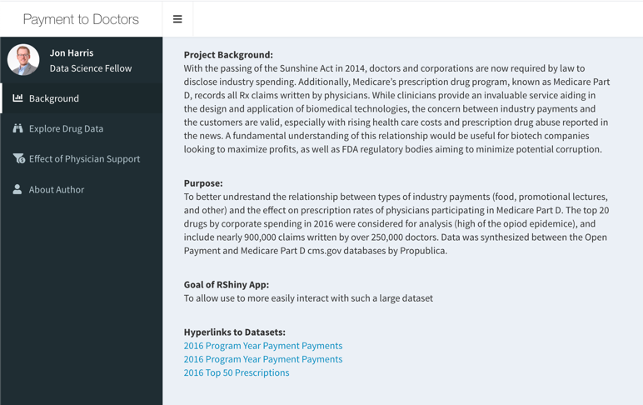
RShiny App
Dataset
ProPublica Top 50 Drugs 2016
Medicare Part D 2016 dataset
Open Payments 2016 dataset
Truncated to top 20 drugs by total payment to clinicians due to size
3M → 900k observations
Purpose
To easily visualize and explore descriptive statistics of each drug
To quickly and easily ascertain effect of physician support
Lead to further analysis presented later

Slide 9
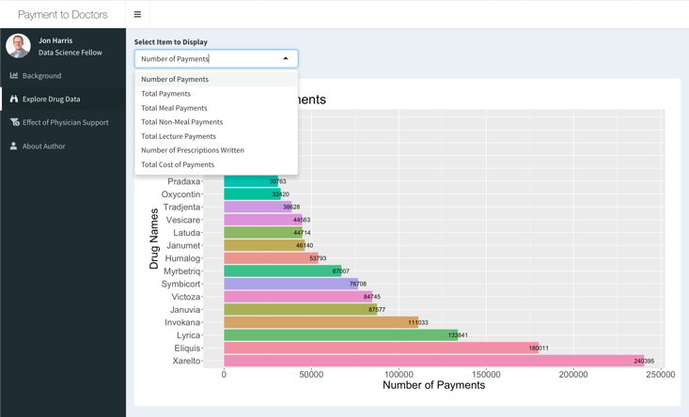
Explore Drug Tab
Variables within dataset
Number of payments
Total payments
Total meal payments
Total non-meal payments
Total lecture payments
Number of Rx claims written
Total cost of Rx claims

Slide 10
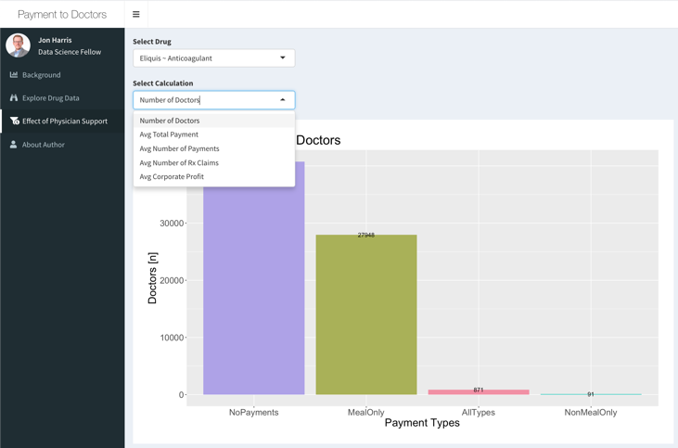
Effect of Physician Support
Calculations grouped by payment types per drug
Number of doctors
Avg total payments
Avg number of payments
Avg number of Rx claims
Avg corporate profit
Drug cost – Payment amount
Quick visualizations allowed survey of drugs/results for even more analyses

Slide 11
Results
2016 Open Payment Database [cms.gov]

Slide 12
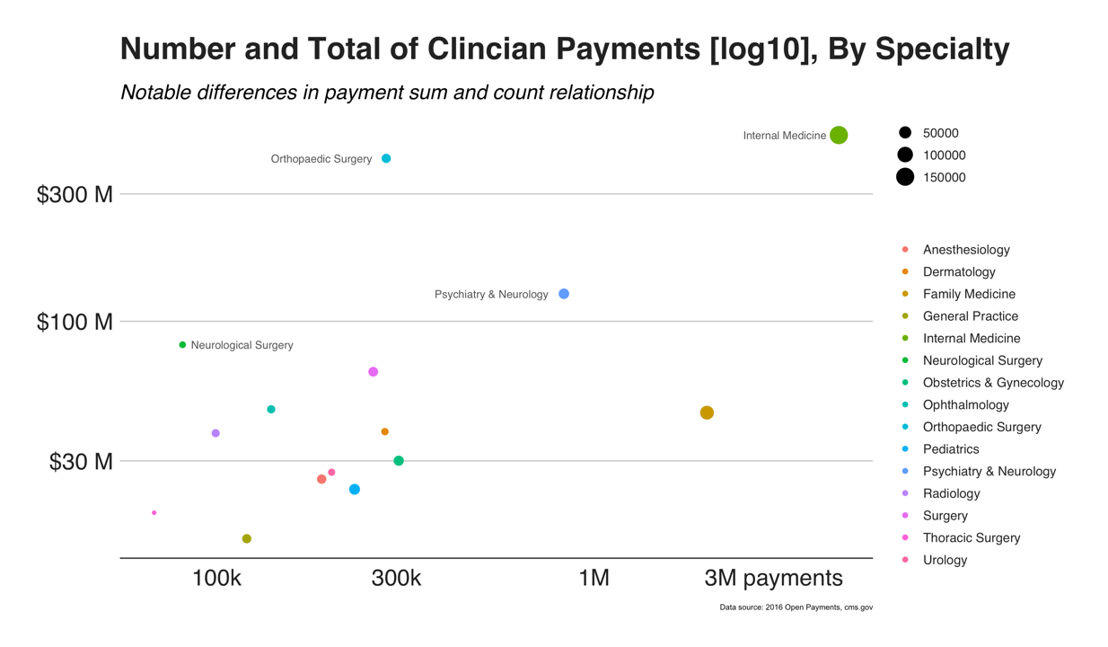
Notes:
2016 Open Payment Dataset:
15 million reported grouped payments (Ex: 1 conference trip = multiple payments)
33 physician subspecialties (only report top 15)
Removed missing data and selected top 15 subspecialties (10million payments)

Slide 13
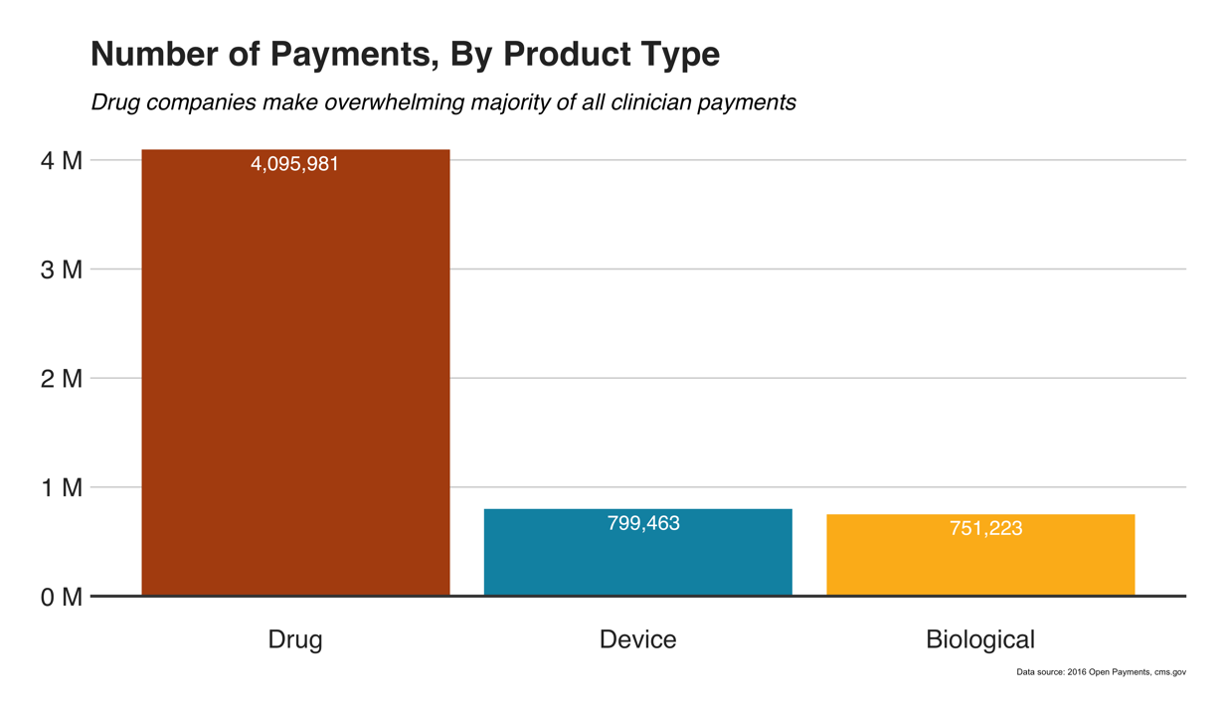

Slide 14
Results
2016 Top 20 Drugs [ProPublica.org]

Slide 15
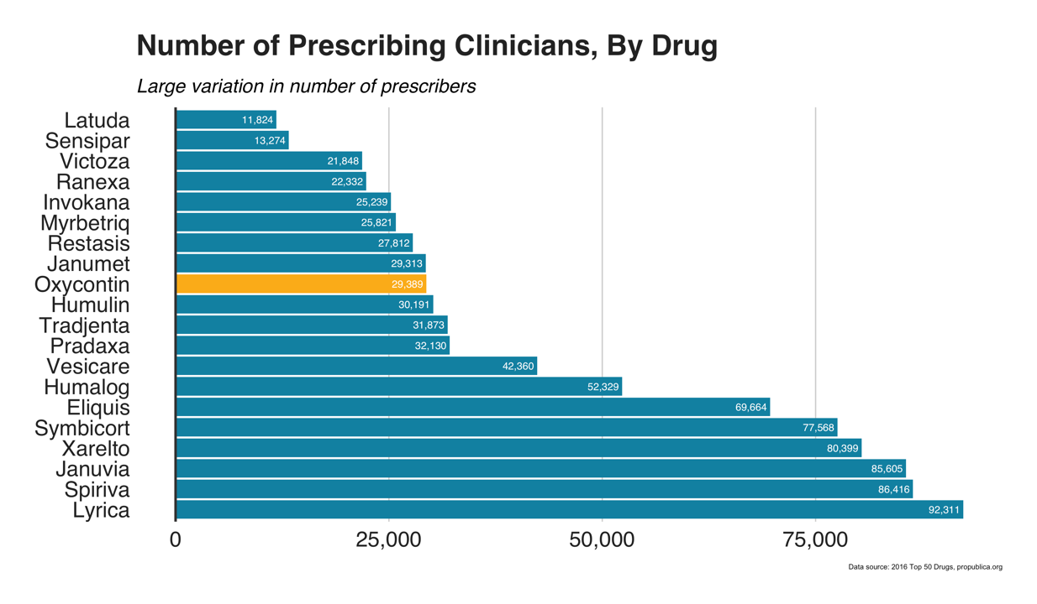

Slide 16
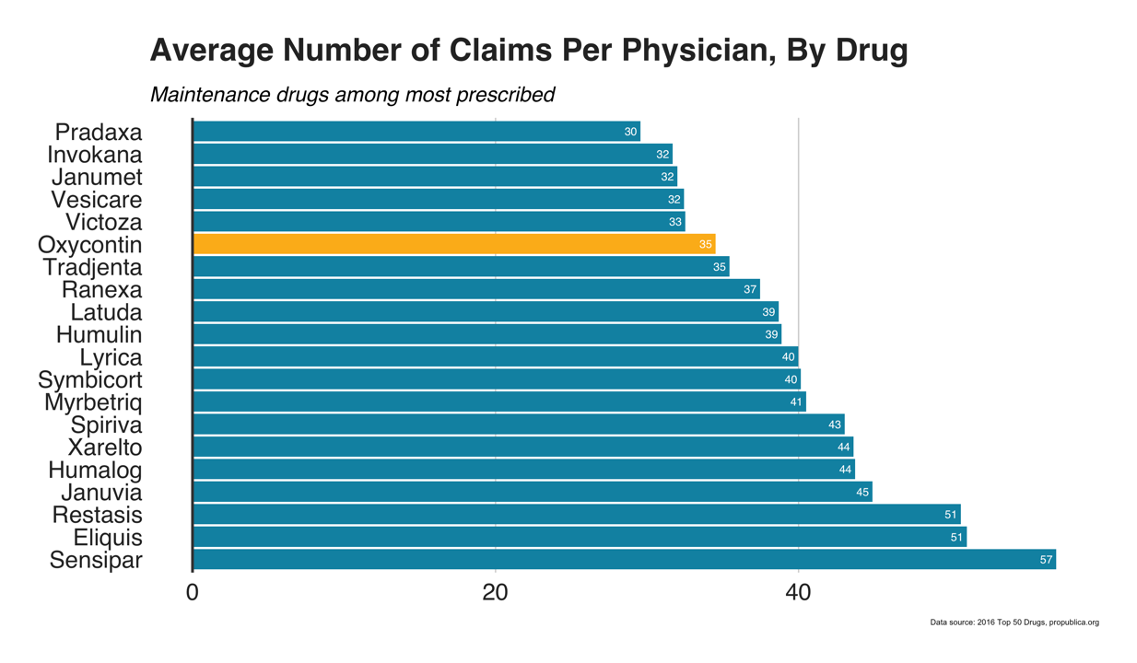

Slide 17
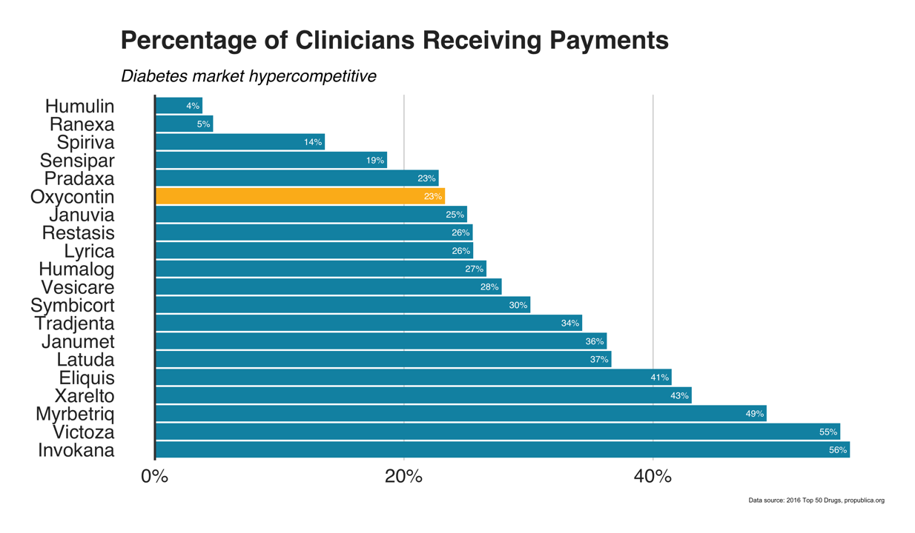

Slide 18
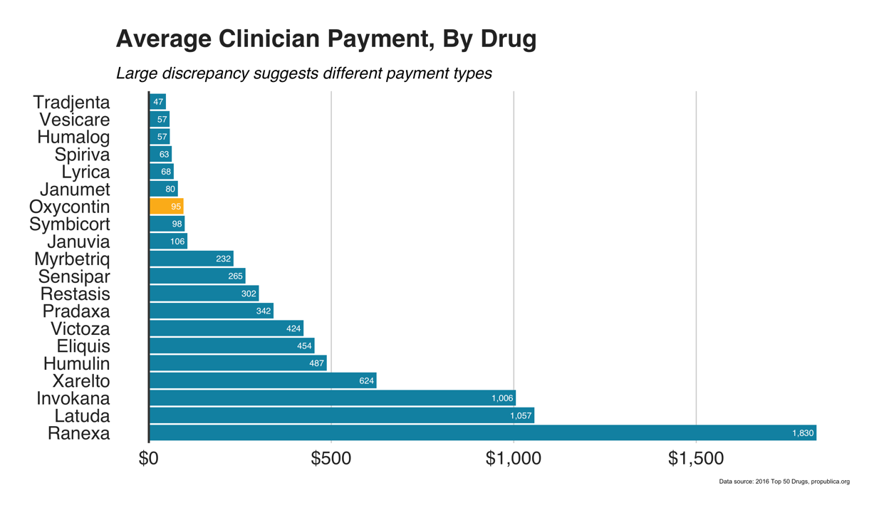

Slide 19
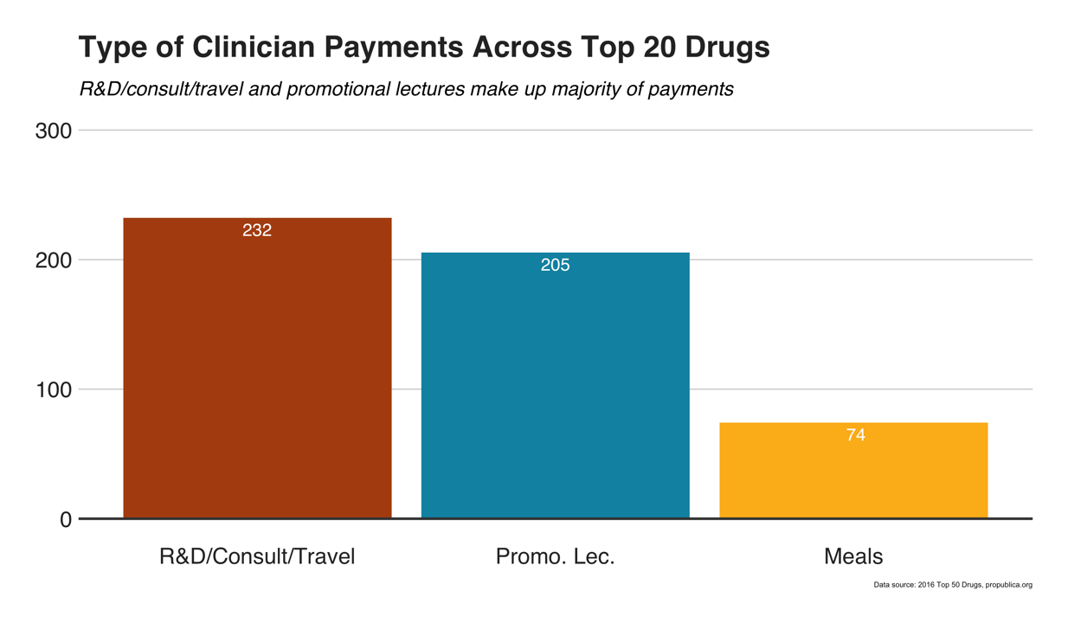

Slide 20
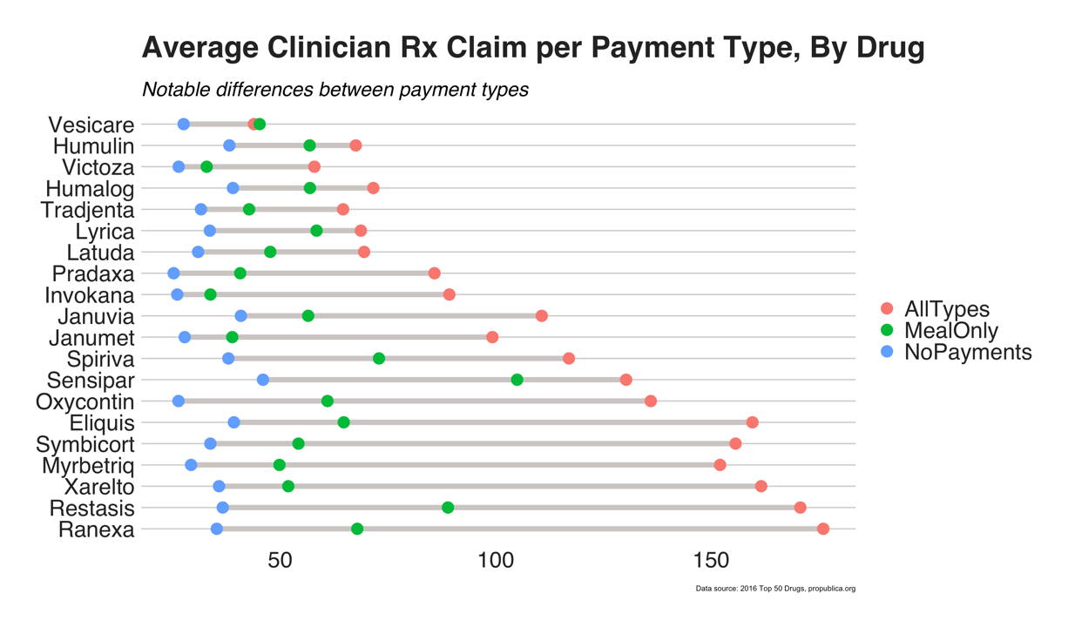

Slide 21
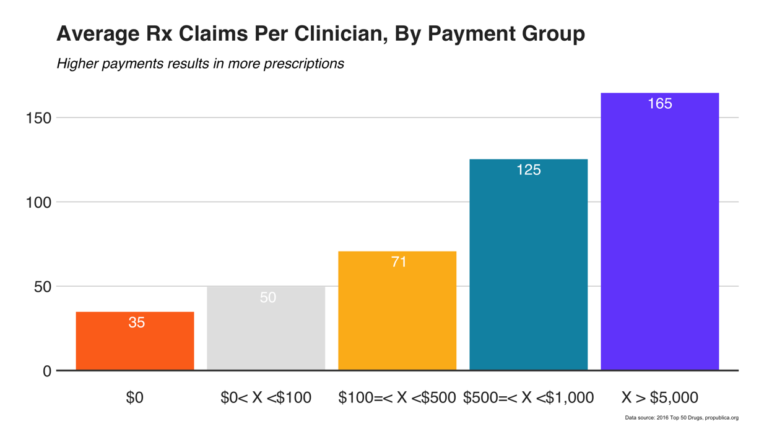

Slide 22
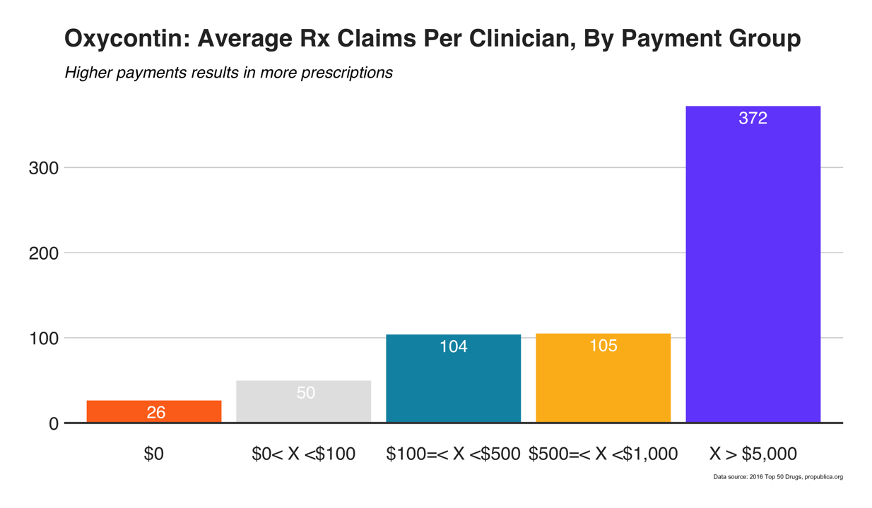

Slide 23
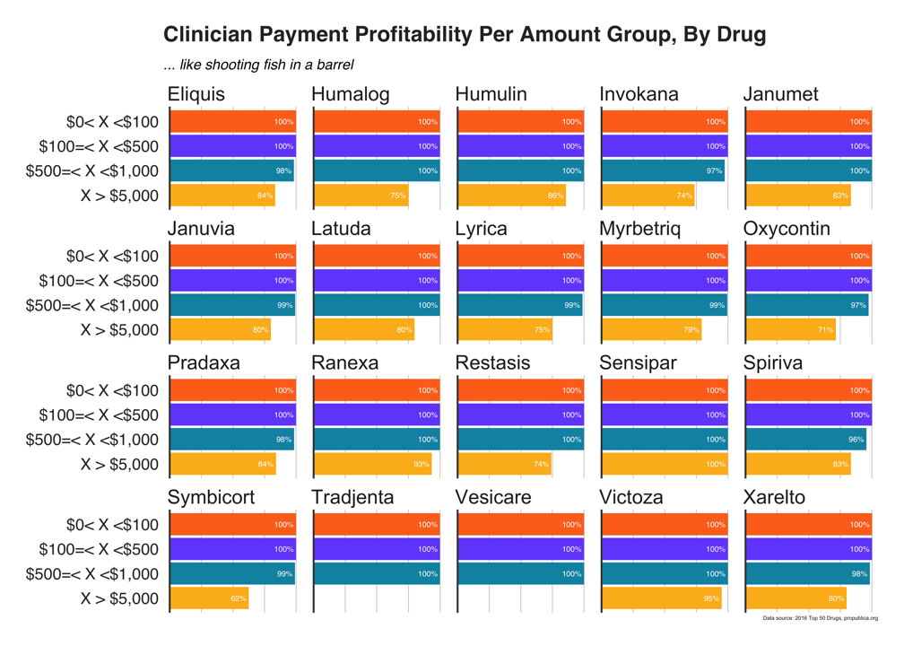

Slide 24
Discussion Section
In 2016, number of payments and total amounts widely vary by specialty
Drug companies made twice as many number of payments as device and biological companies combined
Oxycontin among top 20 drugs by sum of physician payments
Prescribing doctors averaged 35 30-day Rx claims
Maintenance drugs among most prescribed
Diabetes among highest % of doctors receiving payments
Across all drugs considered, on average 40% of physician payment came from promotional lectures
Type of payment associated with dramatic increase in number of claims written by clinician
Oxycontin: 26 (no payment) → 61 (meal only) → 135 (all payment types)
Does a free meal make that much of a difference?
Avg number of Rx claims increases as money increases
Trend especially noticeable for Oxycontin
High rates of profit can be achieved at all payment amounts

Slide 25
Limitations
Drug claims only include medications paid for under the Medicare Part D Prescription Drug Program
Is not representative of all of Medicare as dataset only includes 2/3rd of all Medicare beneficiaries
Is not representative of a physician’s entire practice
Does not account for quality of care

Slide 26
Questions?

Slide 27
Contact Information
Rshiny App
https://jah377.shinyapps.io/NYCDSA_doctorpayments_jonharris_rshinyapp/
LinkedIn
https://www.linkedin.com/in/jonharriseit
GitHub
https://github.com/jah377
ResearchGate
https://www.researchgate.net/profile/Jonathan_Harris23

