Slide 1
TARP Capstone Figures
Jon Harris

Slide 2
For blog post

Slide 3
Proposed Slide 6

Slide 4
Original Slide 7

Slide 5
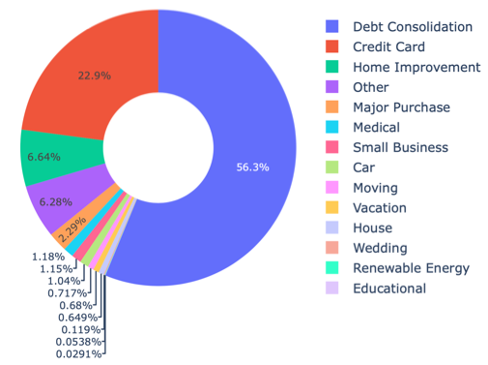
Original Slide 6

Slide 6
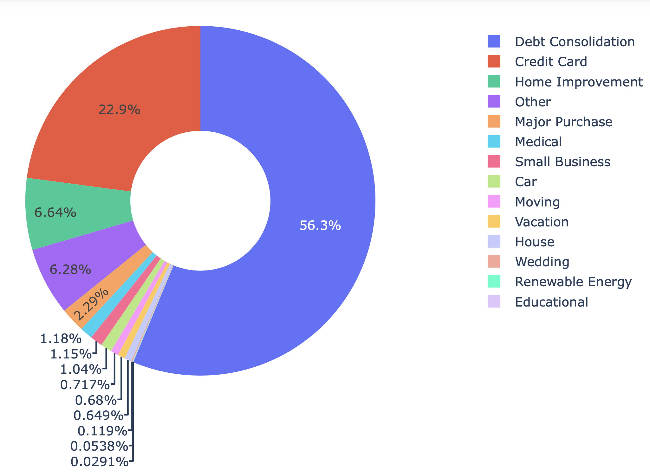
Slide 6 Original Raw

Slide 7
Proposed Slide 7

Slide 8
Slide 7 Raw Image
LendingClub® received a $125 million investment from Google

Slide 9
Slide 7 Original Raw
LendingClub® received a $125 million investment from Google

Slide 10
Slide 10

Slide 11
Slide 9

Slide 12
Slide 11

Slide 13
Slide 11

Slide 14
Feature Importance

Slide 15
Slide 13

Slide 18
Slide 17

Slide 19
Slide 19

Slide 20
Proposed Slide 20

Slide 21
Original Slide 20

