Slide 1
DSA PROJECT: FILE EXPLORER
IN C++
<p> using Trees and Algorithm Library </p>

Slide 2
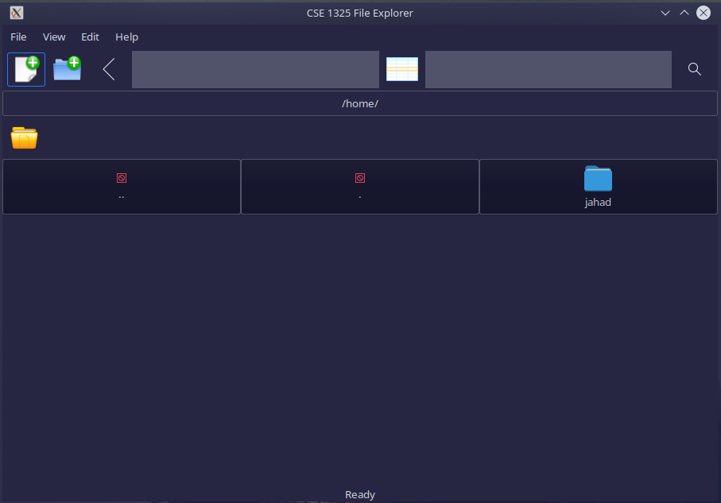
SNEAK PEAK
<p> Here is a snapshot of our GUI </p>
It includes following Functionalities:
Create a new Folder
Create a new File
View current Directory
Go to previous Directory
taskbar

Slide 3
TABLE OF CONTENTS.
01
02
03
04
06
Provided functionalities.
Structure of Project.
How we implemented Tree.
Graphical Interface using GTK.
Ending our talk with conclusion.

Slide 4
RECOMMENDED FEATURES
01
<p> The Concept of File Explorer is to provide a graphical interface for user to interact and manage his files and directories. </p>

Slide 5
PROVIDED FUNCTIONALITIES:
<p> Allow user to create, manage, delete, duplicate and view directories. </p>
<p> Allow user to search for directories. </p>
<p> Allow user to sort his files in a directory (using heap, not implemented yet). </p>
<p> Allow user to browse content of directories in different Views (Grid,List) . </p>

Slide 6
STRUCTURE OF PROJECT
02
<p> The Project consists of different Built-in, Open-source and Developed libraries. </p>

Slide 7
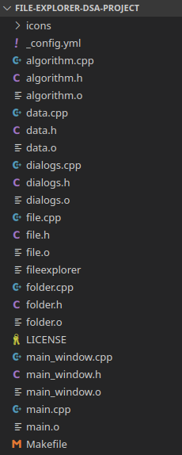
MAIN COMPONENTS:
<p> main.cpp which include mainwindow.cpp </p>
<p> Tree.cpp </p>
<p> GTK Library for GUI </p>
<p> Vectors.h </p>
<p> Algorithm Library for Directory Handling </p>
<p> Dirent.h for exceptional handling </p>

Slide 8
IMPLEMENTATION OF TREE
03
<p> The structure of nodes, how we traverse it & more. </p>

Slide 9
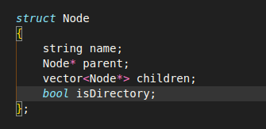
NODE STRUCTURE OF TREE.
NAME : name of file/directory
PARENT : path of parent node
CHILDREN : path of children node
ISDIRECTORY : bool for file/directory

Slide 10
COMPLETE TREE
FUNCTIONS
This is where you section ends. Duplicate this set of slides as many times you need to go over all your sections.

Slide 11
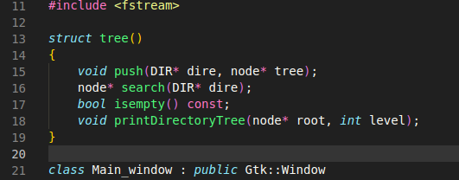
FUNCTIONS:
push
search
remove
isEmpty
printDirectoryTree

Slide 12
GRAPHICAL INTERFACE
04
<p> Development of window using GTK. </p>

Slide 13
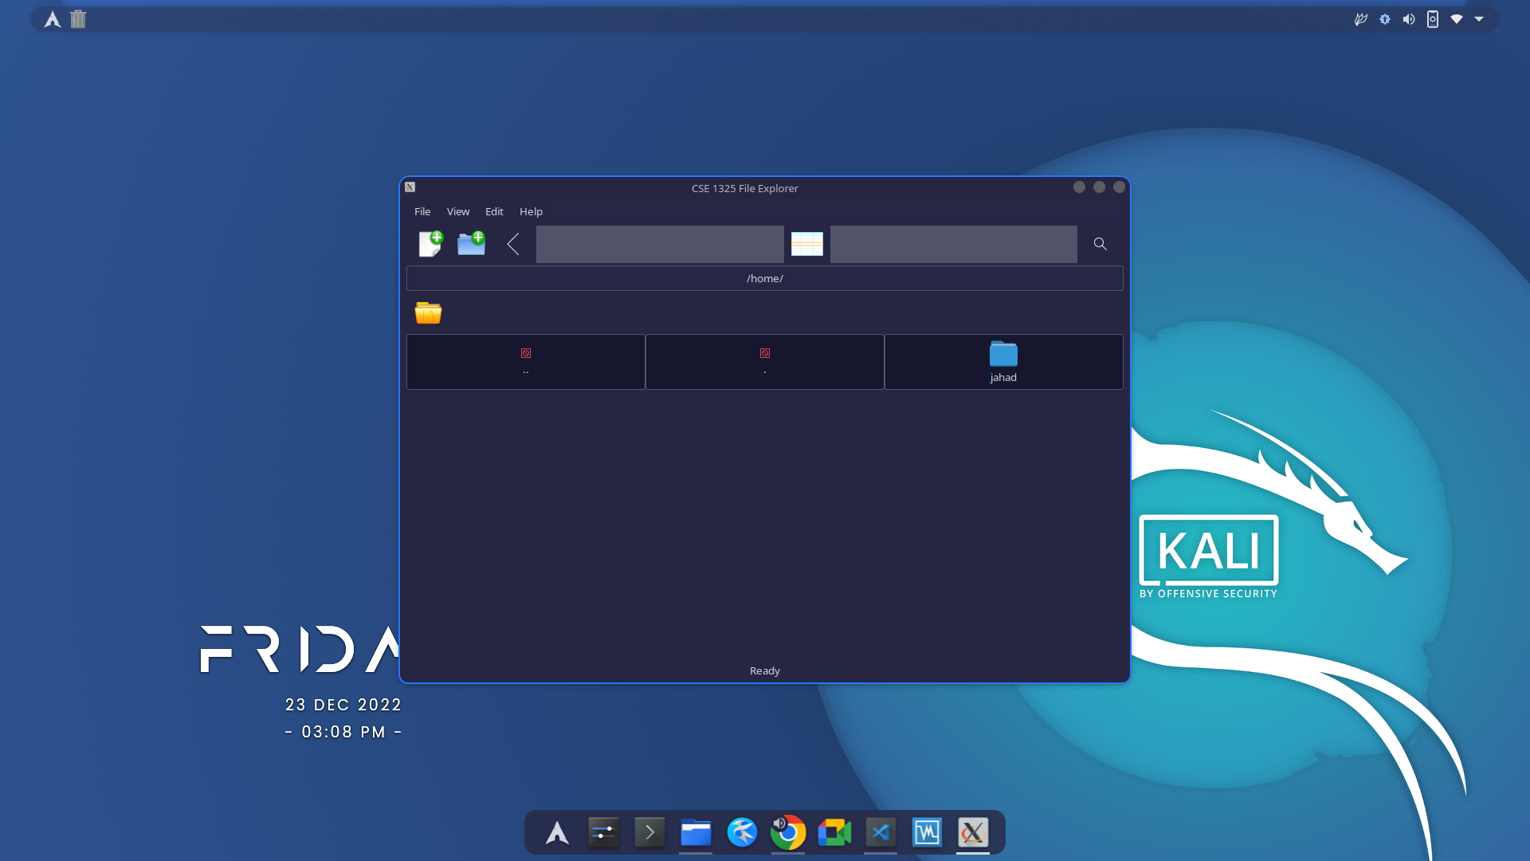
A GLIMPSE OF INTERFACE
ON LINUX

Slide 14
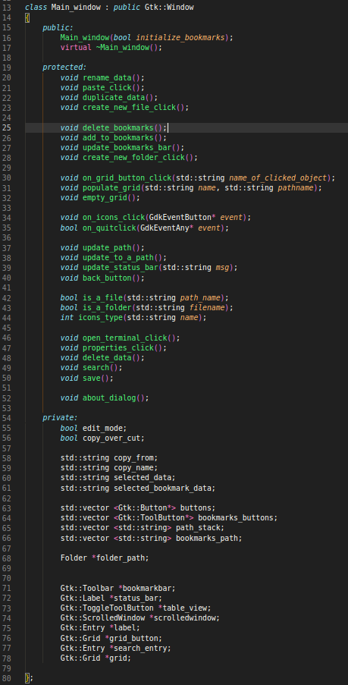
CODE OF GTK
INTERFACE:
The interface is developed using gtkmm* and algorithm* library.
Gtkmm is used for graphical contents.
Algorithm is used for linking the directories to interface.

Slide 15
THANK YOU!
Muhammad Jahad Tariq
Suleman Zahoor
Muhammad Mohshif
Do you have any questions?

