Slide 1
HPalang: An Actor-based Modeling Language for Cyber-physical Systems
Iman Jahandideh
University of Tehran
Winter 2017

Slide 2
Outline
Introduction
Syntax of HPalang
Comparison with SpaceEx
Semantic of HPalang
Conclusion

Slide 3
Outline
Introduction
Syntax of HPalang
Comparison with SpaceEx
Semantic of HPalang
Conclusion

Slide 4
Cyber-Physical Systems
CPSs are integration of
Computation
Network
Physical behaviors
Modeling interactions of these processes is a challenge

Slide 5
Hybrid Automata
A basic modeling language for CPSs
Consist of
Locations and transitions for modeling discrete behaviors
Differential equations for modeling continuous behaviors
Hard to model network communication and complex computations.

Slide 6
Actor-based Model
In CPSs controllers communicate through networks with each other.
Actors are unit of computations
Execute concurrently
Communicate through asynchronous message passing
Timed Rebeca an actor-based language
Computation time
Network delay
Message deadline
No continuous behavior

Slide 7
HPalang
HPlanag modeling language
Based on Palang language
Semantics based on hybrid automata
Actor-based and asynchronous message passing
Modeling continuous behaviors
Modeling computation time.

Slide 8
Outline
Introduction
Syntax of HPalang
Comparison with SpaceEx
Semantic of HPalang
Conclusion

Slide 9
Syntax
A model is consist of
A number of Actor declarations
A main block specifying initial messages to actors
An Actor declaration is consist of
An identifier
A number of variable (discrete or continuous)
A number of method
A method has
A name
A sequence of statements

Slide 10
Statements
Discrete assignment
dVar = dExpr
Continuous assignment
cVar = cExpr
Condition
if(dExpr) statements else statements

Slide 11
Statements
Send
x.m()
Delay
delay(r)
Continuous behavior
inv(cExpr) ode guard(cExpr) statements

Slide 12
Example
Beverage machine specification
Offers two tea and coffee
Temperature / Volume
Tea: 100 / 300
Coffee: 90 / 200

Slide 13
Actors
User for modeling ordering behavior
Machine as the main controller
Heater for heating the drink
Filler for filling the cup with the drink

Slide 14
Machine Actor

Slide 15
Heater Actor

Slide 16
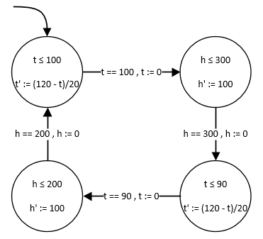
Translation

Slide 17
Outline
Introduction
Syntax of HPalang
Comparison with SpaceEx
Semantic of HPalang
Conclusion

Slide 18
SpaceEx
Compositional modeling based on hybrid automata
Base component
A single hybrid automaton
Network component
One or more instantiation of network or base component

Slide 19
Base Model

Slide 20
SpaceEx Model

Slide 21
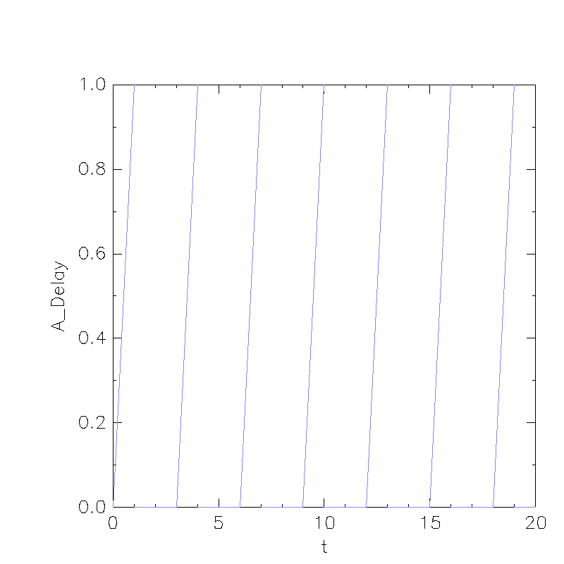
Behavior

Slide 22
Adding Another Actor

Slide 23
SpaceEx Model

Slide 24
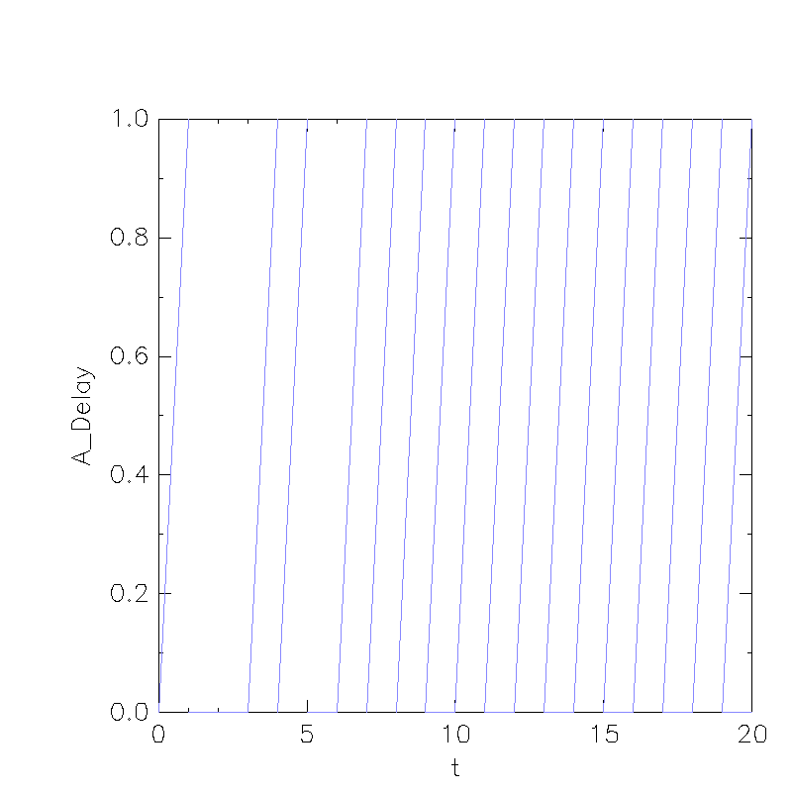
Behavior

Slide 25
Adding New Method

Slide 26
SpaceEx Model

Slide 27
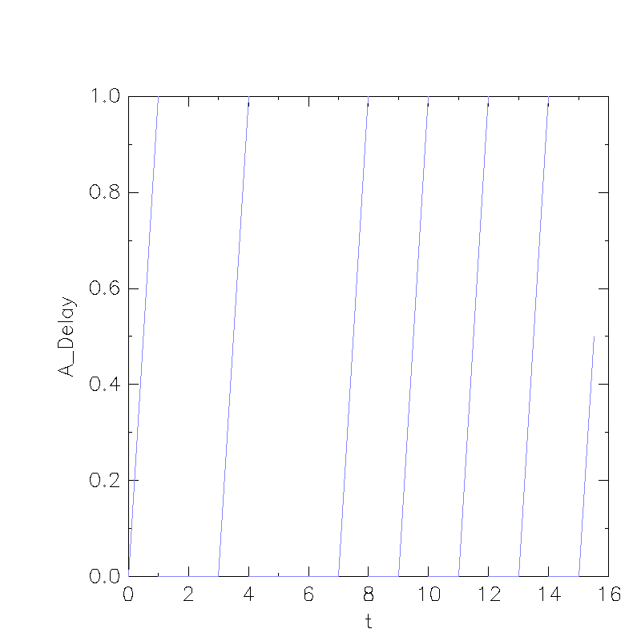
Behavior

Slide 28
Outline
Introduction
Syntax of HPalang
Comparison with SpaceEx
Semantic of HPalang
Conclusion

Slide 29

Semantic
Two staged semantic
HPalang to Transition system
Transition system to hybrid automata
Global state
$l:ID →ActorState$
Actor state
Valuation $v$
High priority and low priority queues $q_{h},q_{l}$
Statement queue $σ$
Continuous behaviors $cs$

Slide 30
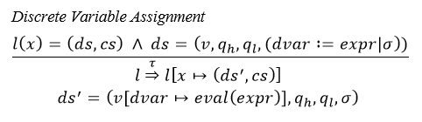

Transitions
Transitions are defined as SOS rules.
Two kind of label
$τ$ transition
$guarded$ transition

Slide 31
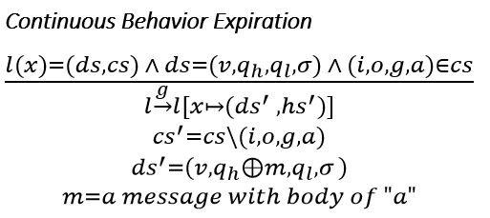
Transitions

Slide 32

Transition system
Transition system $TS=(l,→,l_{0})$
$l$ is set of global states
$→$ is the smallest relation defined by SOS rules
$l_{0}$ is the initial state which
Messages in main block are sent
Initial values for discrete values are set

Slide 33

Hybrid Automaton
Applying following rules to transition system
Prioritizing $τ$ transitions
Merging $τ$ transitions
Hybrid Automaton $HA\left(Loc,V,\left({loc}_{0},v_{0}\right),\underset{⇒}{ },I,F\right)$
$Loc=l$
$V$ set of all define continuous variables
${loc}_{0}$ = $l_{0}$
$v_{0}$ initial values for continuous variables
$\underset{⇒}{ } = →$
$I\left(l\right)=logical and of all invariants in l$
$F\left(l\right)=set of all odes in l$

Slide 34
Draw Bridge Example
Draw bridge specification
Default status is raised
When a car enters the bridge, start lowering
When lowered, cars start passing
When all cars are passed, start raising
Actors
CarDispatcher
DrawBridge

Slide 35
DrawBridge Actor

Slide 36
DrawBridge Actor

Slide 37
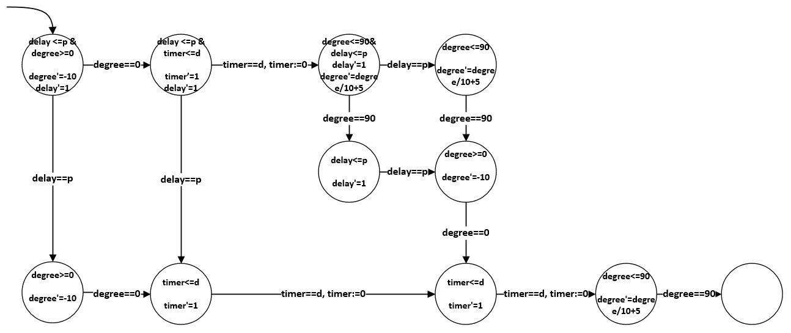
DrawBridge Actor

Slide 38
Outline
Introduction
Syntax of HPalang
Comparison with SpaceEx
Semantic of HPalang
Conclusion

Slide 39
Conclusion
An Actor-based language for CPS
Modular model
Future works
Analysis of physical and cyber behaviors
Defining network concepts
Network delay
Message deadline
Looser restriction on continuous and discrete variable usage

