Slide 1
Assess the landscape of C-V2X Technology and its journey to 6G Networks
Wireless Networks (SSY145) Project
Jahanvi Bhadrashetty Dinesh 20th May 2024
Lisa Mårtensson
Muhammad Uzair
1/16

Slide 2
Outline of presentation
Introduction to C-V2X
LTE
Advantages of LTE
Challenges of LTE
5G
5G for V2X
Challenges of 5G V2X
Future of V2X: 6G vision
6G: Vision for future V2X communication
UAVs and Satellites in 6G V2X
Edge and fog computing
Terahertz communication in 6G
Conclusion
2/16

Slide 3
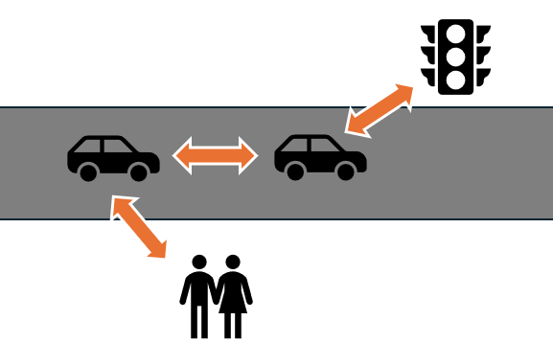
Introduction to C-V2X
3/16

Slide 4
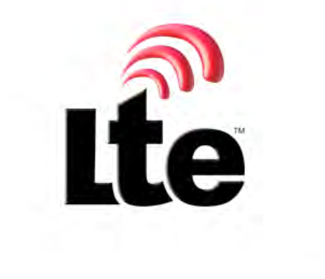
Long Term Evolution
DSRC systems Cellular technologies
Extensive coverage and high vehicle mobility support
Interest from organizations like 3GPP
Development of cellular-based V2X services
Figure from 3GPP
Access: https://www.3gpp.org/about-us/legal-matters/logo-usage
6/16

Slide 5
Advantages of LTE-Cellular-Based V2X
Compared to IEEE 802.11p
Centralized scheduling and decentralized resource selection.
Enhanced reliability and efficient utilization of LTE infrastructure.
Compared to DSRC
Higher packet reception rates (PRR) and reliability.
Superior performance in data rate, latency and congestion handling.
5/16

Slide 6

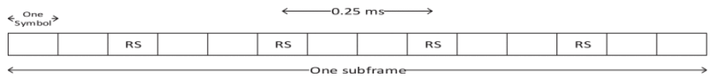
Challenges of LTE-Cellular-Based V2X
Issues with the existing LTE physical layer at high speeds and frequencies
Impact of the Doppler effect on channel estimation accuracy
Existing LTE physical layer structure
Physical layer enhancement
Figure from S. Gyawali et al., "Challenges and Solutions for Cellular Based V2X Communications," in IEEE Access, vol. 23,1 pp. 222-255 2020, doi: https://ieeexplore.ieee.org/document/9217500/authors#authors
6/16

Slide 7
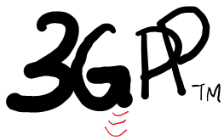
Introduction to 5G
3GPP Release 15: Increase data rates, reduced latency, improve connectivity
Properties:
Spectrum - FR1 (<6GHz) and FR2 (24GHz - 52 GHz)
OFDM
Adaptive Bandwidth
Wireless devices
5GCAR: 5G Communication Automotive Research and Innovation project
7/16

Slide 8
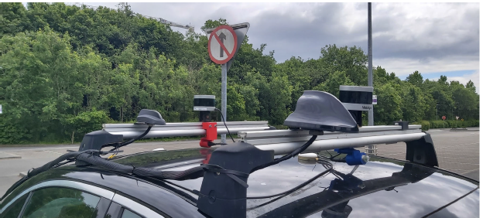
LTE to 5G for V2X
Pre-defined test conditions
Shark fin antenna on car
Results:
Reliability
Latency
Figure from J. Clancy et al., "Feasibility Study of V2X Communications in Initial 5G NR Deployments," in IEEE Access, vol. 11, pp. 75269-75284, 2023, doi: 10.1109/ACCESS.2023.3296089.
8/16

Slide 9
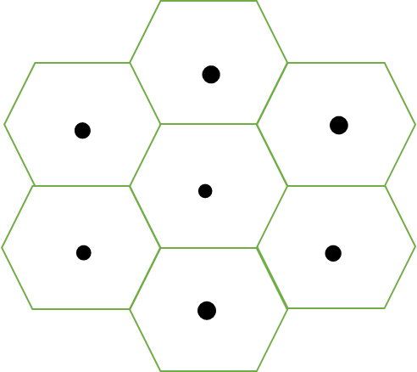
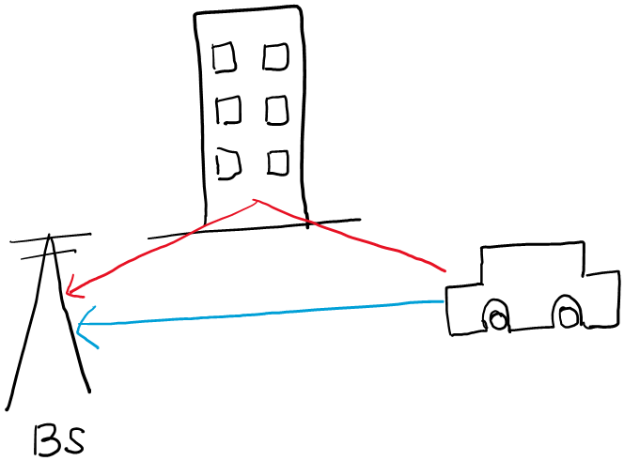
Challenges of 5G V2X
Small cell size - increase in capacity
Handover difficulties - mobile user
Dual Connectivity, Multi access manager, Application Map
mm wave propagation - short wavelength
LoS dependency
Place base stations(BS) closer
Vehicular Positioning - 3 to 4 BS
Single BS
2 Kalman filters - AoD/AoA and IMU
9/16

Slide 10
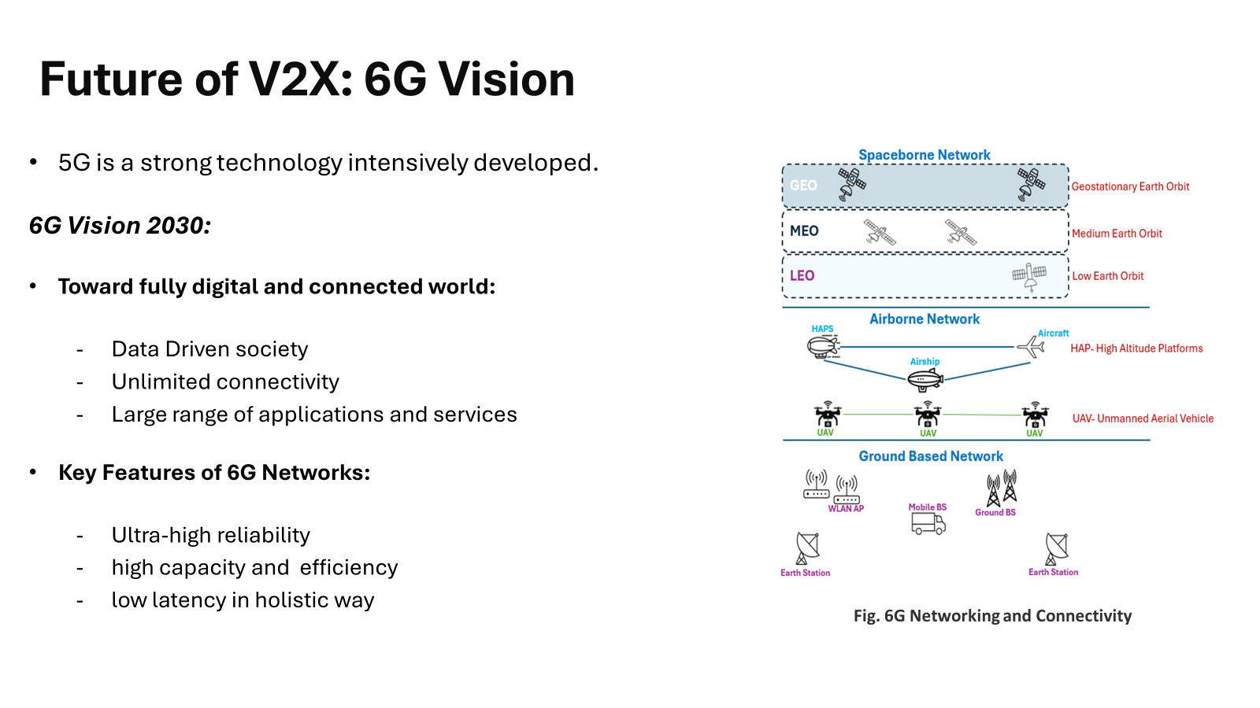
5G
10/16

Slide 11
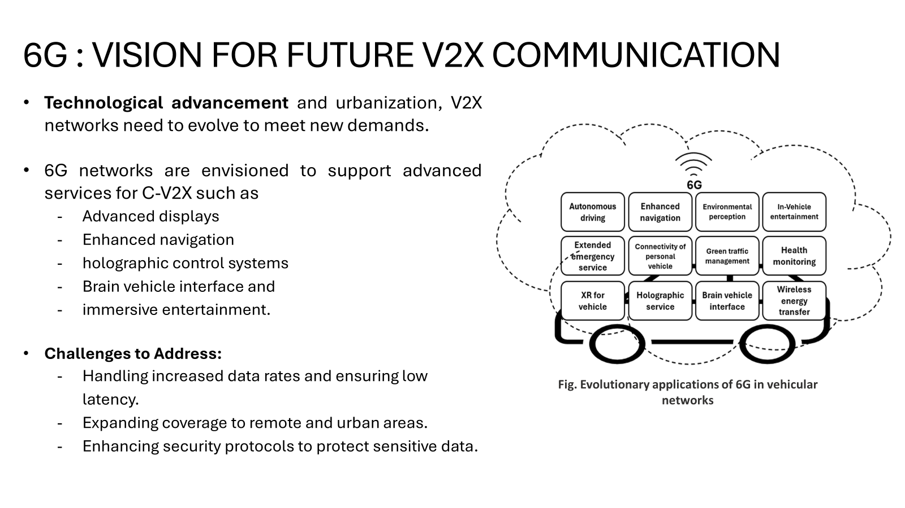
11/16

Slide 12
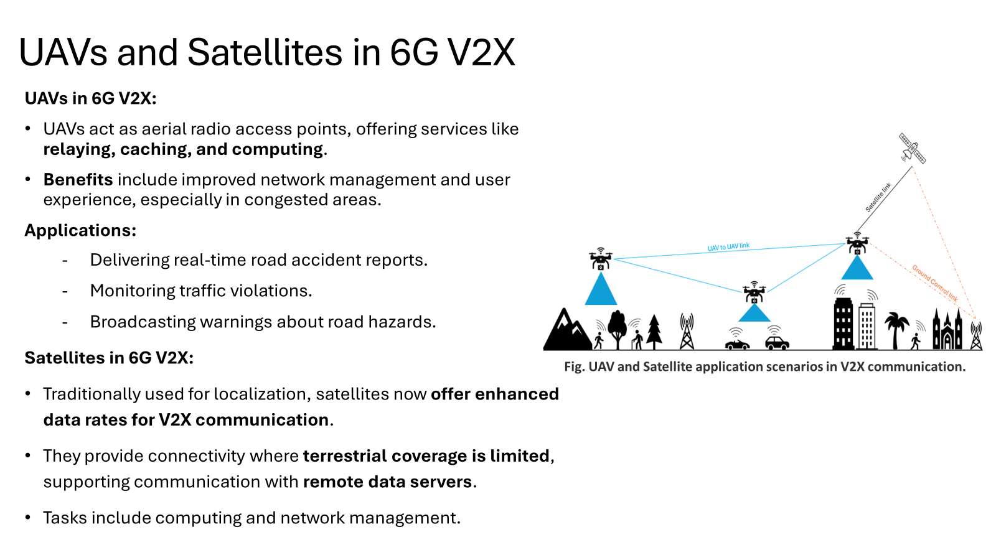
12/16

Slide 13
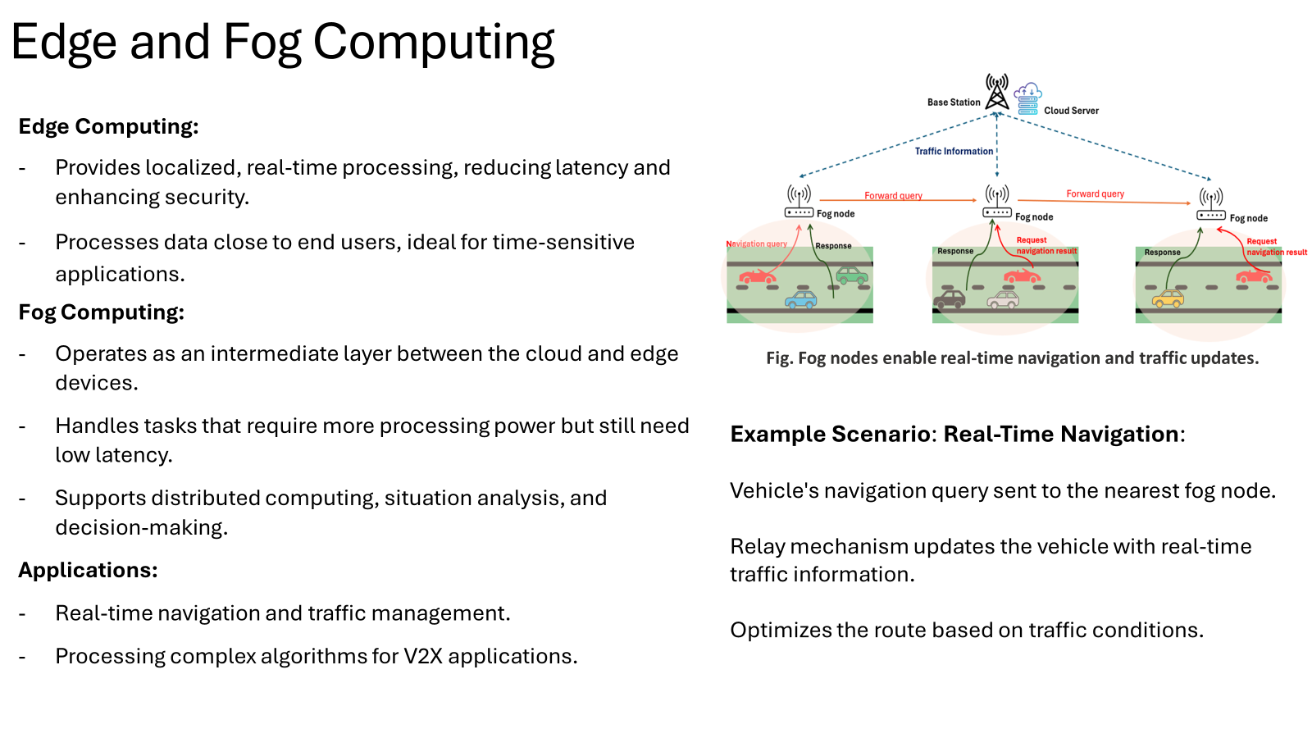
13/16

Slide 14
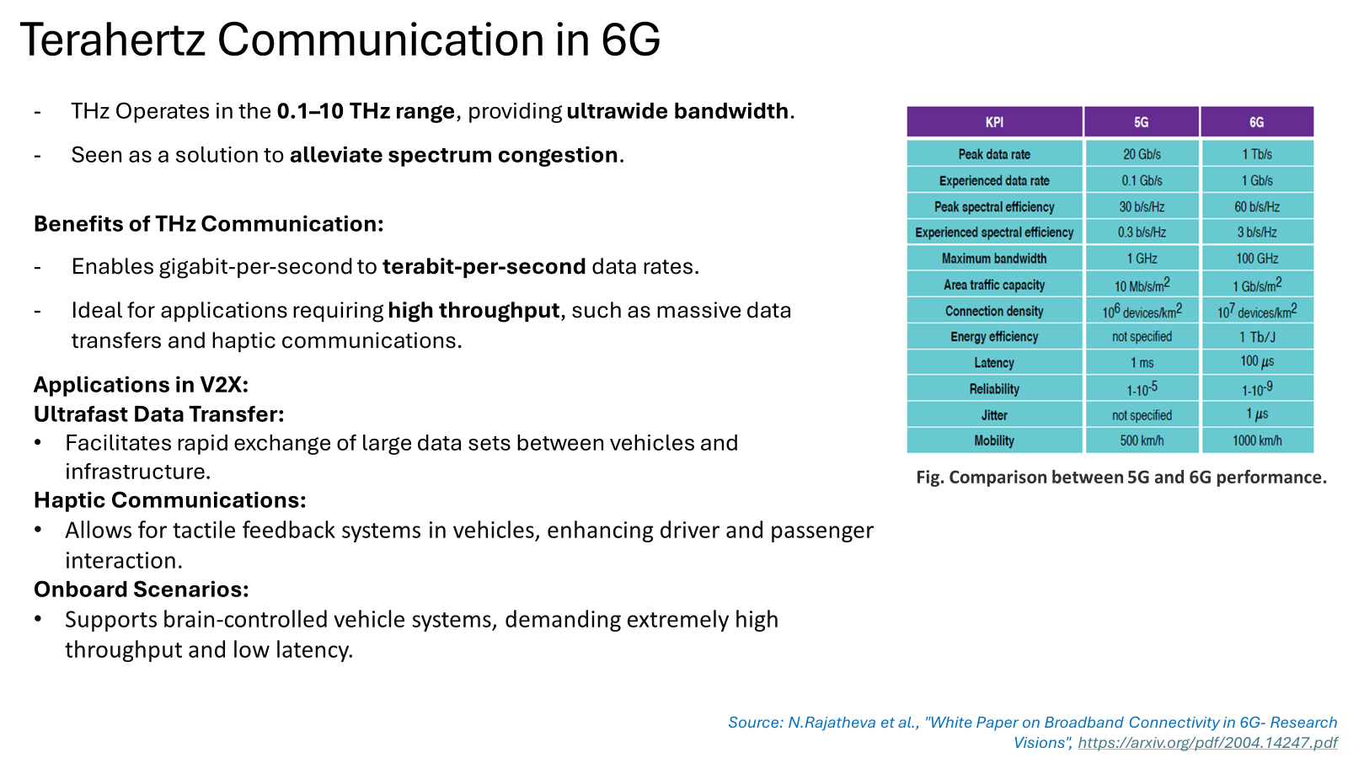
14/16

Slide 15
Conclusion
LTE-Cellular-Based V2X - better reliability then IEEE 802.11p - enhanced throughput and lower latency then DSRC; faces challenges at high vehicle speeds due to the Doppler effect.
While 5G provides better reliability and decent latency, it still faces handover complexities, shadowing and channel interfering.
6G Vision “Fully digital and connected world”:
Improved safety, traffic efficiency, and enhanced user experience.
Seamless connectivity in urban and remote areas.
Final Thoughts:
The evolution of V2X communication is crucial for the future of intelligent transportation systems.
Continuous research and development are essential to overcome current challenges and leverage new opportunities.
Collaboration among industry, academia, and regulatory bodies is key to realizing the full potential of V2X technologies.
15/16

Slide 16
Thank you
16/16

