Slide 1

Get It Done!
Jahanvi Patel
Project Prototype

Slide 2

Frontend Design

Slide 3
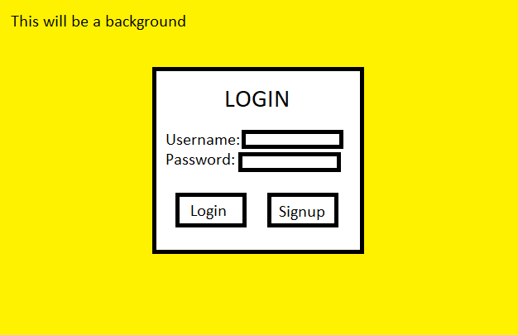
Login Screen
This screen will be the default initial screen of the website
Allows user to login with credentials or go to the signup screen if user does not have credentials

Slide 4
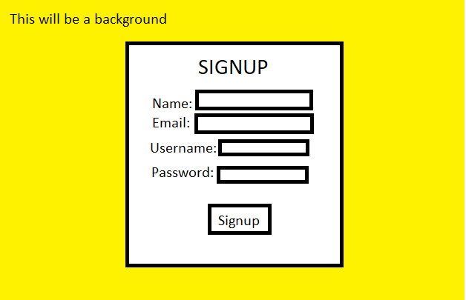
Signup Screen
This screen will show when the user clicks on the “Sign Up” button on the login screen
Allows user to sign up with Name, Email, Username, Password

Slide 5
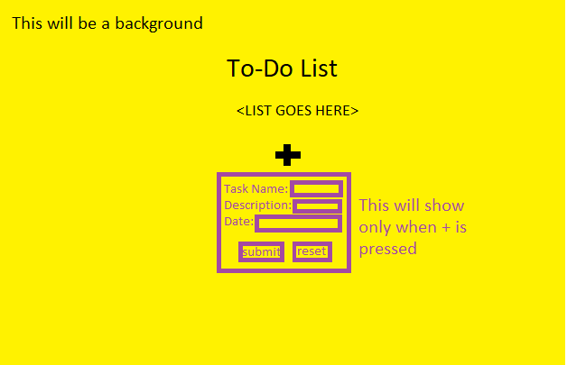
Home Page
Shows a list of tasks that need to be complete
The ability to add tasks
The ability to complete tasks

Slide 6
Backend Design

Slide 7
Database Design
Firebase Realtime Database
Users will be added when created
Users
<USERNAME>
Email: <EMAIL>
Name: <NAME>
Password: <PASSWORD>

Slide 8
Functionality

Slide 9
Functionality of Get It Done! Website
View tasks that need to be complete
Mark tasks as complete
Add tasks
Sign Up, Login as a group
A website allowing a group of individuals to complete tasks

