Slide 1
Project Presentation of CO-OP Project at Industry (Module-2) (22CS421)
On
IoT Based Smart Classroom Monitoring Framework
Jahanvi Sharma(2210991692)
Rahul Mehra (2210992130)
Supervised By
Mr. Shyam Goyal
Department of Computer Science and Engineering,
Chitkara University, Punjab

Slide 2
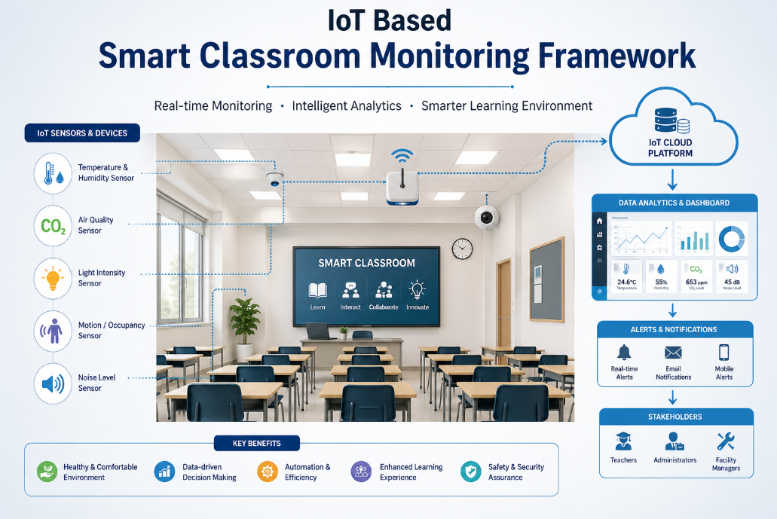
Introduction: The Digital Shift in Mental Health
Contextual Background
An IoT-based smart classroom uses connected sensors to monitor environment and activity in real time.It applies analytics to improve teaching and classroom management.This enables a safer, smarter, and more efficient learning environment.
The Role of Technology
Technology enables real-time monitoring and automation in smart classroom through connected Iot devices.
Research Goal
To design and develop an IoT based smart classroom monitoring framework for real time data collection and to analyze classroom conditions.
2

Slide 3
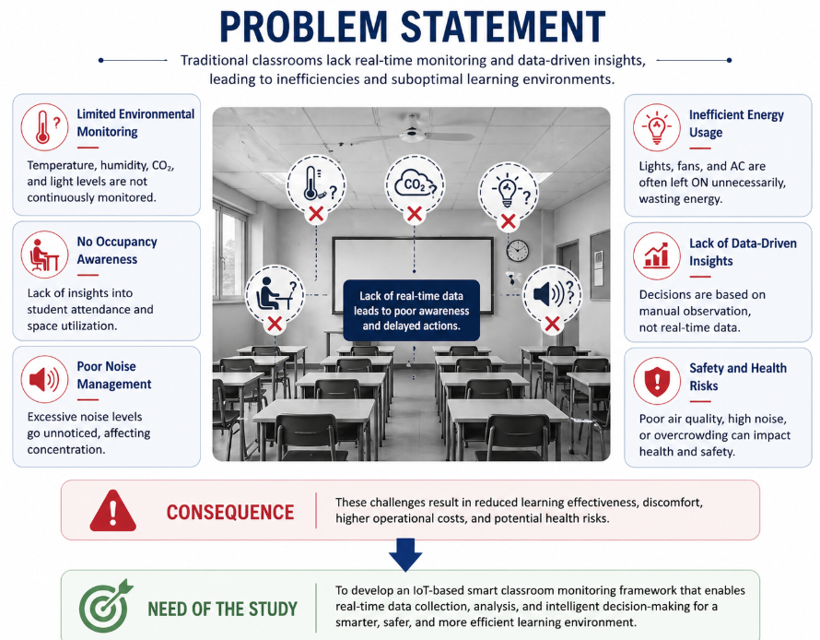
Problem Statement
Current Challenge
The traditional classrooms are old and there are many challenges that affect effective learning of the students like air quality , noise and temperature.
Data Complexity
Data collected from multiple IoT sensors is diverse , high volume and difficult to mange in real time.
The Specific Challenge
There Integrating data from multiple IoT sensors into a unified , real time monitoring system remains a key challenge.

Slide 4
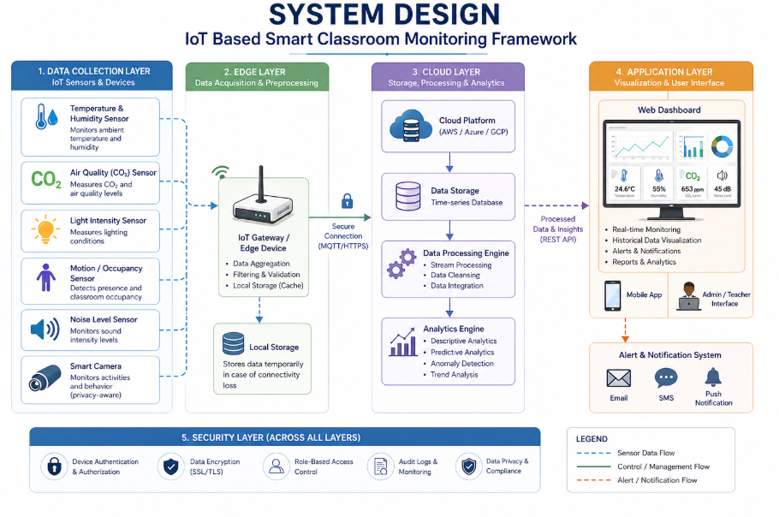
System Design
Data Ingestion:
Input: Real Classroom dataset (1,259+ records).
Feature Set: Temprature, Noise, and light intensity.
Preprocessing Engine:
Cleaning: Removing outliers and handling null values.
Encoding: Label Encoding for
categorical survey responses.
Scaling: Feature normalisation via
Standard Scaler.
Output Layer:
Binary Classification: Risk
vs. No Risk.
Model Implementation:
Comparative analysis: LR, SVM, Random Forest, and Gradient Boosting.
80/20 Train-Test split with Cross-Validation.

Slide 5
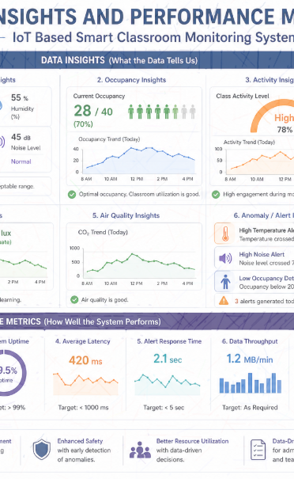
Data Insights & Performance Metrics
Feature Distribution:
Work Features are distributed across multiple layers , including sensing , edge processing , cloud analytics and user applications. This layered distribution ensures efficient data flow.
Comparative Model Strategy:
A collaborative model strategy integrates stakeholders such as teachers , administrators and IT teams to ensure effective system implementation and use.
Success Criteria (The Metrics):
Accuracy: Accurate real time data collection and reliable system performance with minimal latency.

Slide 6
Conclusion
In conclusion, the IoT-based smart classroom monitoring framework offers an efficient and intelligent solution to modern educational challenges by enabling real-time data collection, analysis, and decision-making. It enhances classroom safety, optimizes resource utilization, and improves the overall learning environment through continuous monitoring and automation. By integrating advanced technologies, the system supports data-driven insights that lead to better management, higher engagement, and improved educational outcomes.

Slide 7
Thank You
7

