Slide 1

Foundation of Organizational Structure
Presentation By M.JAHANZAIIB GUL ARIZ HAMZA YOUSAF USMAN GHANI RAZA ALI

Slide 2

What is Organizational Structure?
Organizational Structure: How jobs are formally divided, grouped and coordinated.
Key Elements: Work Specialization Departmentalization Chain of Command Span of control Formalization Centralization and decentralization

Slide 3
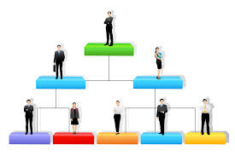
What are different designs for Organizational Structure?
Types of Organizational Structure Administrative Structure Functional Structure Divisional Structure Matrix Structure

Slide 4

What is Organizational Communication?
Organizational Communication: Organizational communication is the process by which activities of an organization are collected and coordinated to reach the goals of both individual and organization.
Types of business Communication Internal Communication External Communication

Slide 5

How does Communication flows in an Organization?
Communication structure in an Organization
The different levels in the organizational structure have to communicate with each other in a systematic manner to avoid confusion, misunderstanding and chaos.
In an organization, communication flows in 5 main directions Downward Upward Lateral Diagonal External

Slide 6

What is importance of a proper Organizational structure?
It enables members to know their responsibilities.
It frees the manager and the individual worker to concentrate on their respective rules and responsibilities
It coordinates all organizational activities so there is minimal duplication of efforts and conflict.
Avoids overlapping of functions because it pinpoints responsibilities.
Show to whom and for whom they are responsible

Slide 7
Thank You…

