Slide 1

Password strength tester & strong password generator
JAHANZEB KHAIRI (22K-4746)
YAHYA KHAN (22K-4690)
JAHANZAIB SHAIKH (22K-4789)

Slide 2

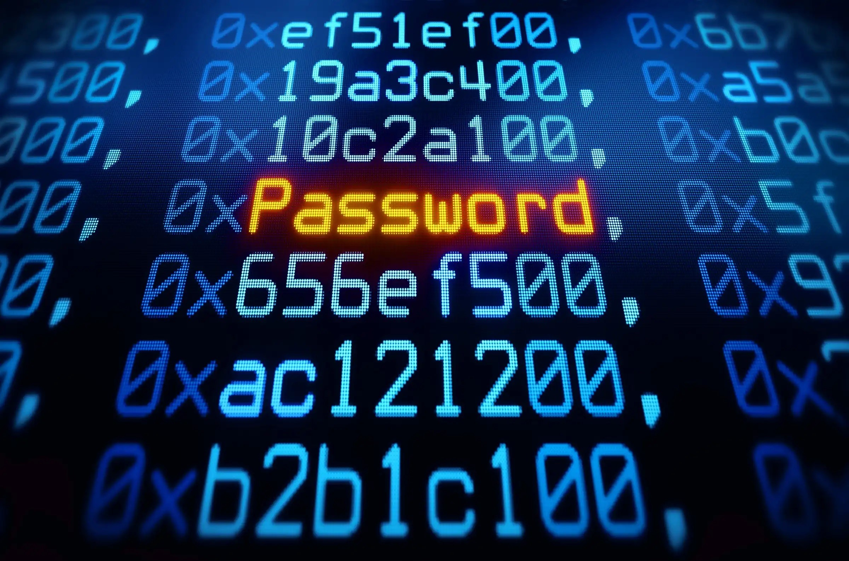

Agenda
What is a password
Project’s Objective
Password Analysis
Password Generation
Conclusion

Slide 3




Introduction
Security is a multifaceted concept aimed at safeguarding individuals, organizations, and societies from potential harm and threats. It encompasses various domains such as physical security, information security, and cybersecurity, all unified by the common goal of risk management. The fundamental principles of prevention, detection, response, and recovery apply across these domains, emphasizing the need for a holistic approach. In an interconnected world, events in one domain can have cascading effects, underscoring the importance of integrated security measures. Collaboration among physical, technological, and human elements, supported by policies and ongoing awareness, is crucial for an effective and adaptive security strategy. Ultimately, security is a dynamic and evolving field that requires a unified and proactive approach to address the diverse challenges and risks in modern society..

Slide 4

What is a password
It’s ties to security

Slide 5
A password is a confidential sequence of characters used to authenticate a user's identity. It ensures that only authorized individuals can access protected information or systems. The strength and confidentiality of passwords directly impact the security of digital assets. Effective password management is essential for preventing unauthorized access and protecting sensitive data, making passwords a fundamental component of overall cybersecurity.

Slide 6
Classification of passwords
Weak password
Average password
Strong password
A weak password is typically short, easily guessable, and lacks complexity. It often includes common words, phrases, or easily accessible personal information, making it susceptible to unauthorized access.
An average password is moderately secure, usually combining letters, numbers, and symbols. While it provides a reasonable level of protection, it may still be vulnerable to advanced hacking techniques if not regularly updated or lacks uniqueness.
A strong password is characterized by its length, complexity, and randomness. It incorporates a mix of uppercase and lowercase letters, numbers, and special characters, making it highly resistant to brute-force attacks. Regularly updating strong passwords enhances overall security

Slide 7
Project’s Objective
The goal to achieve

Slide 8
Objectives
Develop a password strength tester and generator program in C++.
Implement functions to analyze the strength of user-entered passwords based on criteria like length, character types, and the presence of common words.
Create a password generator within the program to generate random passwords meeting specified criteria, including a balance of numerals, lowercase and uppercase letters, and special characters.
Provide an interactive user interface allowing users to choose between testing password strength and generating new passwords.
Enhance cybersecurity awareness by promoting the use of strong passwords through the program's functionalities.

Slide 9

Password Analysis
Road to cybersecurity

Slide 10
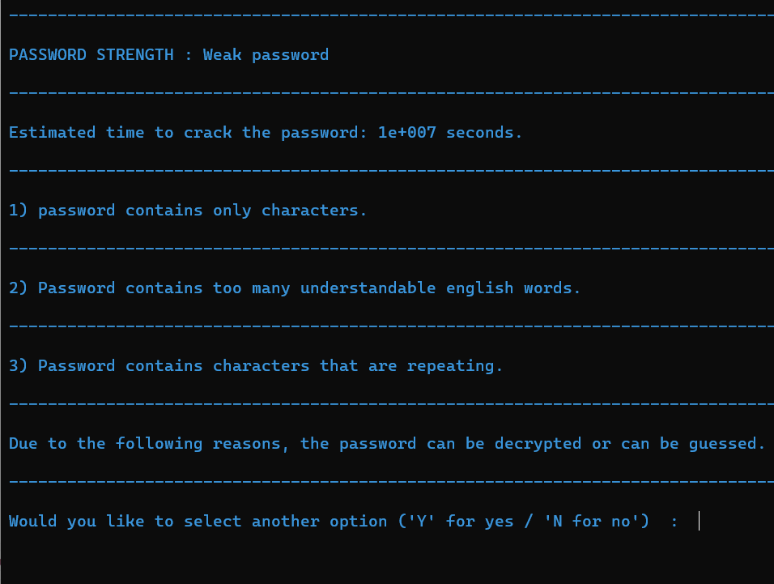
The code employs a comprehensive approach to analyze password strength, taking into account various factors that contribute to weaknesses or strengths in a password :
Length Check : The program ensures a minimum password length of 8 characters, highlighting the importance of sufficient length for security.
Character Composition : It examines the composition of the password, distinguishing between lowercase letters, uppercase letters, digits, and special symbols

Slide 11
Password Analysis
Repetition Check : The code identifies repeated characters within the password, as excessive repetition can weaken its security.
Common Word Detection : Utilizing external word lists from files ("TEXT.txt" and "words.txt"), the program checks if the password contains common English words. A higher count of recognizable words may indicate a weaker password.
Pattern recognition : The code assesses if the password follows certain predictable patterns, such as containing only lowercase or uppercase letters, digits, or special symbols, as these patterns can make the password more susceptible to attacks.
Scoring System : The code employs a scoring system to categorize passwords into three strength levels: Weak, Average, and Strong. The scoring considers factors like word count, repetition, and the presence of different character types.
Time to Crack Estimation : For weak passwords, the program estimates the time it would take to crack the password using a brute-force attack, providing users with a tangible understanding of the potential risks.

Slide 12

Password Generation
Creation of effectiveness

Slide 13
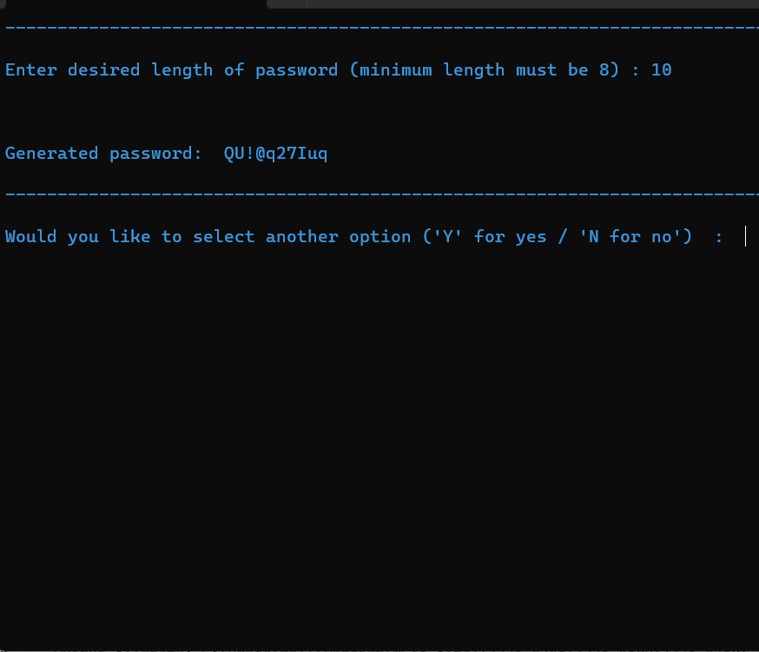
The code employs a systematic approach to automatically generate strong passwords with the following key strategies :
User Input : The program prompts the user to specify the desired length for the generated password, ensuring that it meets a minimum length requirement of 8 characters.
Randomization : The code utilizes the rand() function along with the current time (time(NULL)) to introduce randomness, ensuring the unpredictability of the generated password.
Character Types : The generator maintains a balance of character types, including numerals, lowercase letters, uppercase letters, and special characters, to enhance the complexity of the password.

Slide 14
Password Generation
Pattern Avoidance : To avoid predictable patterns, the generator limits the repetition of characters within the password, preventing consecutive characters from being of the same type.
Dynamic Composition : The generator dynamically composes the password by randomly selecting characters from predefined arrays of numerals, lowercase and uppercase letters, and special symbols.
Balanced Composition : To enhance security, the code ensures a balanced representation of character types, preventing an overemphasis on a single type that could weaken the password.
Interactive Output : The generated password is presented to the user in an interactive and user-friendly manner, ensuring accessibility and ease of use.

Slide 15
Conclusion
In conclusion, the C++ project excels in password security with a robust strength tester and generator. It assesses passwords for weaknesses, educates users on potential risks, and estimates cracking time for weak passwords. The automated generator creates strong passwords by balancing character types and avoiding predictable patterns. The user-friendly interface enhances accessibility, making it a valuable tool for cybersecurity awareness and informed password choices. The project effectively contributes to creating a secure digital environment.

Slide 16


Thank You

