Slide 1
MULTIPLE REGRESSION MODEL

Slide 2
Question: A Data was collected to determine the relationship between the blood pressure(mmHg)
and age and weight (pounds),26 patients were selected at random and the data is shown in
the following table (in .csv file)
#multiple linear regression model
#importing data
library(readxl)
MLRM_data <-read.csv(file.choose(),header=T)
MLRM_data<-read_excel(file.choose(),header=T)
MLRM_data <-read_excel("C:\\Users\\Altaf\\Desktop\\Downloads\\mlrmdata.xlsx")
View(MLRM_data)
#MATRIX of scatter plots we use pair func
pairs(MLRM_data[ ,1:3])
#Correlation coefficient matrix
round(cor(MLRM_data,method = "pearson"),2)

Slide 3
#or
library(Hmisc)
rcorr(as.matrix(MLRM_data))
#FITTING MULTIPLE LINEAR REGRESSION
mlrm<-lm(bd~age+weight , data=MLRM_data)
mlrm
#mlrm<-lm(bd~. , data=MLRM_data)#. space coz of unknown limit
summary(mlrm)
#the model is: bp=65.47722+0.07684*age+0.41343*weight
...The End........
......Thank you!.........
#Confidence intervals for the regression coefficients at 95% level of significance
confint(mlrm,level=0,95)
#predict bp for the given age =40 and weight =200
newdata=data.frame(age=40,weight=200)
predict(mlrm,newdata)
ci=predict(mlrm,newdata,interval="confidence",level=.95)
ci

Slide 4
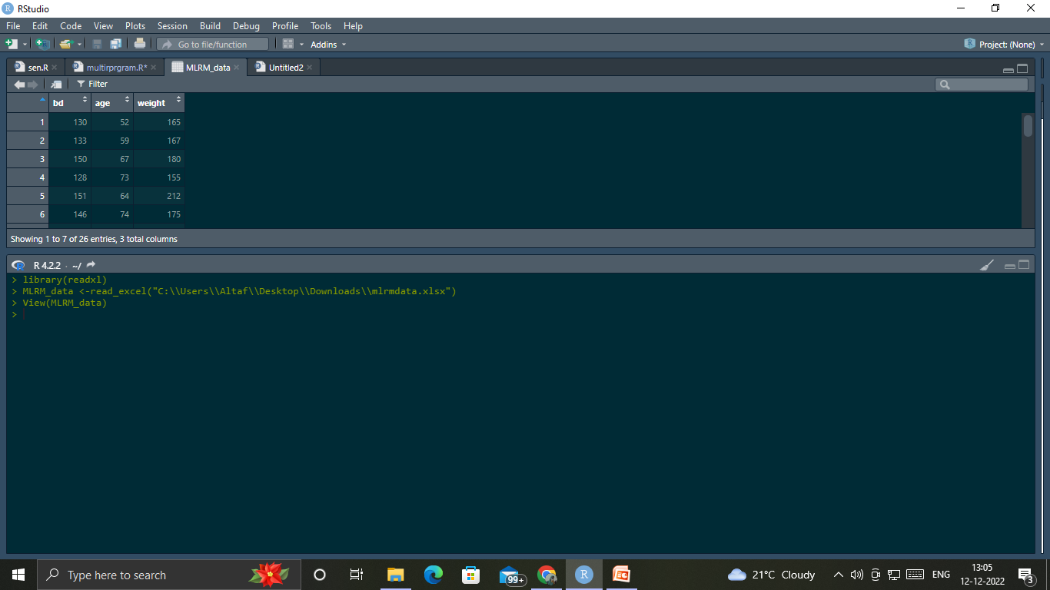

Slide 5
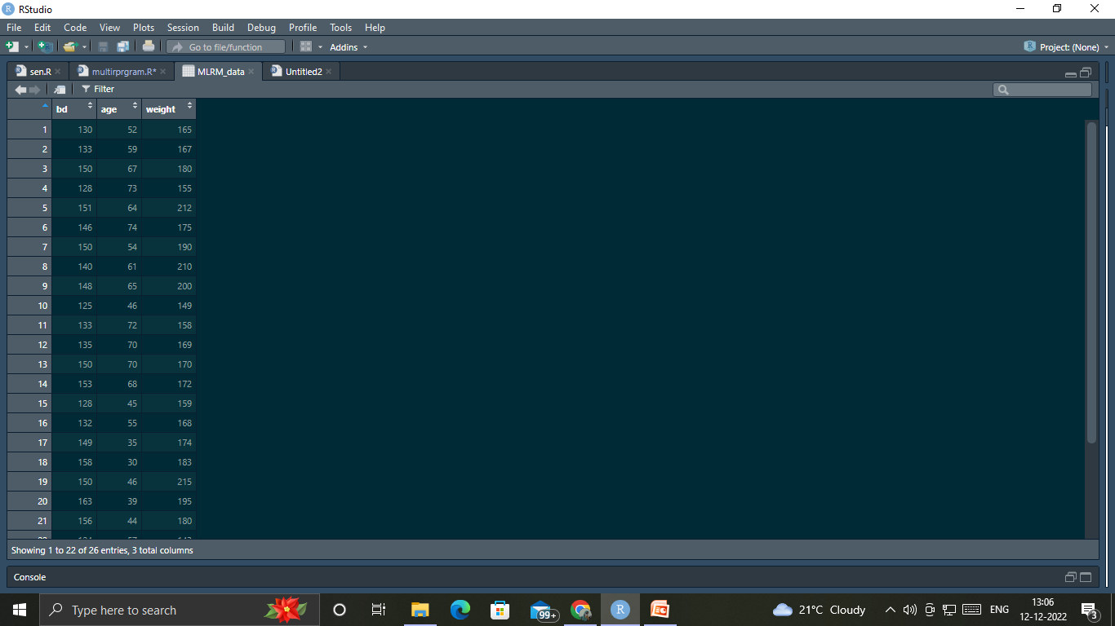

Slide 6
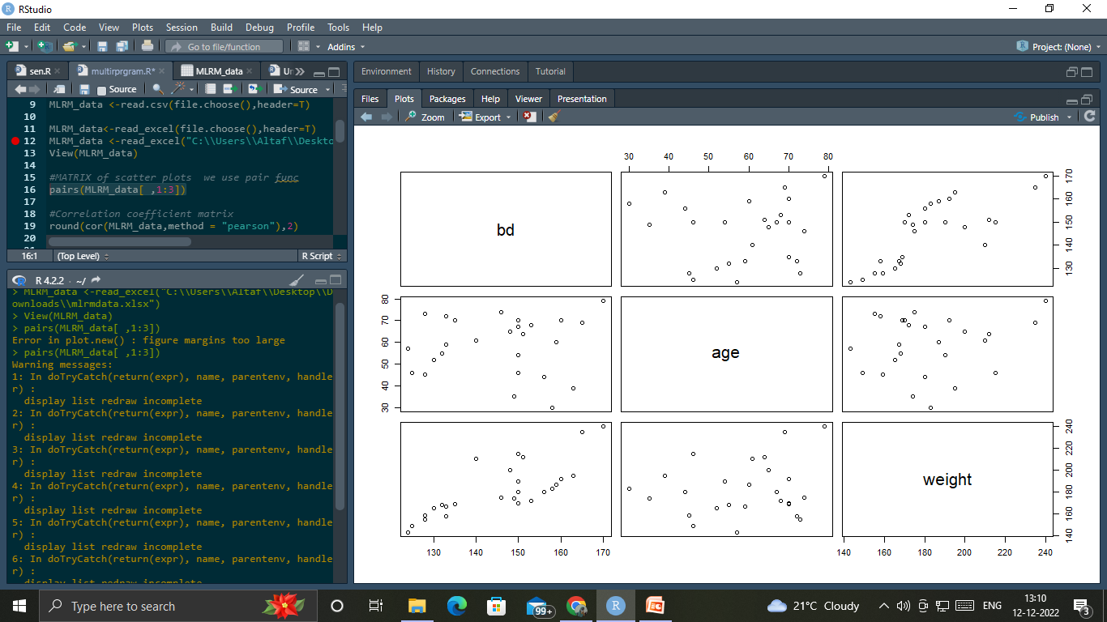

Slide 7
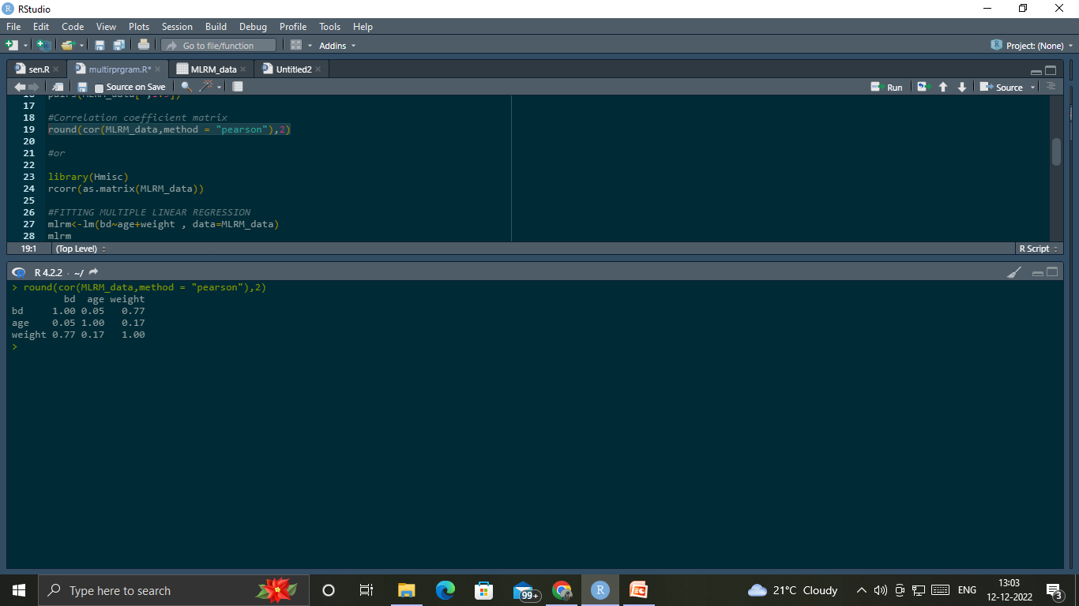

Slide 8
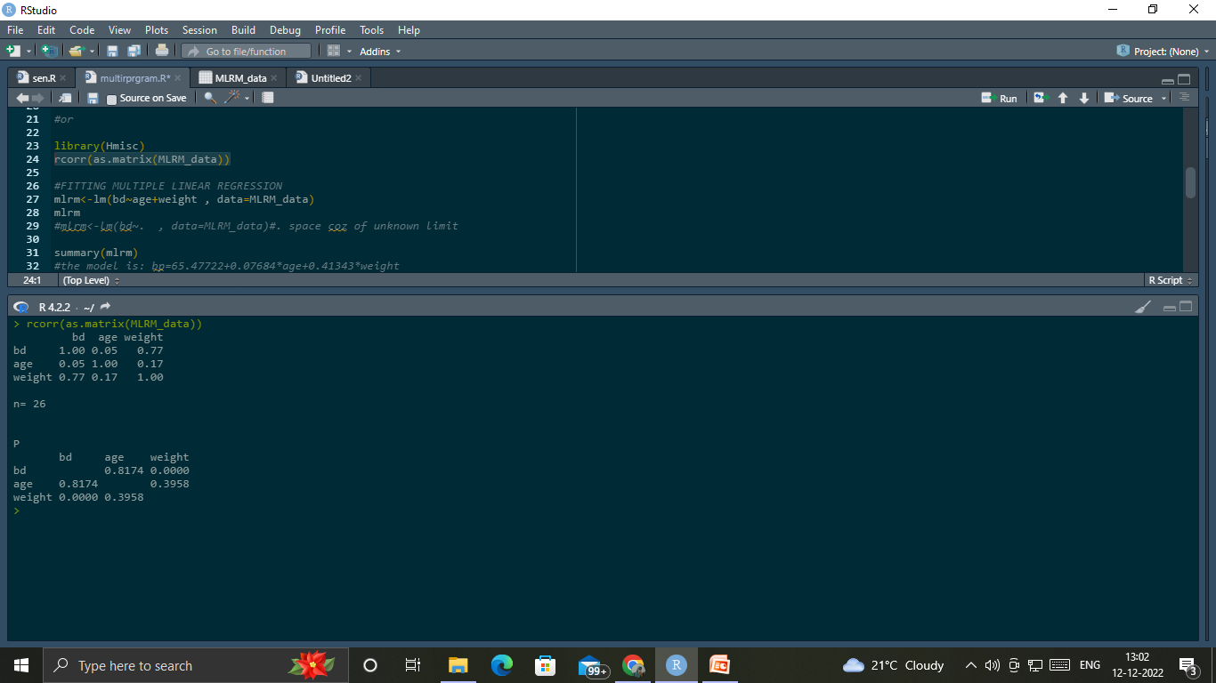

Slide 9
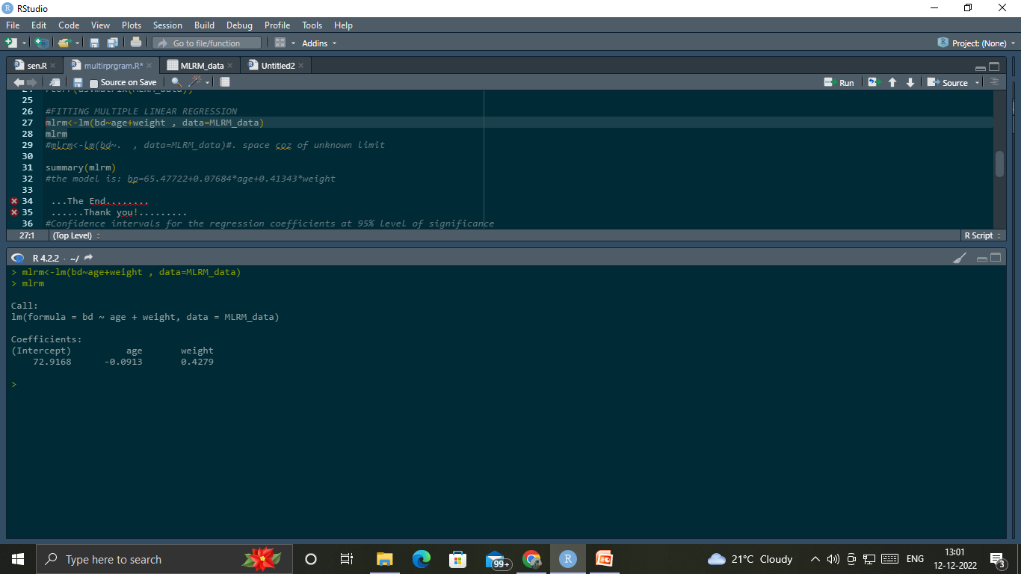

Slide 10
