Slide 1
Advanced Programming in Java
Sadegh Aliakbary
Sharif University of Technology
Spring 2012

Slide 2
Agenda
Object Creation
Object Storage
More on Arrays
Parameter Passing
For Each
VarArgs

Slide 3
public class Dog {
private String name;
public void setName(String n) {
name = n;
}
public void bark(){
System.out.println("Hop! Hop!");
}
}
Dog d = new Dog(); ➔ Object Creation (instantiation)
d.setName("Fido"); ➔ changing the object’s state
d.bark(); ➔ passing message to object
d is an object
d is a reference to an object
Class Declaration

Slide 4
Object Memory
Remember : an object has state, behavior and identity
Each object is stored in memory
Memory address ≈ object identity
Memory content ➔ object state
The behavior of an object is declared in its class
Class declaration is also stored in memory
But class declaration is stored once for each class
For each object a separate piece of memory is needed
To store its state

Slide 5

new Operator
new creates a new object from specified type
new String();
new Book();
new int();
Primitive types are not referenced

Slide 6
new
new operator creates a new object from the specified type
Returns the reference to the created object
String s = new String();
Dog d = new Dog();
Rectangle rectangle = new Rectangle();

Slide 7
Object References
Remember C++ pointers
When you declare an object, you declare its reference
String s;
Book b;
Exception: ?
Primitive types
Primitive types are not actually objects
They can not have references
Java references are different from C++ pointers
Java references are different from C++ references

Slide 8
Create Objects
This code will not create an object:
String str;
It just creates a reference
This is a key difference between Java and C++
You can not use “str” variable
“str” is null
null value in java
You should connect references to real objects
How to create objects?
new

Slide 9
new
new creates a piece of memory
Returns its reference
Where is the piece of memory?
In Heap
Where is the Heap?
Later…

Slide 10
Array in java
Array elements are stored in heap
Integer[] inumbers;
Person[] people = new Person[5];
int N = …
float[] realNumbers = new float[N];
Array elements are references not objects
Exception : primitives

Slide 11
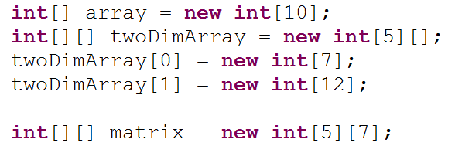
Primitive-Type Array Sample

Slide 12
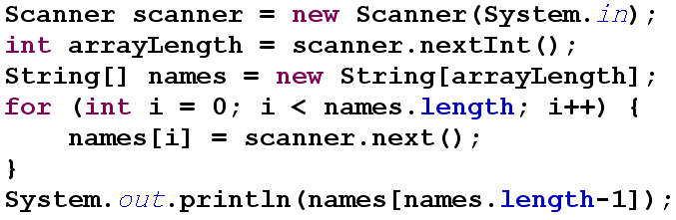
Array Samples

Slide 13
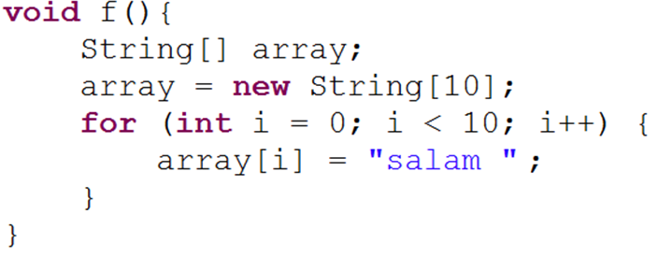
Array References
There is three type of variable in this code
array reference
array[i] references
Initial value: null
array[i] objects

Slide 14
public class Student {
private String name;
private Long id;
public String getName() {
return name;
}
public void setName(String name) {
this.name = name;
}
public Long getId() {
return id;
}
public void setId(Long id) {
this.id = id;
}
}

Slide 15
Array Sample
Student[] students = new Student[10];
for (int i = 0; i < students.length; i++) {
students[i] = new Student();
students[i].setId(i);
}

Slide 16
What Does Happen to Students After f() Method Invocation?
void f() {
Student[] students = new Student[10];
for (int i = 0; i < students.length; i++) {
students[i] = new Student();
students[i].setId(i);
}
}
void g() {
f();
}

Slide 17
Object Destruction
Allocated memory should be released
delete operator in C++
Problems with delete in C++
Error-Prone
Segmentation Fault!
Sometimes causes memory leak
a program consumes memory but is unable to release it
Complicated in many situations
You don’t need it in java
Garbage Collection

Slide 18

Quiz!
Write a java class for representing …

Slide 19
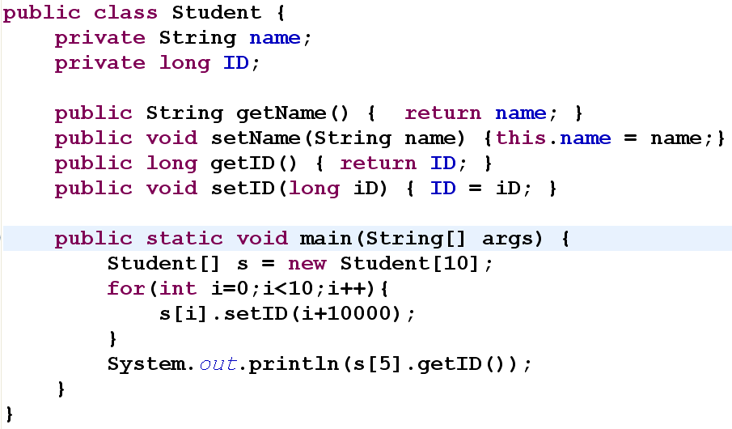
What is the output of this code?

Slide 20
Review
Reality
Object class (category, type)
Person, Book, Ball, …
Object instance
Ali Daei, my laptop, …
Object Abstraction
Abstract Data Type
Object Declaration (Class Declaration)
Object Instantiation
new
Object in Memory

Slide 21

Example
Reality : Person

Slide 22
Example
Object Abstraction
Abstract Data Type
Object Declaration (Class Declaration)
public class Person {
private String name;
private int age;
public void run(){...}
public void talk(){...}
}

Slide 23


Object Instances in Reality
JafarAgha Object

Slide 24
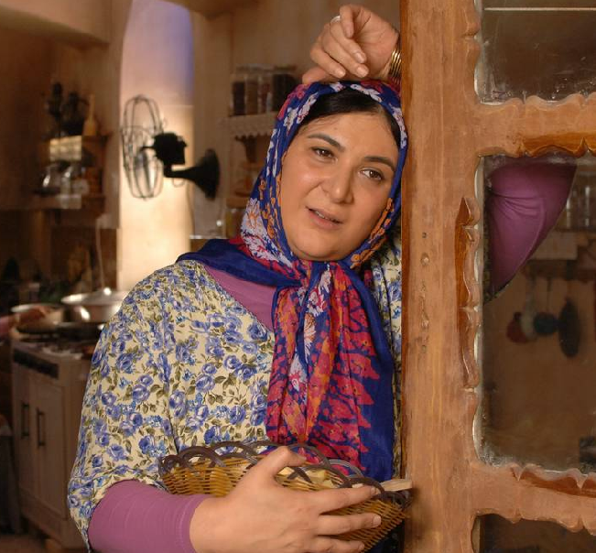
Object Instances in Reality
AzamKhanoom Object

Slide 25
Example
Object Instantiation
new
Person JafarAgha = new Person();
JafarAgha.setAge(50);
JafarAgha.setName("Jafar");
JafarAgha.talk();
Person AzamKhanoom = new Person();

Slide 26
Objects in Memory
50
…
J|a|f|a|r

Slide 27
Parameter Passing Styles
Call by value
Call by reference
Call by pointer
Java style : Call by passing value of references!
Let’s see!

Slide 28
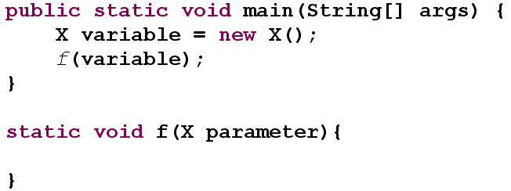

What happens in a method call

Slide 29
C++ Parameter Passing
Call by value
Call by pointer
Call by reference

Slide 30
void cppMethod(
Person byValue,
Person*byPointer,
Person& byReference){
byValue.name = "ali";
byPointer->name = "ali";
byReference.name = "ali";
}
Person p1, p3; Person* p2;
p2 = new Person(…);
cppMethod(p1, p2, p3);
This is a C++ code
This is NOT a java code!
Does p1.name change?
no
Does p2->name change?
yes
Does p3.name change?
yes

Slide 31
void cppMethod(
Person byValue,
Person*byPointer,
Person& byReference){
Person* newP = new Person;
byValue = *newP;
byPointer = newP;
byReference = *newP;
}
cppMethod(p1, p2, p3);
This is a C++ code
This is NOT a java code!
Does p1 change?
no
Does p2 change?
no
Does p3 change?
yes

Slide 32
Java Parameter Passing
Java has no pointer
Java references are different from C++ references
Java references are more like C++ pointers
than C++ references
A Java reference is something like a limited pointer

Slide 33
Does p1.age change?
yes
Does myInt change?
no
Does p2 change?
no
public void javaMethod(
Person first,
Person second,
int number){
first.age = 12;
number = 5;
Person newP = new Person();
second = newP;
}
javaMethod(p1, p2, myInt);
In java, primitive variables are passed to methods by their values
Reference values are passed by their reference values.

Slide 34
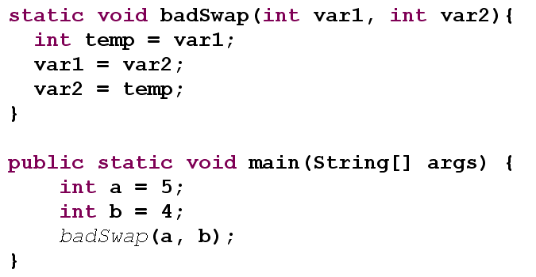
Swap

Slide 35
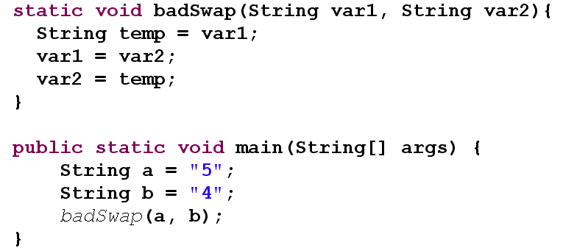
Swap (2)

Slide 36
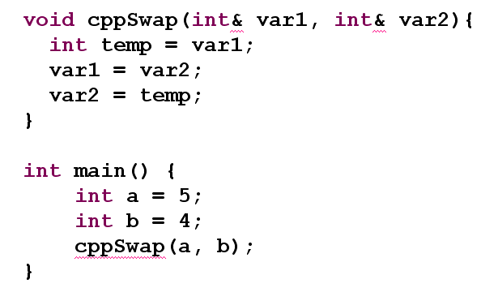
Call by reference in C++

Slide 37
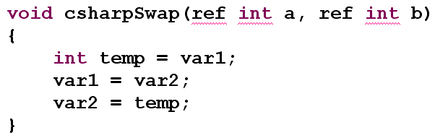
Call by reference in C#

Slide 38
In java
Everything is passed by value
Primitive-types are passed by value
References are passed by value
But not the value of the object
the value of the reference
If you want to pass something by reference…
Wrap it in an object
And make it mutable

Slide 39
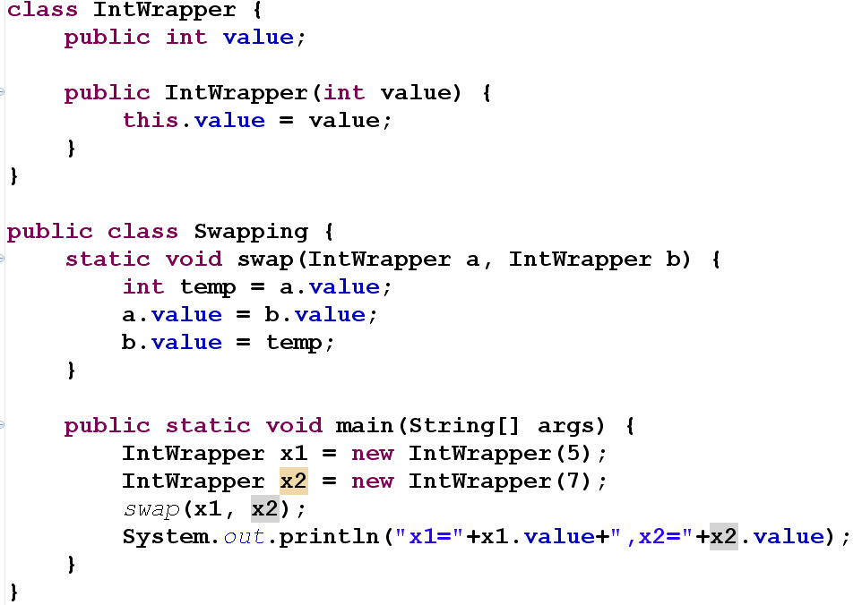

Slide 40
For each

Slide 41
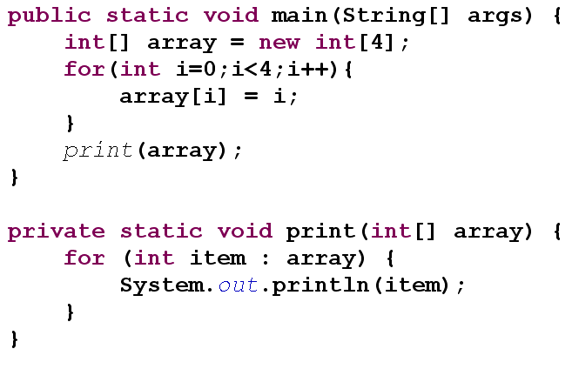
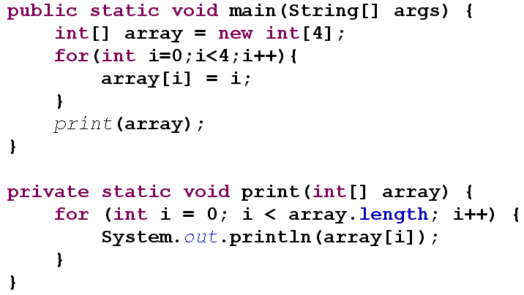
For Each

Slide 42
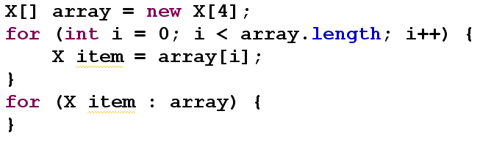
For Each (2)
In for each expression, each element is assigned to another variable
If X is a primitive type, element values are copied into item variable

Slide 43
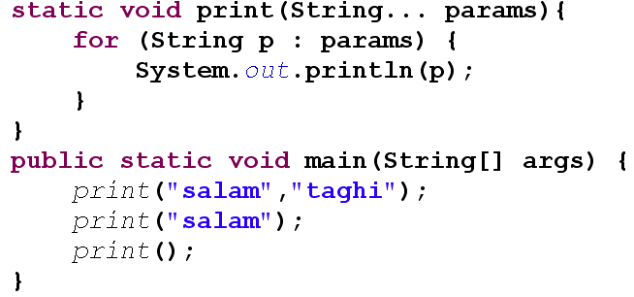
Variable argument lists

Slide 44
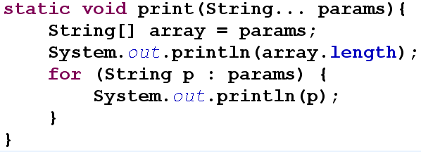
Variable argument lists
Sometimes they are called vararg
Varargs are actually arrays

Slide 45

Quiz!

Slide 46
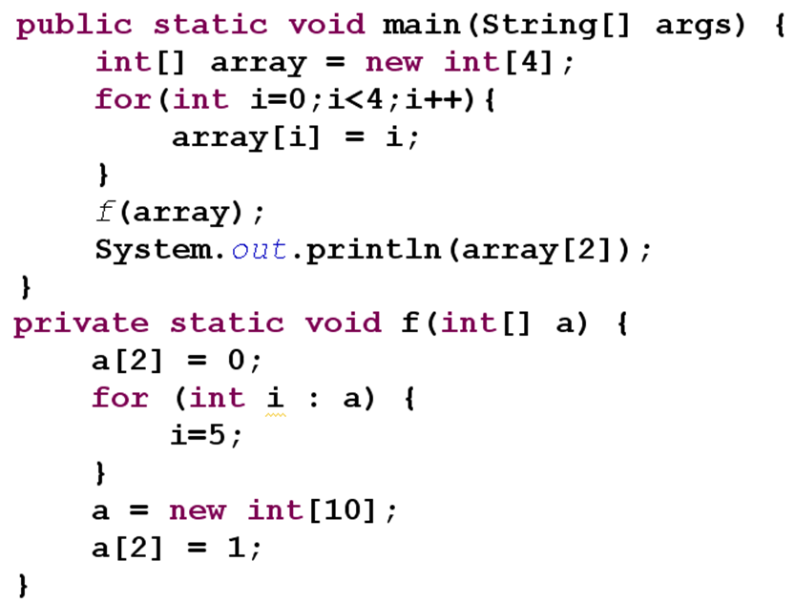

Slide 47
Where storage lives
Registers
Stack
Heap
Constants
Non-RAM

Slide 48
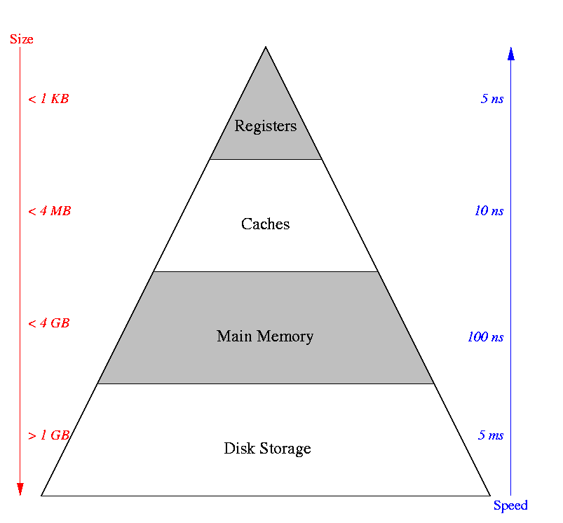
Memory Hierarchy

Slide 49
Registers
Fastest
Inside the CPU
Number of registers are limited
You don’t have direct control over registers
In assembly you have direct access to registers
C and C++ have access to this storage to some extent

Slide 50
The Stack
In RAM
Slower than register but less limited
Mechanism of function call in CPU
Stack pointer (cp)
Support of CPU
Java references are (usually) placed on stack
Primitive data types are also (usually) located in stack
Java compiler must know the lifetime and size of all the items on the stack
Java objects themselves are not placed on the stack

Slide 51
The stack (cont.)
C++ allows allocation of objects on the stack
E.g. this code creates an object on the stack
Person p;
In C++ it creates an object on the stack
In Java it creates only a reference on the stack
The actual object will be on Heap
C++ allows arrays of known size on stack
Java does not!

Slide 52
Compile time vs. Run time
Some information are available at compile time
Stack elements should be specified in compile time
So C++ allows these variables on stack:
int array[10];
Person p;
Some information are not available at compile time
So variable length variables can not be on stack
If n is a variable “int array[n] “ is not allowed in C++
Java is simple! No object on stack!

Slide 53
The Heap
This is a general-purpose pool of memory
Also in the RAM area
All Java objects live here
The compiler doesn’t need to know the length of the variables
new operator ➔ the storage is allocated on the heap
The objects may become garbage
Garbage collection

Slide 54
Heap Generations
The heap is split up into generations
The young generation
stores short-lived objects that are created and immediately garbage collected
The Old generation
Objects that persist longer are moved to the old generation
also called the tenured generation
The permanent generation (or permgen)
is used for class definitions and associated metadata

Slide 55
Other storages
Constant values are often placed directly in the program code
Non-RAM Storage
Streamed objects
Persistent objects

Slide 56
Primitive Types
new is not efficient for these small variables
int a;
char ch;
In these cases, automatic variable is created
that is not a reference
The variable holds the value directly
It’s placed on the stack
Much more efficient
When these primitives are not stored on stack?
When they are inside an object

Slide 57
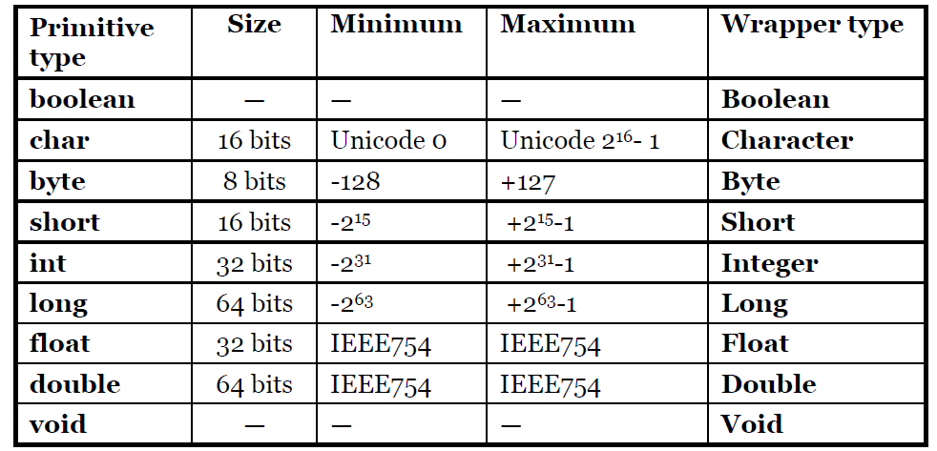
Java Primitive Types

Slide 58
Primitive Wrapper Classes
Used to represent primitive values when an Object is required
All of them are immutable
Java 5 added some shortcuts for their assignment

Slide 59
Sample
Integer i = new Integer(2);
Integer j = new Integer(2);
System.out.println(i==j);
//Prints false. Why?
i = j;//Reference Assignment
i = 2;//OK. A new shortcut in Java5+
Long l = 2;//Syntax Error. Why?
Long l = 2L;//OK
l = i;//Syntax Error. Why?

Slide 60


