Slide 1
Advanced Programming in Java
Sadegh Aliakbary
Sharif University of Technology
Spring 2012

Slide 2
Agenda
Introduction to Course
Syllabus
References
Evaluation Policy

Slide 3
This Course Covers:
Object Oriented Concepts
Fundamentals of Java programming language
Some Programming Skills
Software Quality
Test
Refactoring

Slide 4
Object Oriented Programming
Problem Space
the place where the problem exists
such as a business
Solution Space
the place where you’re implementing that solution
such as a computer
The effort required to perform this mapping.
E.g. think about a library, or a phonebook program
Name solution space entities.

Slide 5
Object Oriented Approach
OOP lets the programmer represent problem space elements
The elements in the problem space
and their representations in the solution space
are referred to as “objects”

Slide 6
OOP
The program is allowed to adapt itself to the lingo of the problem
by adding new types of objects
when you read the code, you’re reading words that also express the problem.

Slide 7
OOP (2)
OOP allows you to describe the problem in terms of the problem
Rather than in terms of the computer
Objects in your code are similar to real objects
Recall the sample programs: phonebook and library

Slide 8
Object Oriented Languages
Smalltalk
The first successful object-oriented language
One of the languages upon which Java is based
Java
C++
C##

Slide 9
Java History
Java was created in 1991
by James Gosling in Sun Microsystems
Initially called Oak
in honor of the tree outside Gosling's window
Its name was changed to Java
because there was already a language called Oak.
Sun Microsystems released the first public implementation as Java 1.0 in 1995
Java syntax is similar to C and C++.

Slide 10
Java Motivation
The need for platform independent language
To be embedded in various consumer electronic products
like toasters and refrigerators
Platform independent?!
Hardware
Operating System

Slide 11
Java Motivation (2)
At the same time, the World Wide Web and the Internet were gaining popularity.
Java could be used for internet programming.
Why?
Platform independence
Creation of Applets

Slide 12
The Java technology is:
A programming language
Java can create all kinds of applications
A development environment
A compiler (javac)
An interpreter (java)
A documentation generator (javadoc)
…
Compare it to C++

Slide 13
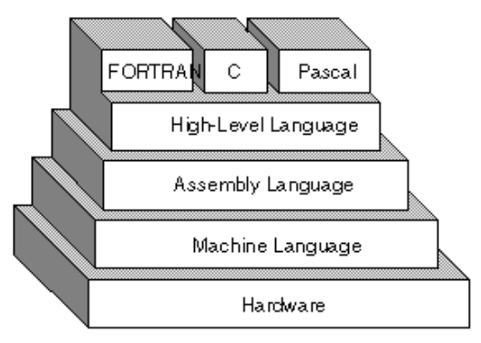
High-Level Languages

Slide 14
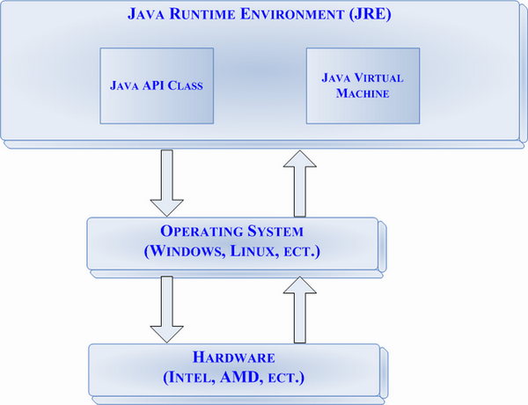
Java Virtual Machine

Slide 15
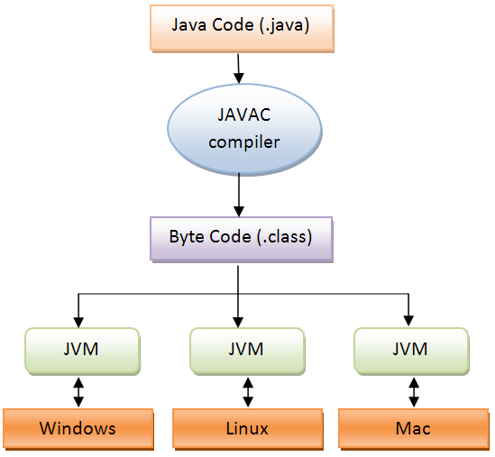
Compile and Execution Stages
Compare to C++ and Assembly
.NET Framework

Slide 16
Java is Popular
Some reports on programming languages popularity
According to
Job advertisements
Book sales
Finding code on the web
…

Slide 17
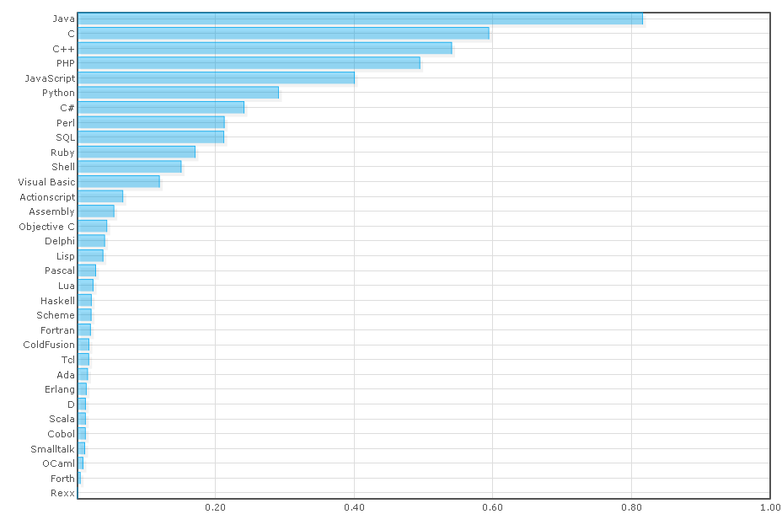
http://www.langpop.com
updated in 2010

Slide 18
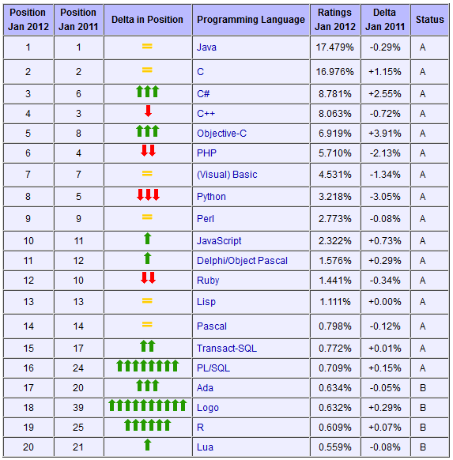
http://www.tiobe.com/index.php/content/paperinfo/tpci/index.html (2012)

Slide 19
Characteristics of Java
Java is simple
Java is object-oriented
Java is architecture-neutral
Java is portable
Java is interpreted
Java is multithreaded
Java is secure
Java is robust

Slide 20
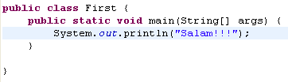
First Example
Create a file named First.java
Java class files have .java extension
Note to naming convention
Copy this lines to the file
Note: File name and class name should be the same.

Slide 21

Oracle, Sun, …

Slide 22
Further Reading
Read Java page on Wikipedia
http://en.wikipedia.org/wiki/Java_(programming_language)
Google this terms and phrases:
Java
Java Mobile
JVM
Byte code
Java Sun
Java and C++
Java and C#

Slide 23
Assignment # 0
Download and install JDK
http://www.oracle.com/technetwork/java/javase/downloads/index.html
JDK 7
Write a program that prints your name on the console
Compile and run the program

Slide 24
Topics
Introduction to java language
Java syntax, operators, conditions, loops, …
Strings
Arrays
Object Oriented Programming
Interface
Inheritance
Polymorphism
Software Quality
Refactoring
Test
Advanced Java Programming
Exception Handling
Generics
Collections
GUI
Threads
Files and Streams
Networking
Reflection

Slide 25
References
Java How to Program
Deitel & Deitel
9th Edition (6th+ editions are ok)
Thinking in Java
Bruce Eckel
Fourth Edition

Slide 26
Evaluation Policy
If you don’t want to attend this class…
Preparing notes for the course (Persian)
Even Slides
Artlets…
 | How many? | Total Grade
Quiz | 10+ | 4
Midterm Exam | 1 | 3
Final Exam | 1 | 5
Assignment | 3 | 3
Project | 3 | 5+

Slide 27
Course Homepage
https://ce.sharif.edu/courses
Lecture notes and reference books are uploaded here

Slide 28


