Slide 1
Advanced Programming in Java
Sadegh Aliakbary
Sharif University of Technology
Spring 2012

Slide 2
Quiz
What does it mean: “Java is platform-independent”
Which one is platform independent?
Microsoft Word
Mozilla Firefox
JVM

Slide 3
Agenda
Review
First program in java
Variables
Methods
Conditions
Loops

Slide 4
Review
Java is
Simple
object oriented
Robust
And popular
Java is platform independent.
Write Once, Run Anywhere!

Slide 5
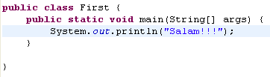
First Example
Create a file named First.java
Java class files have .java extension
Note to naming convention
Copy this lines to the file
Note: File name and class name should be the same.

Slide 6
First Example (2)
Run javac First.java
Run java First
We don’t use any IDE now.
To highlight compile and run stages.
Lets watch it in real world!

Slide 7
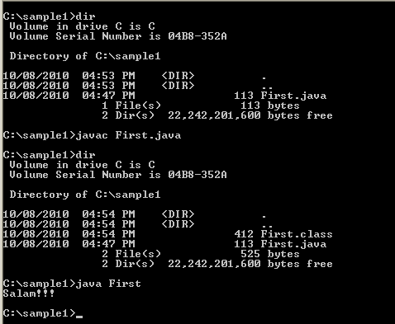
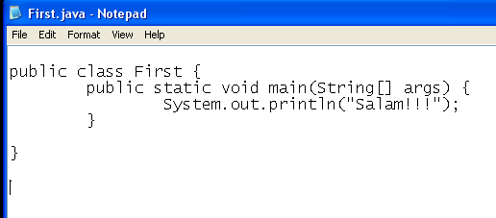
Overview of the Example

Slide 8
Java Programs
A simple java program is a file
The file contains one class
The class name equal to the file name
The names are case sensitive
The class contains a main method
When we run the program, the main method is executed

Slide 9
Variables
What is a variable?
A piece of memory
Holds data
For example a number, string or Boolean
Java variables have a fixed size
Platform independence

Slide 10
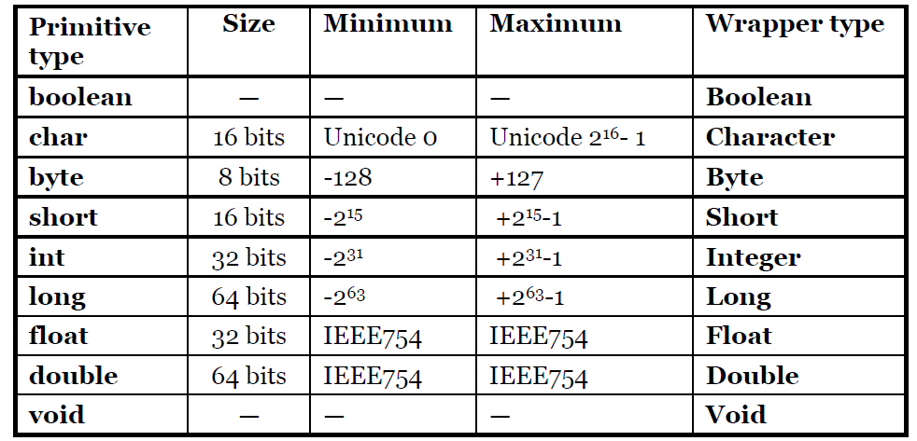
Java Primitive Types

Slide 11
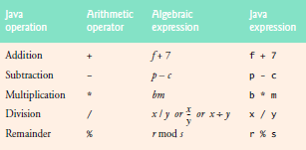
Arithmetic Operators

Slide 12
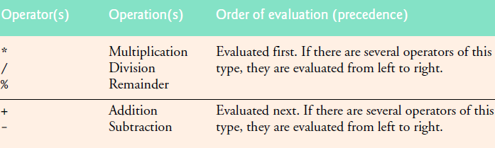
Operator Precedence
1 + 2 * 3 = ?
is treated as 1 + (2 * 3)

Slide 13
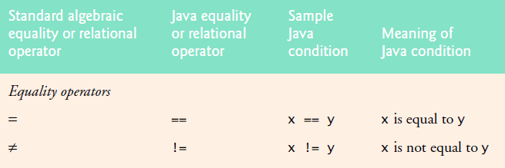
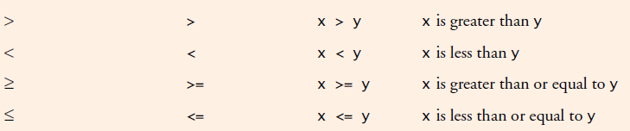
Equality and Relational Operators

Slide 14
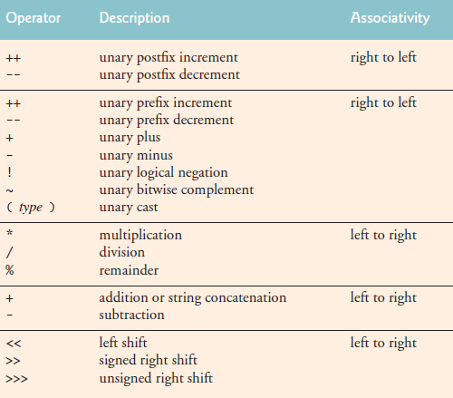
Operators

Slide 15
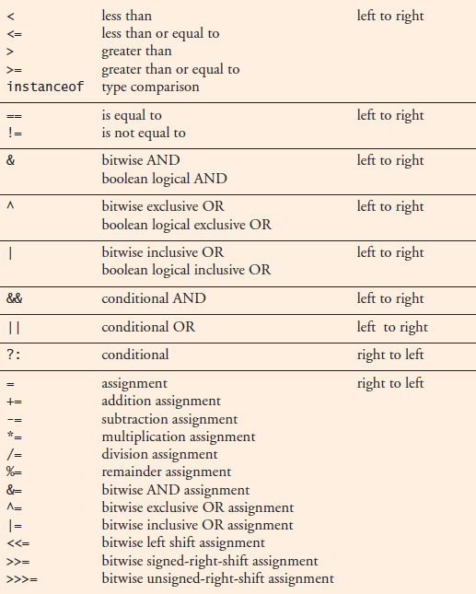
Operators

Slide 16
Associativity
When two operators with the same precendence the expression is evaluated according to its associativity.
x = y = z = 17
is treated as x = (y = (z = 17))
since the = operator has right-to-left associativty
72 / 2 / 3
is treated as (72 / 2) / 3
since the / operator has left-to-right associativity

Slide 17
A simple program
int a;
a = 12;
a+= 2;
int b;
b = 4;
b++;
b = a*b;
System.out.println(b);

Slide 18
Methods
A method is like a machine
Zero or more inputs
Zero or one output
Other names
Function
Procedure
method
inputs
output

Slide 19
Example
double add(double a, double b){
double result = a+b;
return result;
}
double x = 3;
double y = 4;
double add = add(x,y);
System.out.println(add);
Return type
Method name
parameters

Slide 20
Parameter Passing
Local variables
Java passes the parameters by value

Slide 21
Call by Value
public static void main(String[] args) {
double x =3;
double y =4;
double add = add(x,y);
System.out.println(add);
System.out.println(x);
}
static double add(double a, double b){
a = a+b;
return a;
}

Slide 22
Conditions
if(x>y){
System.out.println("X is greater than Y");
} else if(x==y){
System.out.println("X is equal to Y");
} else {
System.out.println("Y is greater than X");
}

Slide 23
Conditions (2)
boolean condition = x>y;
if(condition){
System.out.println("X is greater than Y");
}else{
System.out.println(“Y >= X");
}

Slide 24
Loops
while
do-while
for

Slide 25
While Loop
long counter=0;
while(counter<10){
counter++;
System.out.println(counter);
}

Slide 26
do-while Loop
long counter=0;
do{
counter++;
System.out.println(counter);
}while(counter<10);
do-while loop is executed at least one time

Slide 27
for
for (int i = 1; i <= 10; i++) {
System.out.println(i);
}

Slide 28
For Loop vs. While Loop
for (X; Y; Z) {
body();
}
X;
while(Y){
body();
Z;
}

Slide 29
For Loop vs. While Loop (2)
for (int i = 1; i <= 10; i++) {
System.out.println(i);
}
int i=1;
while(i<=10){
System.out.println(i);
i++;
}

Slide 30
goto
goto is a reserved word in java
But forbidden!

Slide 31


