Slide 1
Advanced Programming in Java
Sadegh Aliakbary
Sharif University of Technology
Spring 2012

Slide 2
Agenda
Review
User input
Scanner
Strong type checking
Other flow-control structures
switch
break & continue
Strings
Arrays

Slide 3
Review
Variables
Primitive data types
Operators
Methods
Parameter passing
Call by value
Conditions
If, else, else if
Loops
while
do-while
for

Slide 4
User Input
Print on console
System.out.println
How to read from console?
Scanner
Example:
Scanner scanner = new Scanner(System.in);
int n = scanner.nextInt();
double d = scanner.nextDouble();

Slide 5
Example
Scanner scanner = new Scanner(System.in);
int a = scanner.nextInt();
int b = scanner.nextInt();
long pow = power(a,b);
System.out.println(pow);

Slide 6
Type Checking
Java has a strong type-checking mechanism
Some assignment is not permitted
int intVal = 2;
long longVal =12;
intVal = longVal;➔Syntax Error
longVal = intVal;➔OK
intVal = (int)longVal;➔ OK (Type Casting)

Slide 7
Direct Type Conversion
byte
The arrows are transitive
All other conversions need an explicit cast
boolean is not convertible
char is a special type
short
char
int
long
boolean
float
double

Slide 8
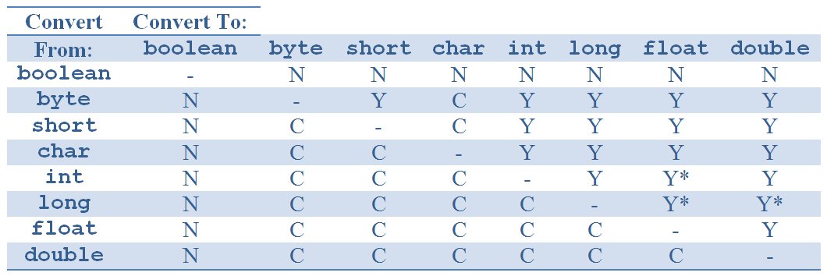
Type Conversion Grid
Notes:
Reference: http://docstore.mik.ua/orelly/java-ent/jnut/ch02_04.htm#javanut3-ch-2-tab-4

Slide 9
Type Conversion
N : the conversion cannot be performed
Y : the conversion is performed automatically and implicitly by Java
C : the conversion is a narrowing conversion and requires an explicit cast
Y* : the conversion is an automatic widening conversion, but that some of the least significant digits of the value may be lost by the conversion

Slide 10
Example
i = 123456789; //a big integer
f = i; //f stores and approximation of i
System.out.println(f);//output : 1.23456792E8
i = (int) f;
System.out.println(i); //output : 123456792
floating-point types are approximations of numbers
They cannot always hold as many significant digits as the integer types

Slide 11
Floating Point, Some Notes
Double.NaN
double nan = 0.0/0.0;
Infinity
double inf = Double.MAX_VALUE*2;
Negative infinity
double inf = Double.MAX_VALUE*(-2);
Double.NEGATIVE_INFINITY
Double.POSITIVE_INFINITY
Formatting a double
System.out.format("min double = %5.2f%n", ff);

Slide 12
Comparison
Compare doubles
Using == with float or double is an anti-pattern
An infinite loop:
for (float f = 10f; f != 0; f -= 0.1) {
System.out.println(f);
}

Slide 13
Numeric Assignments
Numeric Suffix
Double d = 123.54d;
Float f = 123f;
Long l = 123123 l;
byte b = 127;//Nothing
Assignment Overflow
Large long to int
Lower bits are used
No runtime error
Large double to integer
Brings a max int

Slide 14
Switch statement
An alternative to if-else
Better structure
Before Java 1.7
When the condition is a numeric or an ordinal variable
With Java 1.7
Strings are also allowed

Slide 15
switch example
switch (i) {
case 1:
System.out.println("1");
break;
case 2:
System.out.println("2");
break;
default:
System.out.println("default");
}

Slide 16
Scanner scanner = new Scanner(System.in);
boolean again = true;
while(again){
System.out.println("1: Play");
System.out.println("2: Setting:");
System.out.println("3: Exit");
System.out.print("Enter Your Choice:");
int i = scanner.nextInt();
switch (i) {
case 1:
play();
break;
case 2:
setting();
break;
case 3:
again = false;
break;
default:
System.out.println("Enter a valid number");
}
}

Slide 17
Break
Breaks the execution of a loop
while(true){
int nextInt = scanner.nextInt();
if(nextInt==0)
break;
...
}

Slide 18
Continue
Stops the execution of the body of the loop and continues from the beginning of the loop
for(int i=0;i<10;i++){
if(i==4)continue;
System.out.println(i);
}
Difference between continue in for and while

Slide 19
Nested Loops
Scanner scanner = new Scanner (System.in);
int nextInt;
do{
nextInt = scanner.nextInt();
for(int i=0;i<nextInt;i++){
System.out.println(i);
}
}while(nextInt>0);
How to break or continue from outer loop?

Slide 20
Label
outer: for (int i = 0; i < 10; i++)
inner: for (int j = 0; j < 10; j++) {
if (j == 2)
break outer;
else {
System.out.println(i);
System.out.println(j);
continue inner;
}
}

Slide 21
Tip of the Day: Indentation
int nextInt;
do{
nextInt = scanner.nextInt();
for(int i=0;i<nextInt;i++){
System.out.println(i);
}
}while(nextInt>0);

Slide 22
Tip of the Day: Indentation
int nextInt;
do{
nextInt = scanner.nextInt();
for(int i=0;i<nextInt;i++){
System.out.println(i);
}
}while(nextInt>0);

Slide 23
Comments
Comments are ignored by compiler
One-line comment
//nextInt = scanner.nextInt();
Multiple-line comment
/*nextInt = scanner.nextInt();
for(int i=0;i<nextInt;i++){
System.out.println(i);
} */
Javadoc comments
/**
* ... text ...
*/

Slide 24
Comment Example
/**
* @author Ali Alavi
* If the input is a prime number, it returns true
*/
public boolean isPrime(int number){
if(number <1)
return false;
/*if(isEven(number))
return false;
*/
for(int i=2;i<number/2;i++)//searching for a divisible
if(number%i==0)
...

Slide 25
String
A sequence of characters
Character:
char ch = ‘a’;
char ch = ‘1’;
char ch = ‘#’;
Strings:
String st = “Ali”;
String st = “123”;
String st = “1”;
String st = “”;
String is not a primitive type

Slide 26
String
String in C and C++
char* and char[]
\0 at the end of String
Some functions
strlen, strcpy, …
String in java is a class
String in java is not equal to char[]
Constant strings
“salam!”
“Hellow World!”

Slide 27
Example
Scanner scanner = new Scanner(System.in);
String input;
input = scanner.next();
switch (input) {
case "Salam":
System.out.println("Hi!");
break;
case "Khdahafez":
System.out.println("Bye!");
break;
default:
System.out.println("Ha?!");
break;
}
System.out.println(input);

Slide 28
Example(2)
String input = "Nader and Simin, A Separation";
char ch = input.charAt(0);
int i = input.indexOf("Nader");
int j = input.lastIndexOf("Simin");
String newS = input.replace("Separation", "Reconciliation");
String sth = newS + ch + i + j;
System.out.println(sth);

Slide 29
String methods
charAt
concat ➔ plus (+) operator
contains
startsWith
endsWith
indesxOf ➔ first index of sth
lastIndexOf
replace
substring
length
split

Slide 30
Regular Expression
Regular Expression or Regex
Regex is a way to describe a set of strings
Based on their common characteristics
Regex can be used to search, edit, or manipulate text
You must learn a specific syntax to create regex
http://docs.oracle.com/javase/1.4.2/docs/api/java/util/regex/Pattern.html

Slide 31
Regex Examples
Regex | Meaning | Example
Salam | Salam | Salam
\d | A digit | 4 | 5 | 9
. | Any character | 2 | A | #
[afg] | a or f or g | a | f | g
[a-zA-Z] | Range: a through z or A through Z, inclusive | A | a | m
Salam|bye | Salam or bye | Salam | bye
a+ | One or more a | a | aa | aaaaaaa
[a-z]+[\\d]* | A lowercase string and an optional integer number | ali | ali24 | a43

Slide 32
String and Regex
String input = "Nader and Simin";
boolean noDigitString = input.matches("[\\D]+");
System.out.println(noDigitString);
String[] array = input.split("[ ,]");

Slide 33
Regex Usage
String input = "Nader and Simin, A Separation.";
input = input.replace(".", "*");
//input = Nader and Simin, A Separation*
input = input.replaceAll(".", "*");
//input = ******************************

Slide 34
Immutable String
String in java is an immutable class
After creating a string, you can not change it
If you want to change it, you should create a new string
There is no such methods for strings:
setCharAt(int)
setValue(String)
Methods like replace and replaceAll, do not change the value
They return a new String

Slide 35
Example
What is the output of this code?
String str = "Gholi";
str.replaceAll("li", "lam");
System.out.println(str);
String str = "Gholi";
String replaced =
str.replaceAll("li", "lam");
System.out.println(replaced);

Slide 36
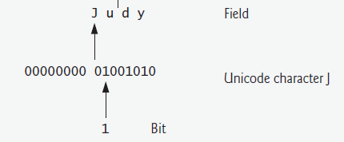
Data Hierarchy
Bit
Byte
Character
Word

Slide 37
Java Characters
A Java character has two bytes
Java supports Unicode character set standard
ASCII
Java uses UTF-16 encoding
Other unicode encodings:
UTF-8
UTF-16
Other non-unicode encodings
Windows-1256

Slide 38
Java Special Characters
Some characters are special characters
Special characters are shown using backslash
Examples:
New line: \n
Tab : \t
Double-quote : \”
Single-quote : \’
Backslash : \\

Slide 39
Java Special Characters
String s = "Salam!\nI am S\tA";
System.out.println(s);
s = "\\ \' \"";
System.out.println(s);
Salam!
I am S A
\ ' "

Slide 40
Array
Collections of related data items
related data items of the same type
Arrays are fixed-length entities
they remain the same length once they are created
An array is a group of variables
called elements
containing values that all have the same type
The position number of the element is it’s index
Array elements are sequentially located in memory

Slide 41
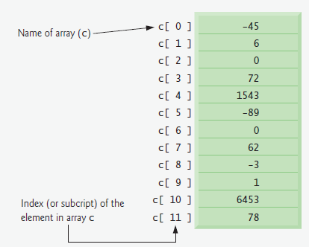
Array

Slide 42
Samples
Create an array of 10 integer elements
int[] array = new int[10]; int array[] = new int[10];//equal
Create an array of n characters
char[] characters = new char[n];
Change value of 5’th element
array[5] = 12;
Retrieving value of n’th element
char ch = array[n];

Slide 43
Exercise
Write a piece of code
Read array length
Create the array
Read the elements (double)
Write the array elements

Slide 44
Example
Scanner scanner = new Scanner(System.in);
int n = scanner.nextInt();
double numbers[] = new double[n];
for(int i=0;i<numbers.length;i++){
numbers[i] = scanner.nextDouble();
}
for(int i=0;i<numbers.length;i++){
double d = numbers[i];
System.out.println(d);
}

Slide 45
Array Creation Shortcut
char[] array = new char[3];
array[0] = 'a';
array[1] = 's';
array[2] = 't';
The above code can be rewritten as:
char[] array = {'a','s','t'};
Other examples:
int[] numbers = {1,2,3,5,9,123};
boolean[] b = {true, true, false, true};

Slide 46
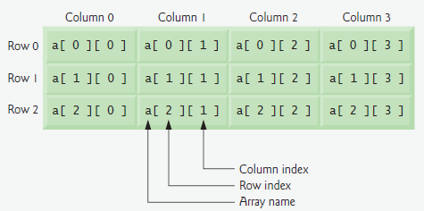
Multidimensional Arrays
int[][] matrix = new int[3][4];
matrix[2][3] = 2;
System.out.println(matrix[2][1]);

Slide 47
Unbalanced Multidimensional Array
int[][] matrix = new int[3][];
matrix[0] = new int[2];
matrix[1] = new int [5];
matrix[2] = new int [4];
matrix[2][3] = 2;
System.out.println(matrix[2][1]);
matrix[0][3] = 2;//Runtime Error
ArrayIndexOutOfBoundsException

Slide 48
Passing Arrays to Methods
public static void main(String[] args) {
int[] array = {1,2,-4,0};
System.out.println(max(array));
}
static int max(int[] numbers){
if(numbers == null || numbers.length == 0)
return -1;
int max = numbers[0];
for (int i = 1; i < numbers.length; i++)
if(max<numbers[i])
max = numbers[i];
return max;
}

Slide 49
Multi-Dimensional Array Parameters
int determinant(int[][] matrix){…}
int [][] matrix = { {1,2}, {3,4}} ;
int de = determinant(matrix);
void check(int[][] array){…}
int [][] unbalanced = { {1,2}, {3,4,5,6,7,8}};
check(unbalanced);
boolean f(double[][][] cube){…}

Slide 50
Call by Element Values?
No
If the method has an array parameter
Array elements are not copied on method invocations
A reference to the array is passed to the method
More about this topic ➔ later

Slide 51
Exercises
Write a method for sorting an array of integers
Write a method that compares two arrays
returns true if elements of the arrays are equal
returns false , otherwise
Write a method that returns determinant of a matrix
Matrix is a two-dimensional array as the method parameter

Slide 52


