Slide 1

Dhaka University of Engineering & Technology, Gazipur
DUET Medical Center Management System
BY
Jahed Hasan ID:204003
Md. Sabbir Hossain Sojib ID: 204057
Md. Ayatullah ID:204059
Supervised By
Dr. Momotaz Begum
PROFESSOR
Department of CSE, DUET Mr. Litan Islam
LECTURER
Department of CSE, DUET

Slide 2
Abstract
DUET Medical Center Management System is one of the most essential tools that are mostly used in Diagnostic Lab; it is mostly used to manage medical lab related activities.
In this project we tried to develop a computerized and web based Diagnostic lab management system. Our main intention is to allow this application to be used in most retailing diagnostic lab, where a small point of customization will be required to each diagnostic lab in the implementation period. This system is designed to overcome all challenges related to the management of diagnostic that were used to be handled locally and manually.
The system is an online diagnostic lab manager application that brings up various diagnoses working online. Using this system, it will help us to records all transaction made at the daily sales; recognize all customers, employees, etc. It will manage all activities around the diagnostic lab that increases productivity and maximize profit, it will also minimizing the risk of getting loss because all transactions are recorded to the system.

Slide 3
Purpose
The main purpose of DUET Medical Management system to provide a platform where authority can manage the center with more convenient way nd students and others can take the appointment online and get their blood test done at home. With the help of this project we are bringing the use of technology in the field of medical diagnosis where patients can avail all the diagnosis facilities at their door steps. Another purpose for developing this application is to generate the report automatically.

Slide 4
Scope
Today also we have to go to the diagnostic center, wait in the queue to get our blood test done. As Technology is growing rapidly we are also moving to a technical world where everything we want to be online. So with the help of this project we are bringing the use of technology in the field of medical diagnosis where patients can avail all the diagnosis facilities at their door steps. This project makes the diagnosis process easy and reduces the burden of patients. At a same time its help the diagnostic center to track all their patients details with their test reports. This access friendly software provides quick and effective services which helps the diagnostic center to increase their sales and profit.
Advantages:
The system allows automate diagnosis system.
Allows for faster service.
Easy, user friendly GUI.
Validation of data will be ensure only accurate valid and complete data stored in the database.
Easy retrieval or data will be made possible by finding techniques.
Report generation will help made it easy to analyze the performance.

Slide 5
Project Modules
DUET Medical Center Management Systemis web based technology which brings up various diagnosis work online. Here patients are first allowed to register on the website and also login using registered details. Once registered with their address and contact details, the patients may now see a variety of tests conducted by the lab along with their costs and also they take appointment of other person who are not registered. The patient will select the required test and book appointment after that lab center send a lab boy at registered address to collect a sample the cost of the test will be paid to the lab while the samples are taken as cash on delivery (COD). After successful testing the user now gets a notification of test result. The system allows admin to attach a copy of the report into the system and automatically shown on user side so user can downloads report.
In DUET Medical Center Management System we use PHP and MySQL database. It has three modules i.e.
Admin
Lab Employee
User

Slide 6
Admin Module
Dashboard: In this sections, admin can briefly view the total register users, total new appointment, total approved appointment, total rejected appointment by admin, total cancelled appointment by user, total sample received, total report uploaded and total employee.
Test Detail: In this section, admin can manage test detail(Add/Update).
Lab Employee: In this section, admin can manage employee(Add/Update).
Appointments: In this section, admin can view the booking appointment and admin also has right to change appointment status according to current status and his/her remarks.
Lab: In this section, admin received the information of sample collected by employee and upload the report a test.
View Reg Users: In this section, admin view the detail registered users.
Search: In this section admin can search a particular appointment detail by patient appointment number, name and mobile number.
Report: In this section admin can view between dates appointment reports, sales report and employee wise report according to dates.
Admin can also update his profile, change the password and recover the password.

Slide 7
Lab Employee Module
Dashboard: In this sections, employee can briefly view total new assign appointment, total sample collected, total sample sent to lab and total appointments.
Test Detail: In this section, employee can view test detail.
Assign Appointments: In this section, employee can view the appointment which is assign by the admin and employee has rights to change the appointment status according to current status.
Search: In this section, employee can search a particular appointment detail by patient appointment number, name and mobile number.
Reports: In this section, employee can view how many appointment has been assign, how many sample has been collected and how many appointment has been pending in his/her end.
Employee can also update his profile, change the password and recover the password.

Slide 8
Users/Patient Module
Dashboard: This is the welcome page for users or patients
Test Detail: In this section, employee can view test detail.
Appointment: In this section, user can book the appointments for test.
Appointment History: In this section, user can view the appointment history and also can check the status of appointment.
View Medical Report: In this section, user can download the patient report.
User can also update his profile, change the password and recover the password.

Slide 9
Requirement Specification
Hardware Configuration:
Client Side
Server Side
RAM | 512 MB
Hard Disk | 10GB
Processor | 1.0 GHz
RAM | 1 GB
Hard Disk | 20GB
Processor | 2.0GHz

Slide 10
Continue.....
Software Requirement:
Client Side
Server Side
Web Browser | Google Chrome or any compatible browser
Operating System | Windows or any equivalent OS
Web Server | APACHE
Server side Language | PHP5.6 or above version
Database Server | MySQL
Web Browser | Google Chrome or any compatible browser
Operating System | Windows or any equivalent OS

Slide 11
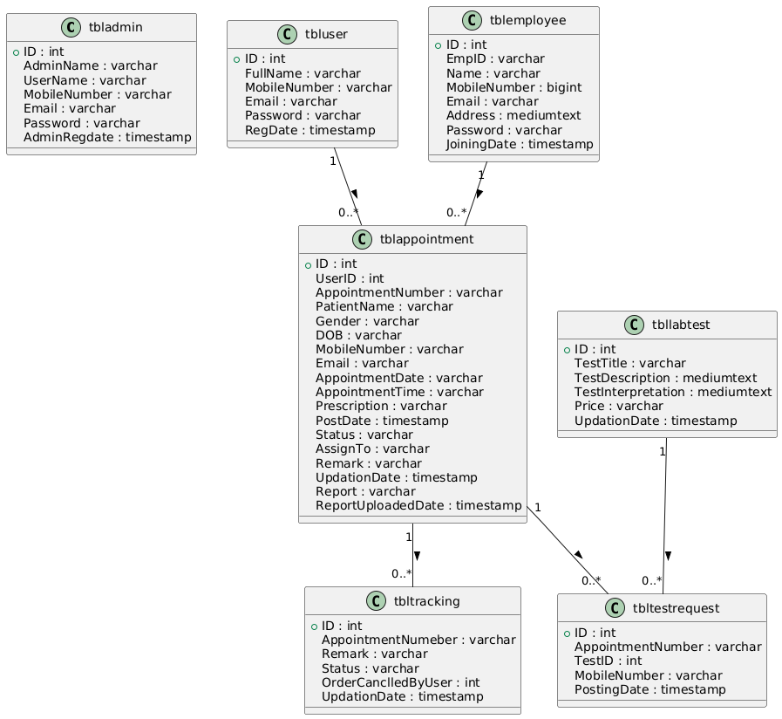
Class / Schema Diagram
Notes:
Class Diagram:
A description of set of objects that share the same attributes operations, relationships, and semantics

Slide 12
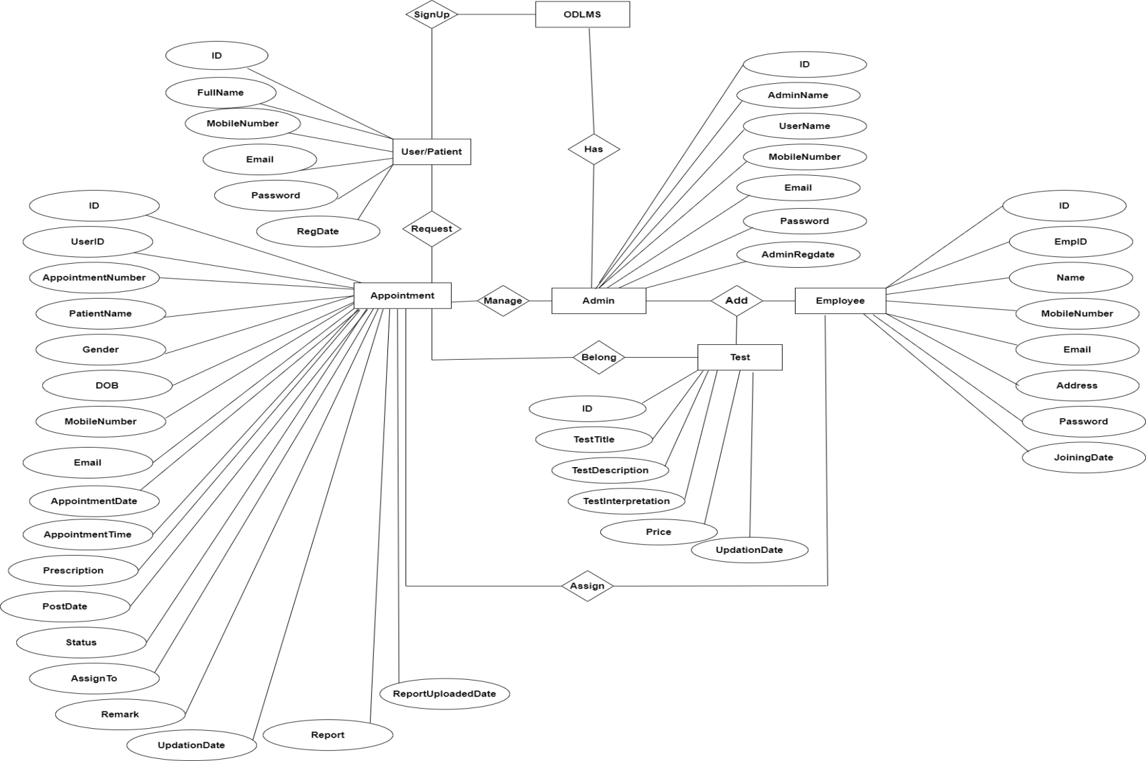
ER Diagram

Slide 13
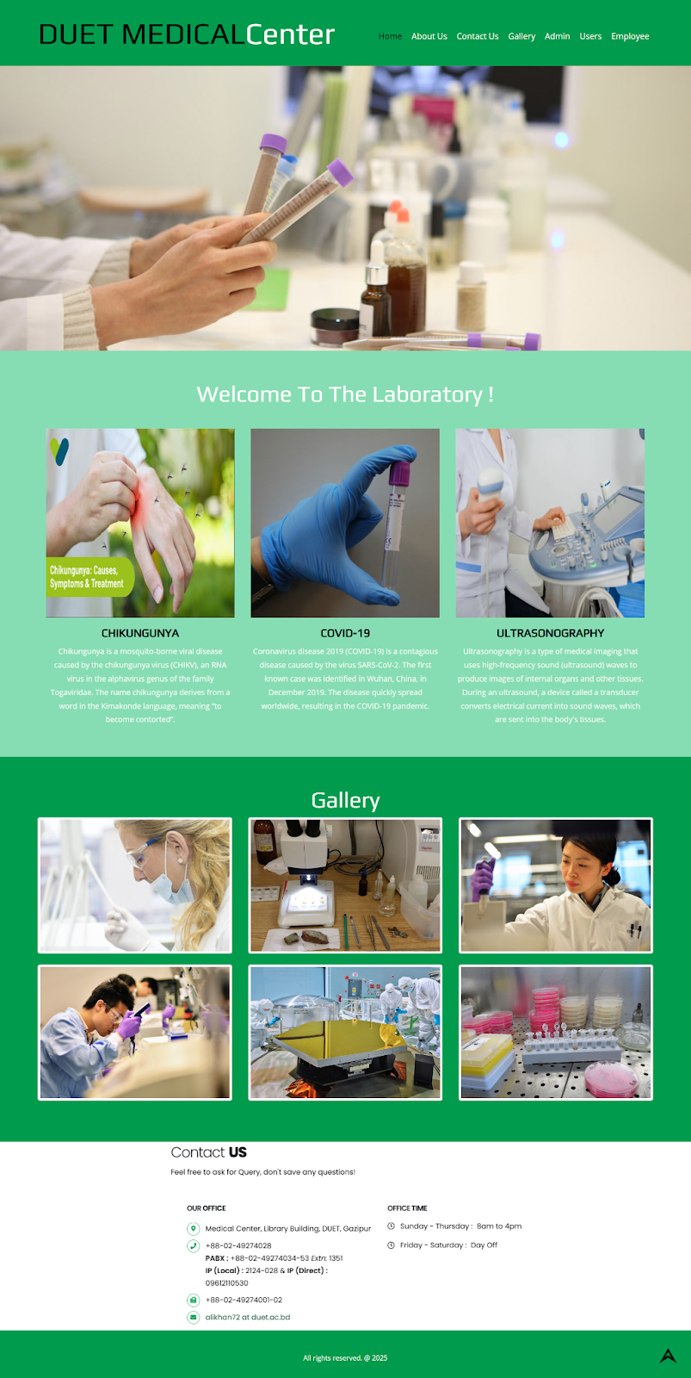
Project Screens
Home Page

Slide 14
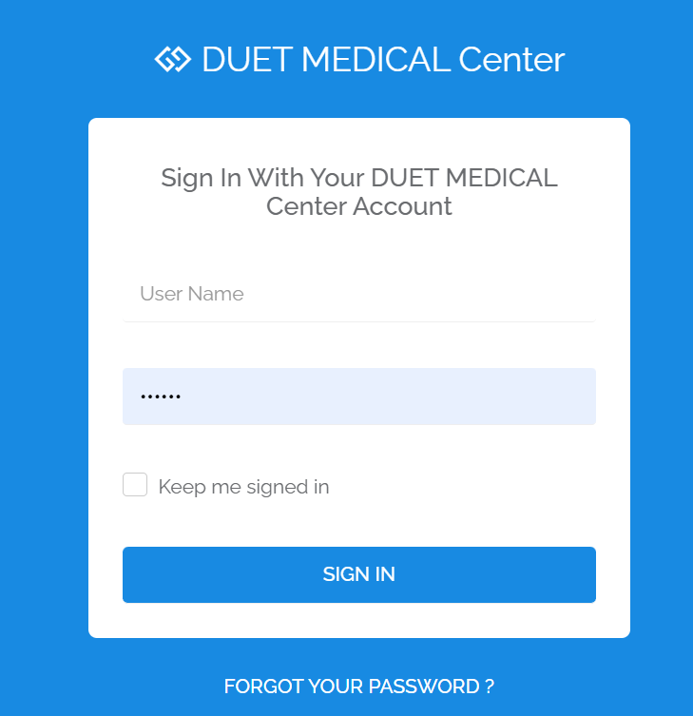
Admin Login

Slide 15
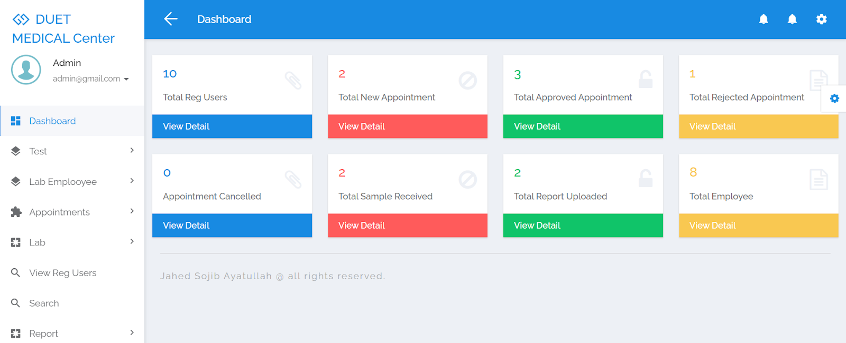
Dashboard

Slide 16
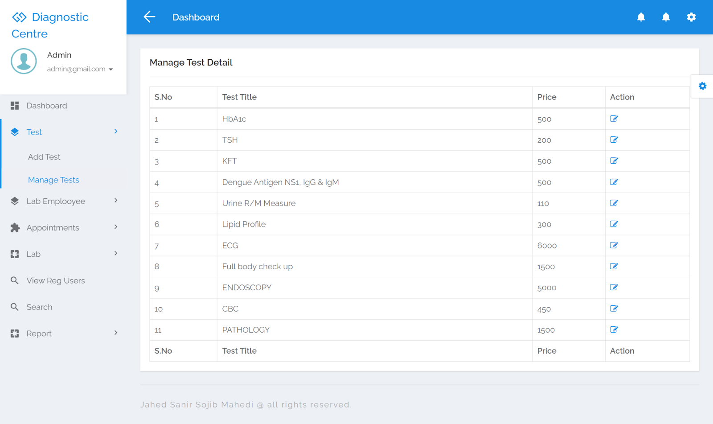
Manage Test Details

Slide 17
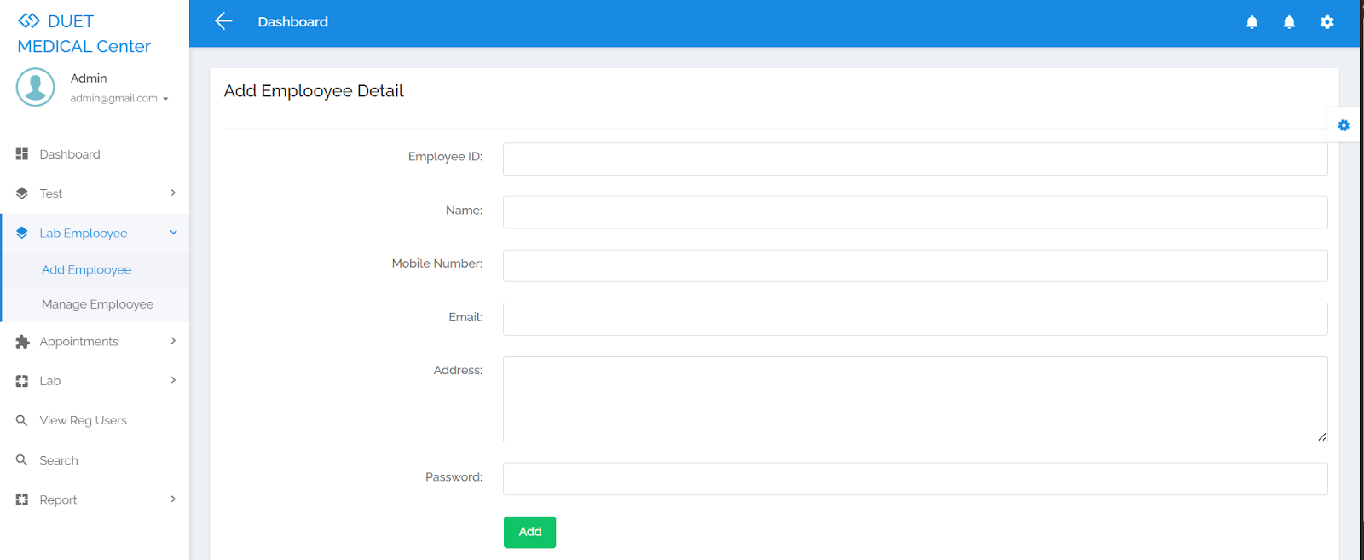
Add New Employee

Slide 18
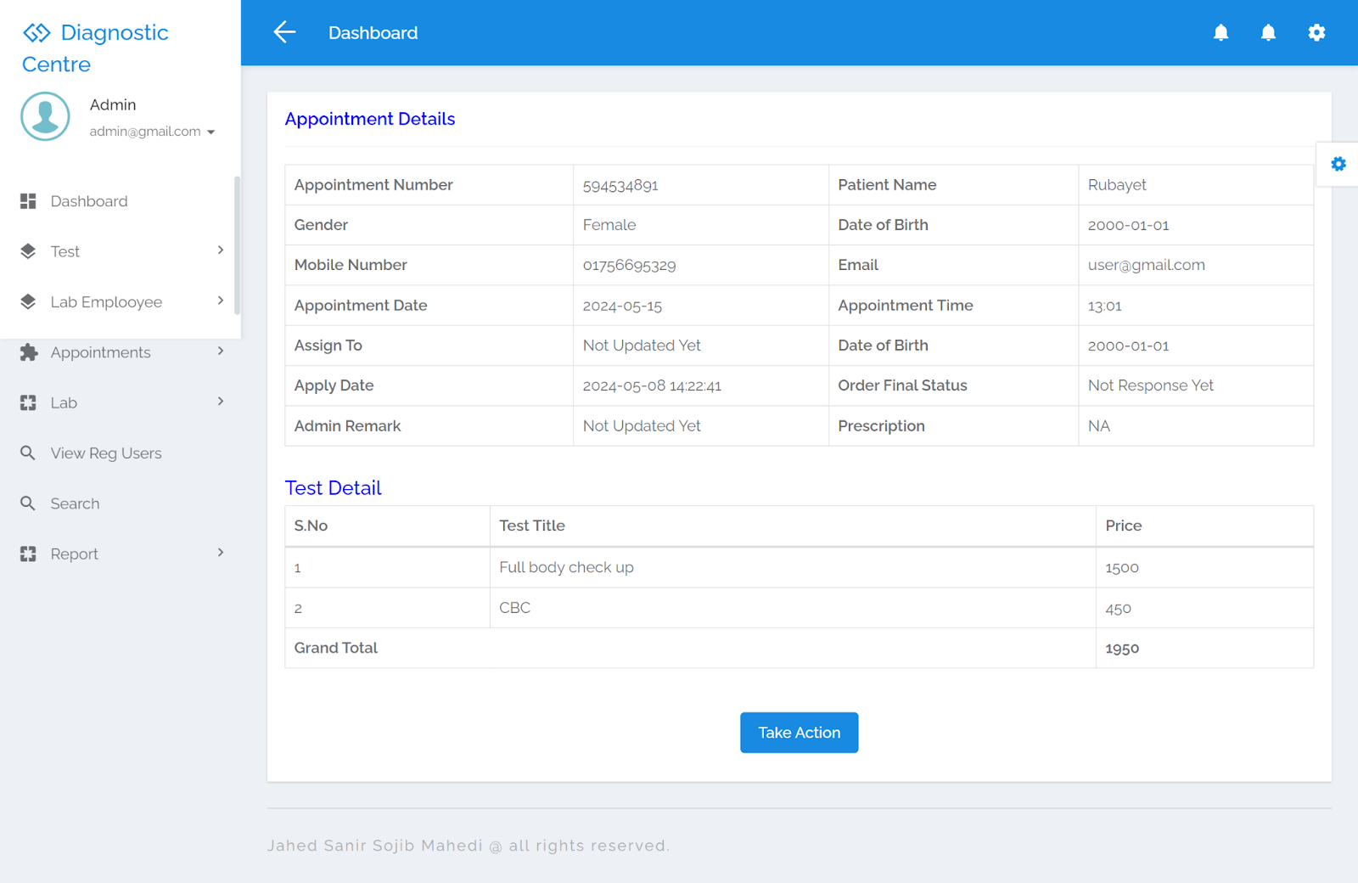
Appointment Details

Slide 19
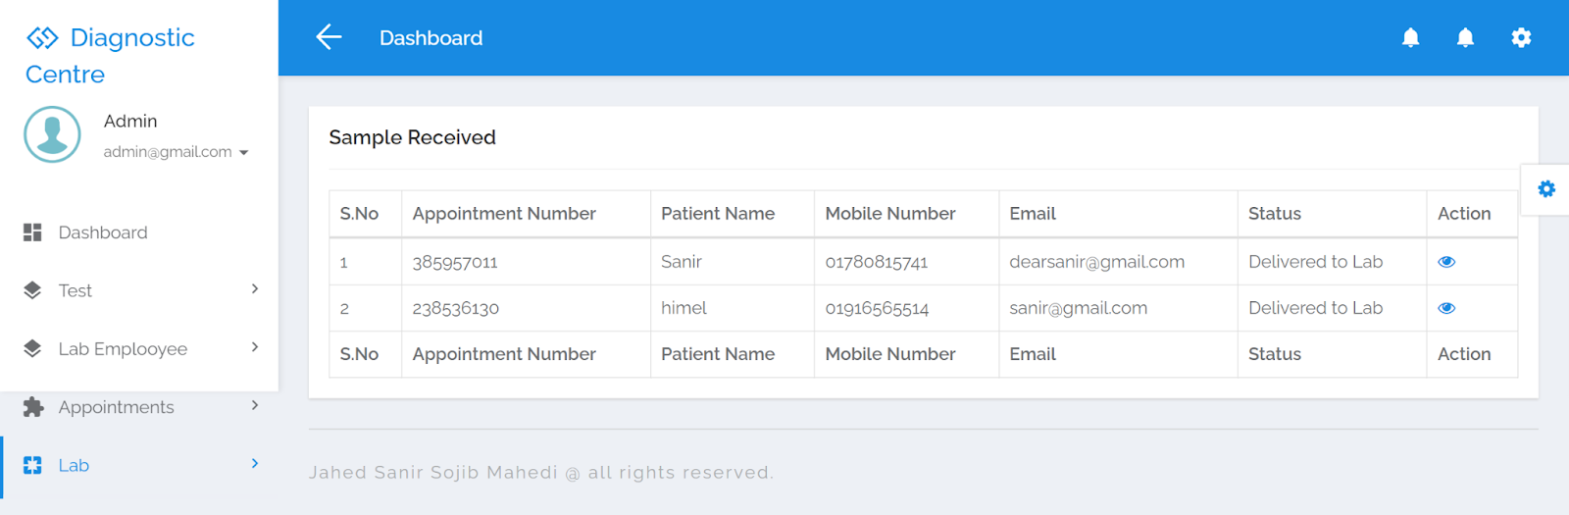
Sample Received

Slide 20
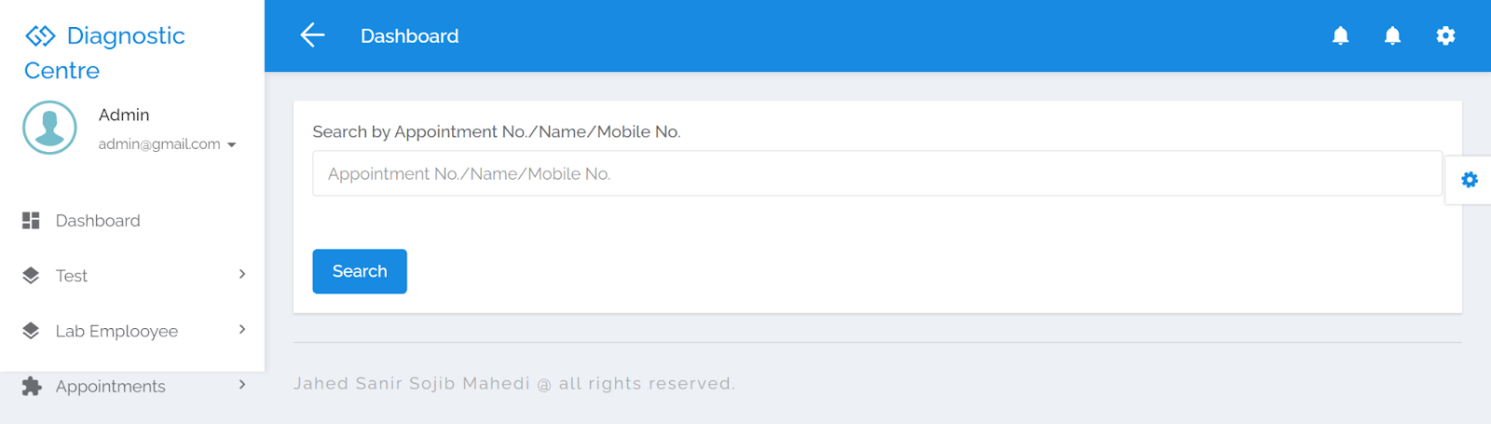
Search to Get quick access

Slide 21
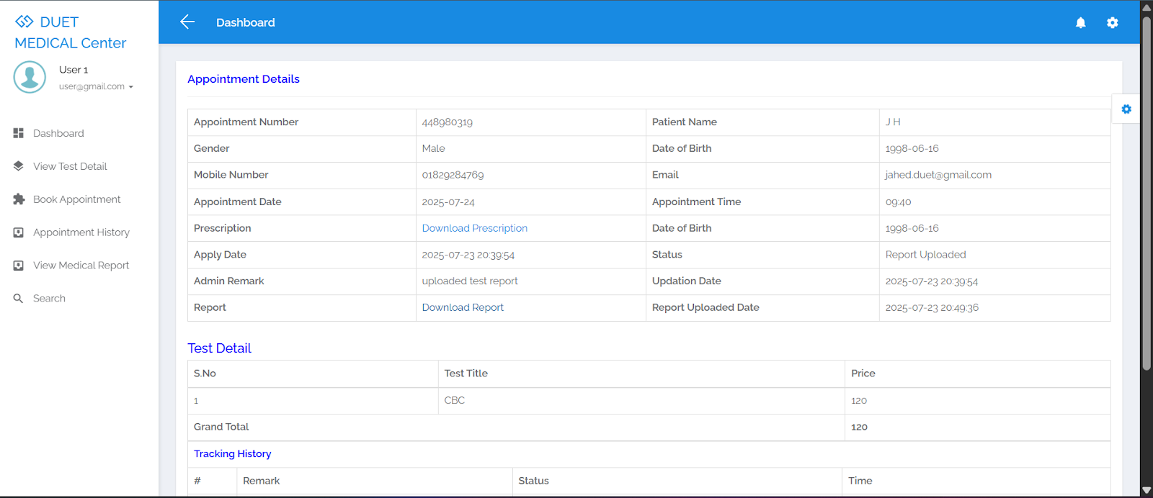
User View Details

Slide 22
Implementation and System Testing
After all phase have been perfectly done, the system will be implemented to the server and the system can be used.
System Testing
The goal of the system testing process was to determine all faults in our project .The program was subjected to a set of test inputs and many explanations were made and based on these explanations it will be decided whether the program behaves as expected or not. Our Project went through two levels of testing
Unit testing
Responsiveness
Deadlink

Slide 23
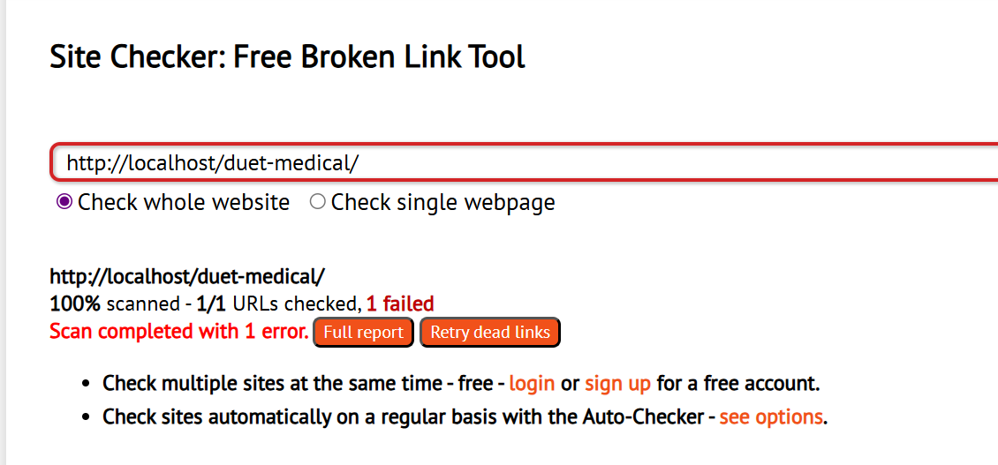
Testing

Slide 24
Conclusion
DUET Medical Center Management System is very much graceful and lively. Patients have to register to the portal by giving their details and then they can take appointment through online with minimal effort. Once appointment is confirm, diagnostic center send the technician to patient address to collect the blood sample. Once test is done and test report is generated patient can download the report by logged in to the portal. This system can be also implemented in diagnostic labs and clinics.
Automation of the entire system improves the productivity.
It provides a friendly graphical user interface which proves to be better when compared to the existing system.
It gives appropriate access to the authorized users depending on their permissions.
It effectively overcomes the delay in communications.
Updating of information becomes so easier.
System security, data security and reliability are the striking features.
The System has adequate scope for modification in future if it is necessary.

Slide 25
Thank You

