Slide 1
AutoDS
The End-to-End AI Data Science Platform
Batch Details:
- D. Jahnavi (24N31A6754)
- B. Lokesh Raju (24N31A6727)
- D. Gurva Raj (24N31A6753)

Slide 2
Problem Statement
- Data Science is manual, time-consuming, and highly technical.
- Cleaning anomalies and selecting models requires extensive boilerplate.
- AutoDS democratizes AI by automating the entire cycle.
- Goal: Transform raw data into industry-ready reports instantly.

Slide 3
System Components
- React Frontend: Stunning dark-mode UI with Plotly visualizations.
- FastAPI Backend: High-performance API orchestration.
- Celery Workers: Asynchronous ML pipeline processing.
- Ollama AI: Generative AI for narrative report synthesis.
- ML Engine: Automated cleaning, EDA, and model selection.

Slide 4
Key Features
- Automated EDA: Shape, nulls, and distributions.
- Intelligent Cleaning: Outlier removal and missing value imputation.
- Model Battle: Automatic cross-validation of multiple classifiers/regressors.
- 3D Data Topography: PCA visualization of the dataset.
- Spline Integration: Interactive 3D robotic greeting.

Slide 5
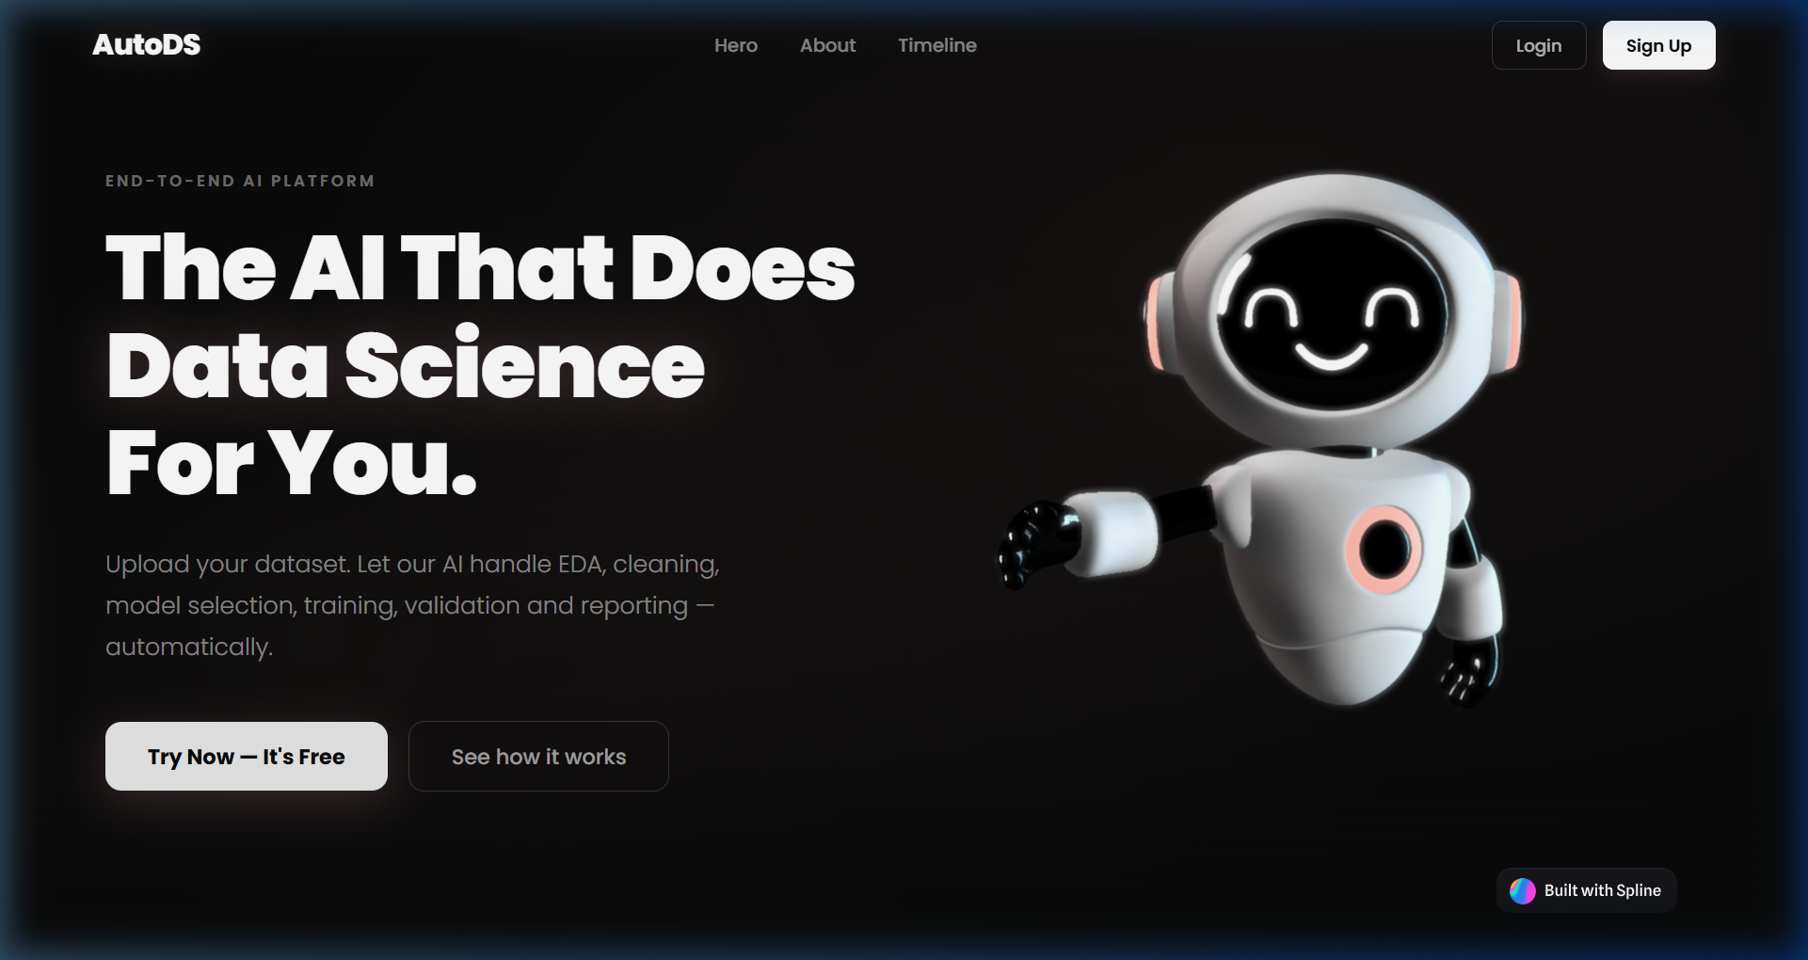
Interactive Landing Page
Interactive 3D Spline Robot greeting users upon entry.

Slide 6
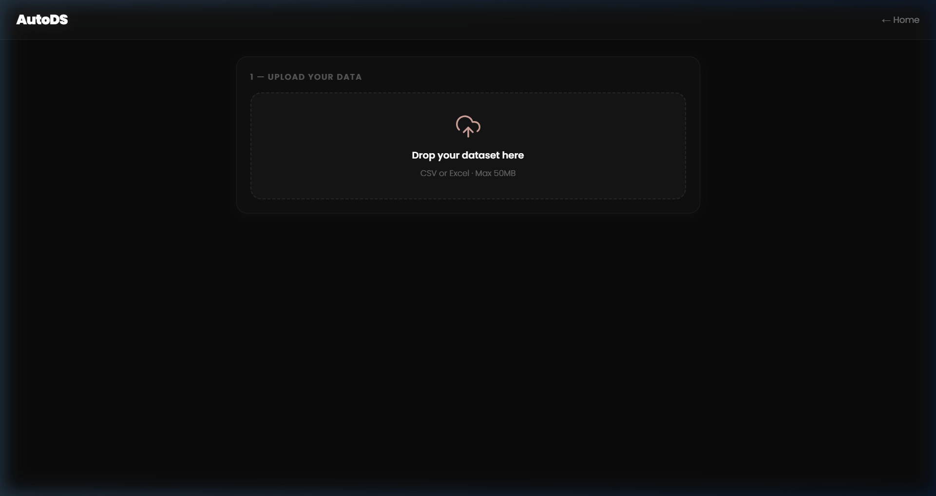
Execution Workspace
Staggered card orchestration for a premium loading experience.

Slide 7
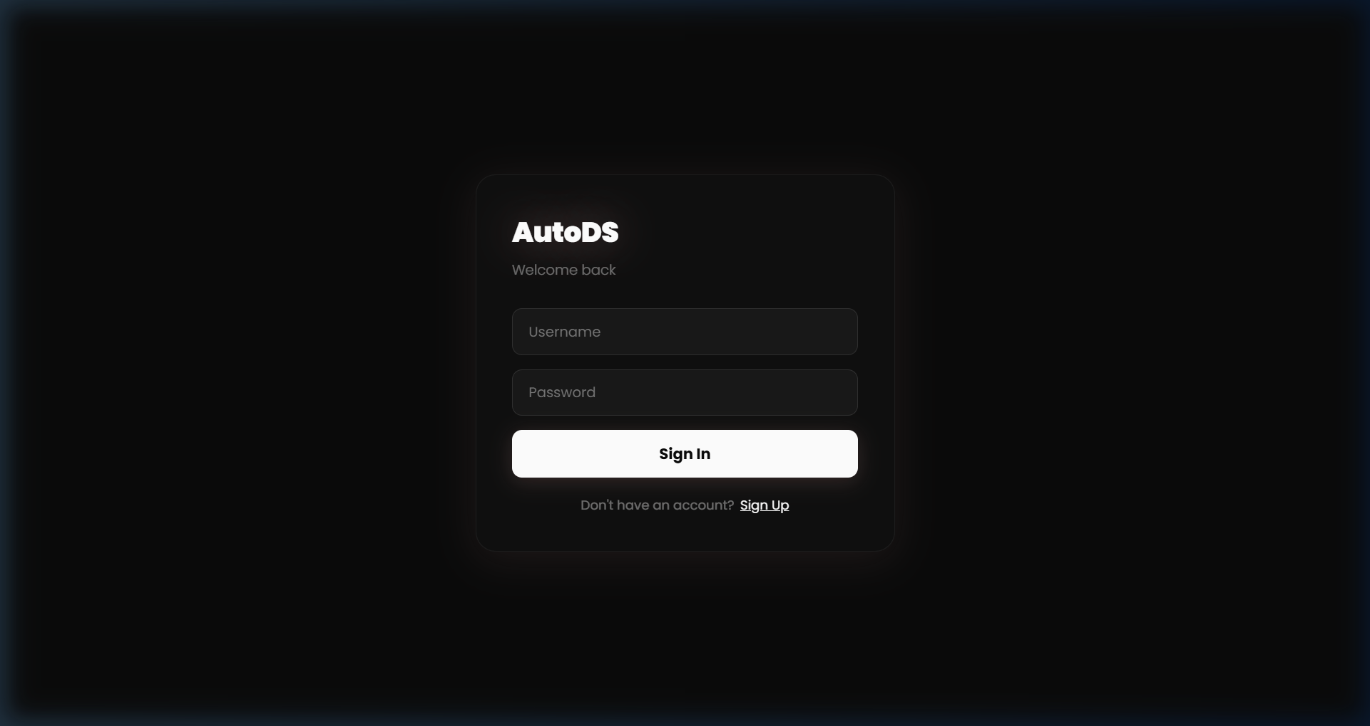
Secure Authentication
Fluid animations and breathing text-shadow for a high-end feel.

Slide 8
Engine Architecture
Frontend: React + Vite + Zustand
Middleware: FastAPI + Celery + Redis
Machine Learning: Sklearn + XGBoost + Pandas
Generative AI: Ollama (Large Language Models)

Slide 9
Conclusion
- AutoDS eliminates the manual 'grunt work' of data science.
- Provides a professional, client-ready aesthetic for AI reporting.
- Scalable architecture capable of handling multi-task ML pipelines.
- Ready for industry-level deployment.

