Slide 1
Covid And AI
Progress Report

Slide 2
Evasion attacks
Zoo attack on Random Forest
Low Pro Fool attack on SVM
FGM and BMI on Neural Net
Zoo attack on KNN and GBC

Slide 3
Zoo attack on Random Forest
Original Model |  | Adversarial Test Data |  | Adversarial Retrain
Accuracy | 0.98 | Accuracy | 0.45 | Accuracy | 0.89
Recall | 0.98 | Recall | 0.45 | Recall | 0.89
Precision | 0.98 | Precision | 0.44 | Precision | 0.90
F1 Score | 0.98 | F1 Score | 0.43 | F1 Score | 0.89

Slide 4
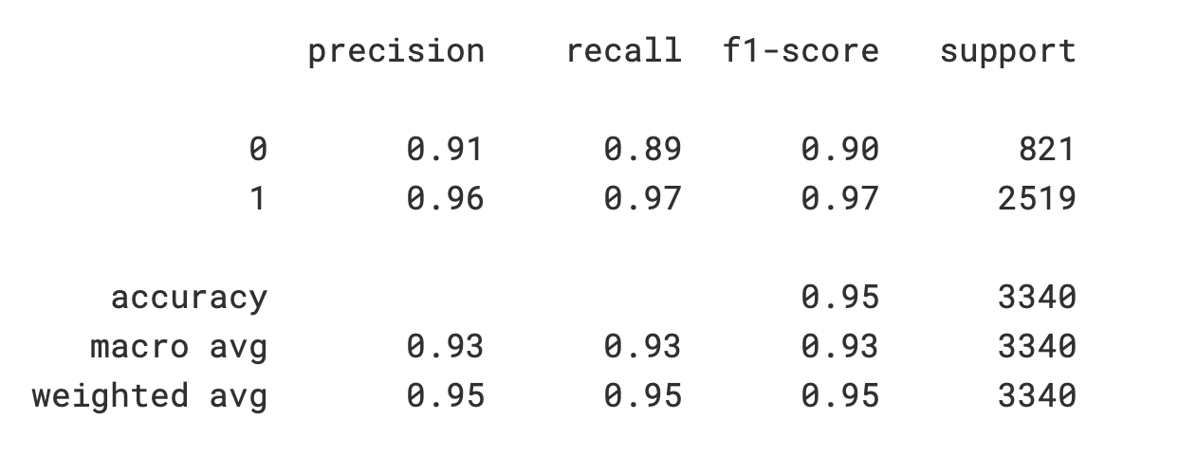
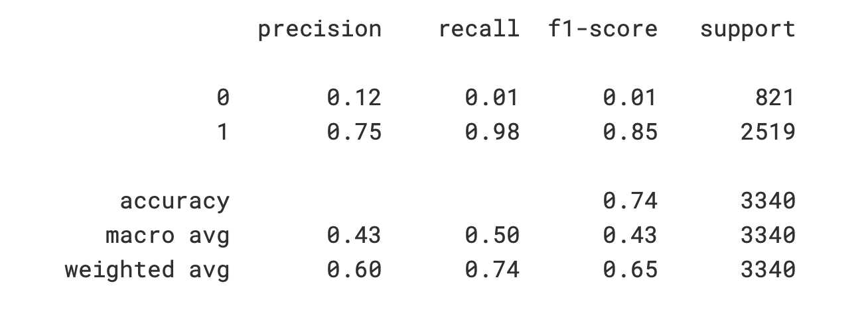
Low Pro Fool attack on SVM
Normal SVM Result | Adversarially Trained Model on Real Data

Slide 5
FGM and BMI on Neural Net
Accuracy on clean test samples after BIM adversarial training: 0.9644
Accuracy on FGM adversarial test samples after BIM adversarial training: 0.8769
Accuracy on BIM adversarial test samples after BIM adversarial training: 0.9653

Slide 6
Data Poisoning attack
Label Flipping poisoning
Feature poisoning

Slide 7
Label Flipping Poisoning
Original Data |  | Poisoned Data
Accuracy | 0.77 | Accuracy | 0.68
Recall | 0.77 | Recall | 0.68
Precision | 0.76 | Precision | 0.70
F1 Score | 0.77 | F1 Score | 0.68

Slide 8
Feature poisoning with GAN Tabular data generation
Original Data |  | Poisoned Data
Accuracy | 0.77 | Accuracy | 0.50
Recall | 0.77 | Recall | 0.50
Precision | 0.76 | Precision | 0.29
F1 Score | 0.77 | F1 Score | 0.34

