Slide 1

Data Lake Value Proposition
Medical Data Processing Company
Jahid Razan

Slide 2
Agenda
What is a Data Lake?
Components of a Data Lake
Data Lake vs Data Warehouse
Business Value of Data Lake Solution
Proposed Data Lake Architecture for Medical Data Processing system
Udacity IPS Ver. 1 2/2020

Slide 3

Philisophy of a modern data sytem
Scalability
Fault Tolerant
Reduced Latency
Image Source: Is Data The New Oil of the 21st Century or Just an Overrated Asset?

Slide 4
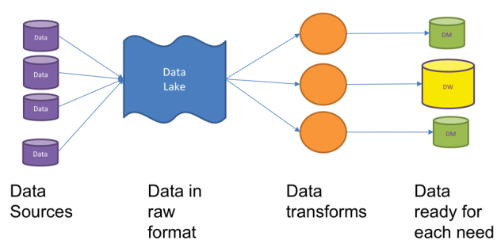
Required Flexbility in a Modern Architecture
Image Source: The Data Lake Is A Design Pattern

Slide 5
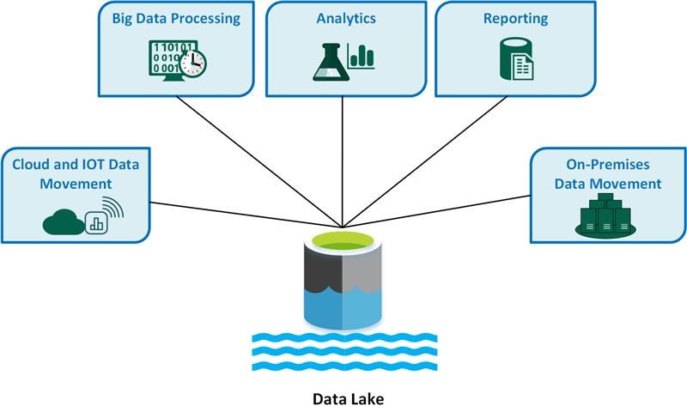
What is a Data Lake ?
A data lake is a storage that contains a large amount of data in its original, raw format.
Can store large amount of data cheaply.
Use Cases:
Data Storage at scale
Data Processing in real time
Data Sharing & Exploration
Predictive analytics
Image Source: What is a data lake ?

Slide 6
Components of Data Lake
Ingestion Layer
Loading of unstructured, semi-structured, and structured data into data lake
Tools : Sqoop, Apache Kafka, Apache nifi, Google Pub/Sub, Amazon Kinesis etc.
Storage Layer
Store data at scale that is cost effective and allow quick access
Tools : HDFS, Apache Cassandra, Apache HBase
Processing Layer
Ingested data are processed at scale using various tool
Tools : MapReduce, Pig, Hive , Flink, Spark and other third party tools.
Serving Layer
Provides low-latency access to data for consumption by end-users or downstream systems.
Tools: Apache Spark, Apache Flink

Slide 7
Data Lake vs Data Warehouse

Slide 8
Data Warehouse
Data Lake
DWH can store relational and structured data
Schema designed at the beginning - not flexible for accommodating changes in the future
Data silos can still exist
Companies can not be ready for unknown cases
Used for historical analytics, visualizations, BI.
Data Lake can store unstructured, unrefined and non-relational data
Schema Design at the end- is fit for schema evolution as it gives the flexbility.
3. Data democritization can be achieved.
4. Companies can be ready for unknown cases
5. Used for predictive analytics, machine learning.
Udacity IPS Ver. 1 2/2020

Slide 9
Business Value of Data Lake
Flexible cloud storage that is highly scalable
Improved Uptime
Can help breaking the existing data silos
Real time analytics with the updated data
Inline with the goal of predictive analytics
Required to comply with federal and local regulation

Slide 10
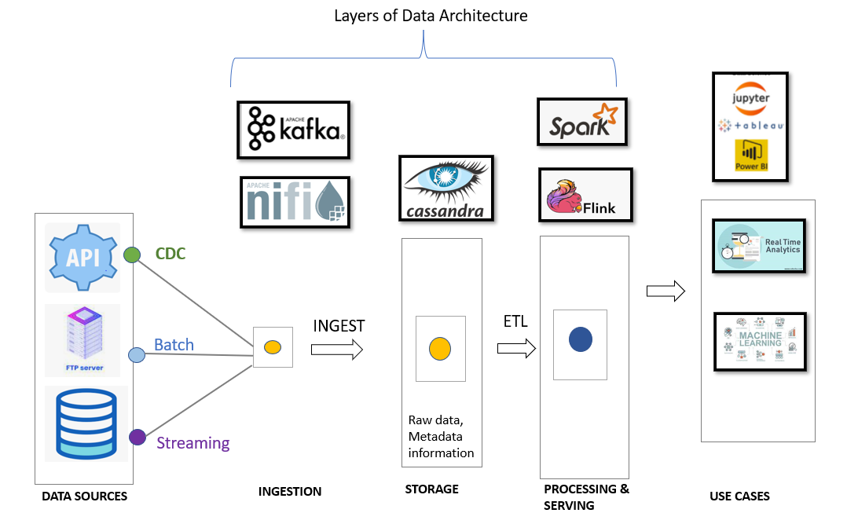
Data Lake Architecture
Fault Tolerant
Scalable
Low latency
Open Source
Secured
Complimentary abilities

Slide 11
THANK YOU
Udacity IPS Version 1.0

