Slide 1



QUANTITATIVE RESEARCH CRITIQUE · RS703
Who reports the phish?
A critique of Petrič & Just (2025): information security culture and employees’ reporting of phishing emails
Verdict: theoretically coherent and statistically sophisticated, but a cross-sectional, self-report design limits causal and behavioural claims.
employee spots → reports → SOC contains
[Your name] · [Student ID] · Journal of Cybersecurity, 11(1), tyaf011
Notes:
[~15 s] Today I critique Petrič and Just (2025), a quantitative study in the Journal of Cybersecurity about why employees report phishing emails. My overall verdict: the study is theoretically coherent and statistically sophisticated, but its cross-sectional, self-report design limits what it can tell us about causes and actual behaviour.

Slide 2



The study at a glance
From “how do we stop clicks?” to “how do we get employees to report?”
Problem
1,017
employees surveyed
Phishing susceptibility is well researched; the drivers of reporting are not.
Objectives
3
countries: DE · UK · US
Test whether four ISC components predict reporting via attitudes and responsibility, and whether the model holds in DE, UK and US.
Significance
4
culture components tested
Timely reports let security teams contain attacks before financial loss and disruption.
Petrič & Just (2025) critique · 2
Notes:
[~35 s] Reporting matters because every reported email is an early warning. The authors note that research focuses on who clicks, not who reports. They surveyed 1,017 employees from organisations with 50+ staff in Germany, the UK and the US, testing whether four components of information security culture (policy awareness, communication quality, knowledge and supportive norms) drive reporting through attitudes and a sense of responsibility.

Slide 3
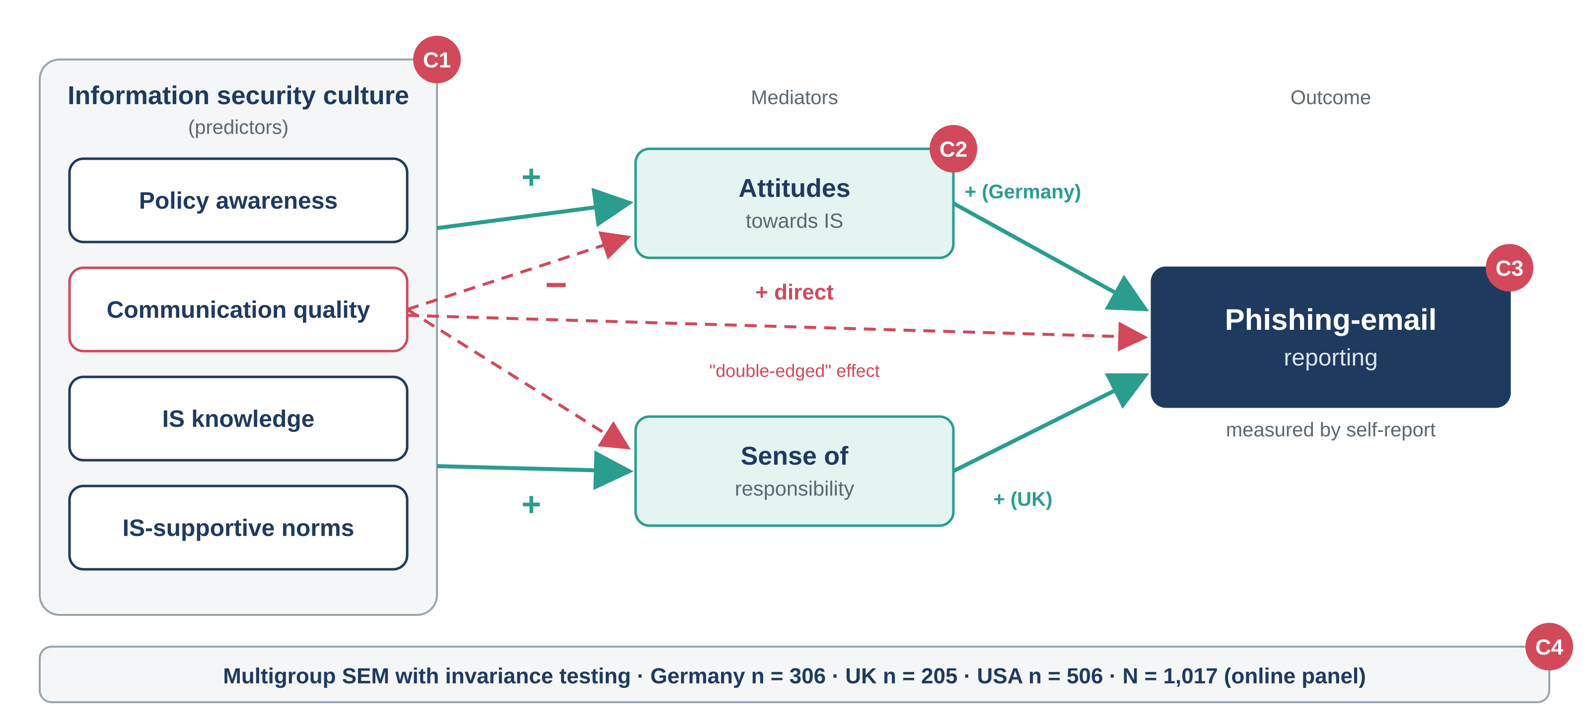
What they tested, and where it is vulnerable
Multigroup SEM; red badges mark the four methodological concerns
Culture measured as individual perception, not a shared property
C1
Mediation inferred from a single time point
C2
Outcome is self-reported, not observed
C3
Panel sample, unequal n; country as proxy for culture
C4
Key finding: norms, policy awareness and knowledge raise attitudes and responsibility, which raise reporting. Communication quality is “double-edged”: it lifts reporting directly but lowers responsibility and attitudes.
Petrič & Just (2025) critique · 3
Notes:
[~40 s] Here is the model. The four culture components on the left predict attitudes and responsibility, which predict reporting. In Germany attitudes mattered most; in the UK responsibility; in the US neither was strong. The surprising result is communication quality: it increases reporting directly but reduces responsibility and attitudes. The red badges show the four concerns I will unpack next.

Slide 4




Methodology scorecard
Each element judged against methods literature
Element
What they did
Verdict
Why it matters
Design
Deductive, cross-sectional survey
Suits theory testing, but mediation needs time order (Maxwell & Cole, 2007)
Fit, but limited
Sampling
Online panel, orgs ≥ 50 staff; n = 306 / 205 / 506
Non-probability, self-selected; unequal groups cut power (Callegaro et al., 2014)
Weak
Data collection
One self-report questionnaire for all constructs
Common method & social desirability bias (Podsakoff et al., 2003)
Weak
Statistics
Multigroup SEM with invariance testing
Invariance is a prerequisite for valid cross-country comparison (Vandenberg & Lance, 2000)
Strong
Petrič & Just (2025) critique · 4
Notes:
[~50 s] Design: a cross-sectional survey suits theory testing, but the model claims mediation, a causal chain that one time point cannot show. Sampling: an online panel is efficient but non-probability and self-selected; the UK group is less than half the size of the US group, so UK estimates are less precise. Data collection: every construct, including the outcome, comes from one questionnaire, inviting common method and social desirability bias. Statistics are the strongest element: multigroup SEM with invariance testing is exactly what cross-country comparison requires. I would still want HTMT for discriminant validity and a check for suppression effects behind the negative communication paths.

Slide 5



Sampling: who was actually asked?
Large overall, but uneven and non-probability
UK group is 60% smaller than the US group
Less precise UK paths and less power to detect country differences.
Online panel members self-select
May be more digitally literate and security-aware than typical staff.
One voice per organisation (apparently)
An organisational culture is inferred from individual perception.
Petrič & Just (2025) critique · 5
Notes:
[~30 s] The sample is large, but look at the balance: the UK has 205 respondents against 506 in the US. Panel respondents self-select and may be unusually security-aware. And because culture is an organisational property, measuring it through one person per organisation captures perception, not shared culture.

Slide 6

Strengths vs limitations
Judged on validity, reliability and generalisability
Limitations
Strengths
Internal validity
No temporal order: reporting may shape attitudes, not vice versa (Shadish et al., 2002)
Theory-driven, parsimonious model with manageable levers
Large three-country sample with demonstrated invariance
Indirect paths reveal the “double-edged” communication effect
Authors are candid about the weak outcome measure
Construct validity
Self-reported reporting ≠ behaviour: the intention–behaviour gap (Sheeran, 2002)
Reliability
One occasion only; shared-method variance may inflate estimates
Statistical conclusion
N > 1,000 makes tiny paths significant; report effect sizes
Generalisability
Three Western economies, larger firms; country ≠ culture
Petrič & Just (2025) critique · 6
Notes:
[~45 s] Strengths: a clear, theory-driven model; a large three-country sample with invariance testing, so the measures mean the same thing across countries; and a nuanced finding on communication. Limitations, by validity type: internally, we cannot rule out reverse causation; for construct validity, saying you report is not the same as reporting; reliability rests on one occasion; with over a thousand respondents, significance is cheap, so effect sizes matter; and the findings generalise only to large Western organisations, with country standing in for culture.

Slide 7




Four evidence-based improvements
Each targets a specific concern
Measure real behaviour
C3
Separate the time points
C2
Link surveys to simulated-phishing report logs (Lain et al., 2022)
Culture at T1 → attitudes at T2 → reporting at T3 (Maxwell & Cole, 2007)
Go multilevel
C1
Measure culture, widen reach
C4
Several employees per organisation; multilevel SEM; power-planned strata (Faul et al., 2007)
Measure cultural values directly; add non-Western and smaller firms
Trade-off: stronger causal and behavioural evidence costs more and raises ethical questions about deception in phishing simulations.
Petrič & Just (2025) critique · 7
Notes:
[~45 s] First, measure real behaviour: partner with organisations running phishing simulations and link survey answers to actual report logs, as Lain and colleagues did in a long-term field study. Second, separate the time points so causes come before effects. Third, survey several employees per organisation to measure culture as a genuinely shared property with multilevel SEM, with power-planned, balanced groups. Fourth, measure cultural values directly and extend beyond large Western firms. The trade-off is cost and ethics, especially deception in simulations. A qualitative phase could also explain why communication seems to lower responsibility.

Slide 8



So what for business research?
Valuable contribution
Association, not causation
Next step
Reframes employees as active defenders and tests the model rigorously across three countries.
A cross-sectional, self-report design shows links between perceptions, not what drives behaviour.
Multilevel, longitudinal and behavioural designs; managers should pilot the levers as testable hypotheses.
Thank you. Questions?
Petrič & Just (2025) critique · 8
Notes:
[~25 s] To conclude: a valuable study that reframes employees as defenders and tests its model carefully across countries. But it shows associations among perceptions, not causes or real behaviour. For business research, the lesson is that survey-based SEM maps relationships well, while claims about culture and behaviour need multilevel, longitudinal and behavioural evidence. Thank you.

Slide 9
References
Brislin, R. W. (1970). Back-translation for cross-cultural research. Journal of Cross-Cultural Psychology, 1(3), 185–216. https://doi.org/10.1177/135910457000100301
Callegaro, M., Baker, R., Bethlehem, J., Göritz, A. S., Krosnick, J. A., & Lavrakas, P. J. (Eds.). (2014). Online panel research: A data quality perspective. Wiley.
Faul, F., Erdfelder, E., Lang, A.-G., & Buchner, A. (2007). G*Power 3: A flexible statistical power analysis program for the social, behavioral, and biomedical sciences. Behavior Research Methods, 39(2), 175–191. https://doi.org/10.3758/BF03193146
Henseler, J., Ringle, C. M., & Sarstedt, M. (2015). A new criterion for assessing discriminant validity in variance-based structural equation modeling. Journal of the Academy of Marketing Science, 43(1), 115–135. https://doi.org/10.1007/s11747-014-0403-8
Lain, D., Kostiainen, K., & Čapkun, S. (2022). Phishing in organizations: Findings from a large-scale and long-term study. In 2022 IEEE Symposium on Security and Privacy (pp. 842–859). IEEE. https://doi.org/10.1109/SP46214.2022.9833766
Maxwell, S. E., & Cole, D. A. (2007). Bias in cross-sectional analyses of longitudinal mediation. Psychological Methods, 12(1), 23–44. https://doi.org/10.1037/1082-989X.12.1.23
Petrič, G., & Just, J. N. (2025). Information security culture and phishing-reporting model: Structural equivalence across Germany, UK, and USA. Journal of Cybersecurity, 11(1), Article tyaf011. https://doi.org/10.1093/cybsec/tyaf011
Podsakoff, P. M., MacKenzie, S. B., Lee, J.-Y., & Podsakoff, N. P. (2003). Common method biases in behavioral research: A critical review of the literature and recommended remedies. Journal of Applied Psychology, 88(5), 879–903. https://doi.org/10.1037/0021-9010.88.5.879
Saunders, M. N. K., Lewis, P., & Thornhill, A. (2023). Research methods for business students (9th ed.). Pearson.
Shadish, W. R., Cook, T. D., & Campbell, D. T. (2002). Experimental and quasi-experimental designs for generalized causal inference. Houghton Mifflin.
Sheeran, P. (2002). Intention–behavior relations: A conceptual and empirical review. European Review of Social Psychology, 12(1), 1–36. https://doi.org/10.1080/14792772143000003
Vandenberg, R. J., & Lance, C. E. (2000). A review and synthesis of the measurement invariance literature: Suggestions, practices, and recommendations for organizational research. Organizational Research Methods, 3(1), 4–70. https://doi.org/10.1177/109442810031002
Petrič & Just (2025) critique · 9
Notes:
References slide: not presented aloud.

