Slide 1
PWscf package (pw.x executable)
PHonon package (ph.x, q2r.x,matdyn.x executables)
EPW package (ZG.x executable)
CP package
(cp.x executable)
Kohn- Sham equations
~ground state electron density n(r)
~Kohn-Sham orbitals (ɸ (r))
Density function perturbation theory
Special displacement Method
Car-Parrinello Molecular Dynamics (CPMD)
~System structure (0 K)
~Norm-conserving
pseudopotential
Force constants at 0 K
Lattice constant at finite temperature
Atomic positions at finite temperature
EPW package (epsilonGaus.x executable)
Kramers-Kronig relation
Imaginary part of dielectric tensor (ε^{imag})
Response function derived from perturbation theory
Kohn- Sham equations
Real part of dielectric tensor (ε^{real})
~electron density n(r)
~Kohn-Sham orbitals (ɸ (r))
PWscf package (pw.x executable)

Slide 2
PWscf package (pw.x executable)
PHonon package (ph.x, q2r.x,matdyn.x executables)
EPW package (ZG.x executable)
Equilibrium System
~NC/Ultrasoft pseudopotential
~Atomic positions (equilibrium)
Kohn- Sham equations
~ground state electron density n(r)
~Kohn-Sham orbitals (ɸ (r))
Density function perturbation theory
Special displacement Method
Force constants at 0 K
Car-Parrinello Molecular Dynamics (CPMD)
Atomic positions at finite temperature
System at finite K
Lattice constant at finite temperature
CP package
(cp.x executable)
Kohn- Sham equations
Temperature dependent band gap
(Eqn 16)
PWscf package (pw.x executable)

Slide 3
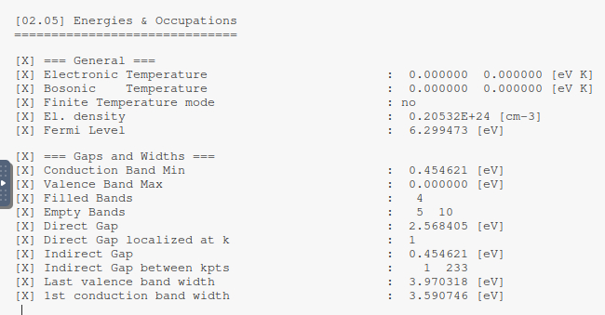
Equilibrium: Indirect band gap: 0.454621 eV

Slide 4
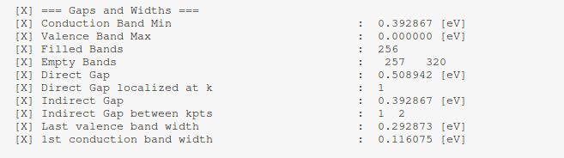
0 K: Indirect band gap: 0.392867 eV
Zero-point renormalization (ZPR) at 0 K: (0.454621- 0.392867) eV =0.061754 eV ~ 62 meV
https://doi.org/10.1063/1.4927081
See table 6, Experimental ZPR at 0K: 62 meV (Perfect match)

Slide 5
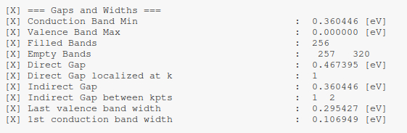
300 K: Indirect band gap: 0.360446 eV
Silicon:
1 https://doi.org/10.1119/1.1512658
2 Simple measurement of the band gap in silicon and germanium(American Journal of Physics, Volume 48, Issue 3, pp. 197-199 (1980).)
(other study 1) Eg (0 K) = 1.16 eV, Eg (300 K) = 1.12 eV
(Present study) Eg (0 K) = 0.392867 eV, Eg (300 K) = 0.360446 eV
Apply rigid shift of 0.767133 eV,
(Present study) Eg (0 K) = 1.16 eV, Eg (300 K) = 1.127579 eV
(other study 1) Eg (300 K) = (1.13+-0.02) eV

