Slide 1
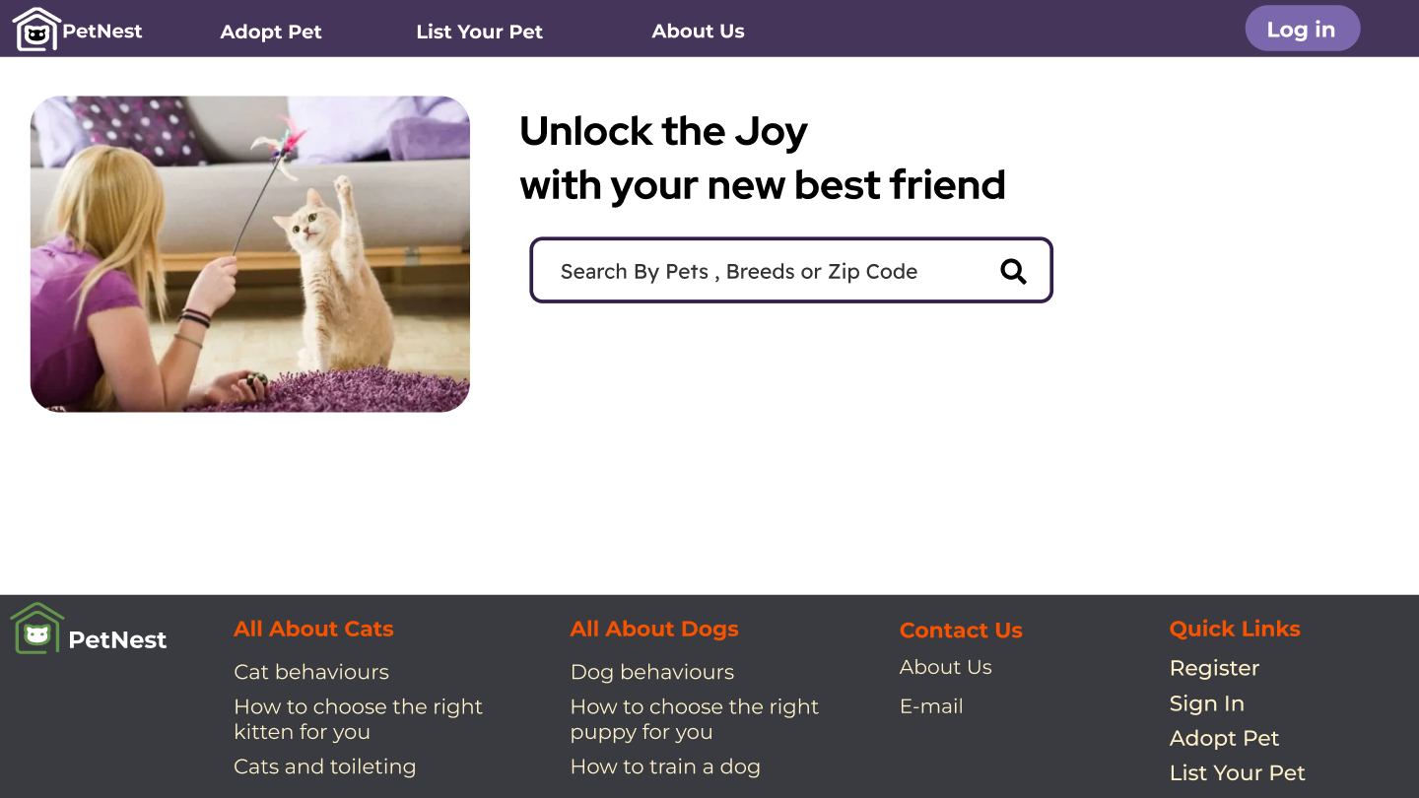
“PetNest”
Pet Adoption Platform

Slide 2

Welcome Everyone
MD Mehedi Hasan
ID : 21225103197
Marcos Galán JOB TITLE
Blue is the colour of the clear sky and the deep sea
Ixchel Valdía JOB TITLE
Blue is the colour of the clear sky and the deep sea
Nils Årud JOB TITLE
Blue is the colour of the clear sky and the deep sea

Slide 3
Project Overview
PetNest is a full-stack web application designed to simplify the pet adoption process. The platform provides users with a user-friendly interface to browse, adopt, and list pets for adoption.

Slide 4
Project Objectives
User-Friendly Interface
Responsive UI
User Authentication
Dynamic Content
Adoption Listings

Slide 5
Key Features
User Registration & Login
Profile Management
Adoption Post
Adoption Request
Alert Post
Messaging
Donation
Shortlisting
Customized Search

Slide 6
Tools
Front End:Html,Css,Java Script
Backend : React js
Database : My sql
Ui/Ux : Figma
Version Control System : Git

Slide 7
Working Plan
Planning & Requirements
25%
50%
75%
100%
W1
W2
W3
W4
W5
w6
W7
W8
W9
W10
W11
W12
Design
Development
Testing & Quality Assurence
Deployment

Slide 8
Completed Task
Project Setup
UI Design
User Registration & Login

Slide 9
Challenges
Technical Challanges
Project Management Challenges
Team Challanges

