Slide 1
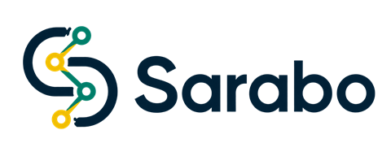

Repair your device with confidence.
Sarabo: An Electronics Repair Service Management Platform
Jahid Hasan
ID 222-115-116 · Batch 57 (C)
Supervisor: Shrabanti Chowdhury, Senior Lecturer
Dept. of CSE, Metropolitan University, Sylhet
Notes:
[0:00-0:15] Assalamu alaikum. I am Jahid Hasan. My project, supervised by Shrabanti Chowdhury, is Sarabo, an electronics repair service platform.

Slide 2
THE PROBLEM
Getting a device repaired is a leap of faith
Customers
Technicians
The business
No price before hand-over
No idea where the device is
Work only by word of mouth
Payment is uncertain
Stuck jobs are invisible
Refunds done by hand
Result: low trust on both sides, and many repairs never happen.
2/11
Notes:
[0:15-0:40] Customers hand over a phone without knowing the price or where it is. Technicians find work only by word of mouth. Whoever runs the service cannot see stuck jobs, and refunds are done by hand.

Slide 3
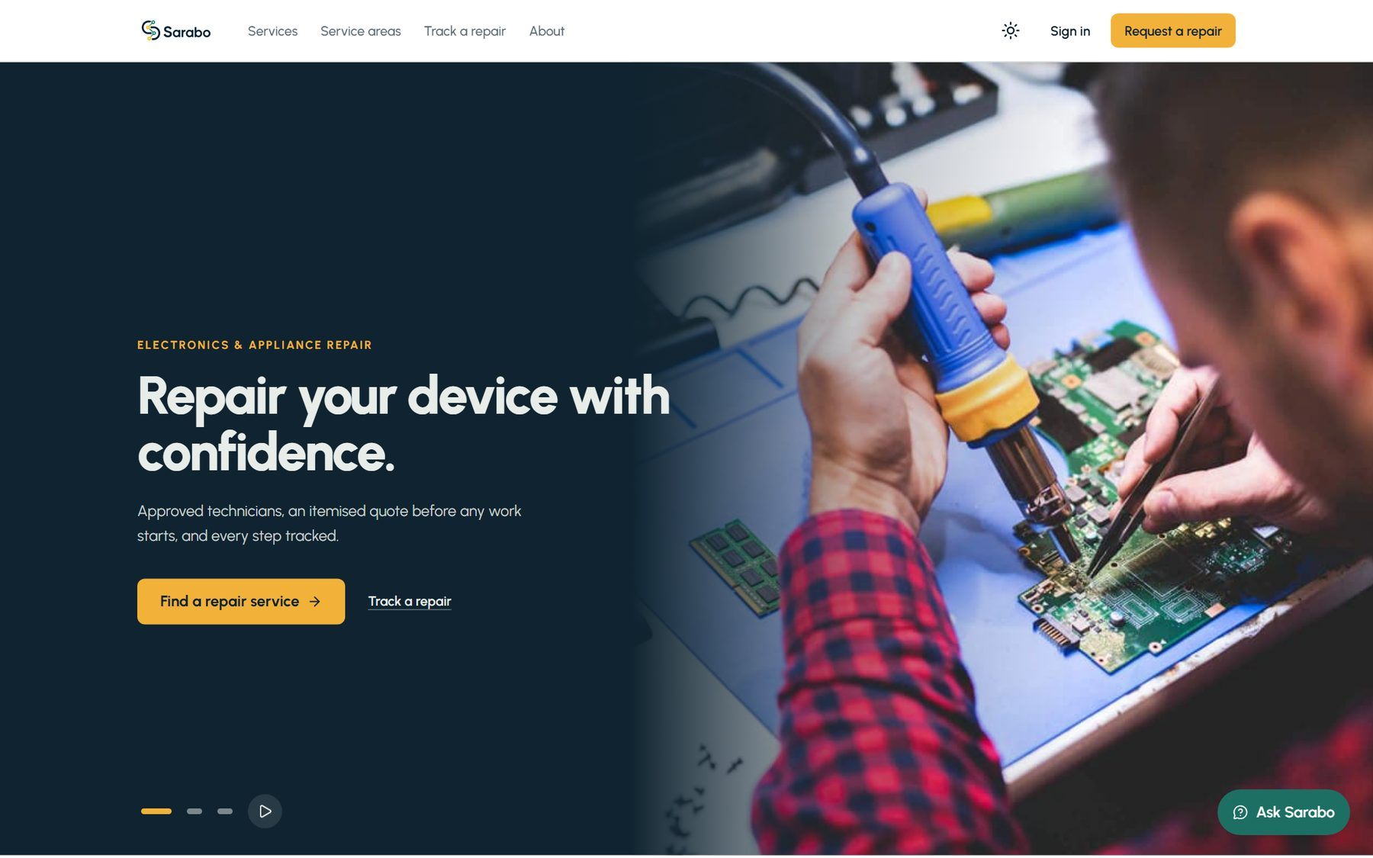
THE SOLUTION
One tracked, priced workflow for three roles
Customer
Request · compare · pay · track
Technician
Find jobs · quote · repair · get paid
Admin
Approve · prices · problems · reports
45 services 8 devices Live on Vercel
3/11
Notes:
[0:40-1:05] Sarabo turns this into one tracked, priced workflow for customers, technicians and admins. 45 repair services across 8 device types, priced in taka, and it is live.

Slide 4
HOW IT WORKS
From broken device to paid technician
1
2
3
4
5
6
Request
Offers
Book
Quote
Pay & repair
Hand-over
AI fills the form
Local technicians bid
Pay inspection fee
Itemised price
Fee already counted
Warranty starts
Fair by design: no-show or early cancel = full refund, otherwise fee split 90/10
4/11
Notes:
[1:05-1:45] One: the customer describes the problem, even in Banglish, and AI fills the form. Two: local technicians with the right skill send offers. Three: the customer pays a small inspection fee to book. Four: an itemised quote after inspection. Five: the customer pays only the rest. Six: hand-over, the technician gets 90 percent, and a 30-day warranty starts.

Slide 5
HOW IT WORKS: THE DATA
Entity-relationship diagram
|| one crow's foot many · MongoDB
User
Service
Payment
PK email
role
creates
PK id
price, inspection fee
FK request
amount, refund
priced by
becomes
Repair Request
Review
PK id
FK customer, technician, service
status, quote
FK request (unique)
rating
Technician
repairs
PK id
FK user email
region, skills
max 2
gets
Warranty Claim
Offer
sends
FK request
status
FK request, technician, estimate
5/11
Notes:
[1:45-2:20] This is the data model in MongoDB. A user creates many repair requests and can become a technician. Each request is priced by one service, gets many offers, and has its payments, one review and at most two warranty claims. The quote and inspection are stored inside the request. The crow's foot marks the 'many' side.

Slide 6
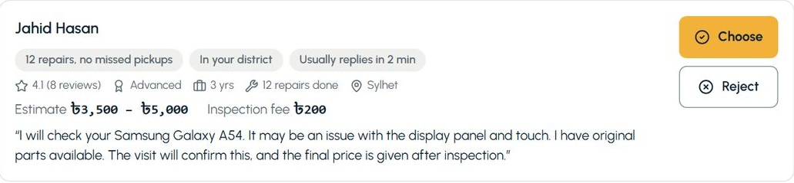
CUSTOMER
Compare ranked offers, pay only what is left
Quote ৳4,000
Inspection fee paid − ৳200
Left to pay ৳3,800
Ranked by rating, reliability, price, district, reply time
Approve and pay in one step
6/11
Notes:
[2:20-3:00] Offers are ranked using five things Sarabo already stores, and the reasons show as tags. The customer pays the inspection fee to book; after inspection the quote shows exactly what is left to pay.

Slide 7
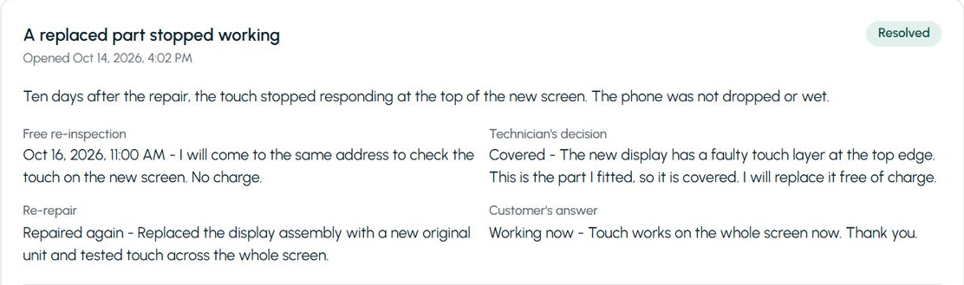
NEW IN THE FINAL PHASE
30-day warranty, and no repair can get stuck
Free re-inspection
Covered: re-repair or refund
Every wait has a deadline
Unpaid quote: 3 days
Receipt: auto, 3 days
Can't finish: refund
Stalled: admin alert
7/11
Notes:
[3:00-3:35] Every repair has a 30-day warranty: the same technician re-inspects free, and a covered fault is repaired again or refunded. I also made sure no request can wait forever: every waiting state has a deadline, an automatic step or an admin alert.

Slide 8
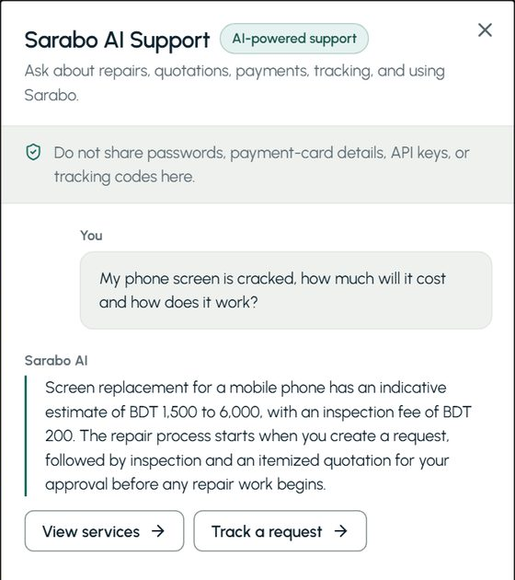
APPLIED AI (GOOGLE GEMINI)
AI suggests, people decide
Request helper
Offer note
Support chat
Report summary
Guardrails
Never sets a price
Checked against live data
No personal data sent
Daily usage limits
8/11
Notes:
[3:35-4:05] Gemini helps in four places, but AI only suggests and people decide. It never sets a price, every answer is checked against live data, no personal data is sent, and usage is limited.

Slide 9
ARCHITECTURE
Built so money and state never get out of sync
React 19
Express 5 API
MongoDB Atlas
web client
Vercel, Mumbai
21 collections
Firebase sign-in · Stripe payments · Supabase photos · Gemini AI · Gmail
Server decides
All-or-nothing
Exactly once
role and state checked on every action
booking, payment, refunds in transactions
no double payment, no double booking
9/11
Notes:
[4:05-4:35] A React app talks to an Express API on Vercel, next to the MongoDB database. Because it handles money, the server checks role and state for every action, money steps run in database transactions, and payments and bookings happen exactly once, even under races.

Slide 10
RESULTS
Verified, deployed, and ready to grow
2,761
58
12 / 12
Live
server tests pass
browser tests pass
objectives met
on Vercel
Limitations
Next
Stripe test mode, manual bKash payouts
No real customers yet
Local gateway (SSLCOMMERZ / bKash)
Mobile app, full Bangla interface
10/11
Notes:
[4:35-4:55] All server tests and all 58 browser tests pass, and the system is live; all twelve objectives were met. Limits: Stripe is in test mode, payouts are manual, and there are no real users yet. Next: a local payment gateway and a mobile app.

Slide 11
Thank you.
Now, the live demo
Live sarabo-client-six.vercel.app
11/11
Notes:
[4:55-5:00] Thank you. Now let me show you Rahim's repair, live.

