Slide 1
Project Final Presentation CSE 465.1 Heart Disease Prediction Shakil Ahmed(1520789042)

Slide 2
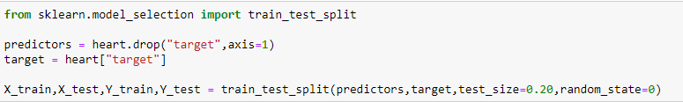
Data preprocessing
Split the Data into Train and Test set
Train set – 80%
Test set – 20%

Slide 3
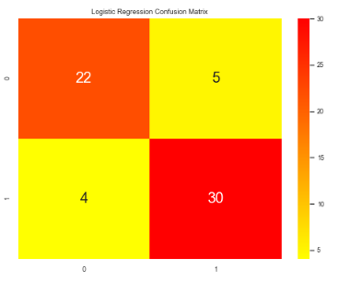
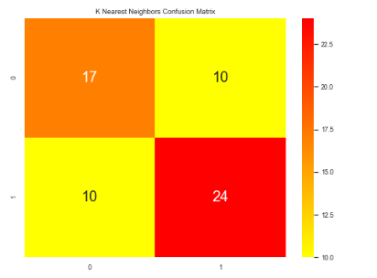
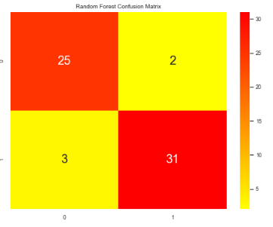
Confusion Matrix

Slide 4
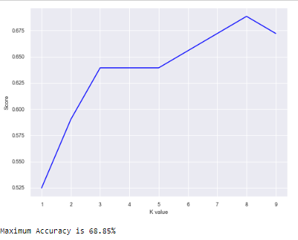
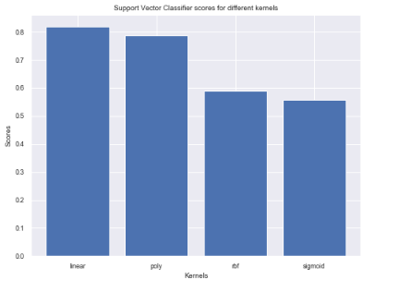
Accuracy Comparison
The accuracy score achieved using Logistic Regression is: 85.2%
The accuracy score achieved using K-Nearest Neighbors is: 68.9%
The accuracy score achieved using Support Vector Machine is: 78.7%
The accuracy score achieved using Random Forest is: 95.08 %

Slide 5
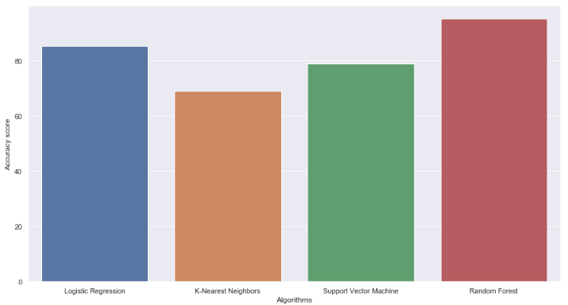
Accuracy Comparison

Slide 6
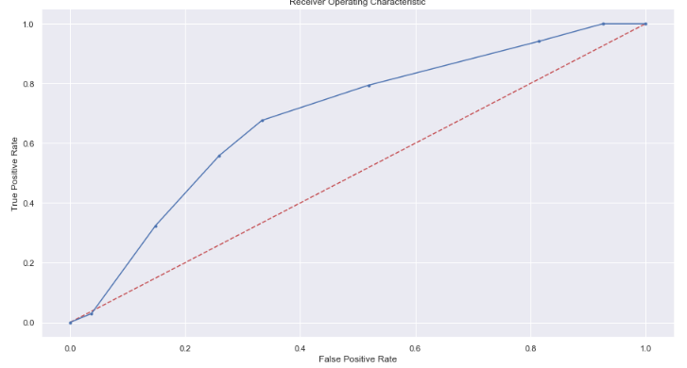
AUC Comparison
AUC for KNN: 0.690087

Slide 7
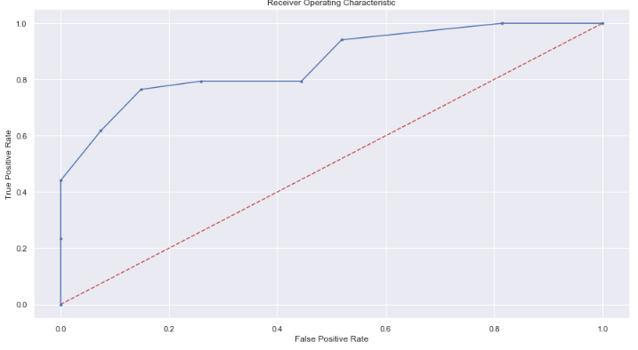
AUC Comparison
AUC for Random Forest Classifier: 0.861111

Slide 8
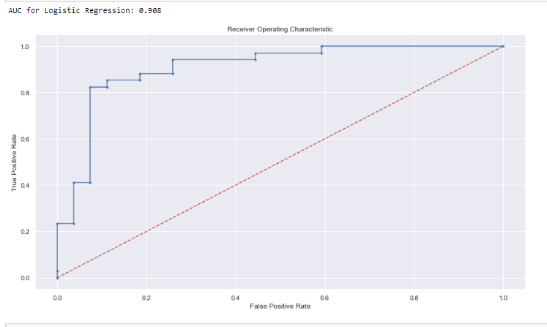
AUC Comparison

Slide 9
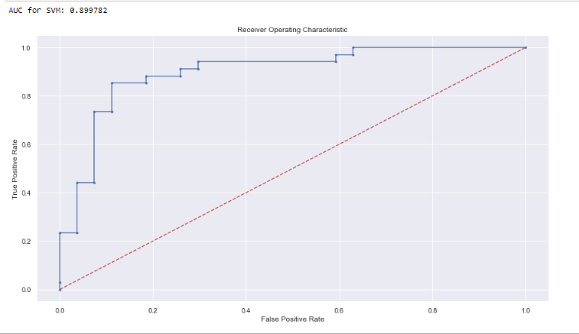
AUC Comparison

Slide 10
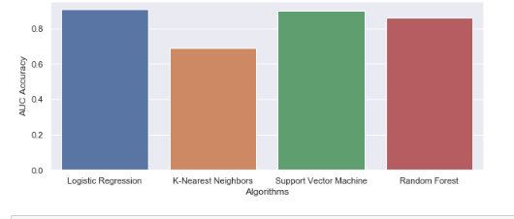
AUC Comparison

