Slide 1
Heart Disease Prediction
Presented By
Md Jahid Hasan Khandaker
ID# 1611131042

Slide 2
Introduction
This project aims to generate a model to predict the presence of a heart disease.
The dataset contains 303 patients records with respect to 14 attributes.
The dataset is collected from https://www.kaggle.com/ronitf/heart-disease-uci

Slide 3
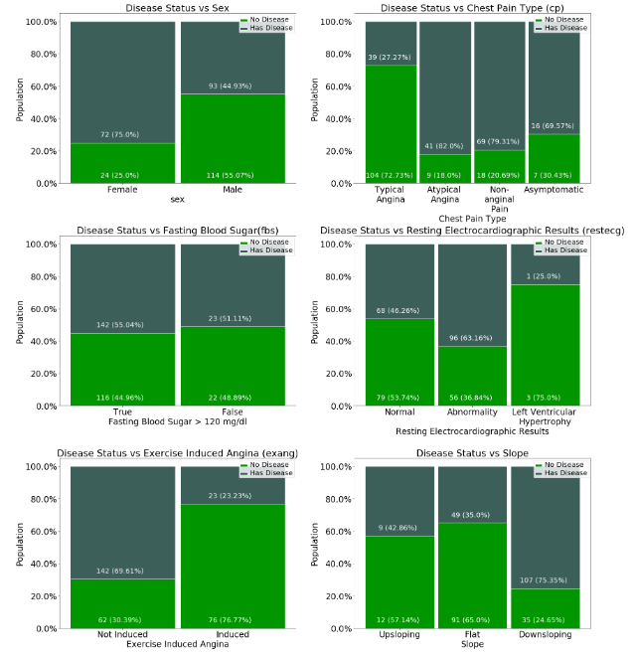
Data Visualization
Categorical Feature Value Ratio against Target

Slide 4
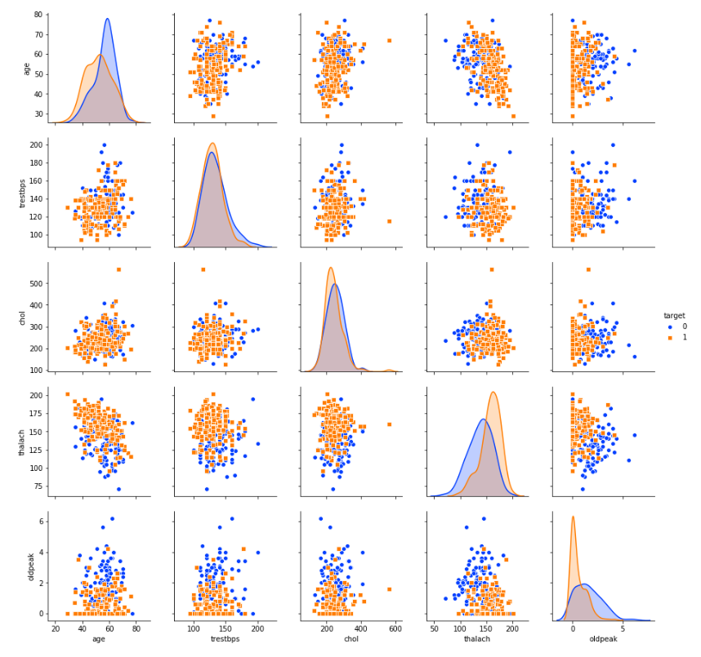
Data Visualization
A “pairs plot” is also known as a scatterplot, in which one variable in the same data row is matched with another variable's value.

Slide 5
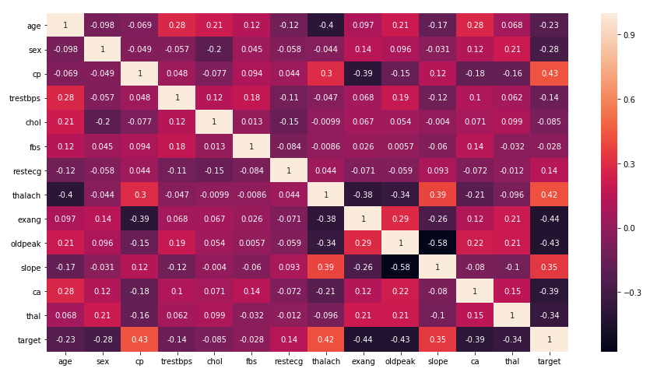
Data Visualization
So, why is correlation useful?
Correlation can help in predicting one attribute from another (Great way to impute missing values).
Correlation can (sometimes) indicate the presence of a causal relationship.
Correlation is used as a basic quantity for many modelling techniques

Slide 6
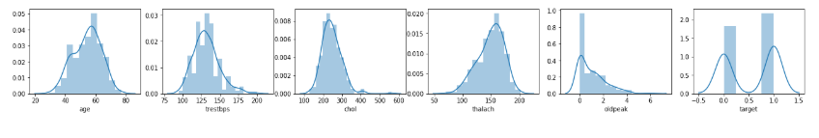
Data Visualization
Distributions
The features Age, trestbps, chol are normally distributed.
The likelihood of getting heart disease of more for the people with age 50 - 60.
The target variable is balanced.

Slide 7
Data Pre-Processing
Extract Independent and Target Variables
Here the independent features will be extracted to the nominal features cp, slope, thal and restecg.
The parameter drop_first = True as been set in order to avoid dummy variable trap after One hot encoding
Split the Data into Train and Test set
Train set – 80%
Test set – 20%

Slide 8
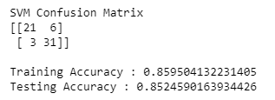
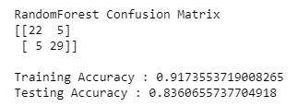
Model Performance Compare
Support Vector Machine Classifier and Random Forest Classifier have been used to compare the model performance.
Support Vector Machine
Random Forest

Slide 9
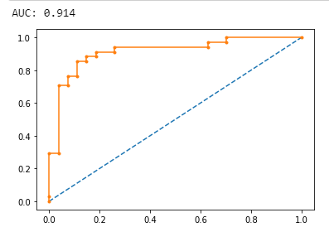
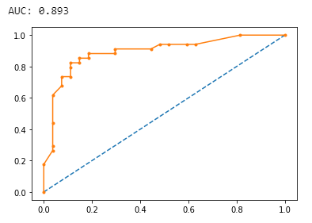
ROC & AUC
AUC from Random Forest: 89.3%
AUC from Support Vector Machine: 91.4%
Support Vector Machine
Random Forest

Slide 10
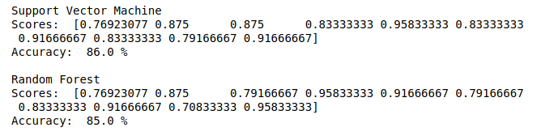
K-Fold Cross Validation
Accuracy from Random Forest: 85.0%
Accuracy from Support Vector Machine: 86.0%

Slide 11
Model Optimization using Grid Search Technique
Grid search is used to find the best hyperparameter for the model on SVM.
Best Score: 85.9%
&
Linear Kernel vs RBF Kernel
Best Kernel is “Linear” Kernel

Slide 12
Problem Faced
It took a lot of time to review the dataset properly
Difficulty in pointing out the necessary features
Difficulty faced while understanding correlation matrix

Slide 13
Thank You

