Slide 1
Project Update Presentation CSE465: Pattern Recognition and Neural Network Heart Disease Prediction
Presented By-
Rezowana Akter
ID: 1610147042

Slide 2
Introduction
This project aims to generate a model to predict the presence of a heart disease.
The dataset contains 303 patients records with respect to 14 attributes.
The dataset is collected from https://www.kaggle.com/ronitf/heart-disease-uci

Slide 3
Work Completed
Read data from .csv file
Reviewed the dataset
Dataset has a total of 303 rows. There are a total of 13 features along with one target value which we will train the models to find.
Checked for null and duplicated value
There are no missing values in the dataset.
There exits one row with duplicated value
Handling missing and duplicated value
Dropped the duplicated row
Data analysis by plotting graphs
Produced Correlation Matrix

Slide 4
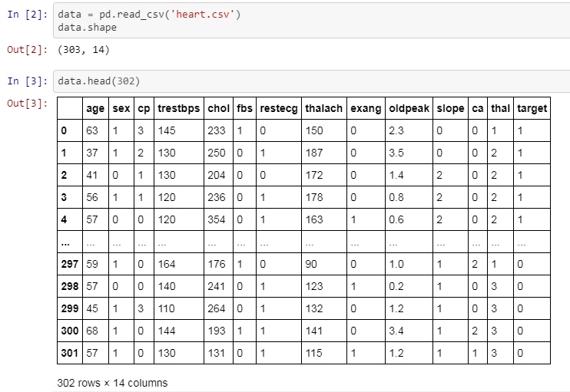
Work Update

Slide 5
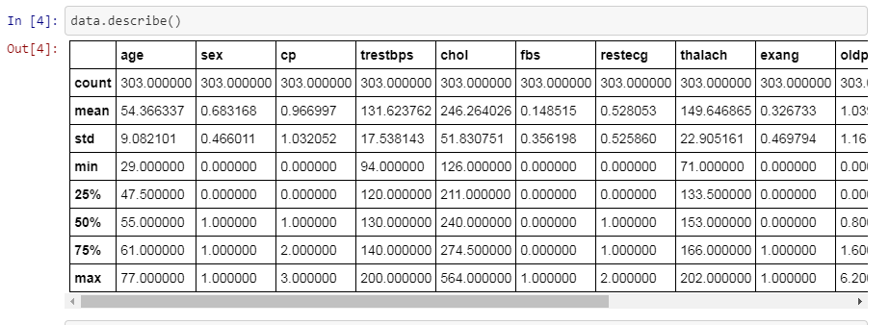
Work Update
The maximum for age reaches 77, the maximum of chol (serum cholestoral) is 564.

Slide 6
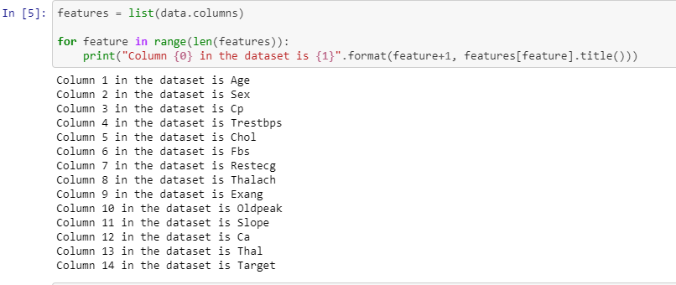
Work Update
The scale of each feature column is different and quite varied as well.

Slide 7
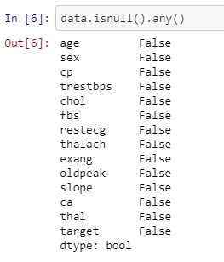
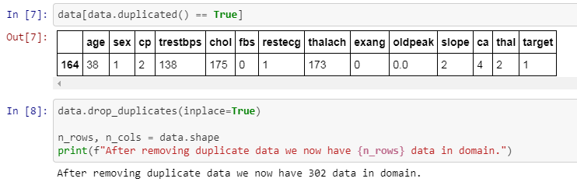
Work Update

Slide 8
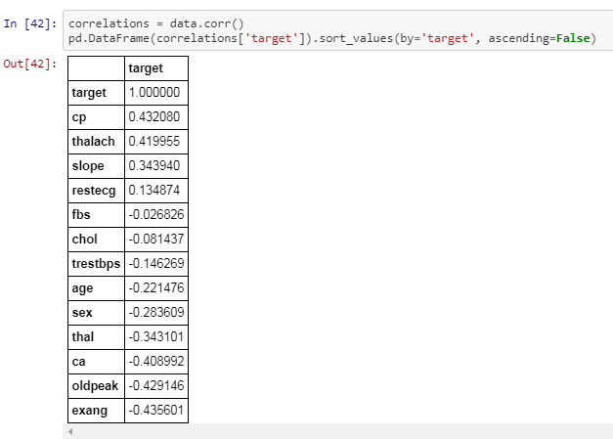
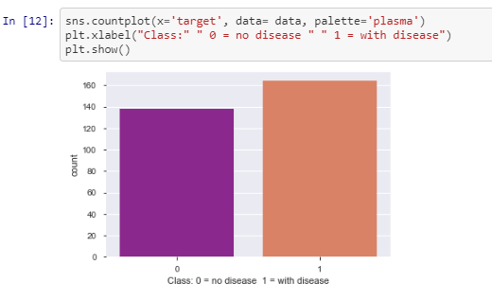
Work Update
Produced a correlation matrix to show how independent features within the dataset affect the target.
0: No heart disease
1: Heart disease
In the above graph, we realized that out of 303 instances within the dataset, 138 people were diagnosed to not have a heart disease and 164 people were diagnosed to have had it.

Slide 9
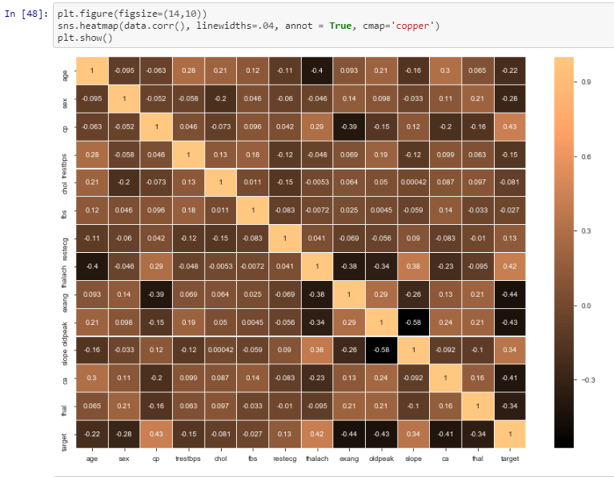
Work Update
Positive relationships chest pain = target thalcah = slope thalach = target slope = target
Negative relationships oldpeak =slope cp = exang age = thalach

Slide 10
Problems Faced
It took a lot of time to review the dataset properly
Difficulty in pointing out the relations of the attributes with the target value
difficulty faced while understanding correlation matrix

Slide 11
Future Work
Data pre-processing
Splitting the dataset into Training dataset and Testing dataset
Training the model
Apply Random Forest Algorithm, Support Vector Machine and Logistic Regression
Evaluation of the Trained Model with the Test Dataset
Confusion Matrix, ROC curve and AUC curve
Accuracy Check
Find the best Classifier

