Slide 1
Project Update Presentation CSE465: Pattern Recognition and Neural Network Heart Disease Prediction
Presented By-
Rezowana Akter
ID: 1610147042

Slide 2
Introduction
This project aims to generate a model to predict the presence of a heart disease.
The dataset contains 303 patients records with respect to 14 attributes.
The dataset is collected from https://www.kaggle.com/ronitf/heart-disease-uci

Slide 3
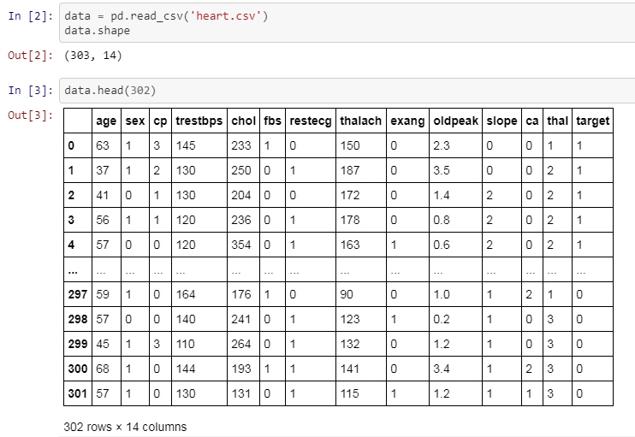
Data Visualization

Slide 4
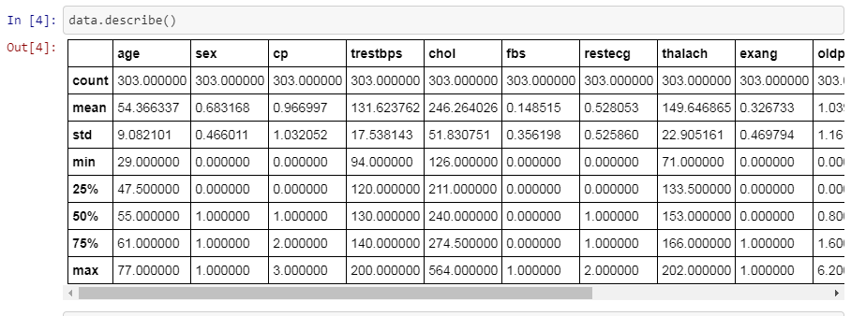
Data Visualization
The maximum for age reaches 77, the maximum of chol (serum cholestoral) is 564.

Slide 5
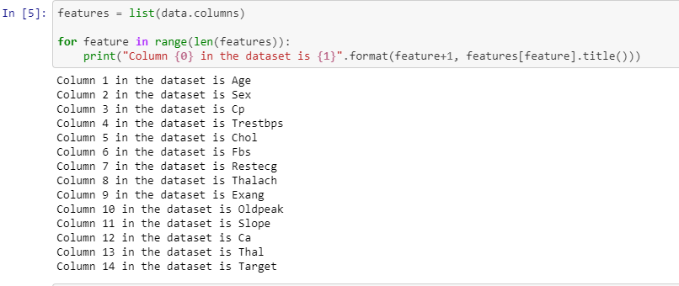
Data Visualization
The scale of each feature column is different and quite varied as well.

Slide 6
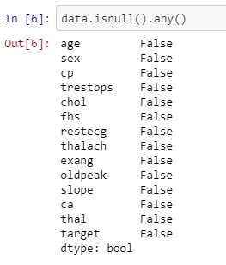
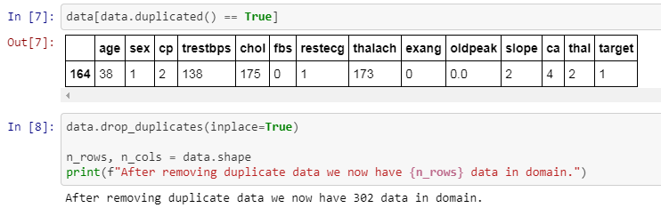
Data Visualization

Slide 7
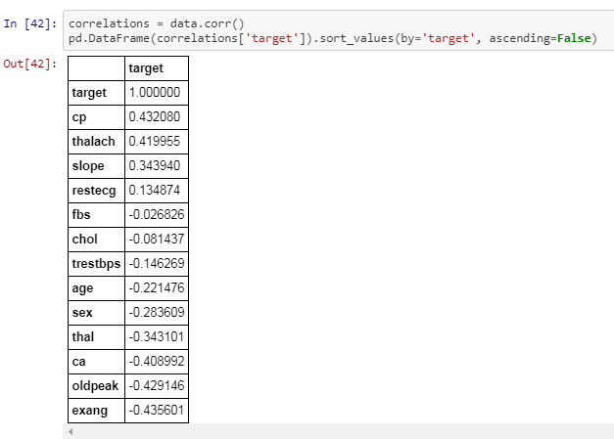
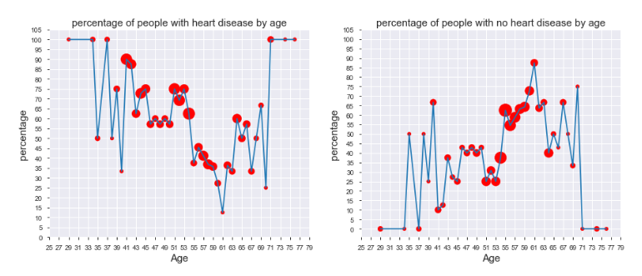
Data Visualization
Produced a correlation matrix to show how independent features within the dataset affect the target.
0: No heart disease
1: Heart disease
In the above graph, we realized that out of 303 instances within the dataset, 138 people were diagnosed to not have a heart disease and 164 people were diagnosed to have had it.

Slide 8
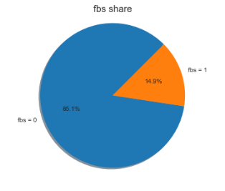
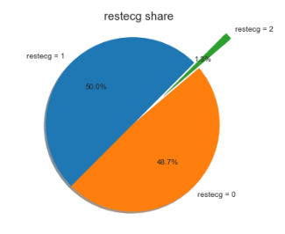
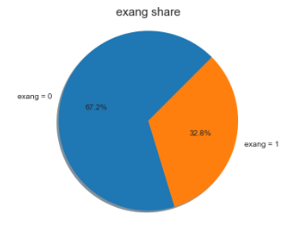
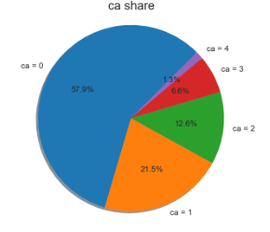
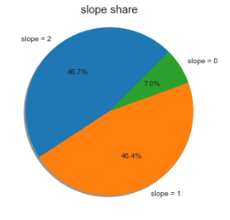
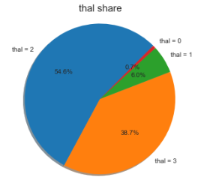
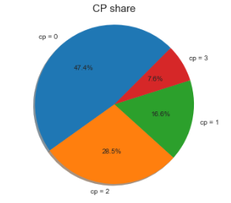
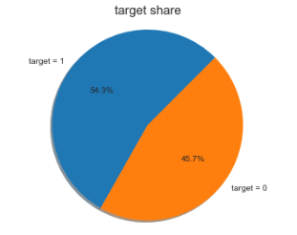
Data Visualization

Slide 9
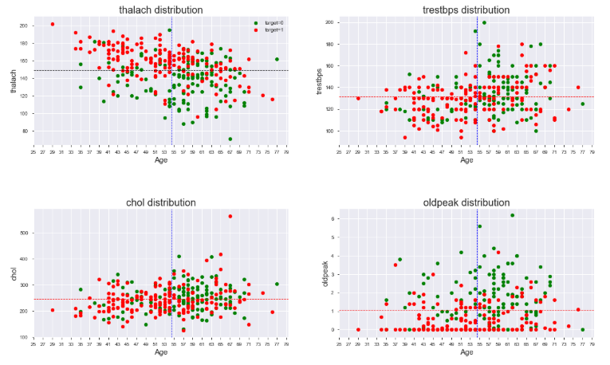
Data Visualization

Slide 10
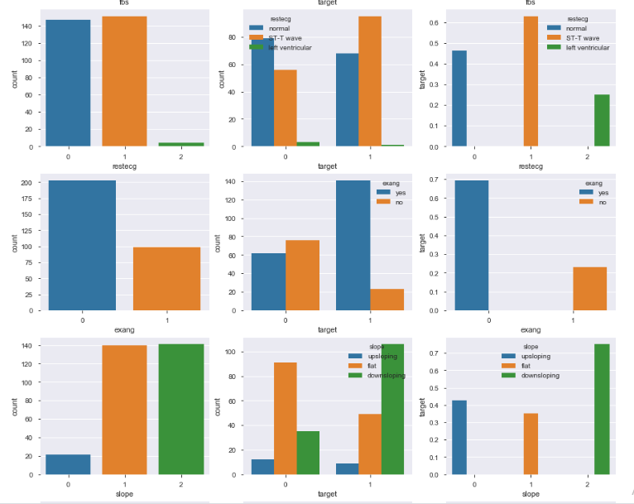
Data Visualization

Slide 11
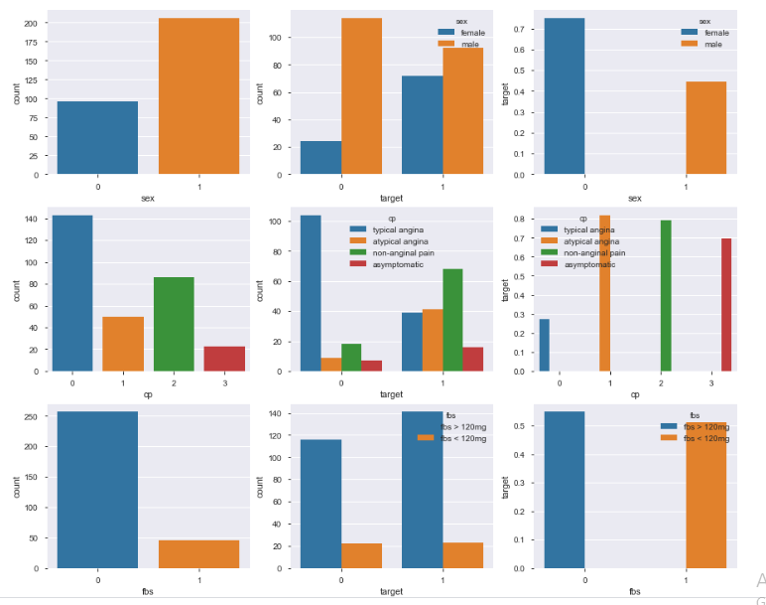
Data Visualization

Slide 12
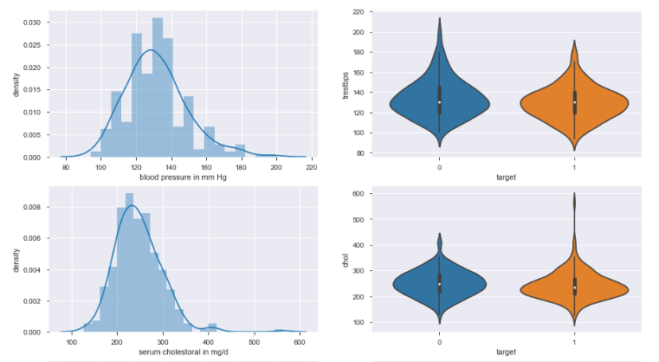
Data Visualization

Slide 13
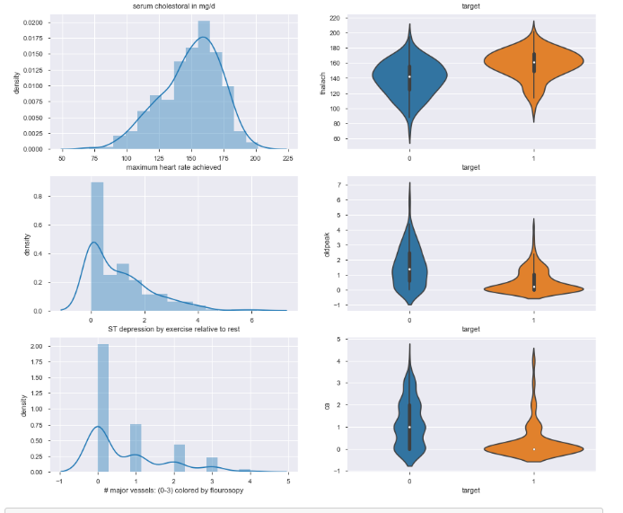
Data Visualization

Slide 14
Data Preprocessing
Split the Data into Train and Test set
Train set – 80%
Test set – 20%

Slide 15
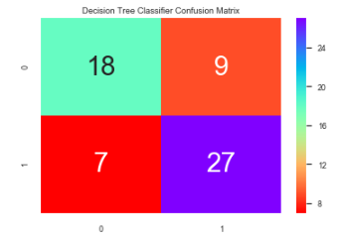
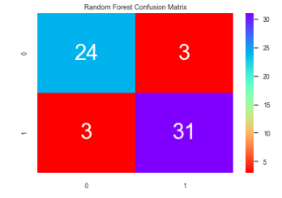
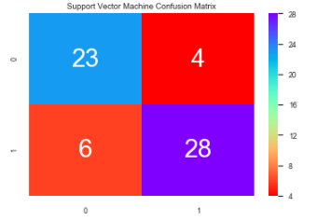
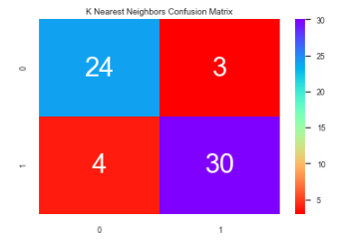
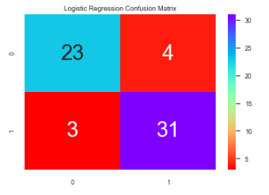
Confusion Matrix

Slide 16
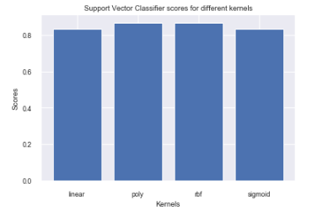
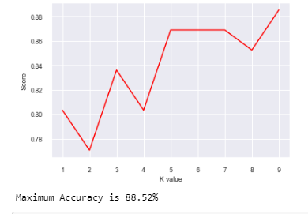
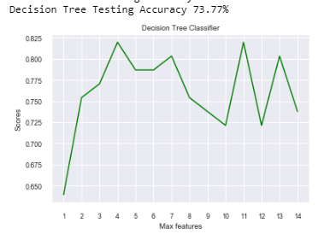
Accuracy Comparison
The Accuracy for Support Vector Classifier is 86.89% with poly kernel.
Logistic Regression
Training Accuracy 86.72199170124482
Testing Accuracy 88.52459016393442

Slide 17
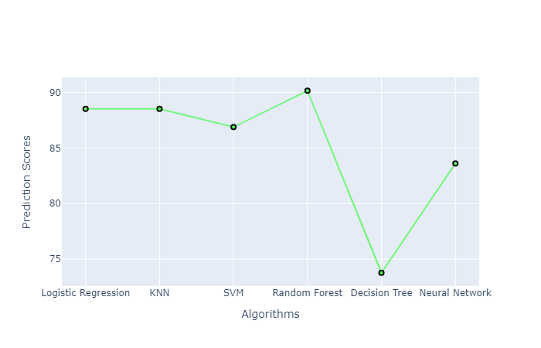
Accuracy Comparison

Slide 18
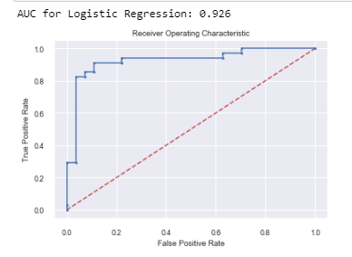
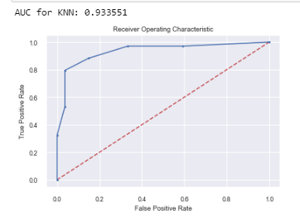
AUC Comparison

Slide 19
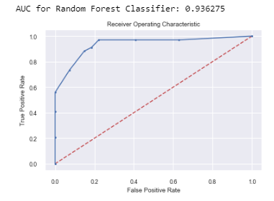
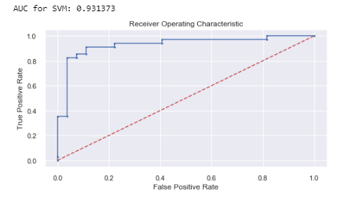
AUC Comparison

Slide 20
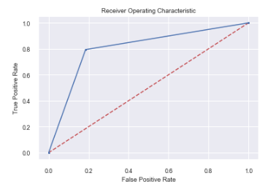
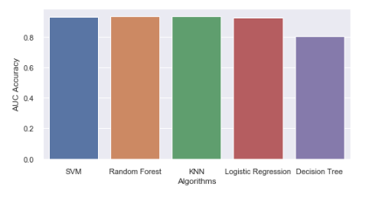
AUC Comparison

