Slide 1
Agile Development and Extreme Programming
Didarul Islam Didar
Lecture, CSE,UIU
Svetlin Nakov
National Academy for Software Development
academy.devbg.org
Notes:
*
11/07/2607/16/96
(c) 2007 National Academy for Software Development - http://academy.devbg.org. All rights reserved. Unauthorized copying or re-distribution is strictly prohibited.*
<number>##

Slide 2
Agenda
Software Engineering
SDLC
Development Methodologies
Agile Development
Extreme Programming (XP)
  How It Works for Me?
Develop Your Own Methodology

Slide 3
Software Engineering
Software engineering is the structured process of designing, developing, testing, and maintaining software using engineering principles.
It focuses on creating reliable and scalable software while managing cost, time, and quality.

Slide 4
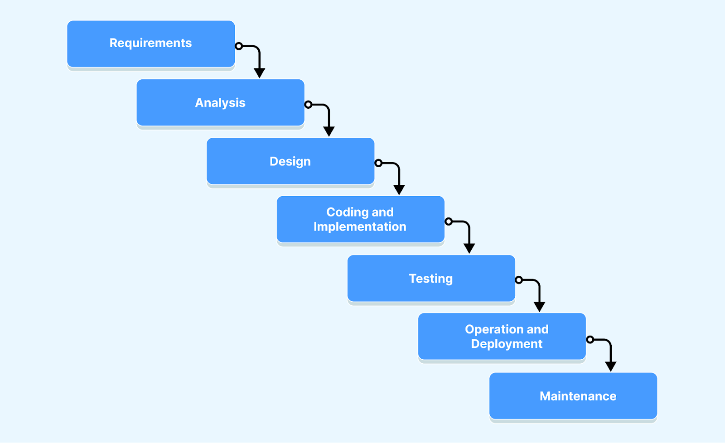
SDLC
The software development life cycle or SDLC is the step-by-step process that is followed to create software.

Slide 5
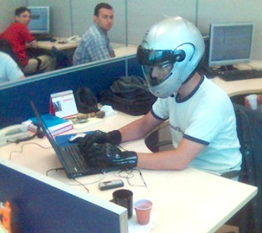


Development Methodologies
Notes:
*
11/07/2607/16/96
(c) 2007 National Academy for Software Development - http://academy.devbg.org. All rights reserved. Unauthorized copying or re-distribution is strictly prohibited.*
<number>##

Slide 6
What is a Methodology?
A methodology is a formalized process or set of practices for creating software
  A set of rules you have to follow
  A set of conventions the organization decides to follow
  A systematical, engineering approach for organizing software projects

Slide 7



The Waterfall Development Process
Notes:
*
11/07/2607/16/96
(c) 2007 National Academy for Software Development - http://academy.devbg.org. All rights reserved. Unauthorized copying or re-distribution is strictly prohibited.*
<number>##

Slide 8
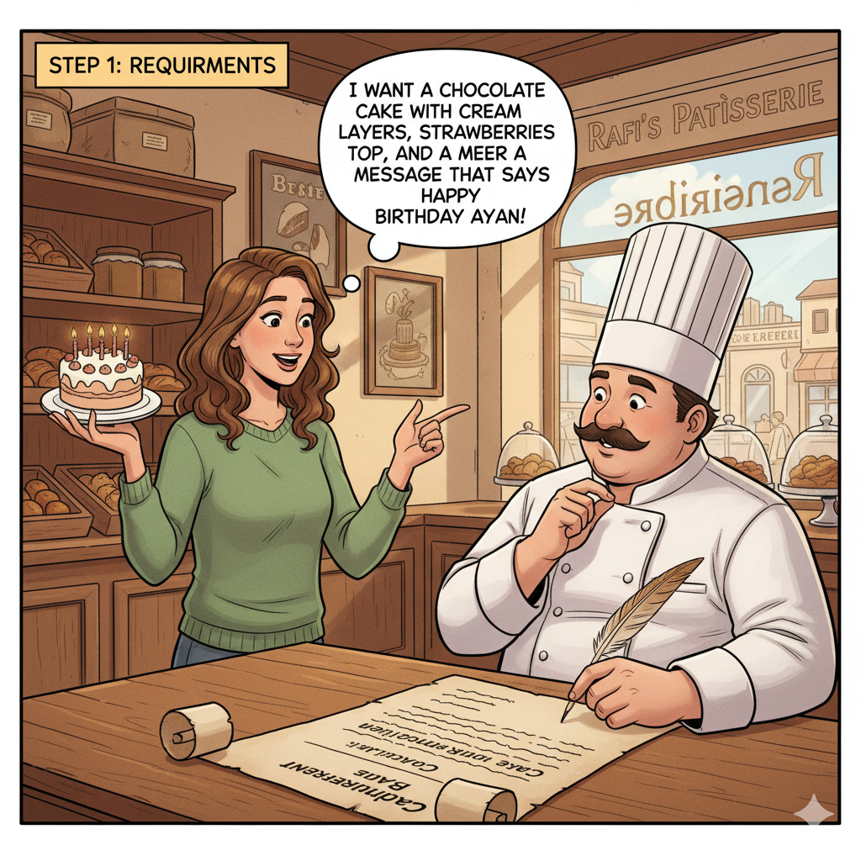

Slide 9
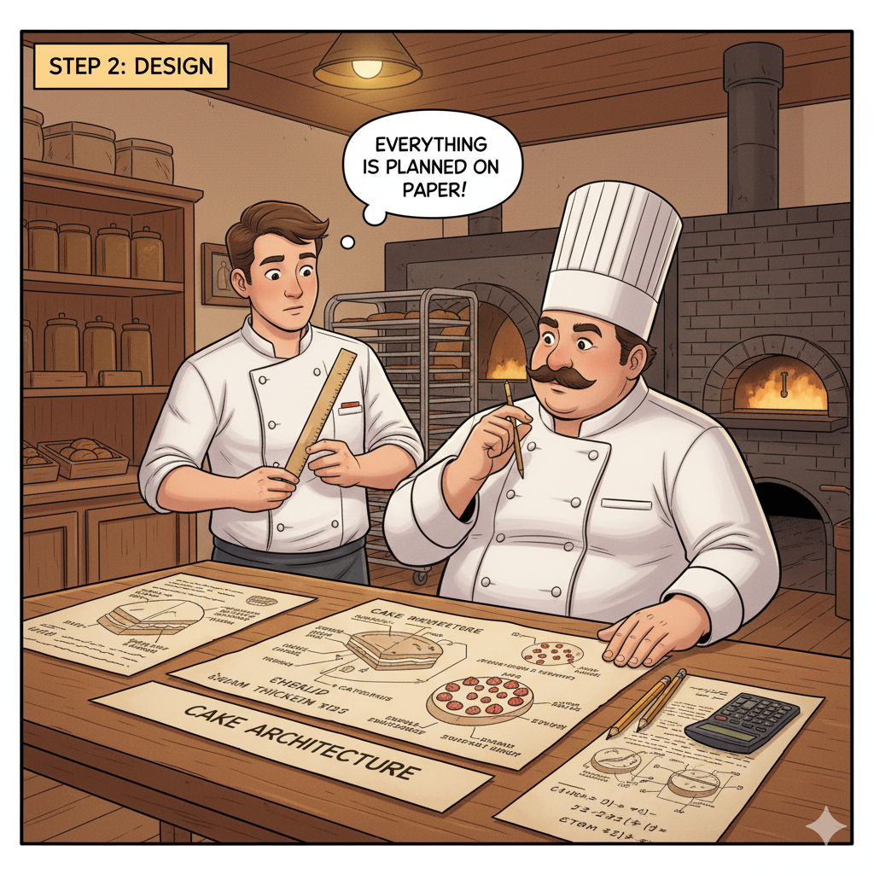

Slide 10
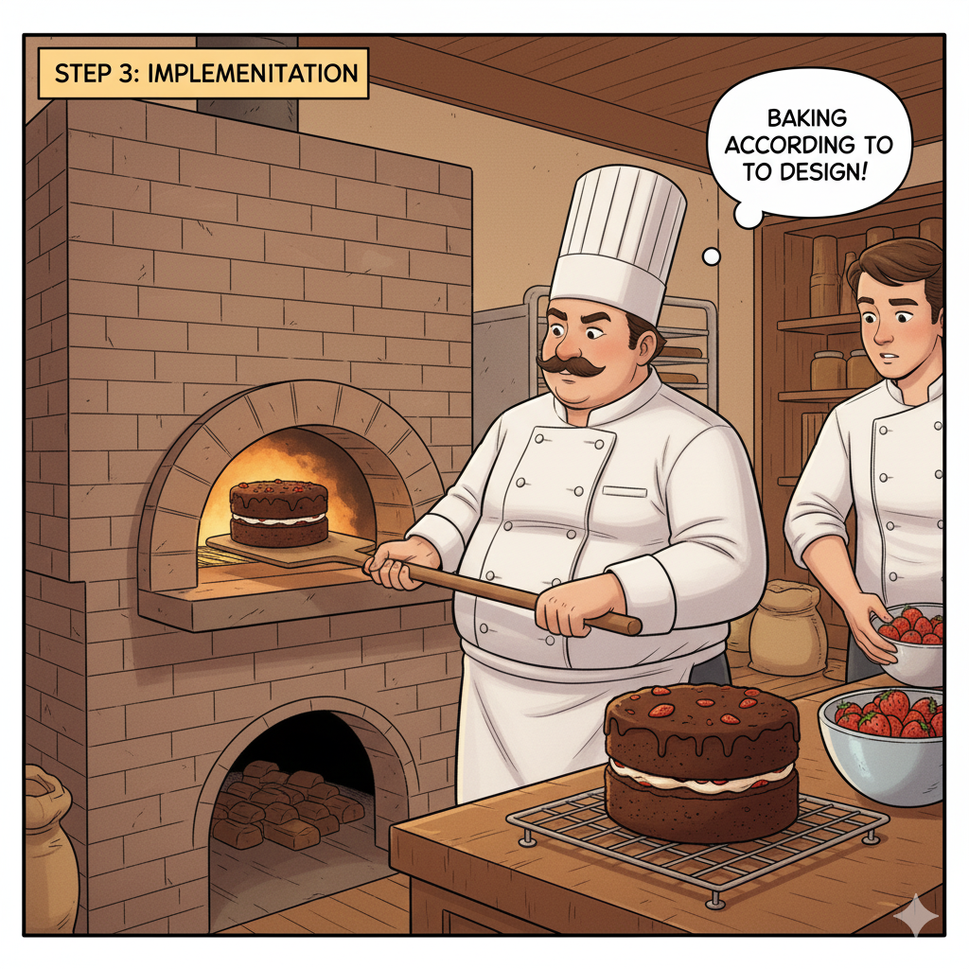

Slide 11
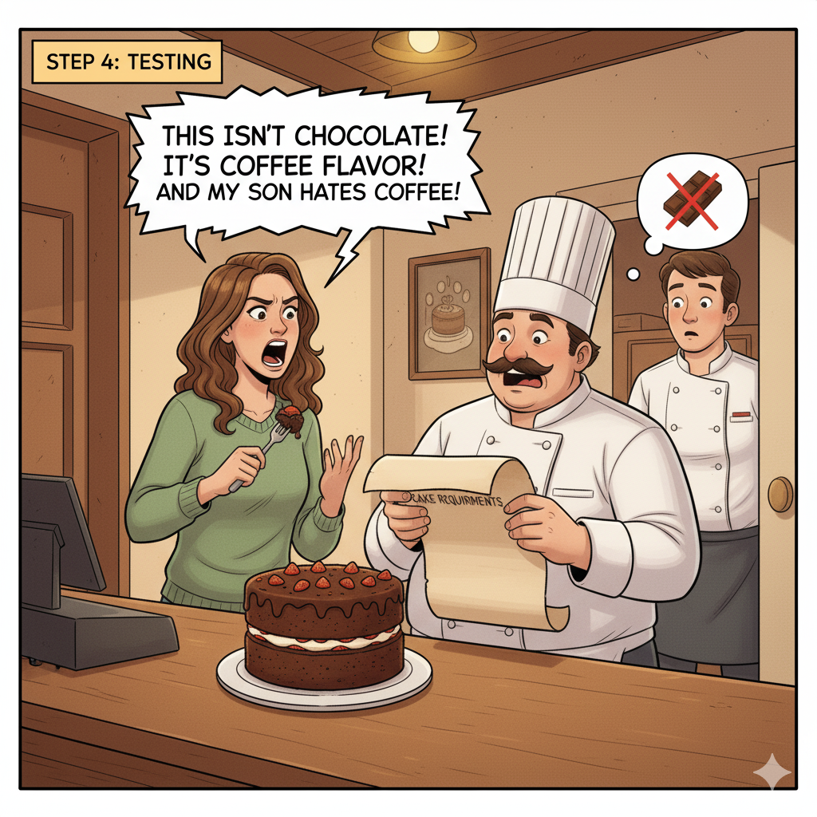

Slide 12
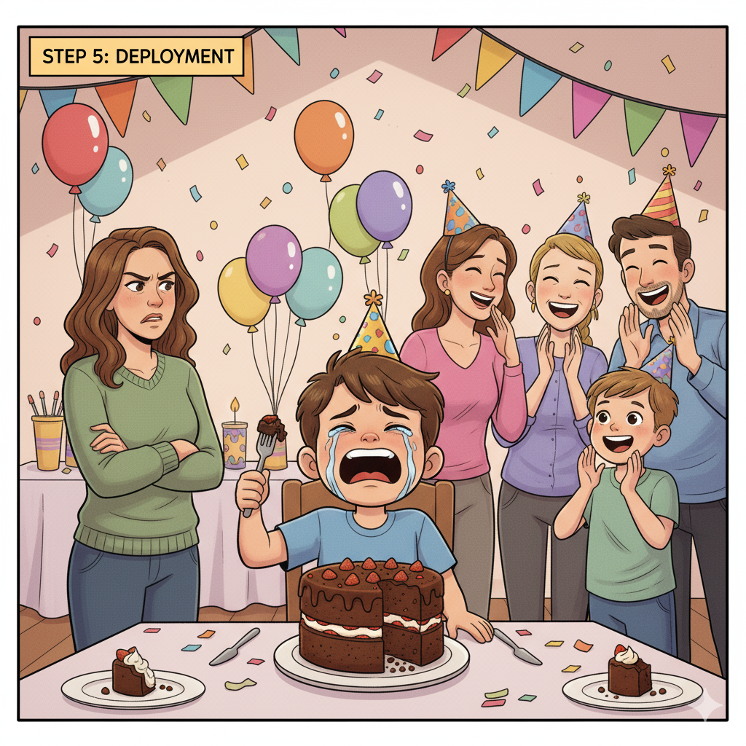

Slide 13
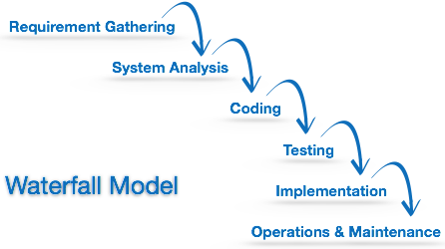
The Waterfall Process
Waterfall model is the simplest model of software development paradigm.
It says the all the phases of SDLC will function one after another in linear manner. That is, when the first phase is finished then only the second phase will start and so on.

Slide 14
This model assumes that everything is carried out and taken place perfectly as planned in the previous stage and there is no need to think about the past issues that may arise in the next phase.
This model does not work smoothly if there are some issues left at the previous step.
The sequential nature of model does not allow us go back and undo or redo our actions.

Slide 15
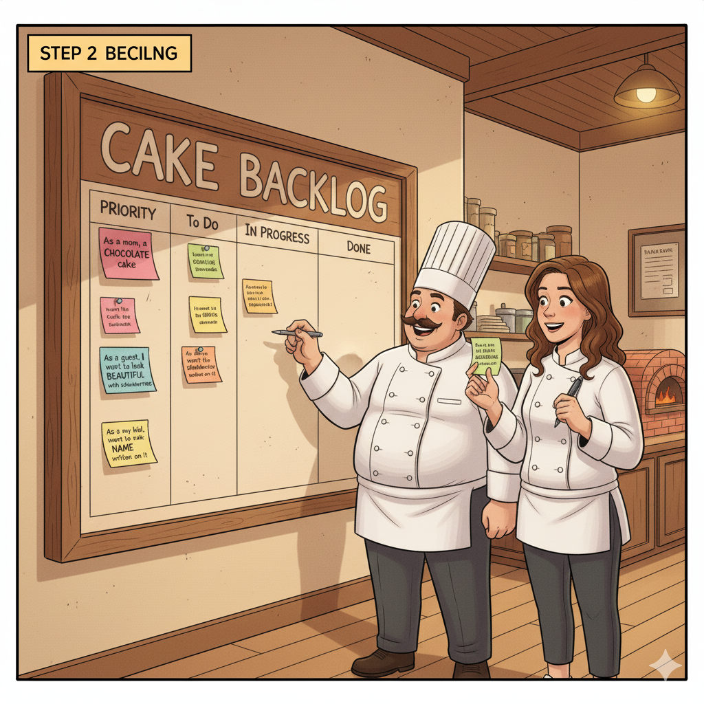

Slide 16
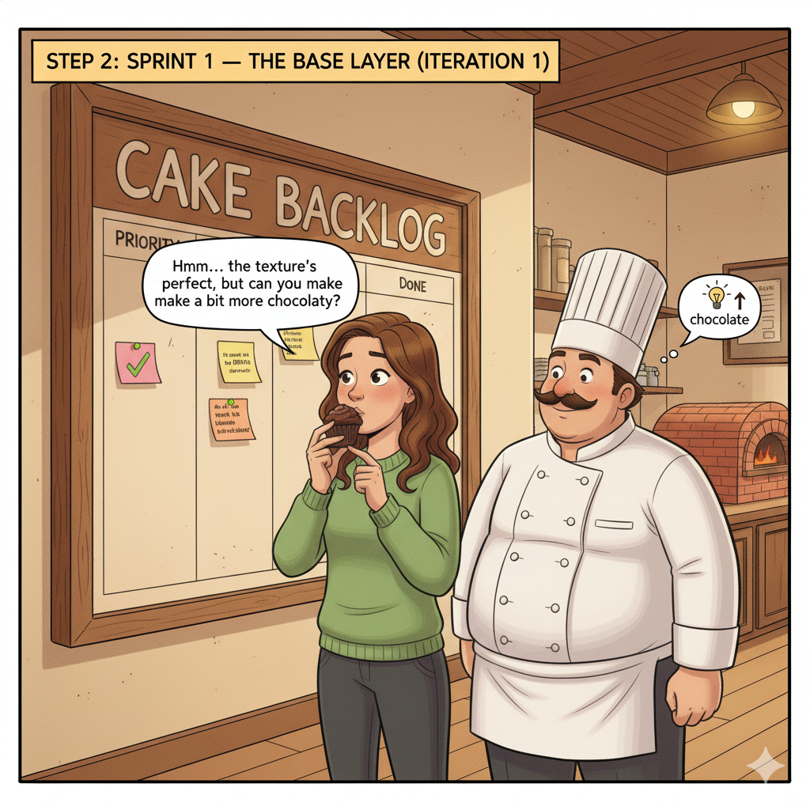

Slide 17
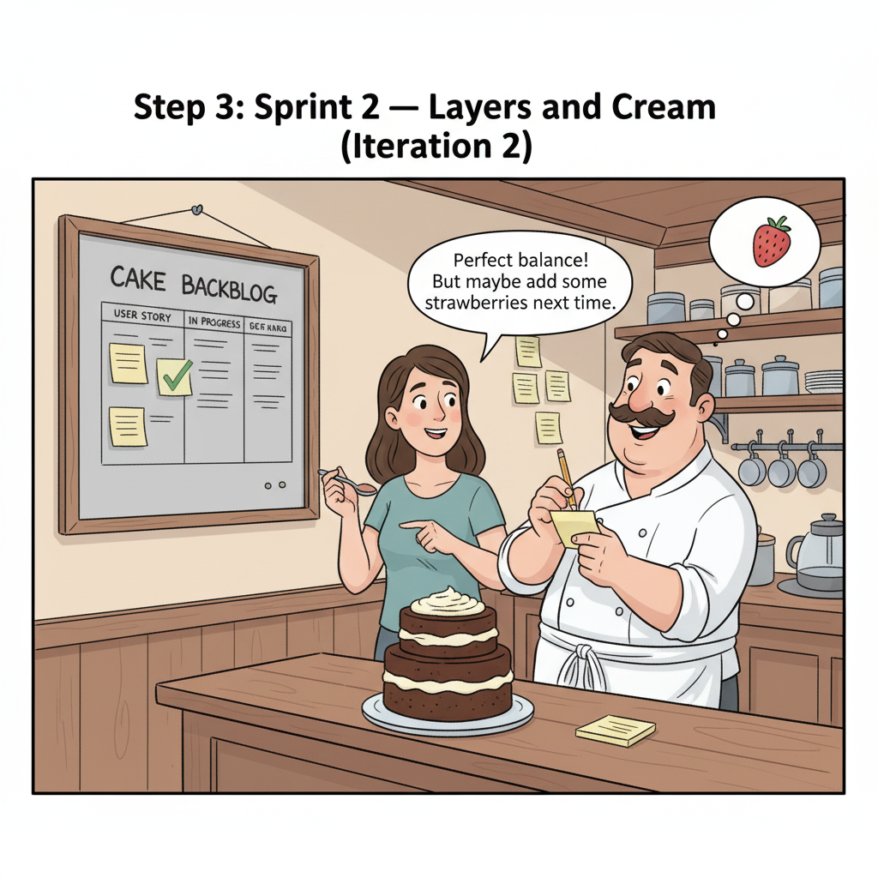

Slide 18
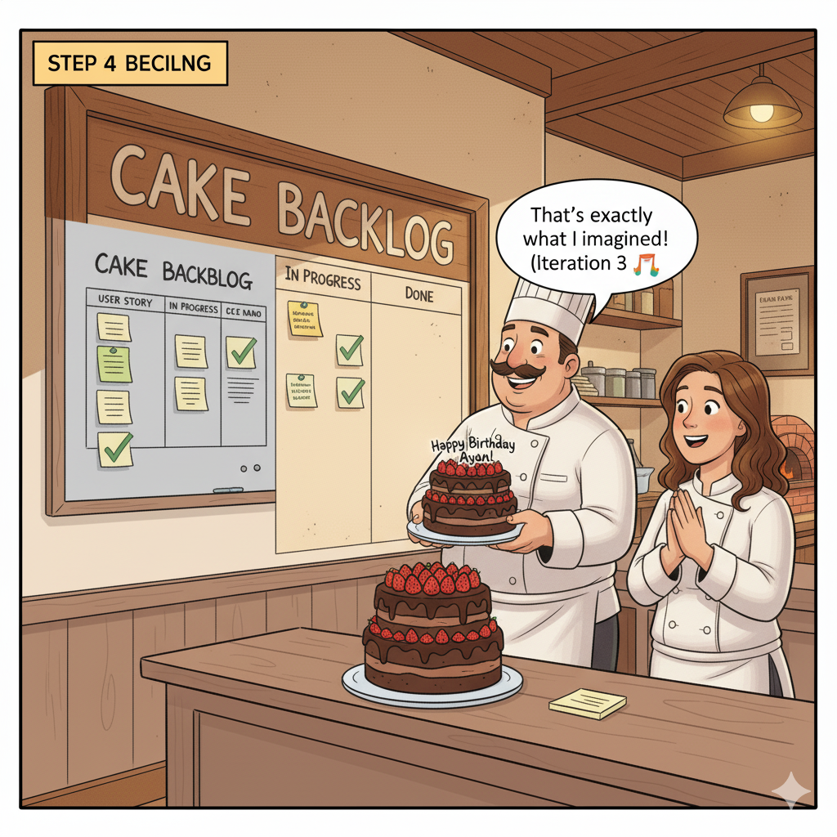

Slide 19

Agile Development
Able to move your body quickly and easily.
Able to think quickly and clearly.
Notes:
*
11/07/2607/16/96
(c) 2007 National Academy for Software Development - http://academy.devbg.org. All rights reserved. Unauthorized copying or re-distribution is strictly prohibited.*
<number>##

Slide 20
Agile
Agile is a software development methodology to build a software incrementally using short iterations of 1 to 4 weeks so that the development process is aligned with the changing business needs.
Instead of a single-pass development of 6 to 18 months , Agile adopts a process of frequent feedback where a workable product is delivered after 1 to 4 week iteration.

Slide 21
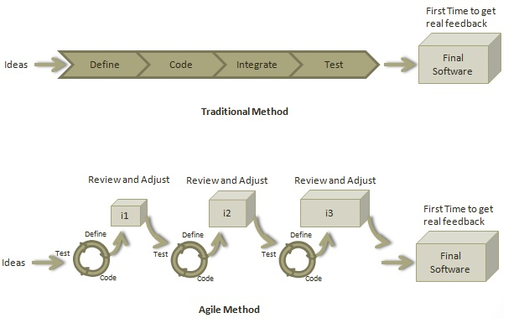

Slide 22
Agile Manifesto
  “Our highest priority is to satisfy the
  customer through early and continuous
  delivery of valuable software“
  [Manifesto for Agile]

Slide 23
The Agile Spirit
Incremental
  Working software over comprehensive documentation
Cooperation
  Customer collaboration over contract negotiation
Straightforward
  Individuals and interactions over processes and tools
Adaptive
  Responding to change over following a plan

Slide 24
Agile Methodologies
eXtreme Programming (XP)
Scrum
Crystal family of methodologies
Feature-Driven Development (FDD)
Adaptive Software Development (ASD)
Dynamic System Development Model (DSDM)
Agile Unified Process (AUP)

Slide 25




eXtreme Programming
Notes:
*
11/07/2607/16/96
(c) 2007 National Academy for Software Development - http://academy.devbg.org. All rights reserved. Unauthorized copying or re-distribution is strictly prohibited.*
<number>##

Slide 26


The XP Guru: Kent Beck
eXtreme Programming
  The most prominent agile development methodology
1st ed. Oct 1999
2nd ed. Nov 2004
Kent Beck
Notes:
*
11/07/2607/16/96
(c) 2007 National Academy for Software Development - http://academy.devbg.org. All rights reserved. Unauthorized copying or re-distribution is strictly prohibited.*
<number>##

Slide 27
XP
XP is a lightweight, efficient, low-risk, flexible, predictable, scientific, and fun way to develop a software.
As a type of agile software development, it advocates frequent "releases" in short development cycles

Slide 28
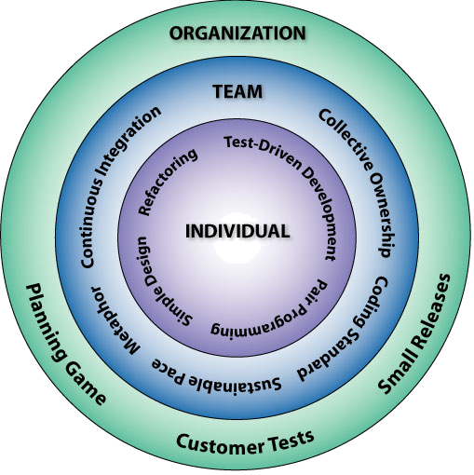
The 12 Key Practices
The Planning Game
Small Releases
Metaphor
Simple Design
Test-Driven Development
Refactoring
Pair Programming
Collective Ownership
Continuous Integration
40-Hour Workweek
On-site Customer
Coding Standards

Slide 29
1. Metaphor
Guide all development and conversations with a simple shared story of how the whole
  Gives the team system works a whole picture of describing the system, where new parts fit, etc.
Words used to identify technical entities should be chosen from the metaphor
The default metaphor is the business domain, and it’s usually just fine

Slide 30
Imagine you’re building an online shopping platform.
The metaphor might be a physical store:
Product database Warehouse
Shopping cart Basket
Order processor Order processor

Slide 31

How It Works for Me?
Metaphors are good idea
People should know the business needs and how their work fits in the project

Slide 32
2. Release Planning
Requirements via User Stories
  Short cards with natural language description of what a customer wants
  Prioritized by customer
Resource and risk estimated by developers
  Via “The Planning Game”
Play the Planning Game after each increment

Slide 33
Release Planning in XP is the process where the customer and development team collaborate to decide what features will be included in the next release and when it will be delivered.
Customer decides what’s valuable,
Developers decide what’s possible,
Together they decide what to do next.

Slide 34
Scenanrio
Online Bookstore
Step 1: Write User Stories
I can search for books by title or author.
I can add books to my shopping cart.
I can see recommended books based on my interests.
I can pay securely using a credit card.
I can rate and review books.
Developer Side
Search for books 3 days risk: Low
Add to cart 2 days risk: Low
Recommendations 6 days risk: High
Secure payment 5 days risk: medium
Rate and review 4 days risk: medium

Slide 35
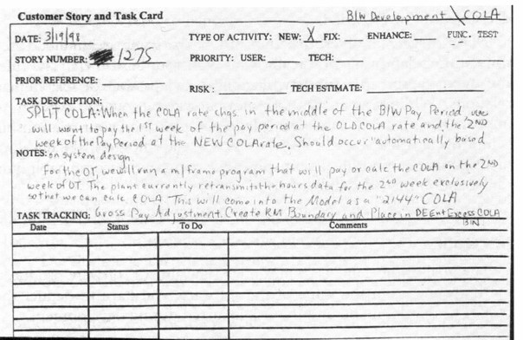
User Stories

Slide 36
How It Works for Me?
Requirements specification (SRS) is better than user stories
  Written documentation works well for large projects
I prefer prototyping the user interface as source of documentation
Sometimes its is hard to estimate the required resources
Small releases have less risk

Slide 37
3. Testing
Test-Driven Development (TDD)
  Write tests before code
  Tests are automated
  Often use xUnit framework
  Must run at 100% before proceeding
Acceptance Tests
  Written with the customer
  Acts as “contract”
  Measure of progress

Slide 38
Test-Driven Development
Write tests before writing the code.”
How TDD works
Write a failing test
  Before coding anything, the developer writes a unit test describing the expected behavior.
Write the simplest code to make the test pass
Refactor the code
  Clean up code while keeping tests green.
High cohesion, low coupling" is a software design principle that promotes modular, maintainable code. High cohesion means that the elements within a single module are closely related and work together to perform a single, well-defined task. Low coupling means that modules are independent of each other, so changes in one module have a minimal impact on others.
Notes:
*
11/07/2607/16/96
(c) 2007 National Academy for Software Development - http://academy.devbg.org. All rights reserved. Unauthorized copying or re-distribution is strictly prohibited.*
<number>##

Slide 39
4. Pair Programming
Two software engineers work on one task at one computer
  The driver has control of the keyboard and mouse and creates the implementation
  The navigator watches the driver’s implementation
    Identifies defects and participates in on-demand brainstorming
  The roles of driver and observer are periodically rotated

Slide 40
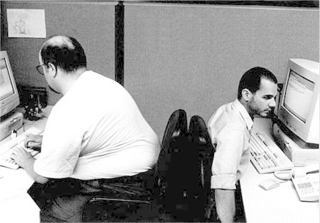
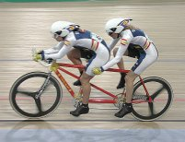
Pair Programming
Pairs produce higher quality code
Pairs complete their tasks faster
Pairs enjoy their work more
Pairs feel more confident in their work

Slide 41
How It Works for Me?
Pair programming is great for complex and critical logic
  When developers need good concentration
  Where quality is really important
  Especially during design
  Reduces time wasting
Trivial tasks can be done alone
Peer reviews instead pair programming is often alternative

Slide 42
5. Refactoring
Improve the design of existing code without changing its functionality
  Relies on unit testing to ensure the code is not broken
Bad smells in code:
  Long method / class
  Duplicate code
  Methods does several different things (bad cohesion)
  Too much dependencies (bad coupling)
  Complex / unreadable code

Slide 43
How It Works for Me?
Delivering working software faster is important!
  You can write the code to run somehow
    With simple design
    With less effort
  Later you can refactor the code if necessary
Refactoring is not a reason to intentionally write bad code!
  Good coding style is always important!

Slide 44
6. Simple Design
No Big Design Up Front (BDUF)
Don’t overthink. Don’t over-plan. Don’t over-design.
  Reduces the overhead
  Ship working functionality faster and get feedback early
  Example: If you only need to store user data temporarily, use an in-memory list.
  Don’t create a database + cache + API + microservices.
“Do The Simplest Thing That Could Possibly Work”
  Later use refactoring to change it
Not too much formal documentation

Slide 45
How It Works for Me?
Simple design does not mean "no design"
  It is about establishing priorities
  It's a set of tradeoffs you make
  If something is important for this release and for the whole system, it should be designed well
  Don't lose time to design something you will not use soon!

Slide 46
7. Collective Code Ownership
Code to belongs to the project, not to an individual engineer!
Any engineer can modify any code
Better quality of the code
Engineers are not required to work around deficiencies in code they do not own
  Faster progress
  No need to wait for someone else to fix something

Slide 47
How It Works for Me?
Collective code ownership is absolutely indispensable
  You need to fight the people who don't agree with this!
  Fire people writing unreadable and unmaintainable code
  Don't allow somebody to own some module and be irreplaceable

Slide 48
8. Continuous Integration
Pair writes up unit test cases and code for a task (part of a user story)
Pair unit tests code to 100%
Pair integrates
Pair runs ALL unit test cases to 100%
Pair moves on to next task with clean slate and clear mind
Should happen once or twice a day

Slide 49
How It Works for Me?
Integrating often is really valuable
  Sometimes you cannot finish a task for one day and integrate it
  For small projects with small teams integration is not an issue
  For large and complex projects it's crucial

Slide 50
9. On-Site Customer
Customer available on site
  Clarify user stories
  Make critical business decisions
Developers don’t make assumptions
Developers don’t have to wait for decisions
Face to face communication minimizes the chances of misunderstanding

Slide 51
How It Works for Me?
On-site customer actually does not work!
  Customers are busy
    Meetings every day is working better
  Customers are not competent!
    Customers always say "Yes, this is what I want" and later say the opposite
    You need to think instead of them
    Use prototyping

Slide 52
10. Small Releases
Timeboxed
As small as possible, but still delivering business value
  No releases to ‘implement the database’
Get customer feedback early and often
Do the planning game after each iteration
  Do they want something different?
  Have their priorities changed?

Slide 53
How It Works for Me?
Small releases are really valuable
  Manage the risk of delivering something wrong
  Helps the customer to define better requirements
Release every few weeks
Large projects are not so flexible
  Try to release something, even you know that it will be changed

Slide 54
11. Forty-Hour Work Week
Kent Beck says, “ . . . fresh and eager every morning, and tired and satisfied every night”
Burning the midnight oil kills performance
Tired developers make more mistakes
  Slows you down more in the long run
If you mess with people’s personal lives (by taking it over), in the long run the project will pay the consequences

Slide 55
How It Works for Me?
40 hours a week or 40 hours without a sleep?
  Come back to the real world!
  Overtime is not recommendable but often can not be avoided
Better planning can help
Highly skilled senior engineers always suffer of overtime and high pressure
  That's how the business works!

Slide 56
12. Coding Standards
Use coding conventions
  Rules for naming, formatting, etc.
  Write readable and maintainable code
Method commenting
  Self-documenting code
  Don't comment bad code, rewrite it!
Refactor to improve the design

Slide 57
How It Works for Me?
Coding standards are important
  Enforce good practices to whole the team – tools, code reviews, etc.
Standards should be simple
  Complex standards are not followed
  Standards should be more strict for larger teams
  Developers don't like utter rules like "comment any class member"

Slide 58
The 13th Practice?
The Stand Up Meeting
Start the day with 15-minute meeting
  Everyone stands up (so the meeting stays short) in circle
  Going around the room everyone says specifically:
    What they did the day before
    What they plan to do today
    Any obstacles they are experiencing
  Can be the way pairs are formed

Slide 59

People Communicate Most Effectively Face-to-Face
2 people at
whiteboard
Communication effectiveness
2 people
on phone
Videotape
2 people
on email
Paper
Richness of the communication channel

Slide 60
How XP Solve Some SE Problems
Problem | Solution
Slipped schedule | Short development cycles
Cancelled project | Intensive customer presence
Cost of changes | Extensive, ongoing testing, system always running
Defect rates | Unit tests, customer tests
Misunderstand the business | Customer part of the team
Business changes | Changes are welcome
Staff turnover | Intensive teamwork

Slide 61
So What does XP Apply to?
Domains with changing requirements
High-risk projects (including those with high schedule risk)
Small project team: 2 – 12 programmers
  Cannot be used with a large team
Extended development team
  Developers, managers and customer
  Co-located
Automated testability

Slide 62

Your Own Development Process?
Notes:
*
11/07/2607/16/96
(c) 2007 National Academy for Software Development - http://academy.devbg.org. All rights reserved. Unauthorized copying or re-distribution is strictly prohibited.*
<number>##

Slide 63
Mix-and-Match
The practices in different agile methods can be extracted and combined
Establish your own process
  Build it step-by-step
  Adapt good practices one by one
Examples
  Pair programming and its variation
  Daily 15-minutes meeting
  Test-driven development

Slide 64

Agile Development and XP

