Slide 1
Software Testing
by “Test Enablement (TE)”

Slide 2
Agenda
Basic software development concepts (components, multi-layer application)
Demo application and get the code.
Demo application implementation details.
Unit Testing (mocking, stubbing).
Component Testing.
Integration Testing.
E2E (Blud-Green deployment).
Testing best practices.

Slide 3
Software Components

Slide 4
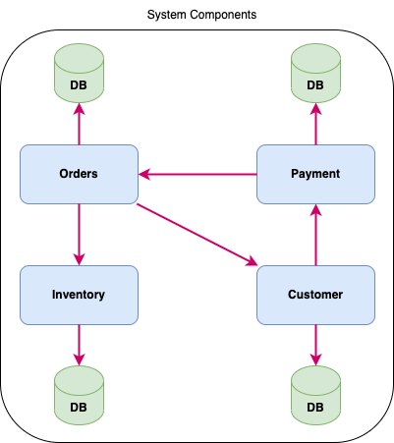
System Components

Slide 5
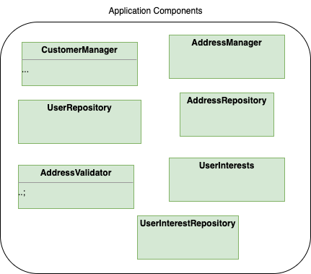
Application Components

Slide 6
Multi Layered Application

Slide 7
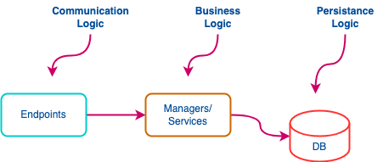
Application Architecture
Communication Logic:
All communication logics should be in this layer.
Authentication and authorization checking for incoming request should happen in this logic.
Business Logic:
All business logics should be in this layer.
Unaware about how the request came.
Unaware about authentication and authorization.
Any changes in functional requirements should effect this layer.
Persistance Logic:
All persistance logic should be in this layer.
Primay key, foreign key, uniqe, not null, etc.
Entity and database configuration and constraints goes here.

Slide 8
Demo Application

Slide 9
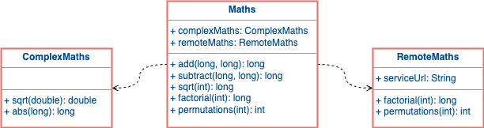
Sample Application
Functional requirements:
CEO should be able to add new Shop.
Supplier should be able to get shop details.
Non-functional requirements:
Application should have capability to persist data.
Application should be responsive.
Application should scale up/down on demand.
Etc…

Slide 10
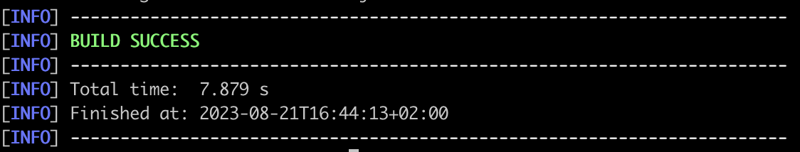
Sample Application
Get the code – git clone https://github.com/jahidshohel/onboarding-demo-java.git cd onboarding-demo-java
Download the dependencies and build the code –
mvn clean install

Slide 11
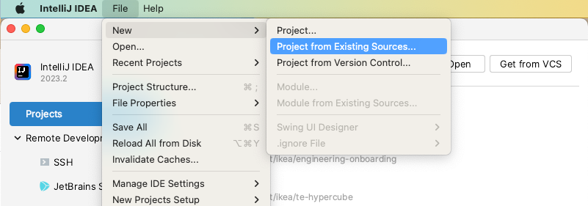
Sample Application
Open the project in the IntelliJ IDEA - File -> New -> Project from Existing Sources...

Slide 12
Business Logic
public class Maths {
private final ComplexMaths complexMaths;
private final RemoteMaths remoteMaths;
public long add(long a, long b){}
public long subtract(long a, long b){}
public double sqrt(double a){}
public long abs(long a){}
public long factorial(int a){}
public int permutations(int a) {} }
public class ComplexMaths { public double sqrt(double a){} public long abs(long a){} }
public interface RemoteMaths {
public long factorial(int a){}
public int permutations(int a) {}
public String send(String url) {}
}

Slide 13
Unit Testing

Slide 14
Unit Testing
public class MathsUnitTest { @Mock private ComplexMaths complexMaths; @Mock private RemoteMaths remoteMaths; private Maths maths; private AutoCloseable closeable; @BeforeEach public void beforeEach() { closeable = MockitoAnnotations.openMocks(this); maths = new Maths(complexMaths, remoteMaths); } @AfterEach public void afterEach() throws Exception { closeable.close(); } @Test public void addTest() { long result = maths.add(2, 3); assertEquals(5, result); } @Test public void subtractTest() { //write your code here } }
public class Maths { private final ComplexMaths complexMaths; private final RemoteMaths remoteMaths; public long add(long a, long b) { return a + b; } public long subtract(long a, long b) { if (a >= b) { return a - b; } return b - a; } }
Initialization
Tear down
Test
Test

Slide 15
Mocking and Stubbing
Stubs:
Already written predetermined behaviour separately.
Mocks:
Written as part of the test
Read More:
What is mocks and stubs?
Mocks Aren't Stubs

Slide 16
Unit Testing
public Shop createShop(String name, String countryCode)
Shop shop = new Shop(name, countryCode); shop = shopRepository.save(shop);
return shop;
}
Code under test
public void createShopTest() { Mockito.when(shopRepository.save(any(Shop.class))).thenAnswer(invocation -> { Shop shop = invocation.getArgument(0, Shop.class); shop.setId(777l); return shop; }); shopManager.createShop("Shop1", "CountryCode1"); verify(shopRepository).save(any(Shop.class)); }
Mocked
Behaviour
The test
Asserting

Slide 17
Mocking
public Shop createShop(String name, String countryCode)
Shop shop = new Shop(name, countryCode); shop = shopRepository.save(shop);
return shop;
}
Code under test
public void createShopTest() { Mockito.when(shopRepository.save(any(Shop.class))).thenAnswer(invocation -> { Shop shop = invocation.getArgument(0, Shop.class); shop.setId(777l); return shop; }); shopManager.createShop("Shop1", "CountryCode1"); verify(shopRepository).save(any(Shop.class)); }
Mocked
Behaviour

Slide 18
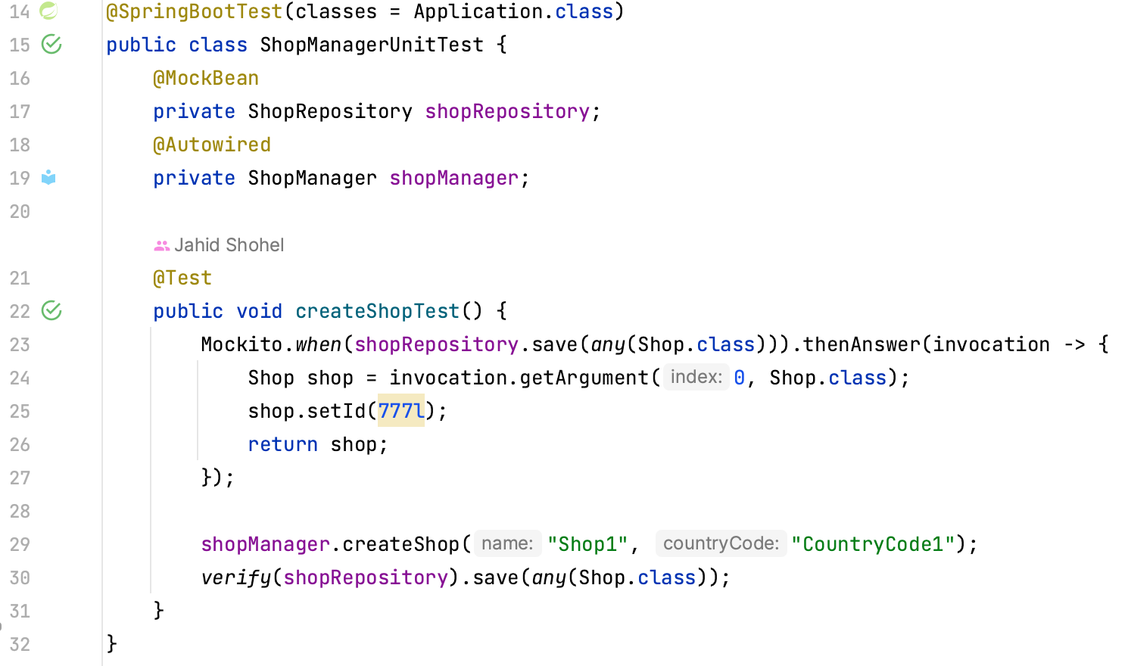
Unit Testing

Slide 19
Unit Testing Hands On
Switch to unit testing branch – git checkout unit-testing

Slide 20
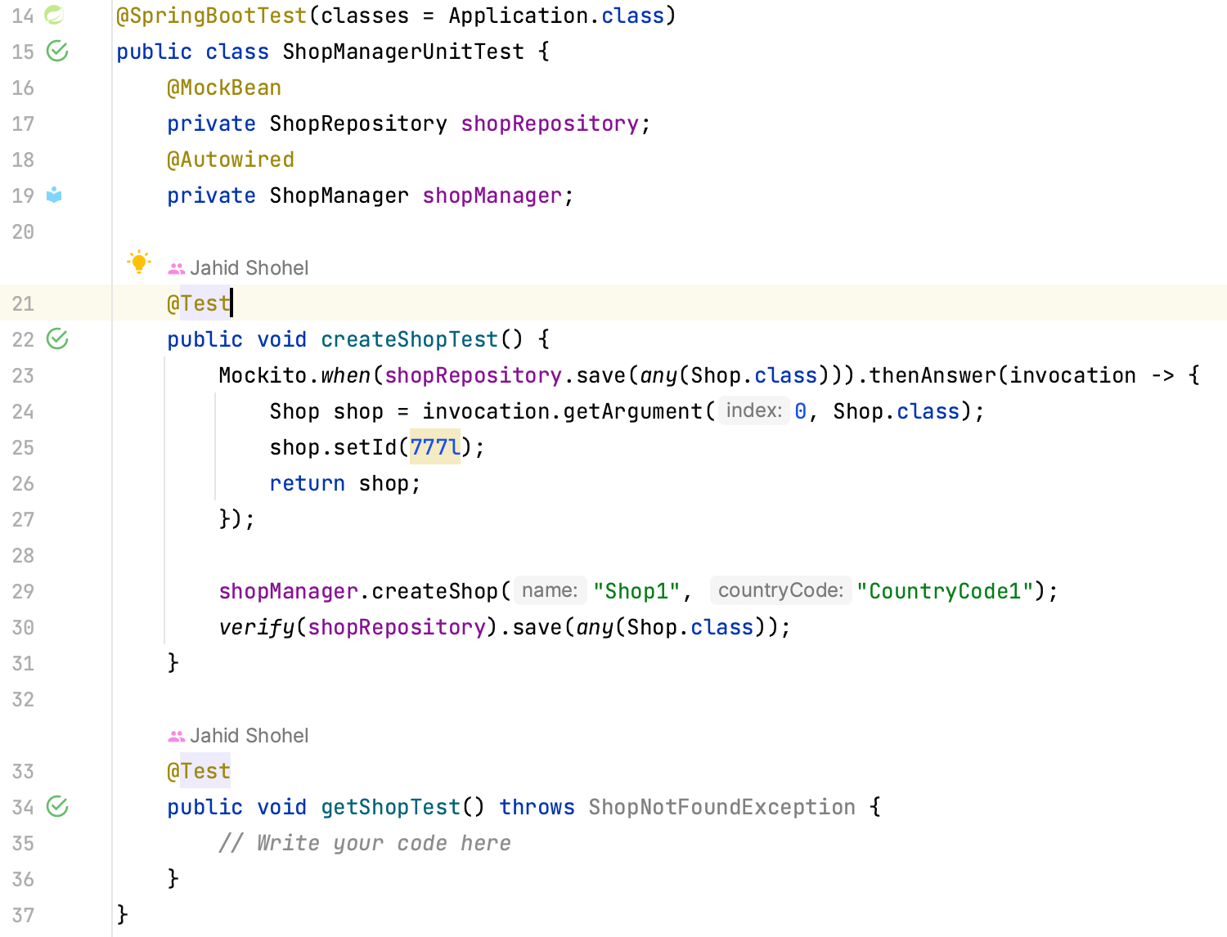
Unit Testing Hands On

Slide 21
Unit Testing
Benefits –
Cheap (execution time and resource wise).
No component or system level dependency.
Does not require separate test environment.

Slide 22
Application Components

Slide 23
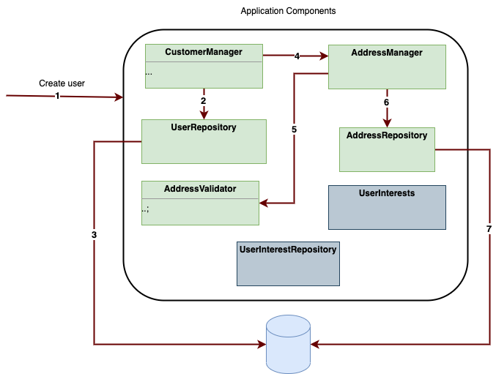
Component Interation

Slide 24
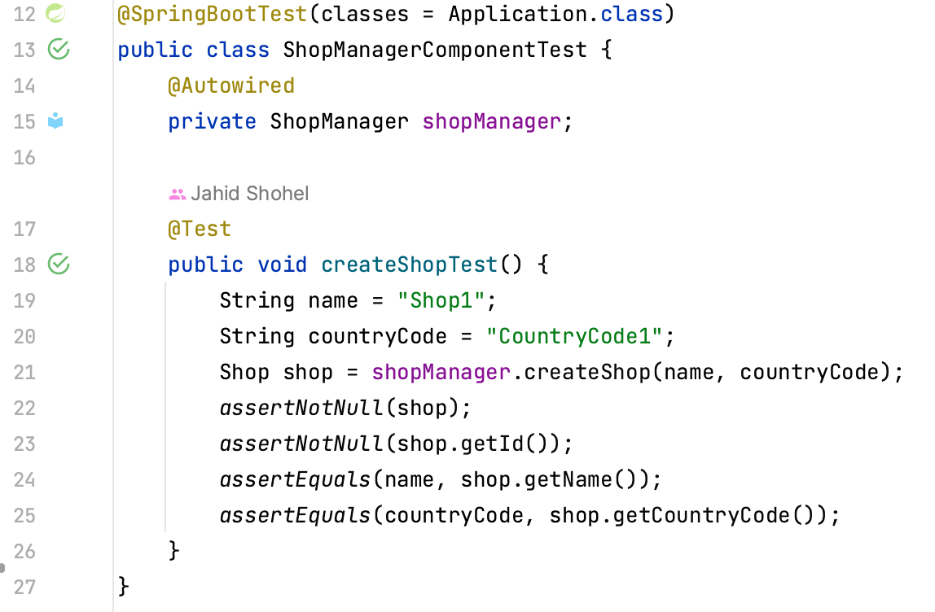
Component Testing

Slide 25
Component Testing
Switch to component testing branch – git checkout component-testing

Slide 26
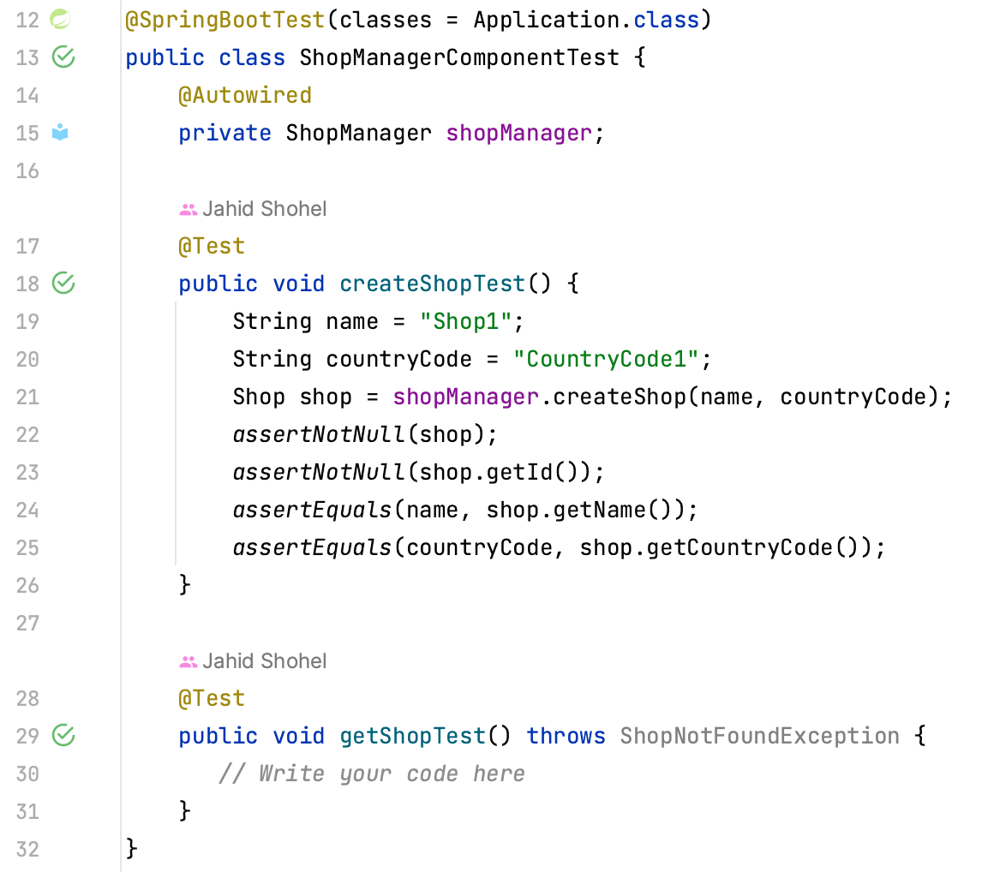
Component Testing Hands On

Slide 27
Component Testing
Benefits –
Can be cheap or expenive (execution time and resource wise).
Only component level dependency, no system level dependency.
Does not require separate test environment.

Slide 28
Business Logic
public class Shop { Long id;
String name; String countryCode; }
Model Object
public class ShopManager {
public Shop createFurniture(String name, String countryCode) {
}
public Shop getShop(String id) {
}
public Coordinate getCoordinate(Long shopId)
} }
Business Logic
public interface ShopRepository {
public Shop saveFurniture(String name, String countryCode); public Shop findShop(Long id); }
Persistence/Repository

Slide 29
Business Logic
public class ShopManager {
public Shop createFurniture(String name, String countryCode) {
}
public Shop getShop(String id) {
}
public Coordinate getCoordinate(Long shopId)
}
private Coordinate getRemoteCoordinate(Long shopId){
} }
Remote
Application
https://raw.githubusercontent.com/Ephigenia/ikea-availability-checker/main/src/data/stores.json

Slide 30
API Integration
Shop Manager
Remote
Remote Application
REST/SOA/RPC

Slide 31
Problem?? Problem??
Shop Manager
Remote
Application
REST/SOA/RPC
- What if the shop manager has network issues?
- Or what if the remote application is down?
- Remote application need to always keep running a test instance for shop manager tests to pass!

Slide 32
Problem?? Problem??
Shop Manager
Remote
Application
- API mocking/stubbing
- Service virtualization
- Contract testing

Slide 33





Mocking/Stubbing The communication
Shop Manager.
MOCK/STUB
THE API COMMUNICATION
Remote
Application

Slide 34


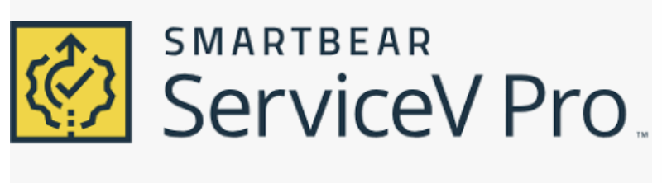

Service Virtualization
Shop Manager.
Virtualization
Server
Remote
Application
Relaying+Recording
Shop Manager.
Virtualization
Server
Remote
Application
Playing/Replaying
Mountebank

Slide 35
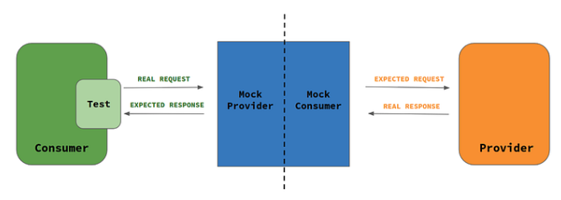
Contract Testing

Slide 36
E2E

Slide 37
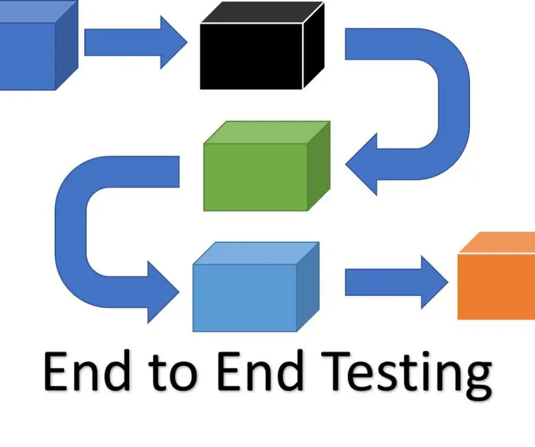
E2E Testing

Slide 38
E2E Testing
- Requires dedicated test environment for all involved modules.
- Slow execution.
- Slows down release(bug/feature) process.
- Extremely difficul to debug.
- Lots of dependencies (direct and transitive).

Slide 39
Blue Green Deployment

Slide 40
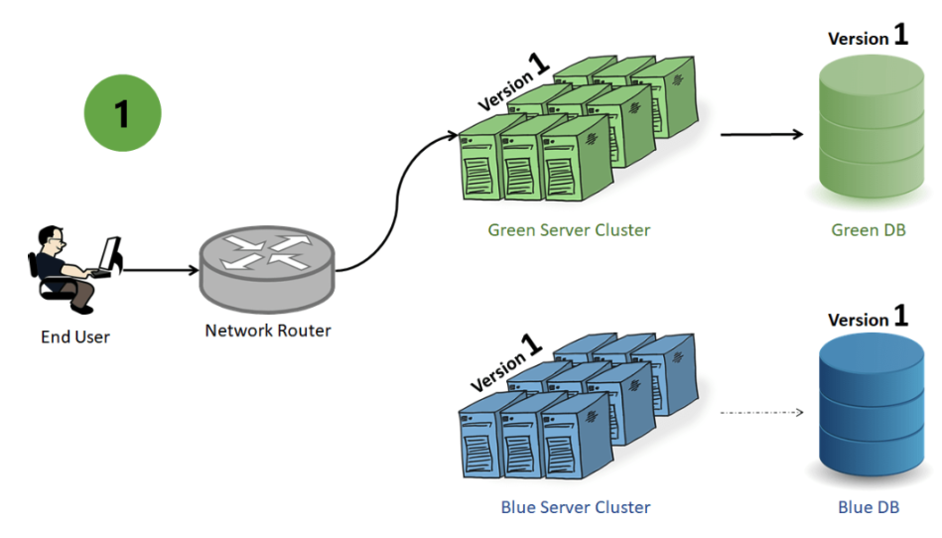
Blue Green Deployment

Slide 41
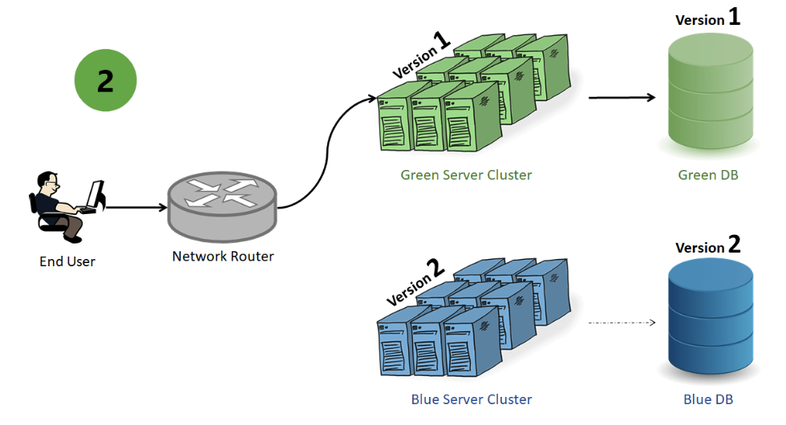
Blue Green Deployment

Slide 42
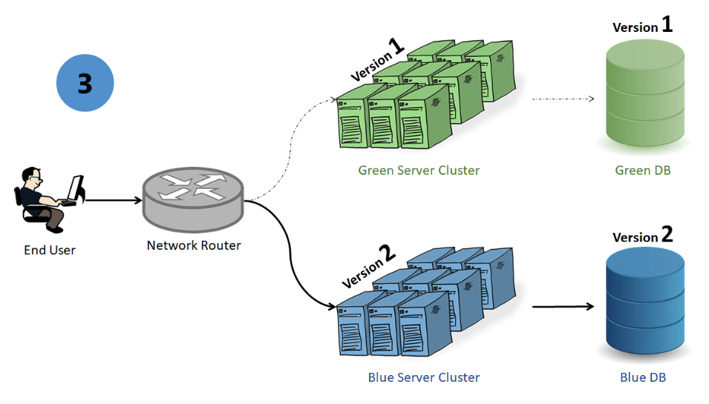
Blue Green Deployment

Slide 43
Blue Green Deployment
a
95%
5%

Slide 44
Blue Green Deployment
b
80%
20%

Slide 45
Blue Green Deployment
c
80%
20%

Slide 46
Blue Green Deployment
d
50%
50%

Slide 47
Blue Green Deployment
e
0%
100%

Slide 48
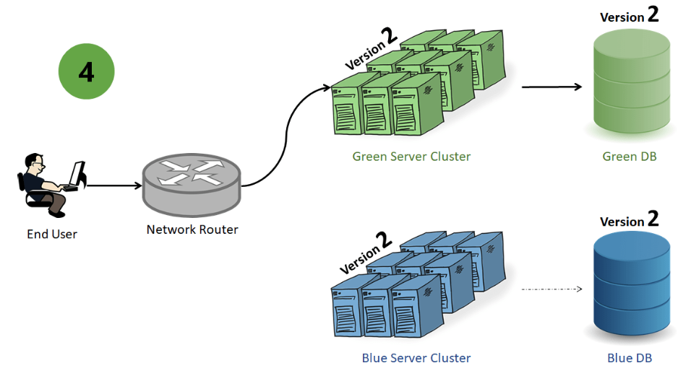
Blue Green Deployment

Slide 49
Test Best Practices

Slide 50
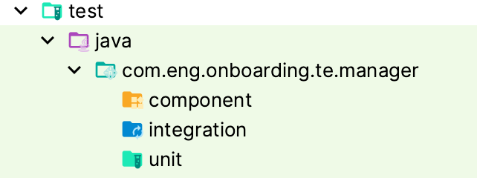
Testing Best Practices
Test class should have similar name as class under test -
public class ShopManager { }
public class ShopManagerTest { }
public class ShopManagerTest { }
Group similar tests under same package (i.e. folder)

Slide 51
Testing Best Practices
Tests should leave the system as it was. Leave no state behind.
public class MyTest { @BeforeAll public static void beforeAll() { // Do initialization for ALL tests } @BeforeEach public void beforeEach() { // Do initialization for THE test } @Test public void doTest1() { // Here goes THE test }
@Test public void doTest2() { // Here goes THE test }
@AfterEach public void afterEach() { // Do clean up the initialization or traces created during running THE tests } @AfterAll public static void afterAll() { // Do clean up the ALL initializations done on "beforeAll" } }

Slide 52
Testing Best Practices
Stay focused. One usecase at at a time in one test
public class MyTest { @Test public void createUserTest() { // Just focus that we can create user, absolutely nothing else } @Test public void createUserTest_withInvalidEmail() { // Just focus on creating user with invalid email, and handle the exception } @Test public void createUserTest_withInvalidPhone() { // Just focus on creating user with invalid phone, and handle the exception } }

Slide 53
Testing Best Practices
Tests shouldn’t be ordered
public class MyTest { @Test @Order(1) public void myTest1() { } @Test @Order(3) public void myTest2() { } @Test @Order(2) public void myTest3() { } }

Slide 54
Testing Best Practices
Test with real like data on real device.
Follow “No Test-No Merge” approach.

Slide 55






Good read

Slide 56
Reach out to us
Slack channel #test-enablement-support
Use Allen to get onboarded to different testing tools
Create a ticket in our Jira Service Desk
Email us: jira.testenablement.se@ingka.com (this will auto-create a ticket in our Jira Service Desk)

Slide 57
Question? Thoughts?

