Slide 1

Statistical Analysis of Shishu Mela Operations
Course Title: Management Information System
Submitted by: Jahid Hasan ID- 0242310005341038
Submitted to: Dr. Imran Mahmud, Head & Associate Professor, Department of Software Engineering, Daffodil International University
Notes:
1

Slide 2

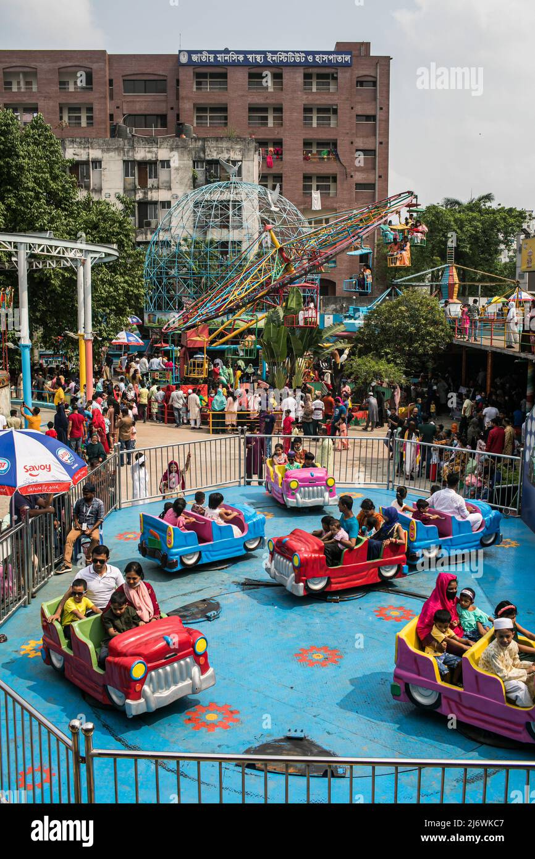



Dataset Overview: Shishu Mela Operations
Our analysis is based on a simulated dataset representing visitor activities at a children's fair (Shishu Mela).
Total Data Points
Key Variables Analysed
200
  Age & Gender
  Ride Name & Ticket Price
  Visitor Satisfaction Score
Visitor Observations
Data Source
Simulated Dataset based on hypothetical operational metrics.
Notes:
2

Slide 3
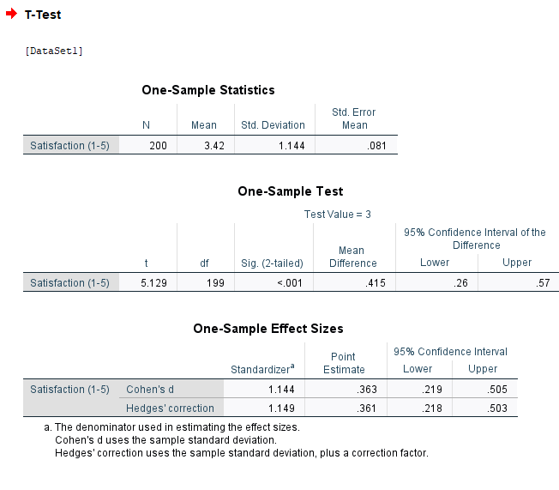
Card 3: One-Sample t-test on Visitor Satisfaction
1
2
Null Hypothesis (H_0)
Alternative Hypothesis (H_a)
Visitors are not generally satisfied.
Visitors are generally satisfied (Mean Satisfaction \neq Threshold).
SPSS Output: One-Sample Test
Notes:
3

Slide 4
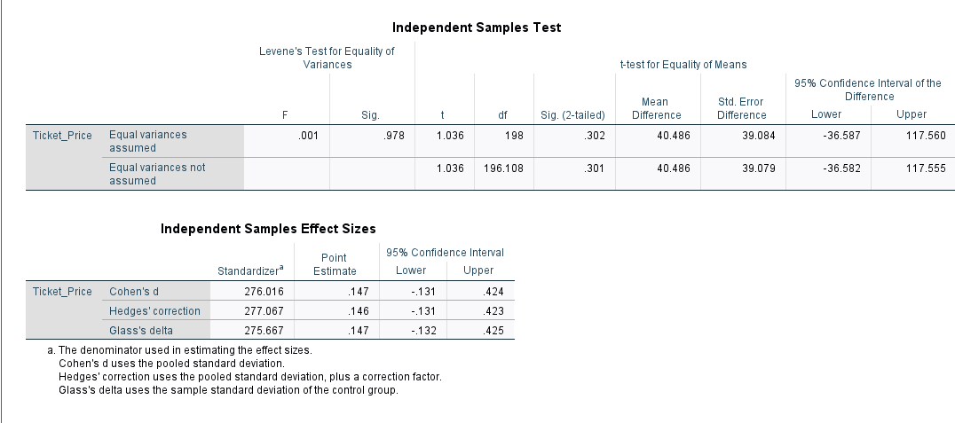
Card 4: Independent Samples t-test
Gender Differences in Visitor Spending
This test assesses whether the average spending (Ticket Price) differs significantly between male and female visitors.
Hypothesis
Is there a statistically significant difference in mean spending based on Gender?
Independent Sample Test
Group Statistics
Independent Test
[[Space for SPSS "Independent Samples Test" Table Screenshot]]
Notes:
4

Slide 5
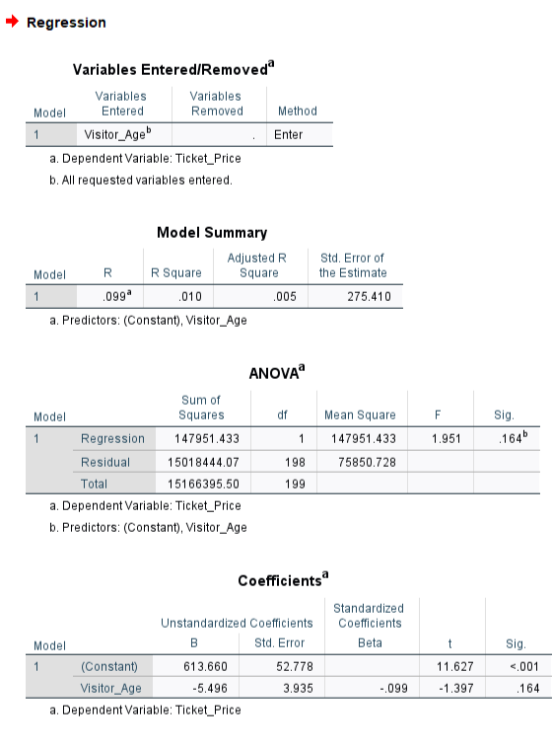


Card 5: Linear Regression Analysis
Key Regression Outputs
Independent Variable (X)
Visitor Age
Dependent Variable (Y)
Ticket Price / Spending
Result: "Age has a positive correlation with Ticket Price. As age increases, spending is predicted to increase."
Notes:
5

Slide 6
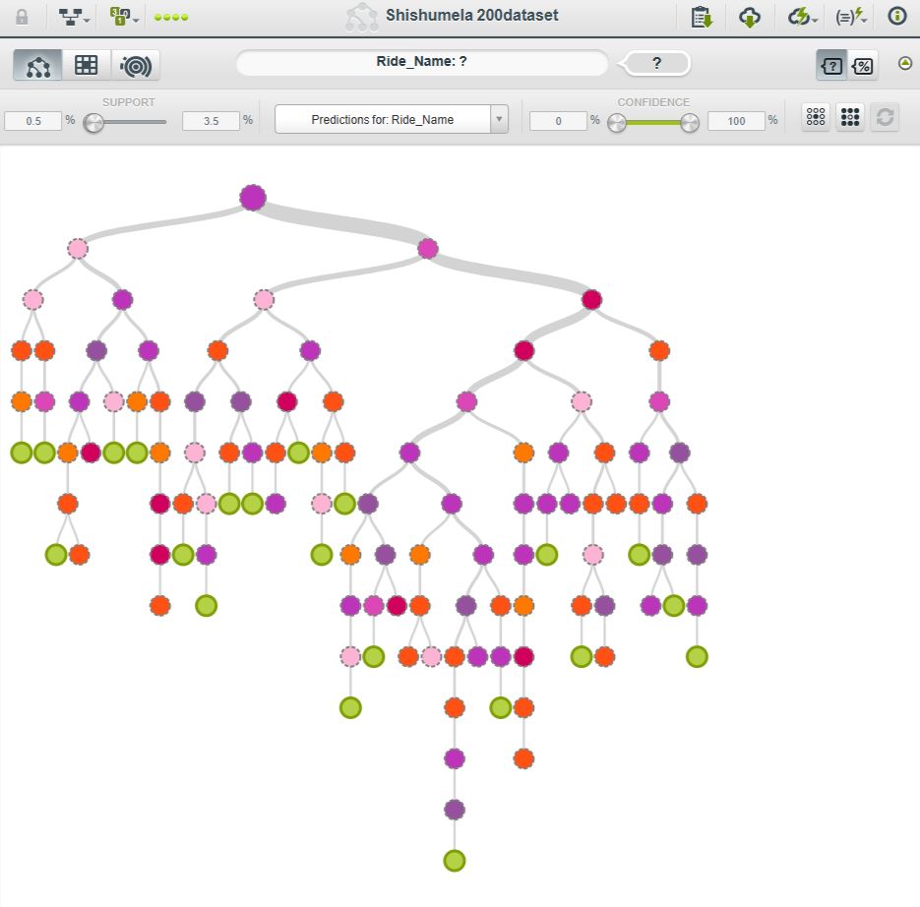
Card 6: Predictive Modelling (BigML)
Decision Tree: Predicting Ride Choice
Objective
Tool
Use Age and Gender to predict which ride a visitor will choose.
BigML Decision Tree/Ensemble Learning.
Visual Output: Decision Tree or Sunburst
Finding 1
Kids under 10 mostly prefer Toy Trains.
Finding 2
Teenagers (13-18) show preference for the 3D Cinema.
Decision Trees offer clear, interpretable rules for market segmentation.
Notes:
6

Slide 7



Conclusion & Recommendations
High Satisfaction
The One-Sample t-test confirms Shishu Mela is performing well in terms of overall visitor satisfaction.
Marketing Focus
Based on the Regression analysis, marketing campaigns should target the [Target Age Group found in Regression] for maximum revenue impact.
Actionable Insights
Age is a strong predictor of spending, while ride choice is strongly segmented by age groups (Decision Tree).
Notes:
7

Slide 8
Thank You!
Notes:
4

