Slide 1
Bangla Voice Based Text independent Speaker Recognition Using Machine Learning and CNN – A Comparative Model performance
Group : 3
Student ID
1706011|1706013|1706015|1706017|1706019

Slide 2
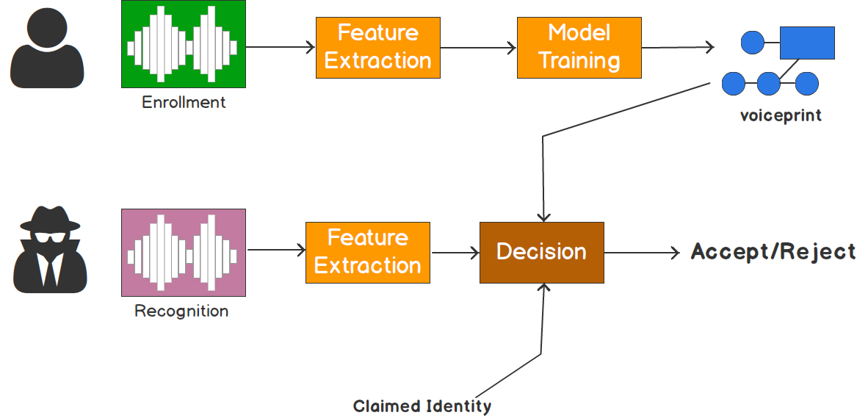
What is Speaker Recognition ?

Slide 3
Project Go through
Data Collection and Preparation
Data Augmentation
Feature Extraction
Define Training Model
Train and validation
Test the trained Model using a test data set
Save the Model

Slide 4
Data Collection and Preparation
Test Data
Train Data
Speaker Space
Total attained speakers/classes
100 Audio File Per Class
Department of EEE
Batch 17, Section A
27 Persons
1 Noise Class
28 audio clips
Slicing each file into 100 audio files.
2800 audio files
20
560
File Length : 5 minutes
Format : WAV
File Length : 3 Seconds
Format : WAV
80
2240
.
Sampled at a rate of 441000

Slide 5

Data Augmentation
Augmentation Types
Time Stretching
Pitch shift
Background noise
Low pass filter
Harmonic
Speed
Percussion
Insert In Background
Clicks
High Pass filter
Normalize
1
14
Single file
Total Train Data
Per class
80
1120
2240
31360

Slide 6
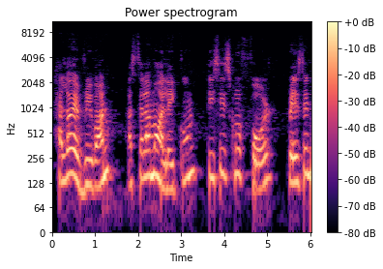
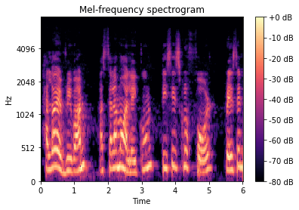
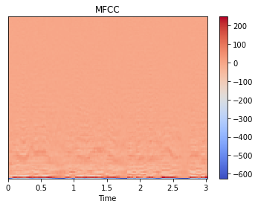
Feature Extraction
Spectrogram
Mel-Spectrogram
MFCC

Slide 7
Feature Extraction
Features | DFT | Hop Length | Window | Window Length | Number of MFCCS | Sampling Rate
MFCC | 256 | 256 | Hann | 256 | 40 | 44100
Mel-Spectrogram | 256 | 256 | Hann | 256 |  | 44100
Spectrogram | 256 | 256 | Hann | 256 |  | 44100

Slide 8
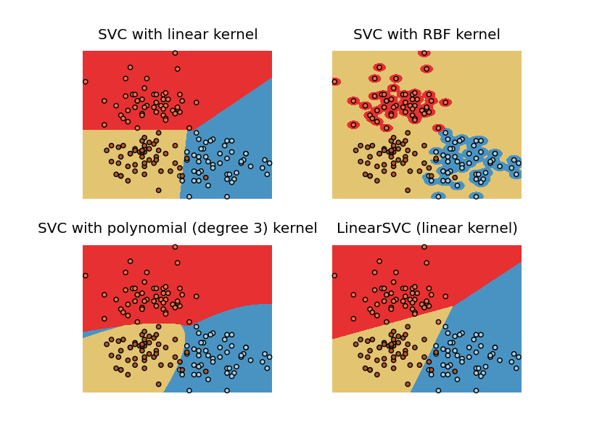
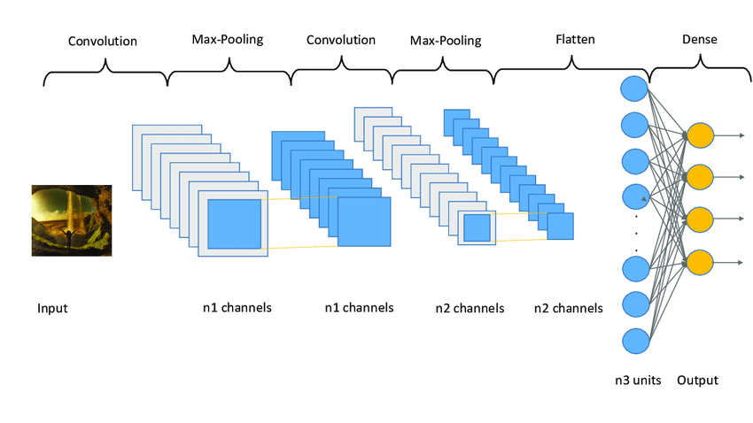
Define Model
CNN
Support Vector Machine
Convolutional Neural Network

Slide 9
Support Vector Machine
Regularization Parameter = 10
Linear Kernel
SVM
Features
SVM -MFCC
SVM – Mel-Spectrogram
SVM - Spectrogram
Data
Train Set size - 6720,66176
Test set size - 1680,66176

Slide 10
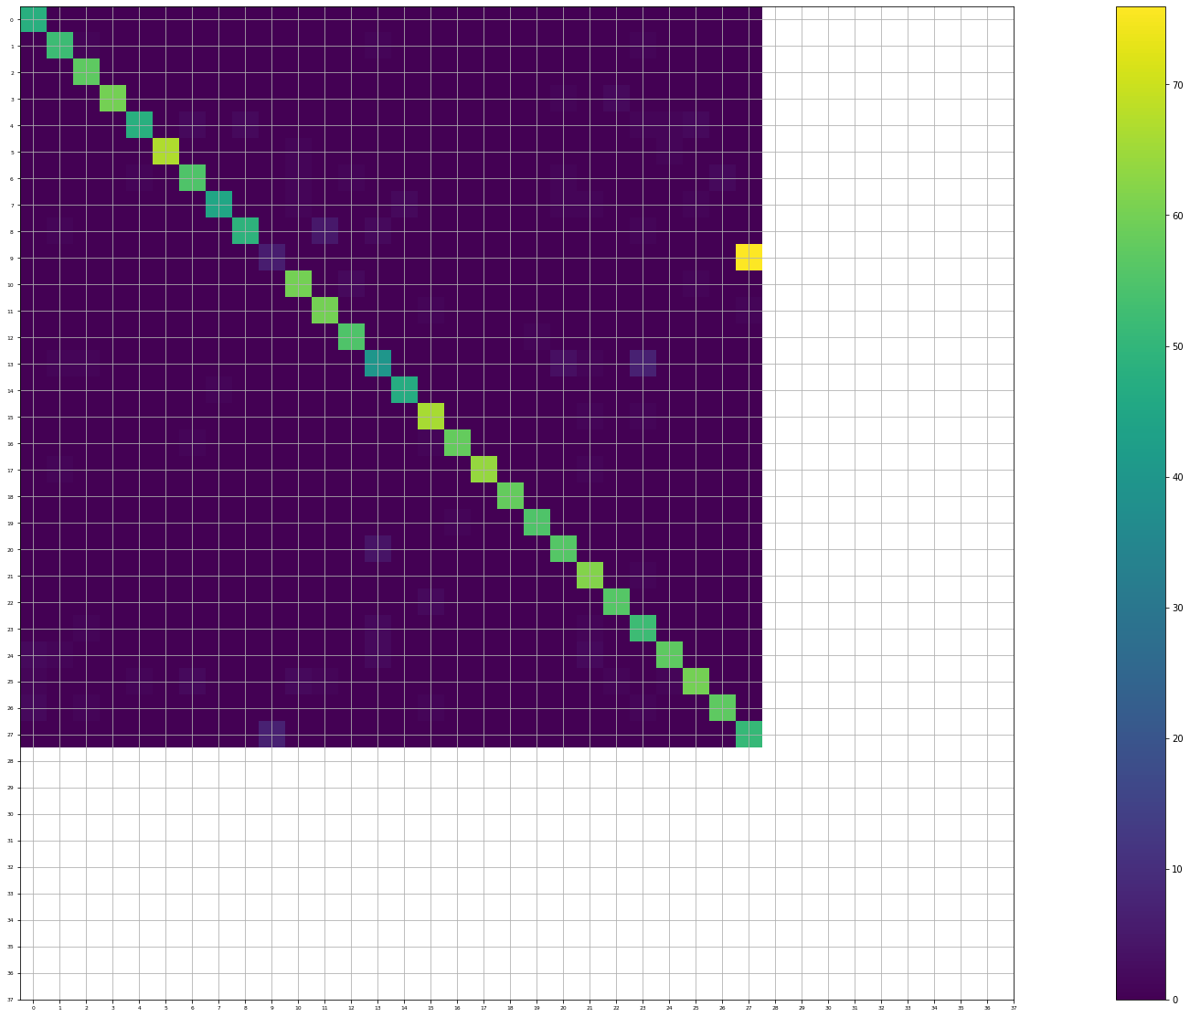
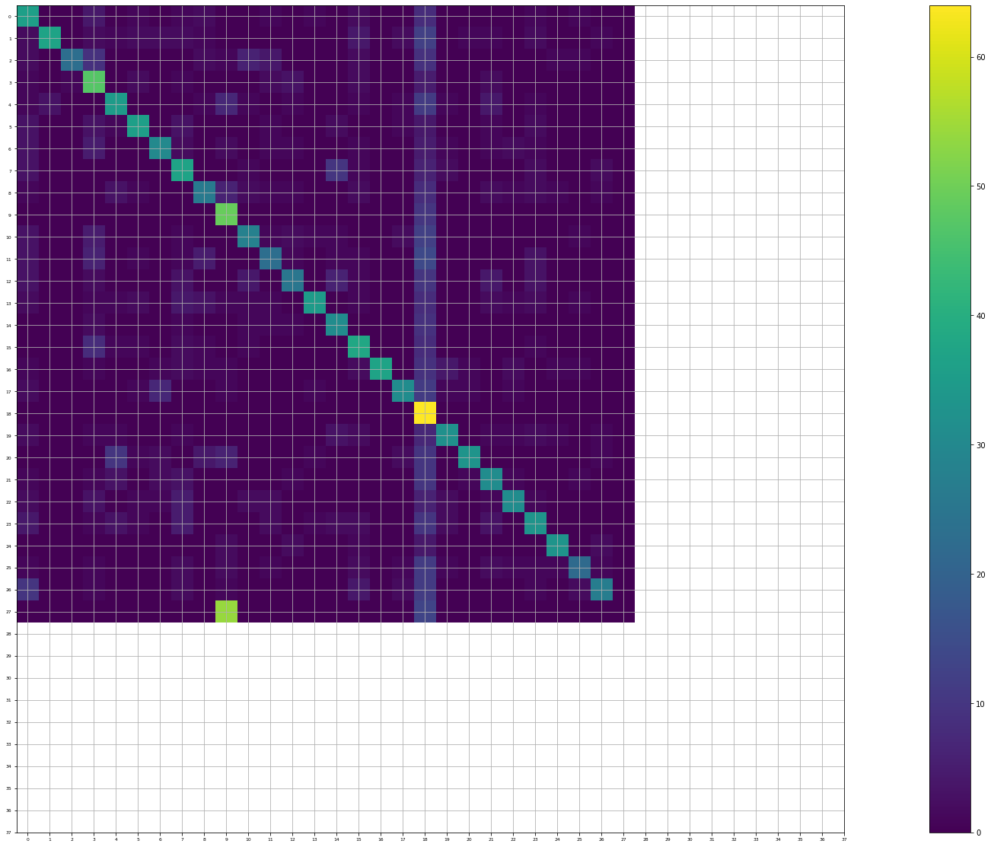

Confusion Matrices
Noise Class
MFCC
Spectrogram
Mel-Spectrogram

Slide 11
CNN Architecture
Class 1
Class 2
Class 3
Class 4
Class 5
Class 6
Class 7
Input Data
(517,40,1)
conv2D
(517,38,64)
Max_pooling2D
(257,19,64)
INPUT DATA
Fully Connected Layer
Max_pool2D(2,2)
relu
Flatten
…..
64,(3,3)
Class 28
Dense
(28,)
softmax

Slide 12
Model Performance
Data Per Class | 300
Train Set Size | 6720,1,132300
Validation Set Size | 1680,1,132300
Test Set Size | 560,1,132300
Epoch | 50
Optimizer - Adam
Learning rate = 3e-4
Loss = categorical cross entropy
Metrics = accuracy

Slide 13
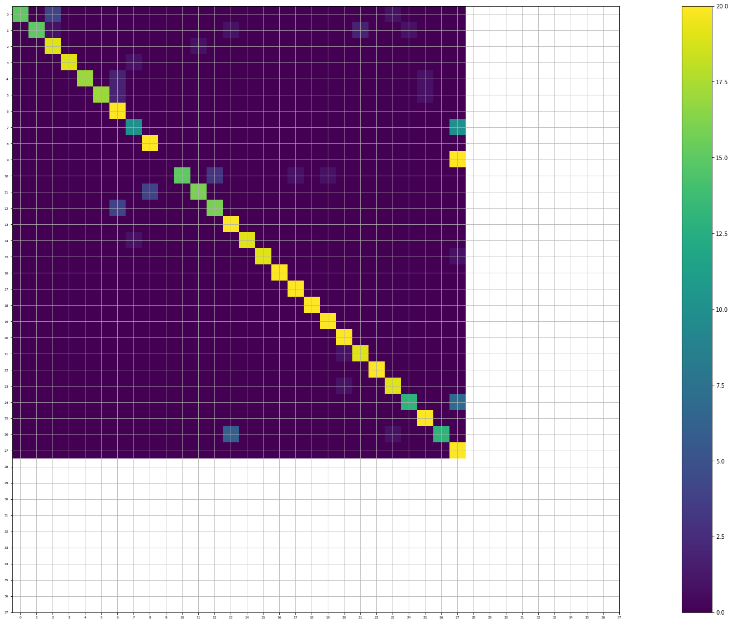
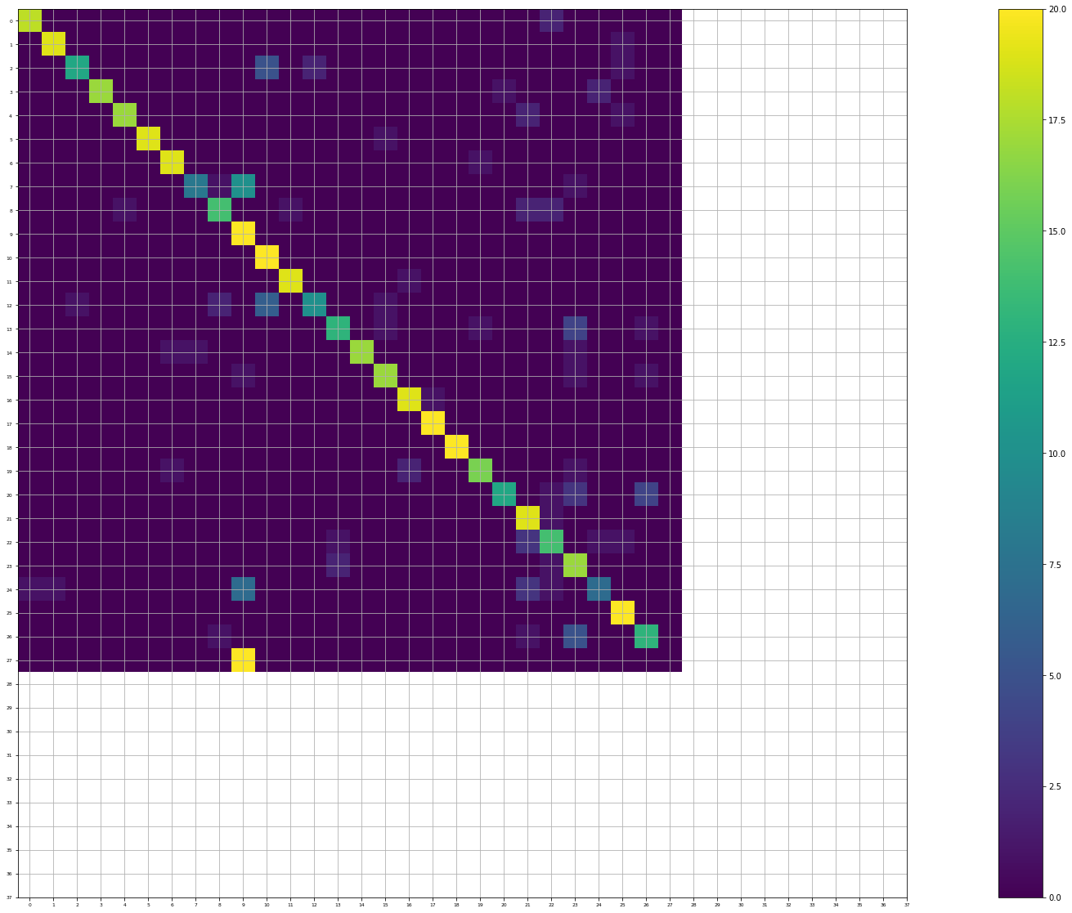
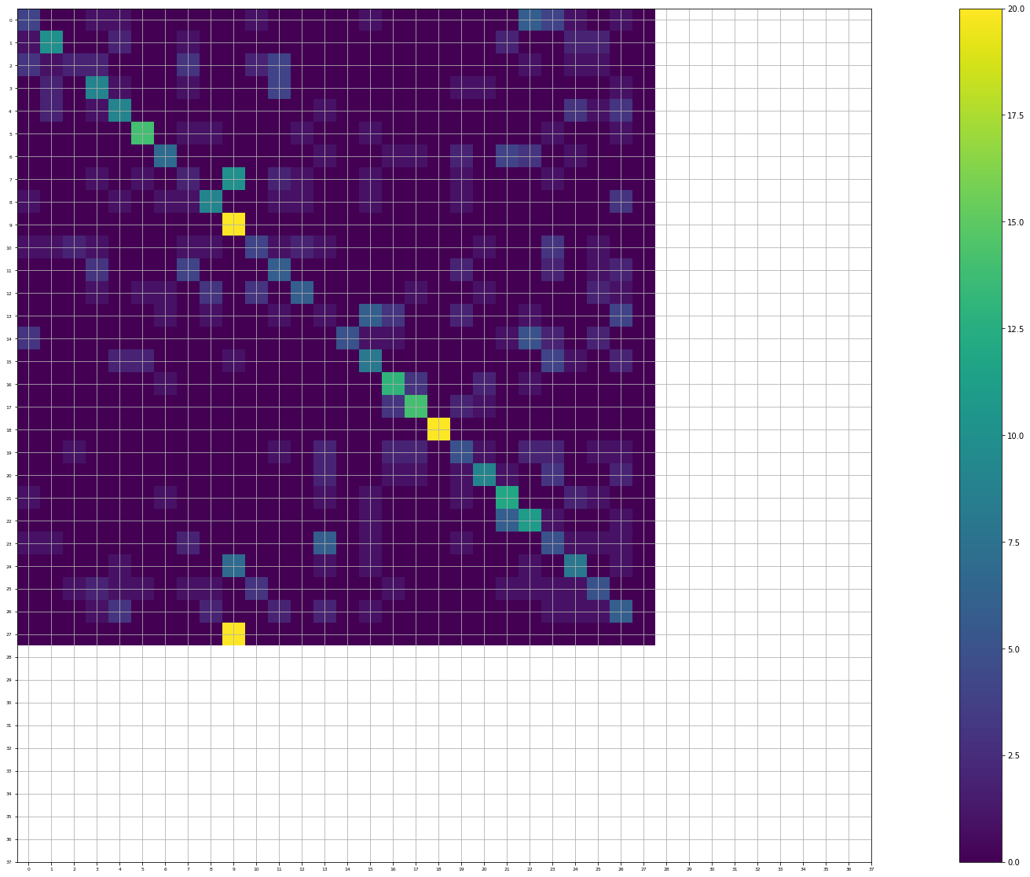
Confusion Matrices
MFCC
Spectrogram
Mel-Spectrogram

Slide 14
Comparison
SVM works better along with MFCC
Mel-Spectrogram is not a good speech feature in terms of speaker recognition
A Complex architecture could have a higher accuracy and beat SVM
Better data would ensure higher accuracy

Slide 15

Limitations of our project
Couldn’t use full dataset due to computational complexity
Did not work on CNN architecture modeling

Slide 16
We, Group 3, created a Bangla Voice Dataset (5.8GB)
Thanks to these amazing people who contributed.

