Slide 1

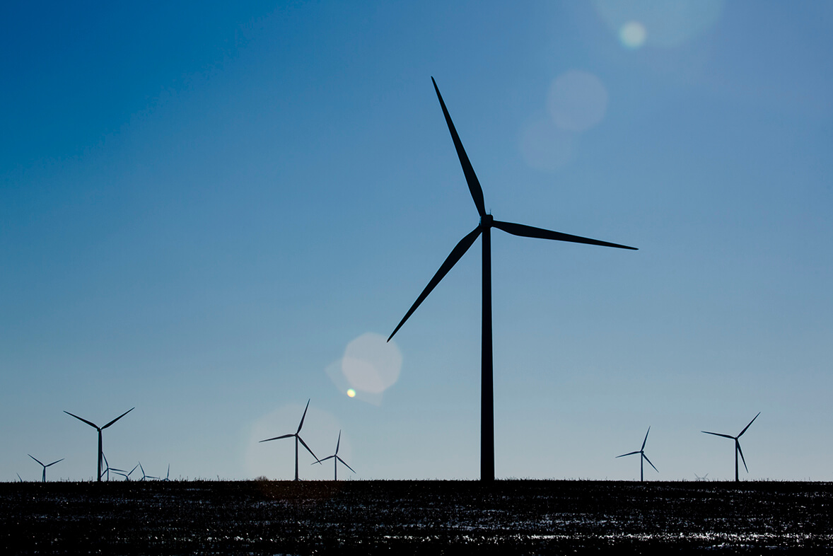
Bangladesh University Of Engineering & Technology
Department Of Electrical & Electronic Engineering
EEE 306
Project Presentation On
Wind Power Plant Simulation Using Simulink
Level -3, Term - 1
Submitted By
Group No. 05 (EEE Sec-A)
Md. Jahidul Hoq Emon (1706017)
Swapnil Siddiky (1706018)
Md. Redwan Hossen (1706019)
Shafin Shadman Ahmed(1706020)

Slide 2
Introduction
Wind power is the use of wind to provide mechanical power through wind turbines to turn electric generators for electric power. To harness this natural resource in the best possible way wind turbines are designed.
All the wind turbines used today are usually horizontal-axis machines with 3 bladed rotor spinning in a vertical plane. Wind energy is used to rotate these blades, which are mounted at a height of almost 40 meters, thus converting kinetic energy of the wind into mechanical energy. This mechanical energy is then converted to electrical energy using a generator.
Objectives
Making a wind turbine model (Induction Generator Type) using Simulink.
Varying the wind speed to observe the change in different characteristics of the turbine such as Power, Torque, Efficiency etc.
Plotting the various characteristics with varying speed.
Finding the maximum efficiency which can be extracted from the turbine (Betz limit).

Slide 3
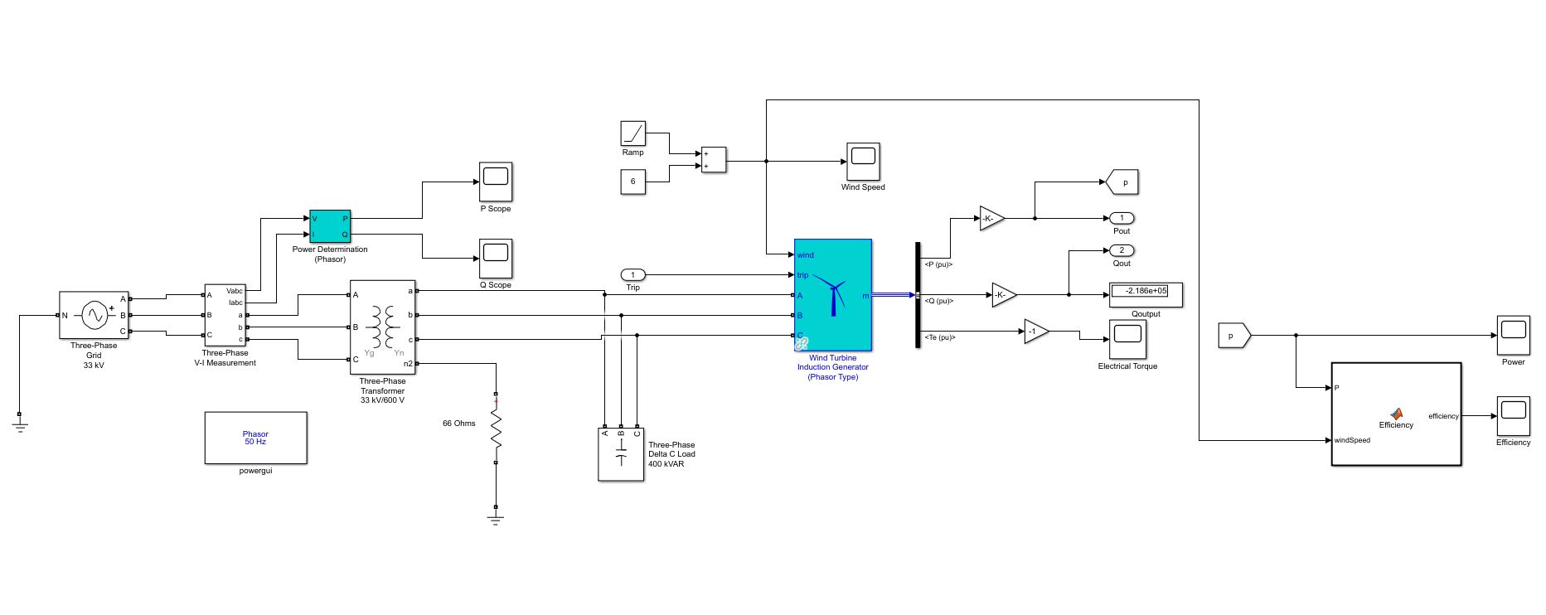
Simulink Model
Fig: Simulink Model of a 1.5 MW Wind Turbine Induction Generator

Slide 4
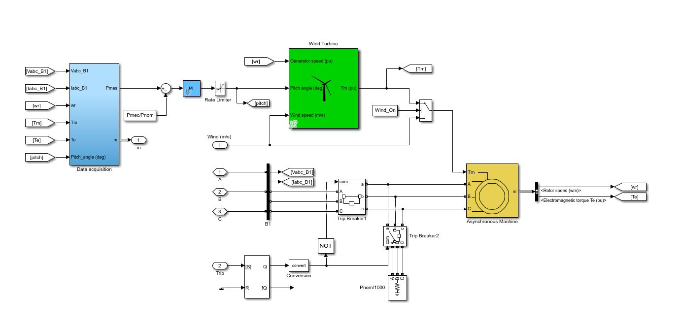
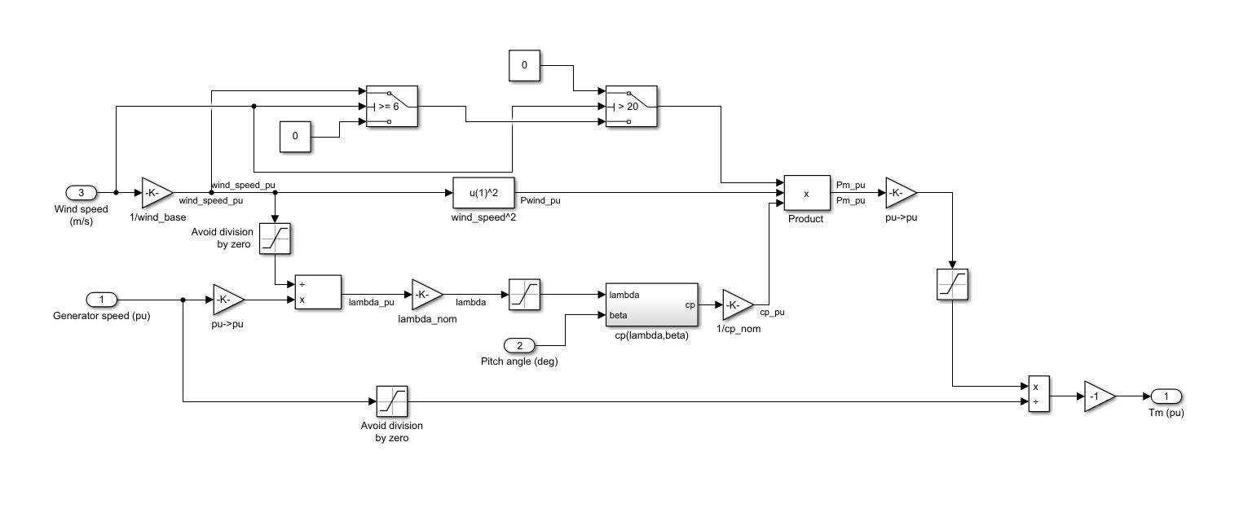
Inside Wind Turbine Induction Generator:
Inside Wind Turbine:

Slide 5
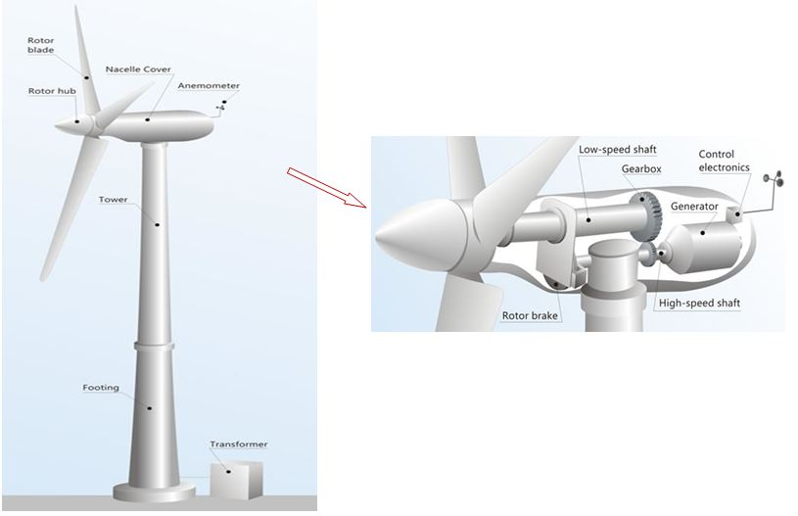
Internal Structure of a Wind Turbine:

Slide 6
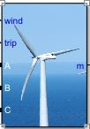



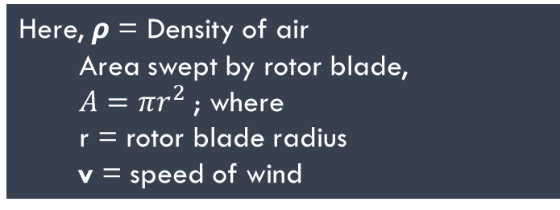
Principal Components
Wind Turbine Induction Generator (Phasor Type) of 1.5 MW base power.
Three-Phase Grid and Three-Phase Transformer.
Capacitor Bank and Grounding Resistor.
Ramp Function.
VI measurement block and Power (Phasor) block.
Different blocks like gain, scope, display etc. for data visualization.
MATLAB function block for calculating efficiency.
Mathematical Equations
Wind Power, $P_{w}= \frac{1}{2}ρAv^{3}$
Here, $ρ$ = Density of air
Area swept by rotor blade,
$A=πr^{2}$; where
r = rotor blade radius
v = speed of wind
Let, output electrical power = $P_{e}$
Efficiency = $\frac{P_{e}}{P_{w}}$
*Maximum achievable efficiency from a wind turbine is 59.3 % which is known as Betz Limit

Slide 7
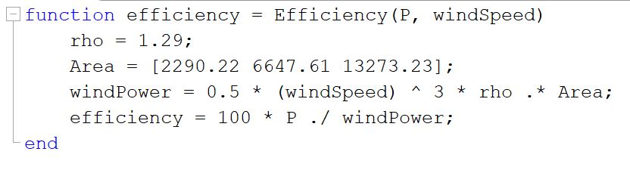
Workflow
Creating Simulink Model Of Wind Turbine
Varying speed and creating logic for cut in and cutoff speed of turbine.
Building MATLAB function to calculate efficiency
Finding limitations and ways to improve the model
Comparing output graphs with theoretical knowledge
Plotting wind vs time graph, efficiency vs time graph and other graphs
MATLAB Function to calculate efficiency for different rotor-swept areas

Slide 8
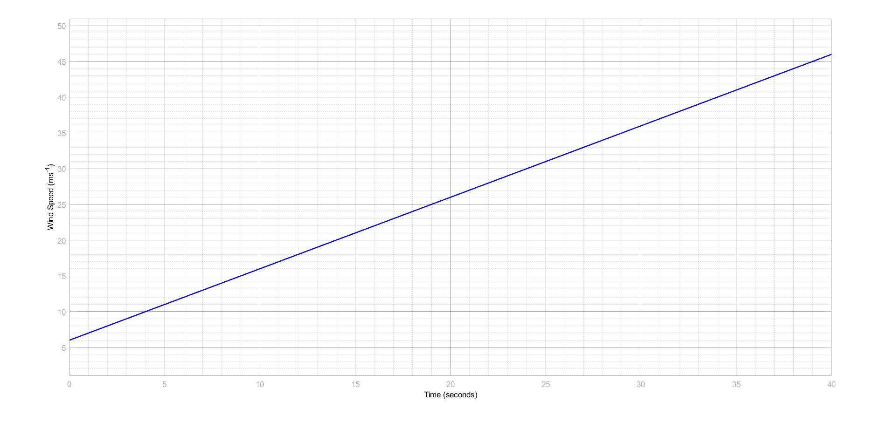
Outputs & Observations
(i) Wind vs Time graph:
Observation: Here, we vary the wind according to time using a ramp function of slope 1 for a linear increment. Initial speed assumed here is 6 m/s.

Slide 9
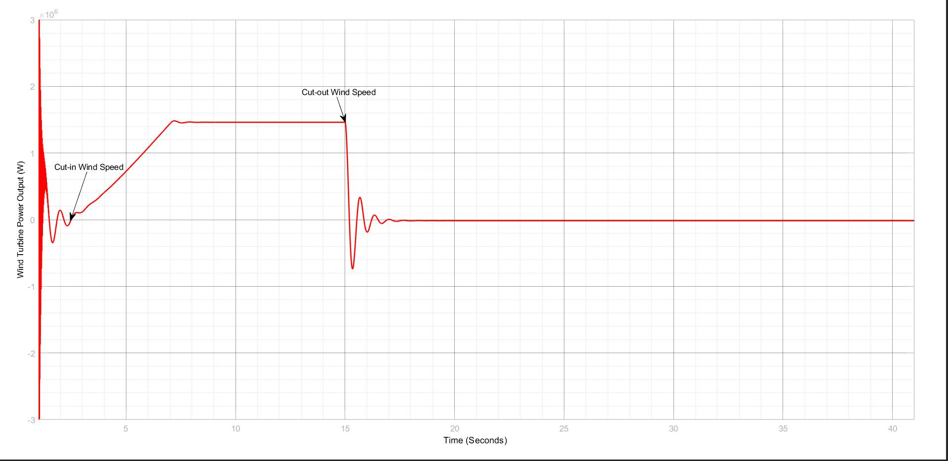
(ii) Real Power vs Time graph:
Observation: Here, the generated power at first increases with increase of speed, then reaches a maximum power (rated power) for which the output power is saturated and then finally for a particular speed also known as cutout speed (20 m/s) , the generated power falls to zero.

Slide 10
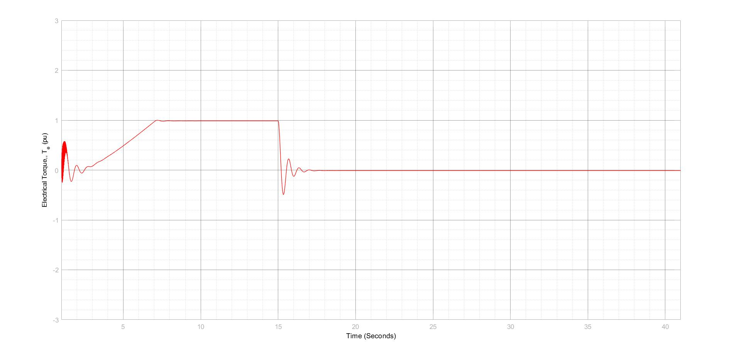
(iii) Electric Torque graph:
Observation : Here, characteristics for electrical torque graph are found to similar to those of Real Power graph shown earlier.

Slide 11
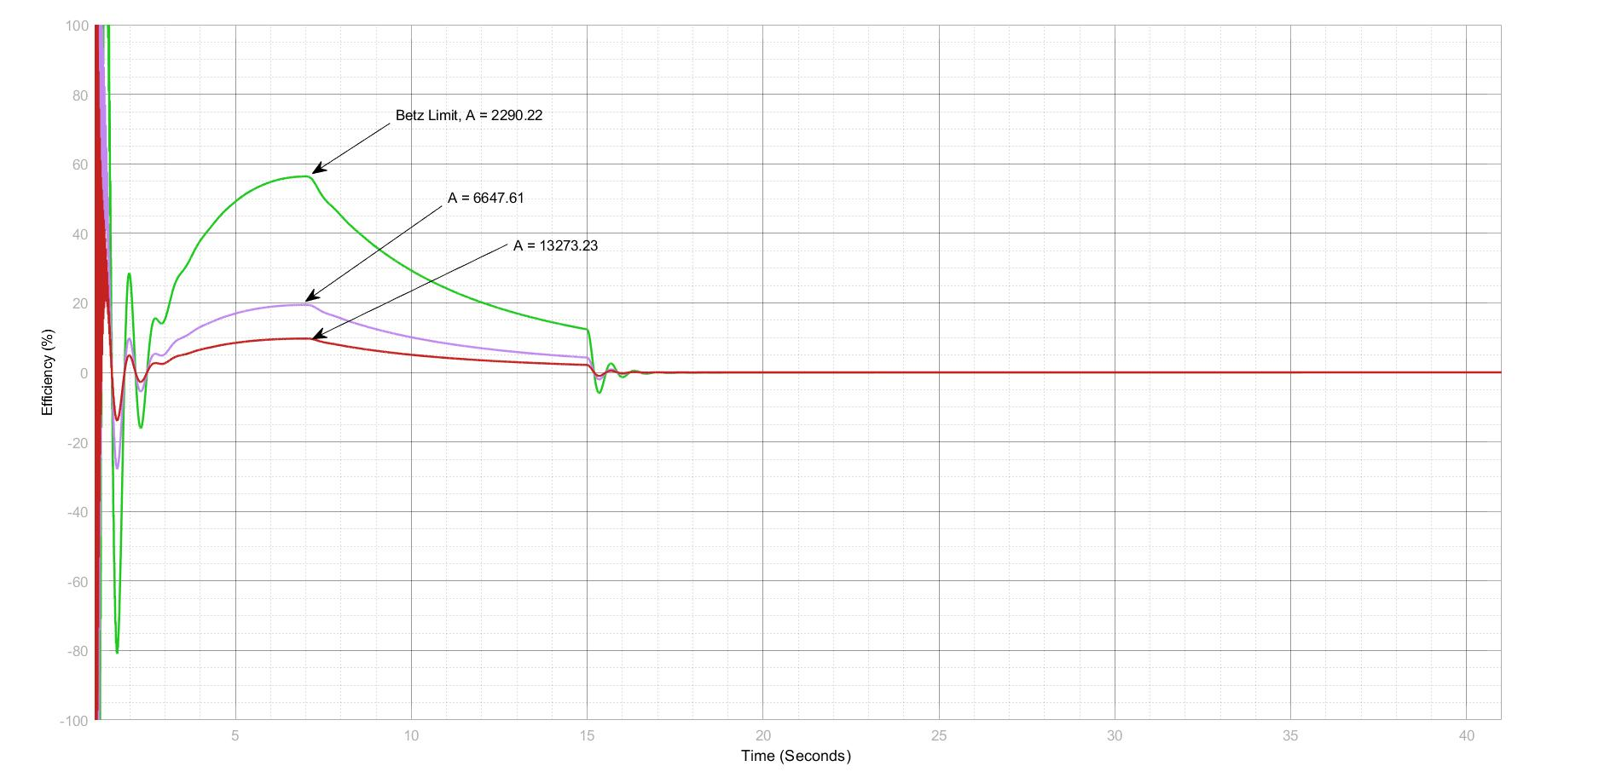

(iv) Efficiency graph:
Observation: Here, efficiency curves for different areas swept by rotor blades are plotted. We find for A = 2290.22 $m^{2}$, we have maximum efficiency of around 59%. For all the area parameters, the curves are of same shape . At first they increase till a certain point, then decrease with further increase in wind speed.

Slide 12
Limitations of the project:
A plant protection unit for the system has not been integrated in the model.
Some transient phases have been seen in the graphs which couldn’t be mitigated.
A rather simple grid model has been used to demonstrate the project.
How to control the plant in overloaded condition has not been projected.

Slide 13
Summary:
Despite having some discrepancies with real-life wind turbine systems, our main objectives to observe different characteristics of a wind turbine with varying speed have been fulfilled. We observed our desired curves and matched them with our theoretical knowledge. A lot has been learnt by us about Simulink and Wind Systems by performing this project.
Thank You

