Slide 1

Ride-Hailing Insights
Data analysis to improve operations, satisfaction, and revenue

Slide 2

Project Overview
Workflow
Objective
Excel → SQL → Power BI
Turn raw bookings into actionable insights
Outcomes
Efficiency, satisfaction, revenue optimization

Slide 3

Data Summary
Dataset
Rows: 30,000 · Columns: 19
Key fields
Date, Booking_ID, Status, Vehicle_Type, Pickup, Drop, Booking_Value, Payment_Method, Dist., Ratings

Slide 4





SQL Questions Answered
Successful Bookings
Retrieve all successful bookings
Avg Distance
Average ride distance by vehicle type
Customer Cancellations
Total cancelled rides by customers
Top Customers
Top 5 by ride count

Slide 5




More SQL Answers
Driver Cancellations
Ratings Range
Count by personal & car issues
Max/min driver ratings for Prime Sedan
UPI Payments
Booking Value
Retrieve rides paid via UPI
Total booking value for completed rides

Slide 6

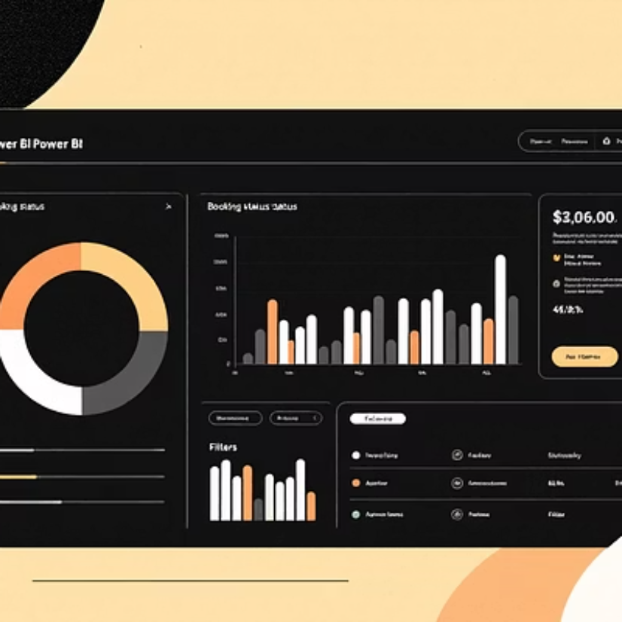
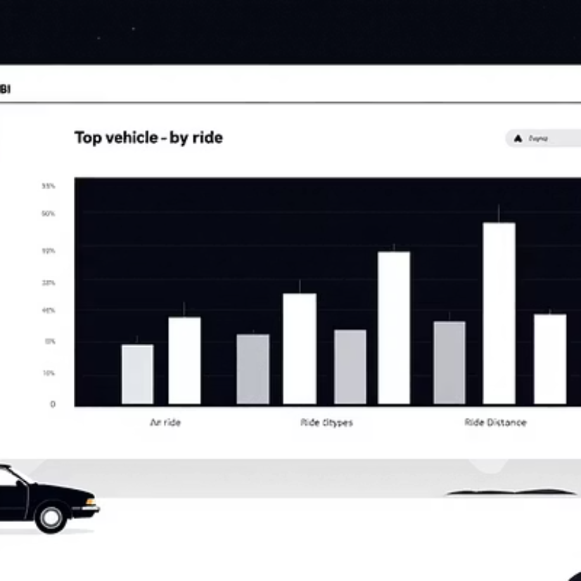

Power BI Dashboards
Interactive visuals for operational decisions

Slide 7
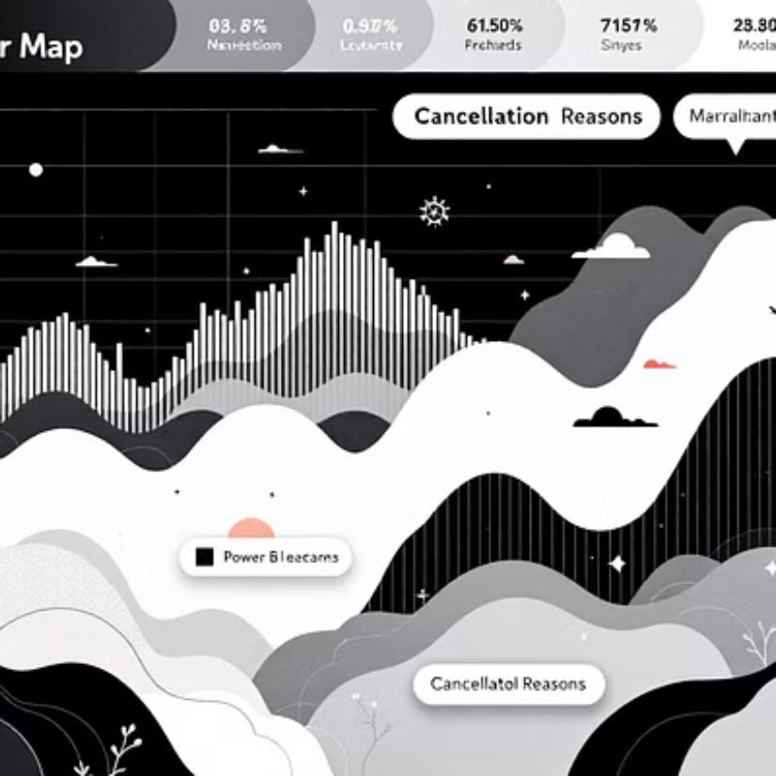
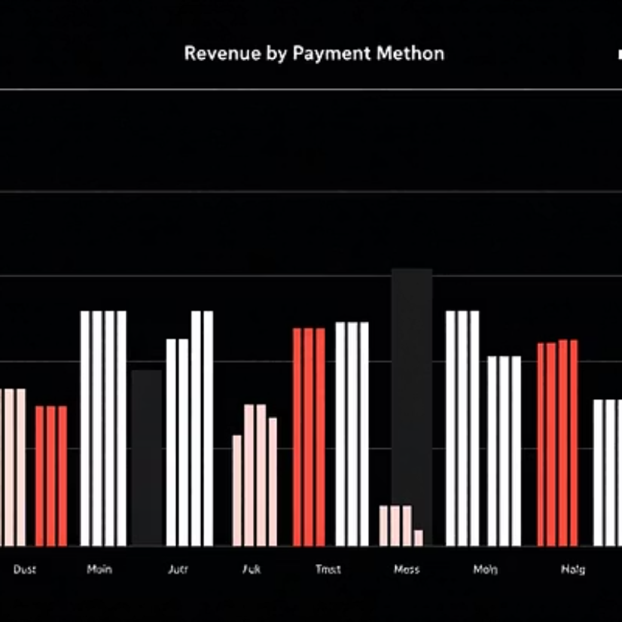
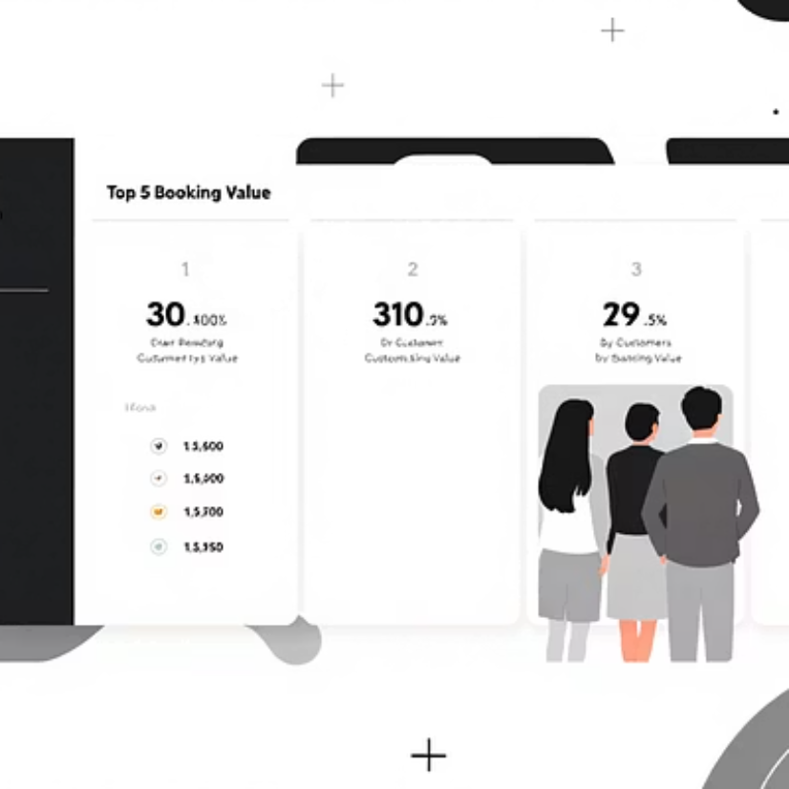
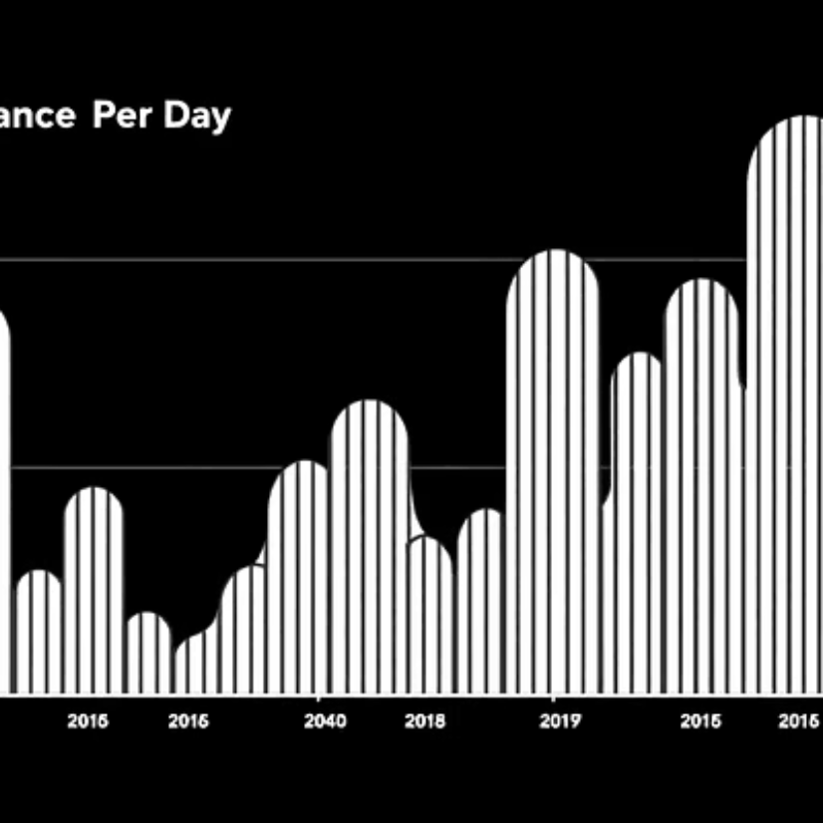
Additional Dashboards
Focus: cancellations, revenue, top customers, distance patterns

Slide 8

Problems Solved
1
High Cancellations
Identified top reasons (customers & drivers)
2
Revenue Leakage
Analyzed payment methods & booking values
3
Customer Retention
Recognized top customers for loyalty
4
Service Quality
Compared driver & customer ratings by vehicle

Slide 9

Business Value Delivered
Efficiency
Revenue
Reduced failed rides
Optimized payments & value tracking
Customer Insights
Strategy
Loyalty & personalization
Data-driven planning & competitive edge

Slide 10
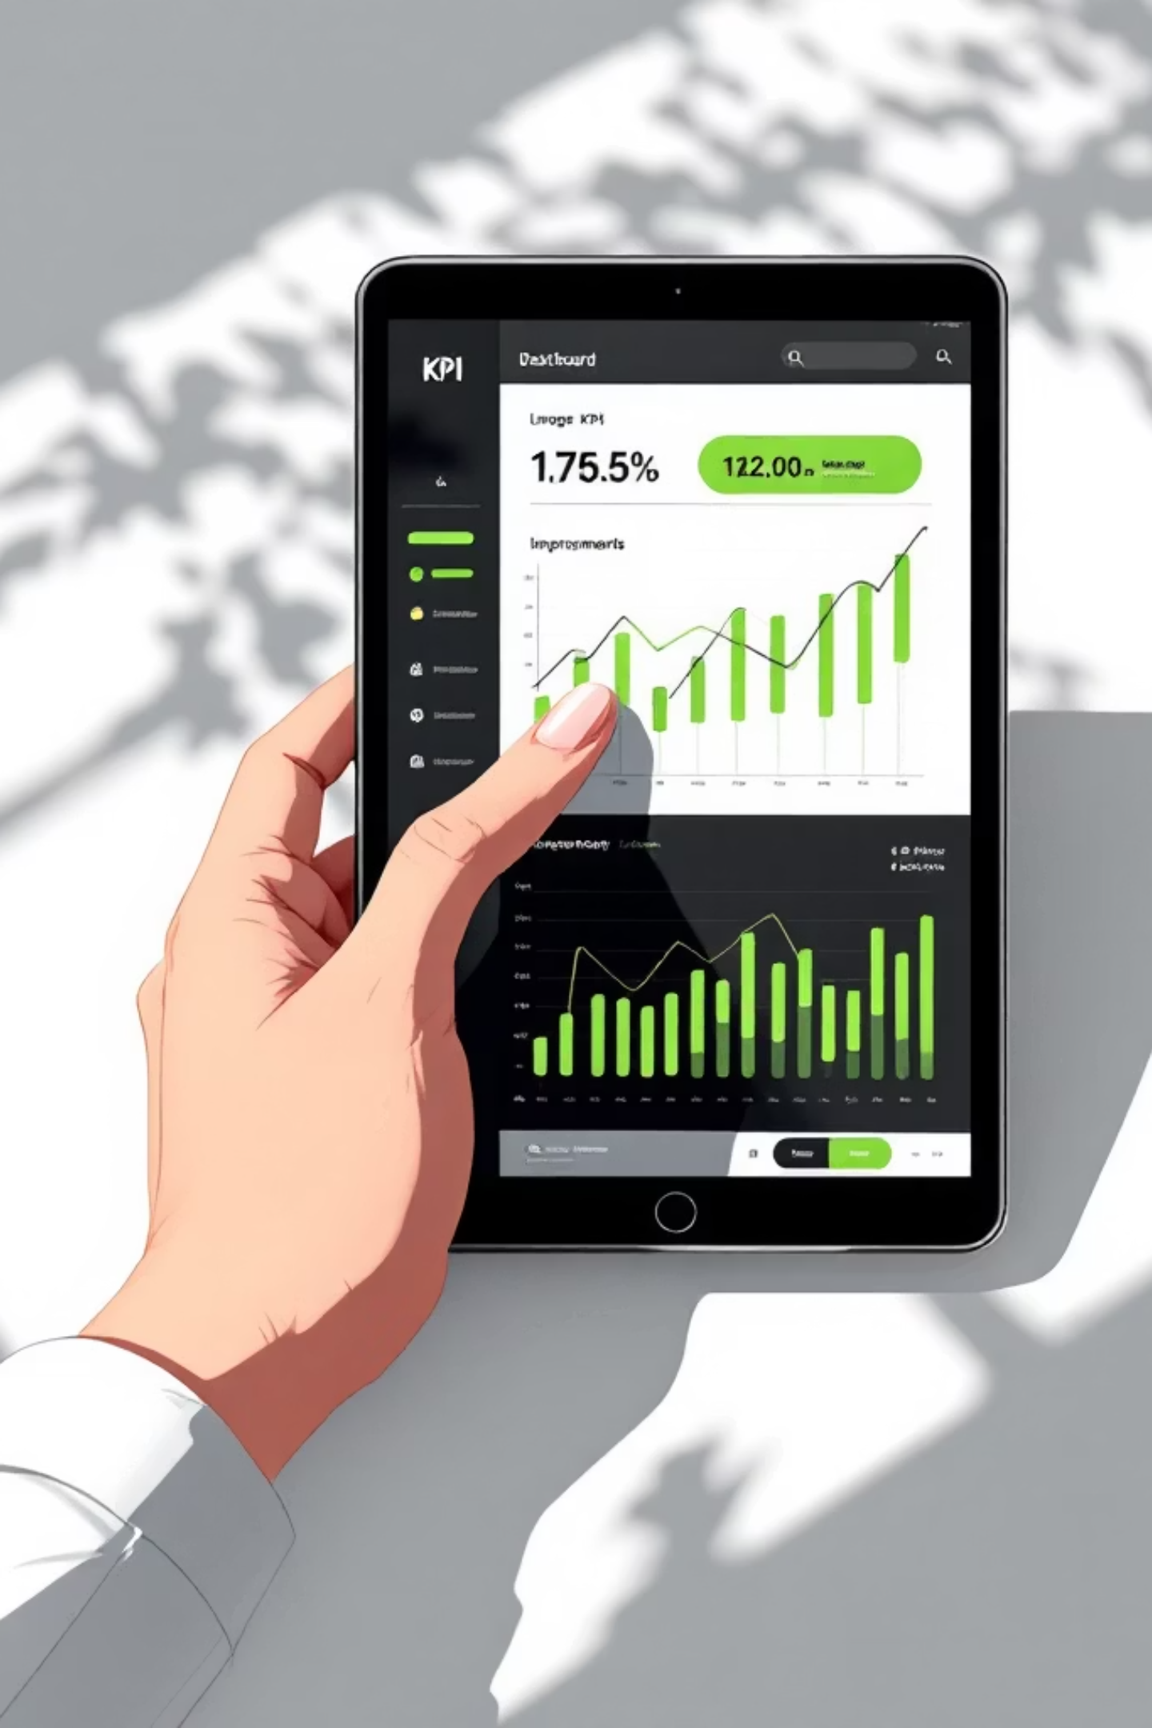

Impact & Next Steps
Reduce Cancellations
Improve Satisfaction
Grow Revenue
Monitor KPIs and scale wins
Fix top cancellation reasons
Target loyalty offers and support
Actions: implement fixes for top cancellation reasons, target loyalty offers, monitor KPIs in Power BI

